Slide 1


EAI 320 Practical session 4
Presented: 6 May 2026
Due: 19 May 2026
UNIVERSITY OF PRETORIA
Presentation to the Board of Directors
International Studies
29 April 2026

Slide 2

Instructions
Goal: Implement a naive Bayes classifier, individually.
Use the same RPS framework as previous practicals.
MATLAB Grader is used for grading your naive Bayes classifier performance.
Comment the fundamental principles of the naive Bayes classifier in the code
file. It should be a single paragraph describing how the classifier works and
why it works
There is no report for this practical.
Submit your code to the MATLAB Grader, TurnItIn (PDF format), and AMS (.m).
Submit before 19 May 2026, 23:59.
2

Slide 3
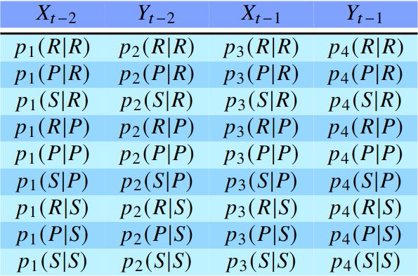
Introduction
Naive Bayes is a probabilistic classification algorithm that predicts the class of an object.
Your naive Bayes classifier must learn ‘online’, i.e. each passing move contributes to the ‘knowledge’ of your agent.
Your naive Bayes classifier must construct a conditional probability table for a history of two moves to calculate the most probable next move of the opponent and thus the correct response; [xt-2, yt-2, xt-1, yt-1], where x is your agent’s play, and y is the opponent’s. An example is shown below.
3

Slide 4
Introduction
The diagram below gives some context as to the structure of the table to assist in calculation.
P(...| R )
P(...| P )
Observed opponent’s move
P(...| S )
4

Slide 5
Introduction
Section 12.6 in ‘Artificial Intelligence: A modern Approach (4th ed.) describes the Naive Bayes principle.
Recall that the normalisation in Eq. 12.21 in the textbook allows inference based on current knowledge. You can utilise this to make a decision on the object to play.
Note: Some conditional probabilities might evaluate to zero given certain observations – this will cause problems when calculating the opponent’s most probable move, and thus you have to artificially add observations.
5

Slide 6
This is a simple practical, don’t over-think it. Good luck!
6

