Slide 1
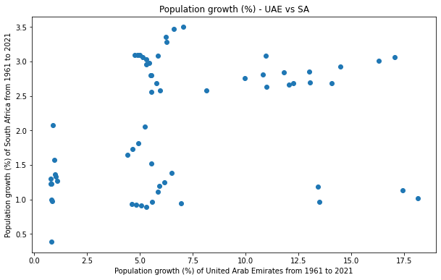
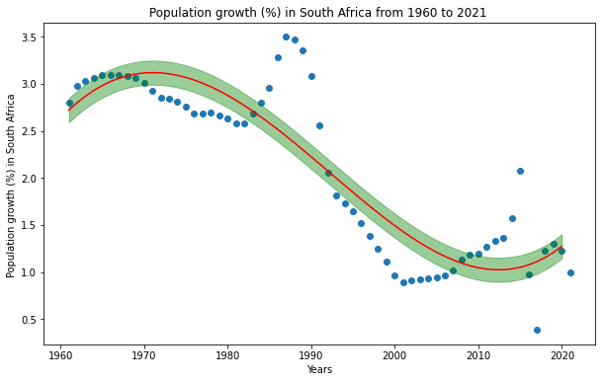
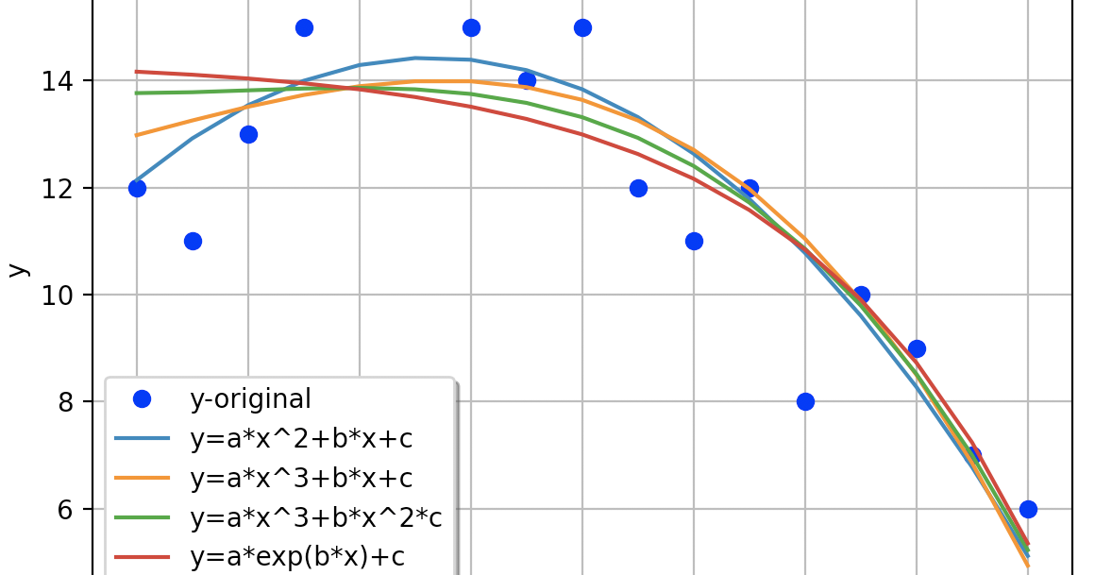
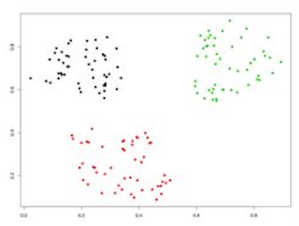
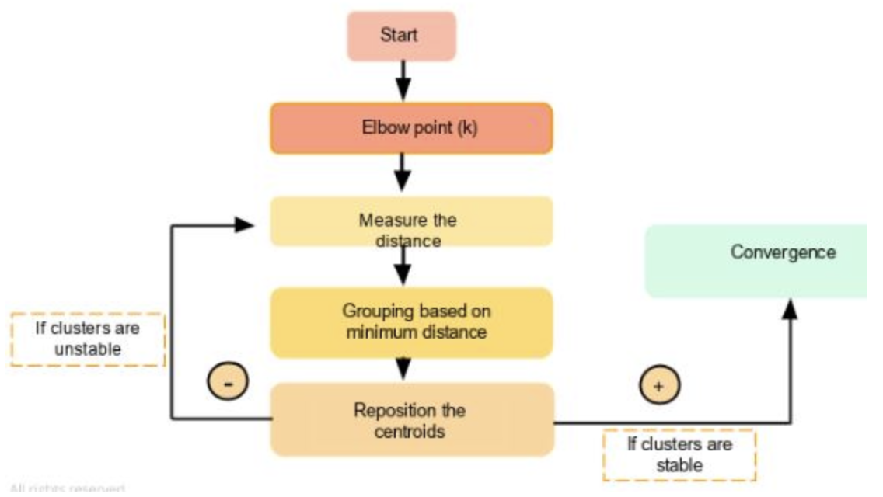
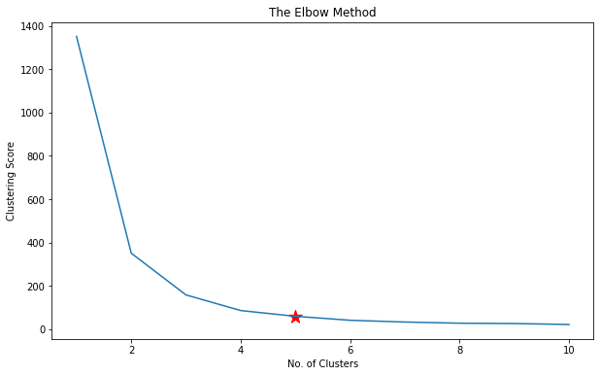
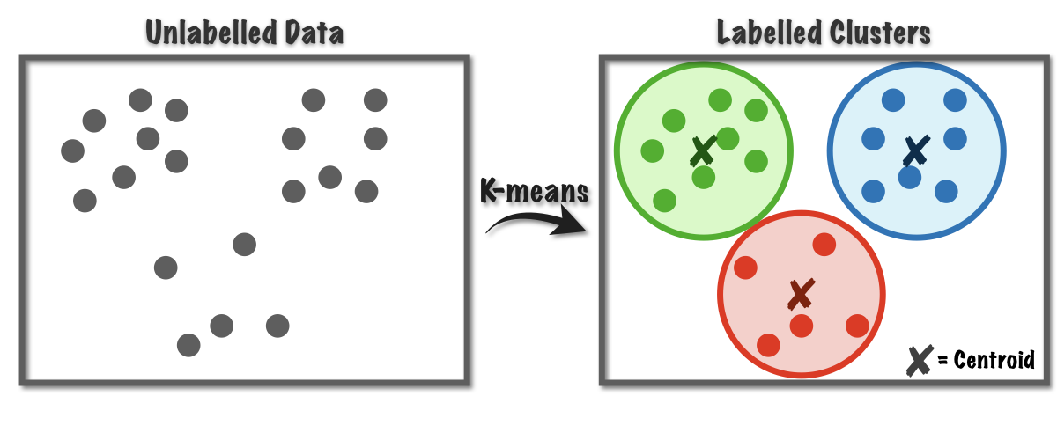
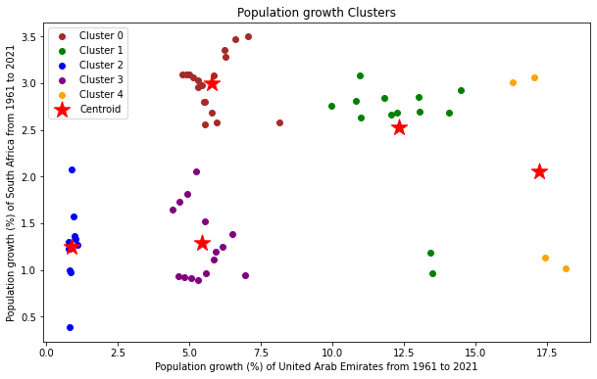
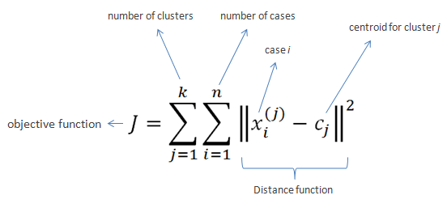
Clustering with K-means and curve fitting
Introduction
Curve fitting
Algorithm in practice
In pratice (Continued)
Popoulation growth in the world are plotted to identify the trends in order to cater human needs and wants. Data clustering and fitting is one segment of data analysis which is used by many data scientist in order to retrive usefull information. Such data is used in this project to thus produce usefull information for the reader.
What is clustering?
Clustering is used to identify distinct groups in a data set and assign a group label to each observation.
Such clusters display observations with similar parameters
Curve fitting is a sort of optimization in which the optimal set of values for an equation that perfectly suited a given set of observations is found. Curve fitting necessitates the definition of a function that translates an instance of inputs into outputs.
Population growth Data: UAE and South Africa from 1961 to 2021
Curve fitting applied to the population growth in South Africa from 1961 to 2021
How does it work?
Elbow method to find the clustering score where the star indicates the optimum number of clusters
Conclusion and comments
The generated plots above using K means clustering and curve fitting shows that the recorded data are much more meaning when represented in these format.
The generated graphs can be imporoved further with more fine tuning parameters to suit the user requirements.
In conclusion, K means clustering has produced meaningful clusters for the data feeded.
K-means Clustering
The K Means Algorithm is a widely used Algorithm. When a user requests k clusters, the method locates k cluster centers that minimize the within-cluster average squared Euclidean values from each cluster's point to its center, implying that many common clustering algorithms rely on Euclidean distance.
Clustering
Step 1: The elbow approach is used in step one to estimate the number of groups. Following that, an algorithm is run to determine the optimal number of clusters produced for the given collection.
Step 2: Two different spots are chosen.
Step 3: The range as from centroid is calculated for each location, and each data item is allocated to the centroid that is closest to it.
Step 4: The actual centroid of the first set of data points is calculated.
Step 5: Move the random centroid closer to the real centroid.
Curve fitting
A curve is searched in the plot such that the sum of squares of the residulas is minimum.
Below plot indicates the growth clusters

