Slide 1

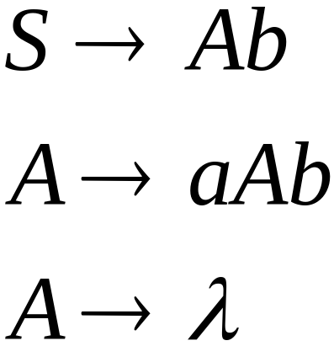
Linear Grammars
Grammars with
at most one variable at the right side
of a production
Examples:
Costas Busch - LSU

Slide 2

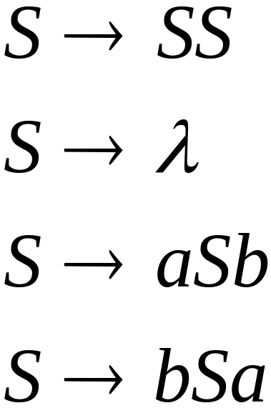
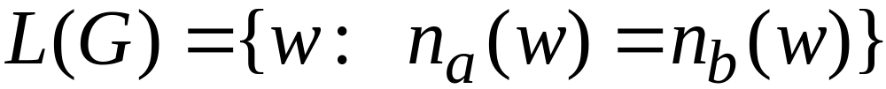


A Non-Linear Grammar
Grammar :
Number of in string
Costas Busch - LSU

Slide 3
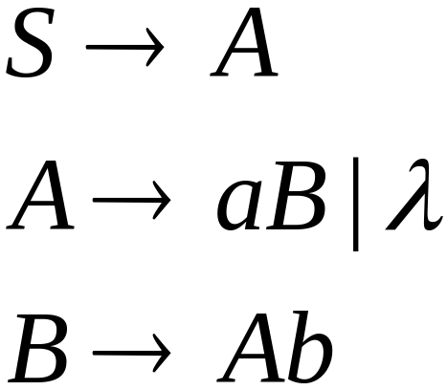
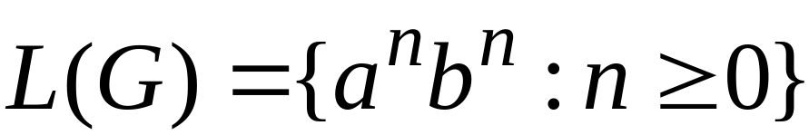
Another Linear Grammar
Grammar :
Costas Busch - LSU

Slide 4


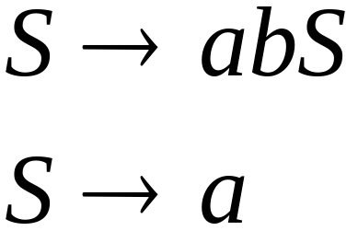
Right-Linear Grammars
All productions have form:
Example:
or
string of
terminals
Costas Busch - LSU

Slide 5

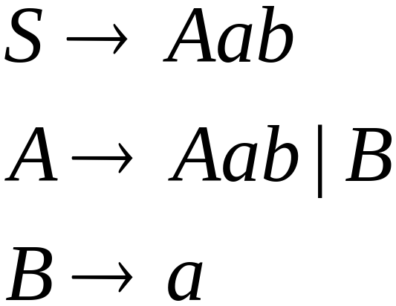
Left-Linear Grammars
All productions have form:
Example:
or
string of
terminals
Costas Busch - LSU

Slide 6
Regular Grammars
Costas Busch - LSU

Slide 7
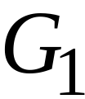
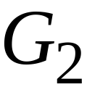
Regular Grammars
A regular grammar is any
right-linear or left-linear grammar
Examples:
Costas Busch - LSU

Slide 8
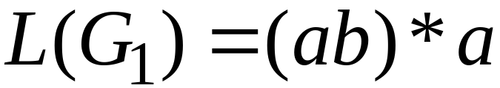
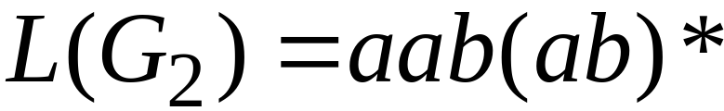
Observation
Regular grammars generate regular languages
Examples:
Costas Busch - LSU

Slide 9
Regular Grammars
Generate
Regular Languages
Costas Busch - LSU

Slide 10

Theorem
Languages
Generated by
Regular Grammars
Regular
Languages
Costas Busch - LSU

Slide 11

Theorem - Part 1
Languages
Generated by
Regular Grammars
Regular
Languages
Any regular grammar generates
a regular language
Costas Busch - LSU

Slide 12

Theorem - Part 2
Languages
Generated by
Regular Grammars
Regular
Languages
Any regular language is generated
by a regular grammar
Costas Busch - LSU

Slide 13
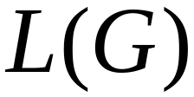
Proof – Part 1
Languages
Generated by
Regular Grammars
Regular
Languages
The language generated by
any regular grammar is regular
Costas Busch - LSU

Slide 14

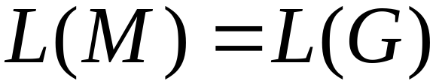
The case of Right-Linear Grammars
Let be a right-linear grammar
We will prove: is regular
Proof idea: We will construct NFA
with
Costas Busch - LSU

Slide 15
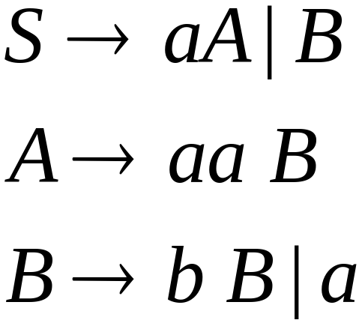
Grammar is right-linear
Example:
Costas Busch - LSU

Slide 16



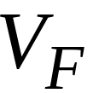

Construct NFA such that
every state is a grammar variable:
special
final state
Costas Busch - LSU

Slide 17


Add edges for each production:
Costas Busch - LSU

Slide 18

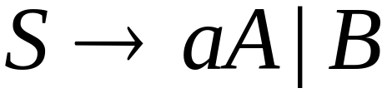
Costas Busch - LSU

Slide 19
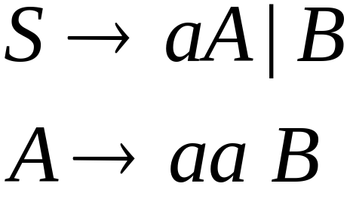
Costas Busch - LSU

Slide 20
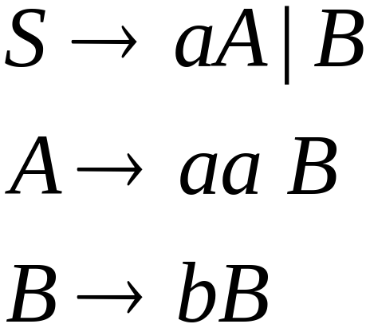

Costas Busch - LSU

Slide 21
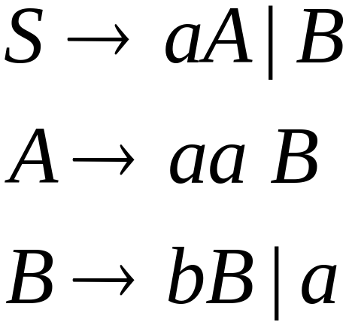
Costas Busch - LSU

Slide 22
Costas Busch - LSU

Slide 23
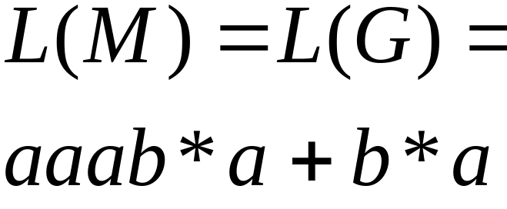
NFA
Grammar
Costas Busch - LSU

Slide 24
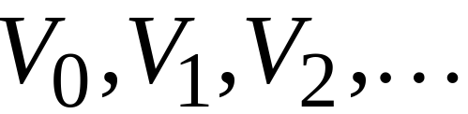
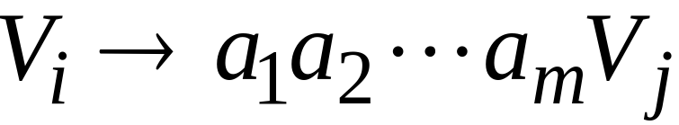
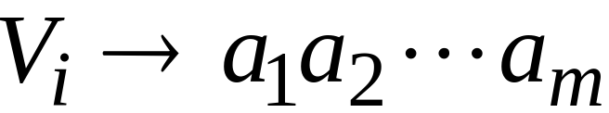
In General
A right-linear grammar
has variables:
and productions:
or
Costas Busch - LSU

Slide 25






We construct the NFA such that:
each variable corresponds to a node:
special
final state
Costas Busch - LSU

Slide 26


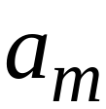


For each production:
we add transitions and intermediate nodes
………
Costas Busch - LSU

Slide 27
For each production:
we add transitions and intermediate nodes
………
Costas Busch - LSU

Slide 28







Resulting NFA looks like this:
It holds that:
Costas Busch - LSU

Slide 29
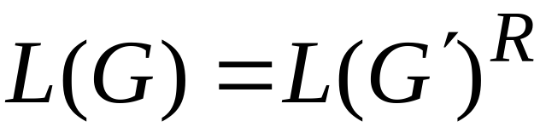

The case of Left-Linear Grammars
Let be a left-linear grammar
We will prove: is regular
Proof idea:
We will construct a right-linear
grammar with
Costas Busch - LSU

Slide 30
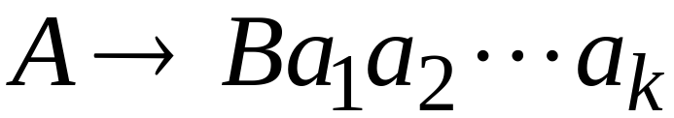
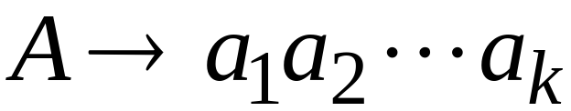
Since is left-linear grammar
the productions look like:
Costas Busch - LSU

Slide 31

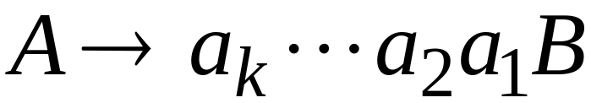
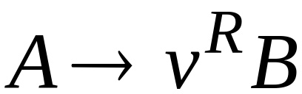
Construct right-linear grammar
Left
linear
Right
linear
Costas Busch - LSU

Slide 32

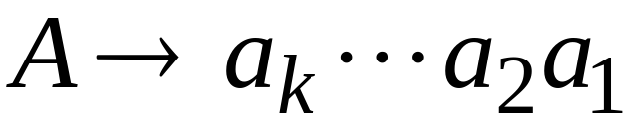
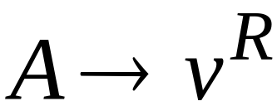
Construct right-linear grammar
Left
linear
Right
linear
Costas Busch - LSU

Slide 33
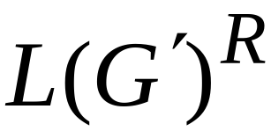
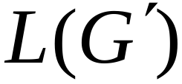
It is easy to see that:
Since is right-linear, we have:
Regular
Language
Regular
Language
Regular
Language
Costas Busch - LSU

Slide 34

Proof - Part 2
Languages
Generated by
Regular Grammars
Regular
Languages
Any regular language is generated
by some regular grammar
Costas Busch - LSU

Slide 35
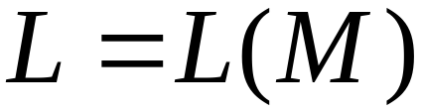
Any regular language is generated
by some regular grammar
Proof idea:
Let be the NFA with .
Construct from a regular grammar
such that
Costas Busch - LSU

Slide 36


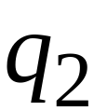
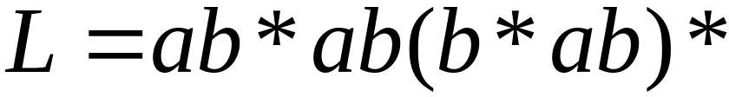

Since is regular
there is an NFA such that
Example:
Costas Busch - LSU

Slide 37


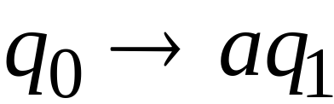

Convert to a right-linear grammar
Costas Busch - LSU

Slide 38
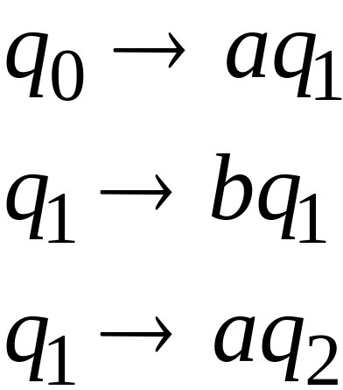
Costas Busch - LSU

Slide 39
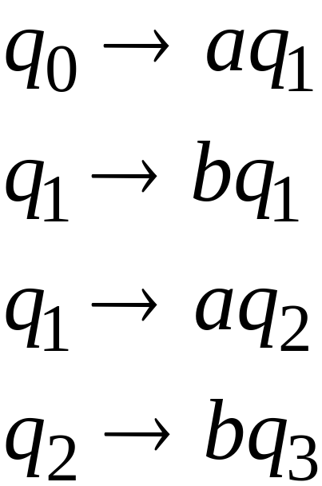
Costas Busch - LSU

Slide 40
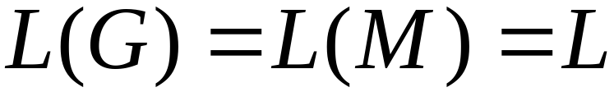
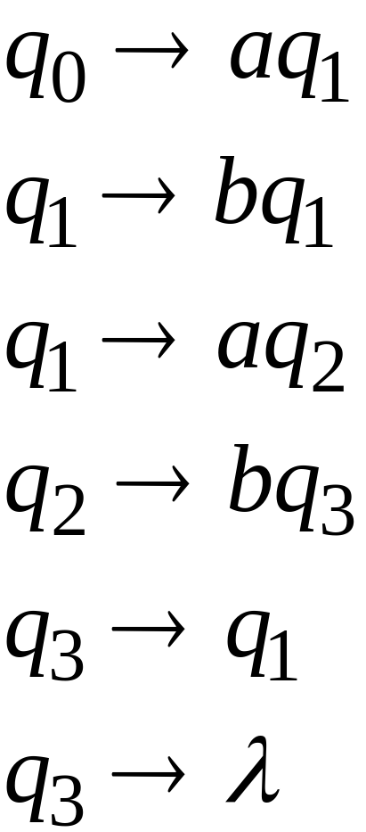
Costas Busch - LSU

Slide 41



In General
For any transition:
Add production:
variable
terminal
variable
Costas Busch - LSU

Slide 42

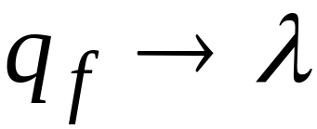
For any final state:
Add production:
Costas Busch - LSU

Slide 43
Since is right-linear grammar
is also a regular grammar
with
Costas Busch - LSU

Slide 44
Pumping lemma
This theorem can be used to prove that certain sets are not regular.
We now give the steps needed for proving that a given set is not regular.
Step 1: Assume L is regular. Let ‘n’ be the number of states in the corresponding F.A.
Step 2: choose a string w such that |w|>=n.Use pumping lemma to write,w =xyz,with |xy| <=n and |y|>0
Step 3: Find suitable integer ‘i’ such that xy^iz should not belongs to L.
Costas Busch - LSU

Slide 45
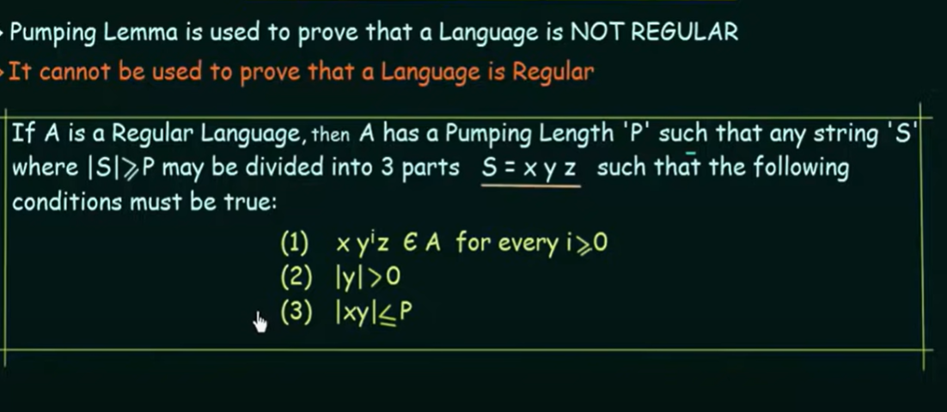
Pumping Lemma
Costas Busch - LSU

Slide 46
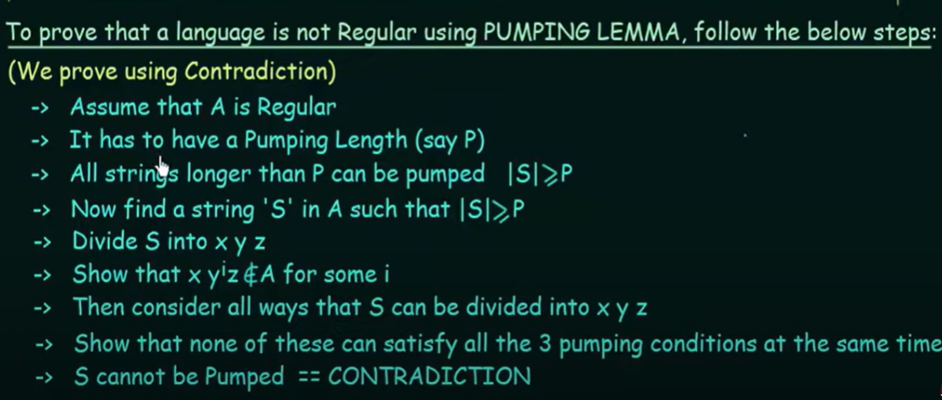
Costas Busch - LSU

Slide 47
Example 1
Shoe that the set,L={a^n |n>=0} is regular or not.
W=aa
Case 1:
X=null
Y=aa
Z=null
For all value of i, still belongs to language.
Costas Busch - LSU

Slide 48
Example 2
Shoe that the set,L={a^2n |n>=0} is regular or not.
W=aa
Case 1:
X=null
Y=aa
Z=null
For all value of i, still belongs to language.
Costas Busch - LSU

Slide 49
Example 3
Shoe that the set,L={a^nb^n |n>0} is regular or not.
W=ab
Case 1:
X=a
Y=b
Z=null
For all value of i,
When i=1 result will be still belongs to language.
When i=2 result will be abb ,string not belongs to language ,hence proved language is not regular
Shoe that the set,L={a^nb^nc^n |n>0} is regular or not.
W=abc
Case 1:
X=a
Y=b
Z=c
For all value of i,
When i=1 result will be still belongs to language.
When i=2 result will be abbc ,string not belongs to language ,hence proved language is not
Costas Busch - LSU

Slide 50
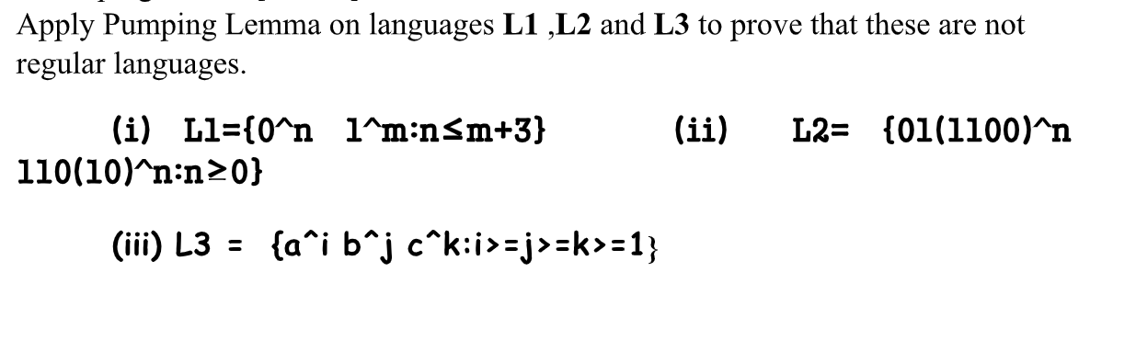
Pumping lemma
Costas Busch - LSU

Slide 51
Pumping lemma
Is the language
L = {w | w is a binary string with at least as many 1’s as 0’s}
regular? Prove your answer using pumping lemma
Bilal, a student of CS301, has submitted following answer:
Costas Busch - LSU

Slide 52
I will prove that L is not regular, using the pumping lemma.
i. Let p is a pumping length
ii. Let w = 01 p , so that w ∈ L and |w| ≥ p.
iii. Let w = xyz, with x = Ɛ, y = 0, and z = 1 p , so that |xy| ≤ p and |y| &gt; 0.
iv. Then xy p+1 z is not in L.
Identify the single incorrect line in Bilal’s proof and explain what he did wrong.
(NOTE: do not list small mistakes, typos, etc.; explain the major logical error which invalidates Bilal’s
proof.)
Solution
Costas Busch - LSU

Slide 53
In line iii., Bilal did wrong split of w. As 0 is finite in w, therefore cannot be pumped and hence invalidate
the proof. In another words, Bilal is not permitted to pick a specific split of w.
b. “Let L be any finite, nonempty language of binary strings. Is L regular?”
Jameel has submitted the following answer:
I will prove that L is not regular, using the pumping lemma.
i. Since L is finite, it has a longest string. Let p be the length of the
longest string in L.
ii. Let w ∈ L, such that |w| ≥ p.
iii. Let w = xyz, so that |xy| ≤ p and |y| &gt; 0.
iv. Then xy 2 z is not in L, since it has length longer than p, but all the
strings in L have length at most p.
Identify the single incorrect line in Jameel’s proof, and explain what he did wrong.
(NOTE: Do not just say, “L is actually regular”; explain the major logical error which invalidates Jameel’s
proof.)
Costas Busch - LSU

Slide 54

Costas Busch - LSU

