Slide 1

Financial Accounting
Jahangir Tanveer
Lecture 3

Slide 2
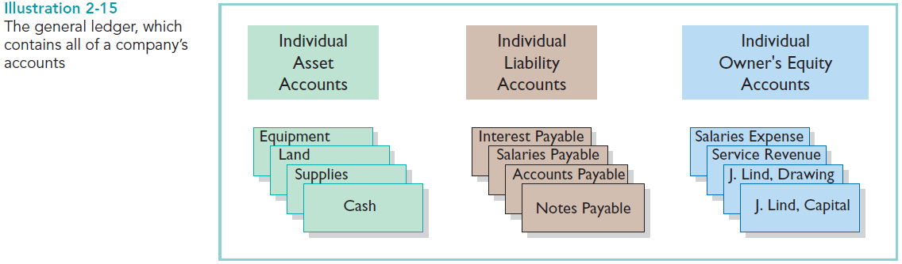
The Ledger
The entire group of accounts maintained by a company is the ledger. The ledger keeps in one place all the information about changes in specific account balances.

Slide 3
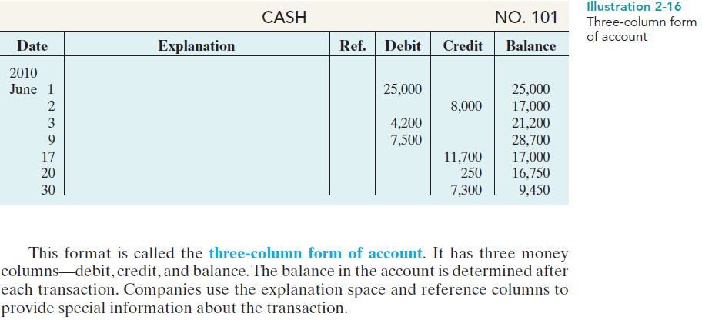
STANDARD FORM OF ACCOUNT

Slide 4
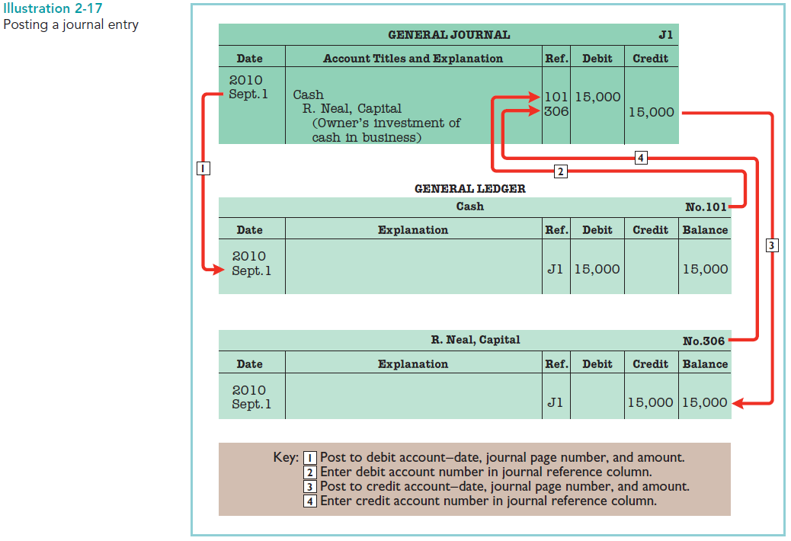

Slide 6
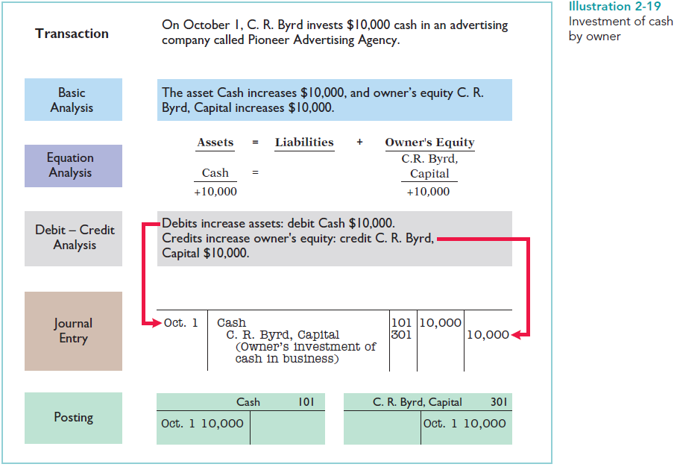

Slide 7
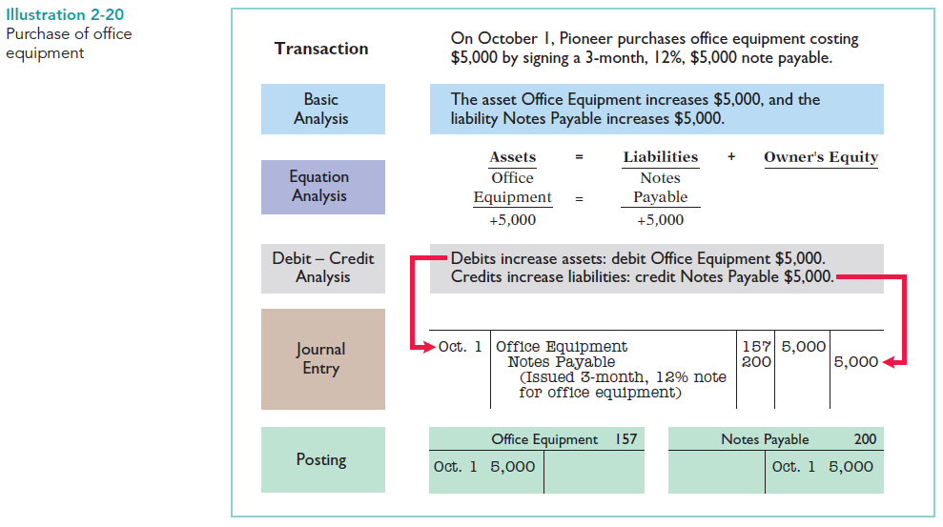

Slide 8
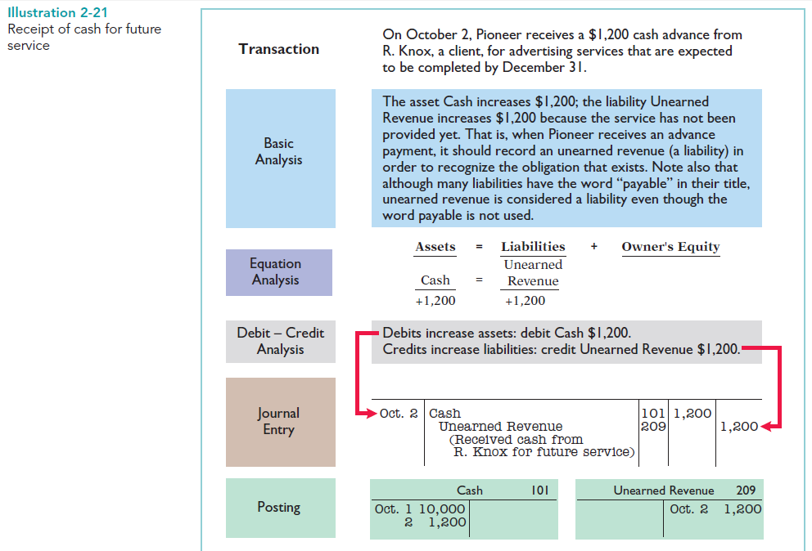

Slide 9
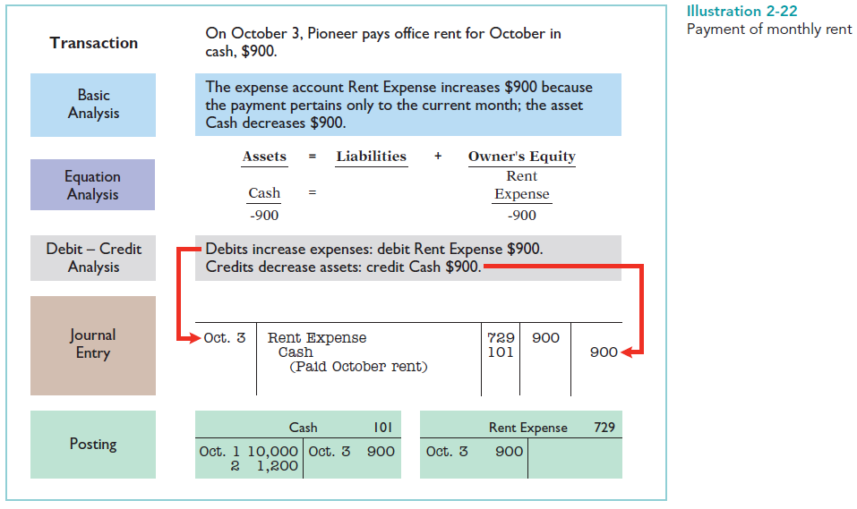

Slide 10
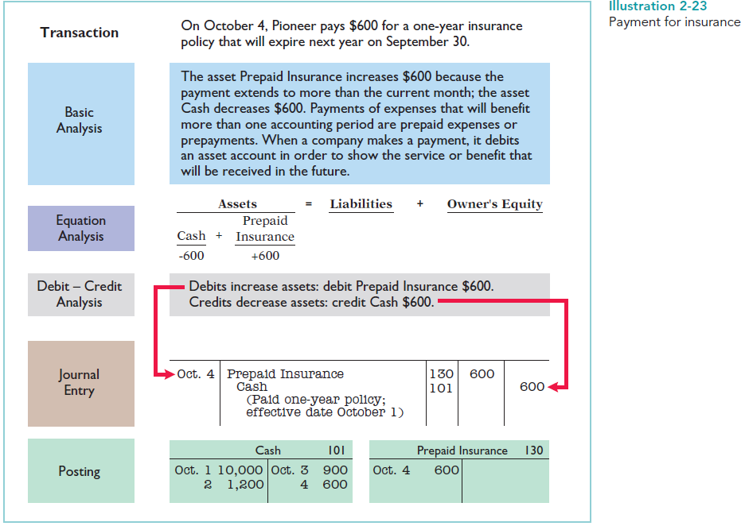

Slide 11
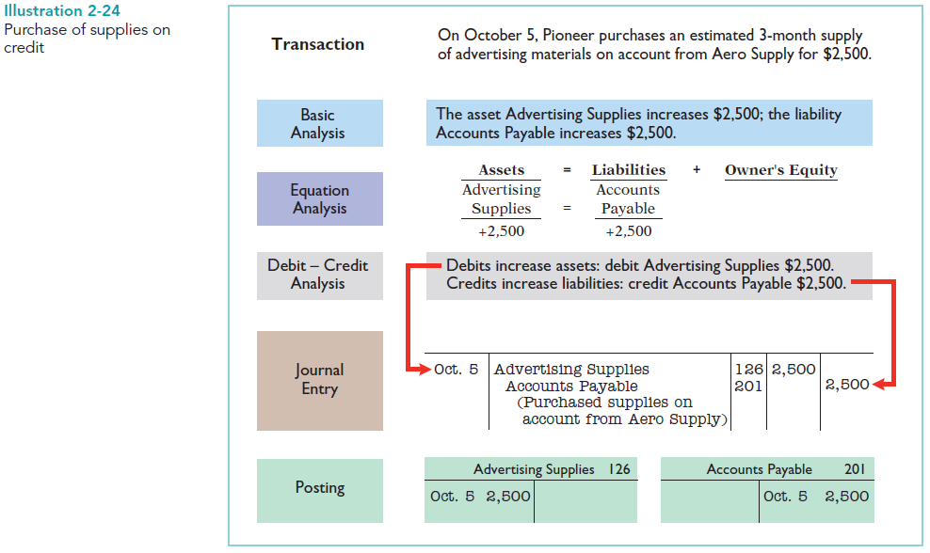

Slide 12
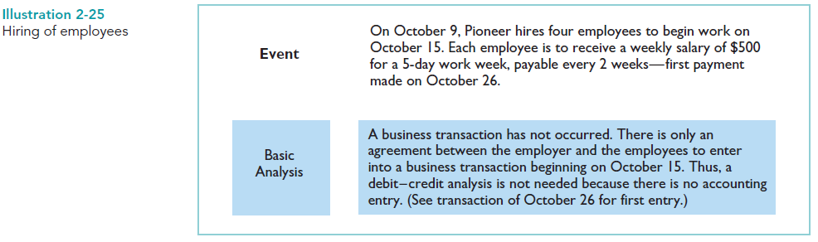

Slide 13
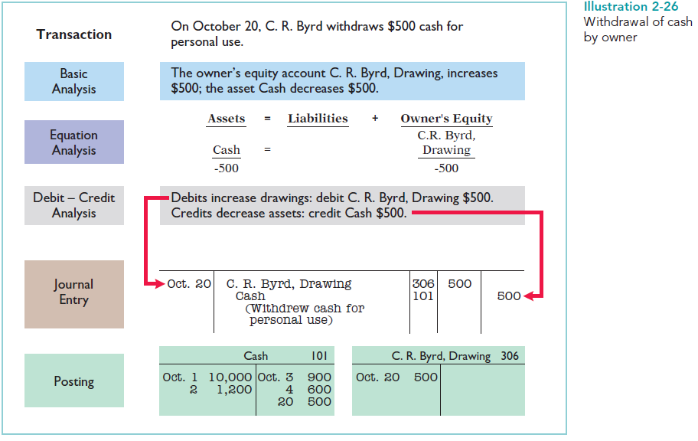

Slide 14
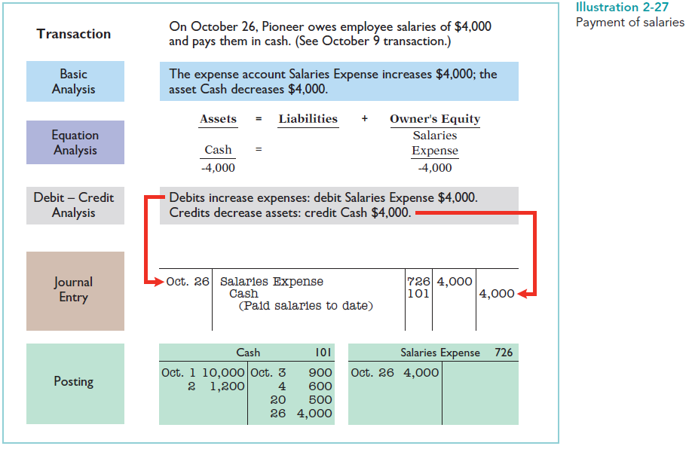

Slide 15
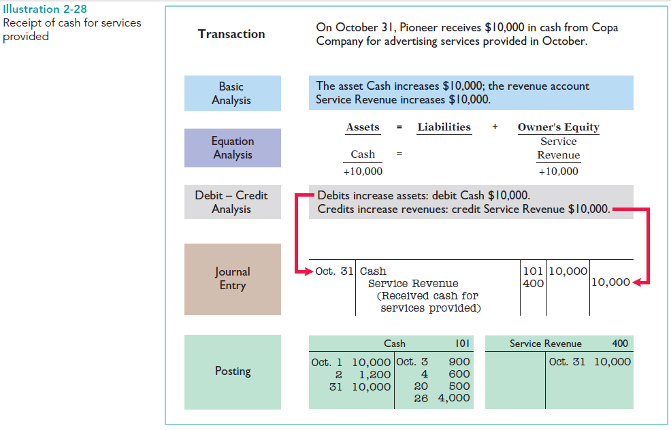

Slide 16
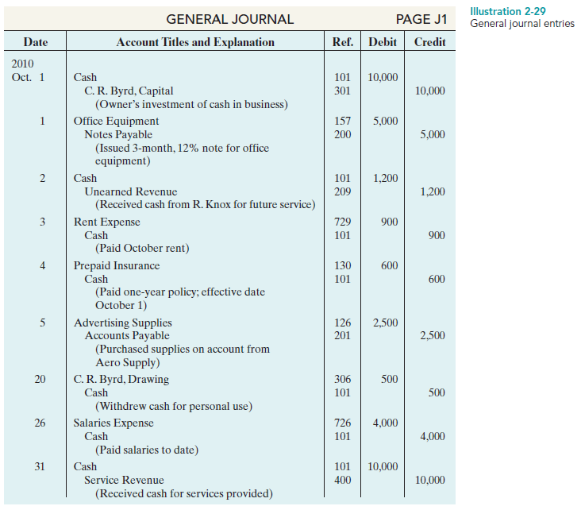

Slide 17
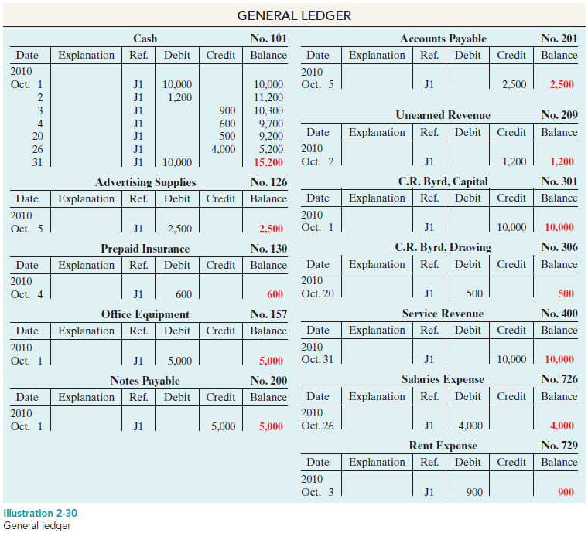

Slide 18
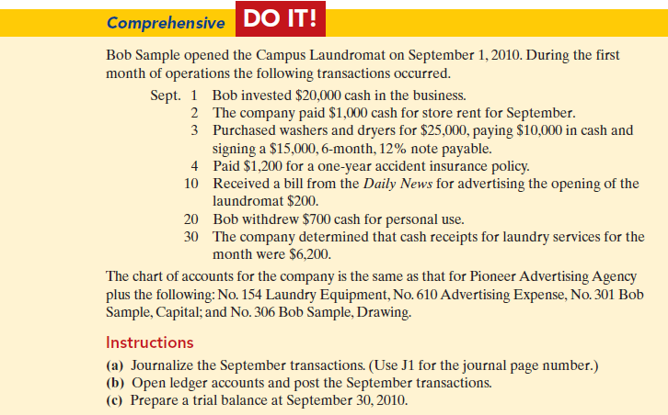

Slide 19
A trial balance is a list of accounts and their balances at a given time.
The primary purpose of a trial balance is to prove (check) that the debits equal the credits after posting.

Slide 20
Steps for preparing a trial balance
1. List the account titles and their balances in the appropriate debit or credit column.
2. Total the debit and credit columns.
3. Prove the equality of the two columns.

Slide 21
Limitations of a Trial Balance
A trial balance does not guarantee freedom from recording errors, however. Numerous errors may exist even though the trial balance columns agree.
For example, the trial balance may balance even when:
1. a transaction is not journalized,
2. a correct journal entry is not posted,
3. a journal entry is posted twice,
4. incorrect accounts are used in journalizing or posting, or
5. offsetting errors are made in recording the amount of a transaction.
As long as equal debits and credits are posted, even to the wrong account or in the wrong amount, the total debits will equal the total credits. The trial balance does not prove that the company has recorded all transactions or that the ledger is correct.

Slide 22
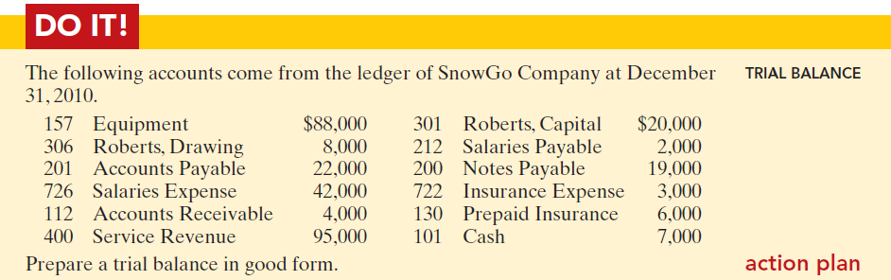
PRACTICE QUESTION

Slide 23
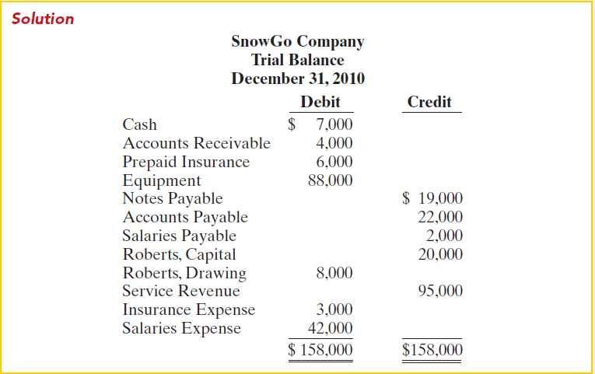
SOLUTION

Slide 24
QUESTION
P2-3B Slowhand Services was formed on May 1, 2010. The following transactions took place during the first month.
Transactions on May 1:
1. Eric Clapton invested $50,000 cash in the company, as its sole owner.
2. Hired two employees to work in the warehouse. They will each be paid a salary of $2,800 per month.
3. Signed a 2-year rental agreement on a warehouse; paid $24,000 cash in advance for the first year.
4. Purchased furniture and equipment costing $30,000. A cash payment of $10,000 was made immediately; the remainder will be paid in 6 months.
5. Paid $1,800 cash for a one-year insurance policy on the furniture and equipment.
Transactions during the remainder of the month:
6. Purchased basic office supplies for $500 cash.
7. Purchased more office supplies for $1,500 on account.
8. Total revenues earned were $20,000—$8,000 cash and $12,000 on account.
9. Paid $400 to suppliers for accounts payable due.
10. Received $3,000 from customers in payment of accounts receivable.
11. Received utility bills in the amount of $200, to be paid next month.
12. Paid the monthly salaries of the two employees, totalling $5,600.
Instructions
(a) Prepare journal entries to record each of the events listed. (Omit explanations.)
(b) Post the journal entries to T accounts.
(c) Prepare a trial balance as of May 31, 2010.

Slide 25
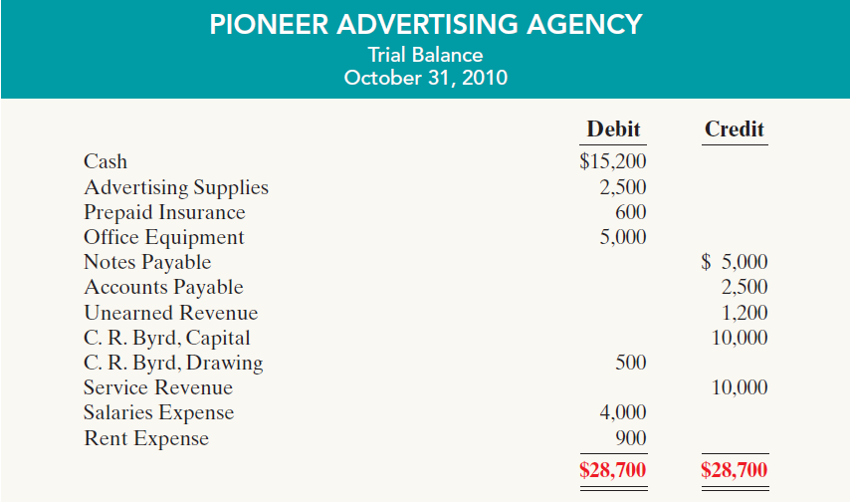
Illustration

