Slide 1
Economics and Technology
Andrew DeMaria
Mandy Erskine
Casey Davis
John Kelly

Slide 2



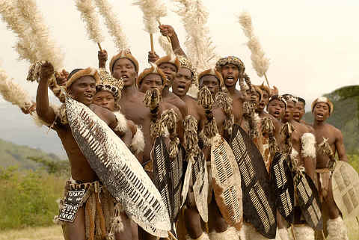




What do you think about when you hear Africa?

Slide 3
Insert videos
http://www.youtube.com/watch?v=duJUvvXvN40
http://www.youtube.com/watch?v=vT-bVG4kkQs

Slide 4

Three articles that discussed the rise of technology in African countries
Tech Startups in Africa
  Companies and governments are trying to increase amount of startups and entrepreneurs in Africa
A Guide in Africa
  Discusses the need for locals to help foreign companies get through the local customs in Africa
The Next Frontier
  IBM, Microsoft, and Google are all building labs and offices in Africa
  Nairobi, Kenya is the tech hub of Africa
  Africa is going to be where solutions for, public transportation, water quality, and public health come from

Slide 5
Do you see Africa becoming a tech hub?
  The article “Tech Startups in Africa” talks about all the startups. Are they going to be successful?
  There is a significant amount of entrepreneurs showing up in Africa.
What role does the education level play in the increase in technology?
  In 2002 only 32% of Africans have secondary or tertiary education. In 2012 87% of the United States has a high school degree.
Are the locals getting the jobs or are the companies bringing in employees?
Is this helping Africa’s Economy as much as it could?
The article “A guide in Africa” shows the dedication of the individuals to bring technology and companies into Africa. Is it enough to have a potential workforce, and the desire to fix society’s problems?

Slide 6
Will the solutions for public transport, water quality, and public safety come from a location where there is a more immediate need?
IBM’s main focus in Africa is building a public sector for better communication between different governments and agencies and traffic control.
IBM just built its 12th laboratory in Nairobi, Kenya. Does this location fit in with its other locations?
  Australia – Melbourne
  North America
    Almaden – San Jose, California
    Watson –New york and Massachusetts
    Austin, Texas
  South America –Brazil
  Asia
    Delhi – India
    Beijing and Shanghai – China
    Tokyo –Japan
    Haifa - Israel
  Europe
    Dublin – Ireland
    Zurich – Switzerland

Slide 7
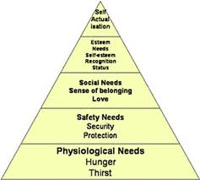
Is it realistic for Africa to jump from 3% of household having internet to a tech hub?
  How can they become a tech hub, if the resources are so hard to obtain?
  What basic needs need to be met in order
  to become a tech hub?
  Does it follow Maslow’s hierarchy of
  needs?
Can companies work in an environment that is
unstable and disconnected from the other African countries?
Are these companies giving them the resources they need.
How many years is it going to take for Africa to make an impact in the technology world?

Slide 8
Bitcoin background
http://www.youtube.com/watch?feature=player_embedded&v=Um63OQz3bjo

Slide 9
Bitcoin Article Summary
There are some businesses starting to accept Bitcoin (reddit, wordpress)
What can go wrong?
  DDos / MtGox take down
  Government steps in and declares it “illegal”
  Bitcoin algorithm / wallet software failure.
  Another decentralized digital currency arises (Litecoin).

Slide 10
Bitcoin Article Discussion
General
  Has anyone used Bitcoin? Buying/Selling? Mining?
  Do you think that it is important to have a actual value behind a currency?
Privacy
  Why should a government be concerned with Bitcoin?
  Is Bitcoin to blame for making illegal goods and services were more accessible [by allowing people to be anonymous]
  Would you prefer to remain anonymous when purchasing? How might companies adapt?
If Bitcoin crashes, is there any hope for a similar decentralized currency? How many of you are interested in the idea of Bitcoin?
Notes:
- tax evasion, black markets
- @crash government step in and make it illegal

