Slide 1
EBGN 320 – Economics and Technology
Network Economies
March 18, 2013

Slide 2
Midterm
Mean: 81.4
Median: 81.5
Max/Min: 98/54

Slide 3

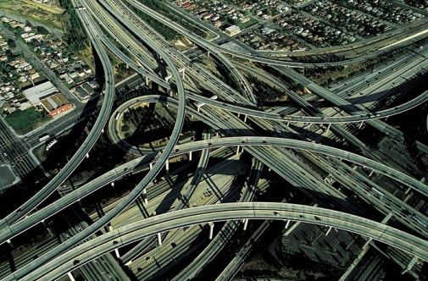


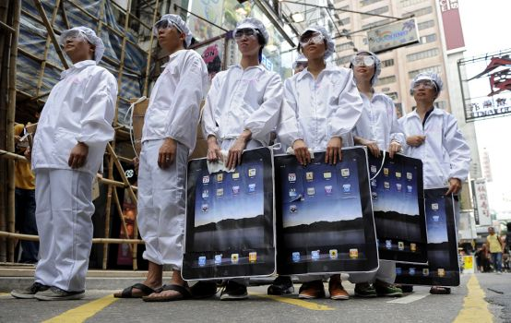

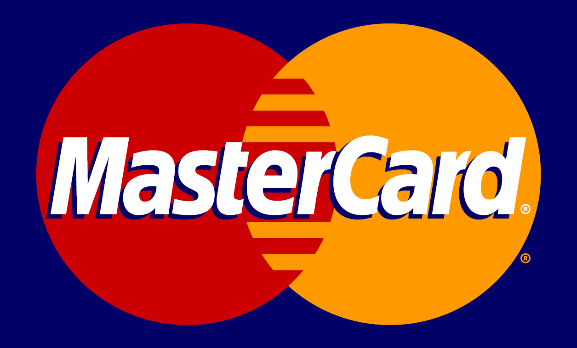
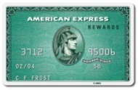
Networks
“The old industrial economy was driven by economies of scale; the new information economy is driven by the economics of networks” –Varian , Google economist
Networks can be real (physical) or virtual
Real networks:
Communications infrastructure
Transportation infrastructure
Virtual networks:
Apple community
Apple is the network “sponsor”

Slide 4

Network Effects
Direct Network Effects: each user’s payoff from the adoption of a good, and his incentive to adopt it, increase as others adopt it
Adoption by different users is complementary
For example: Facebook’s value to you increases as more of your friends sign up – This also makes it attractive to non-users contemplating adoption
Indirect Network Effects: arise if adoption is complementary because of its effect on a related market
For example: Users a new game console may benefit when others also purchase that console because it encourages the provision of more and better software
Network effects create incentives to “herd” with others

Slide 5
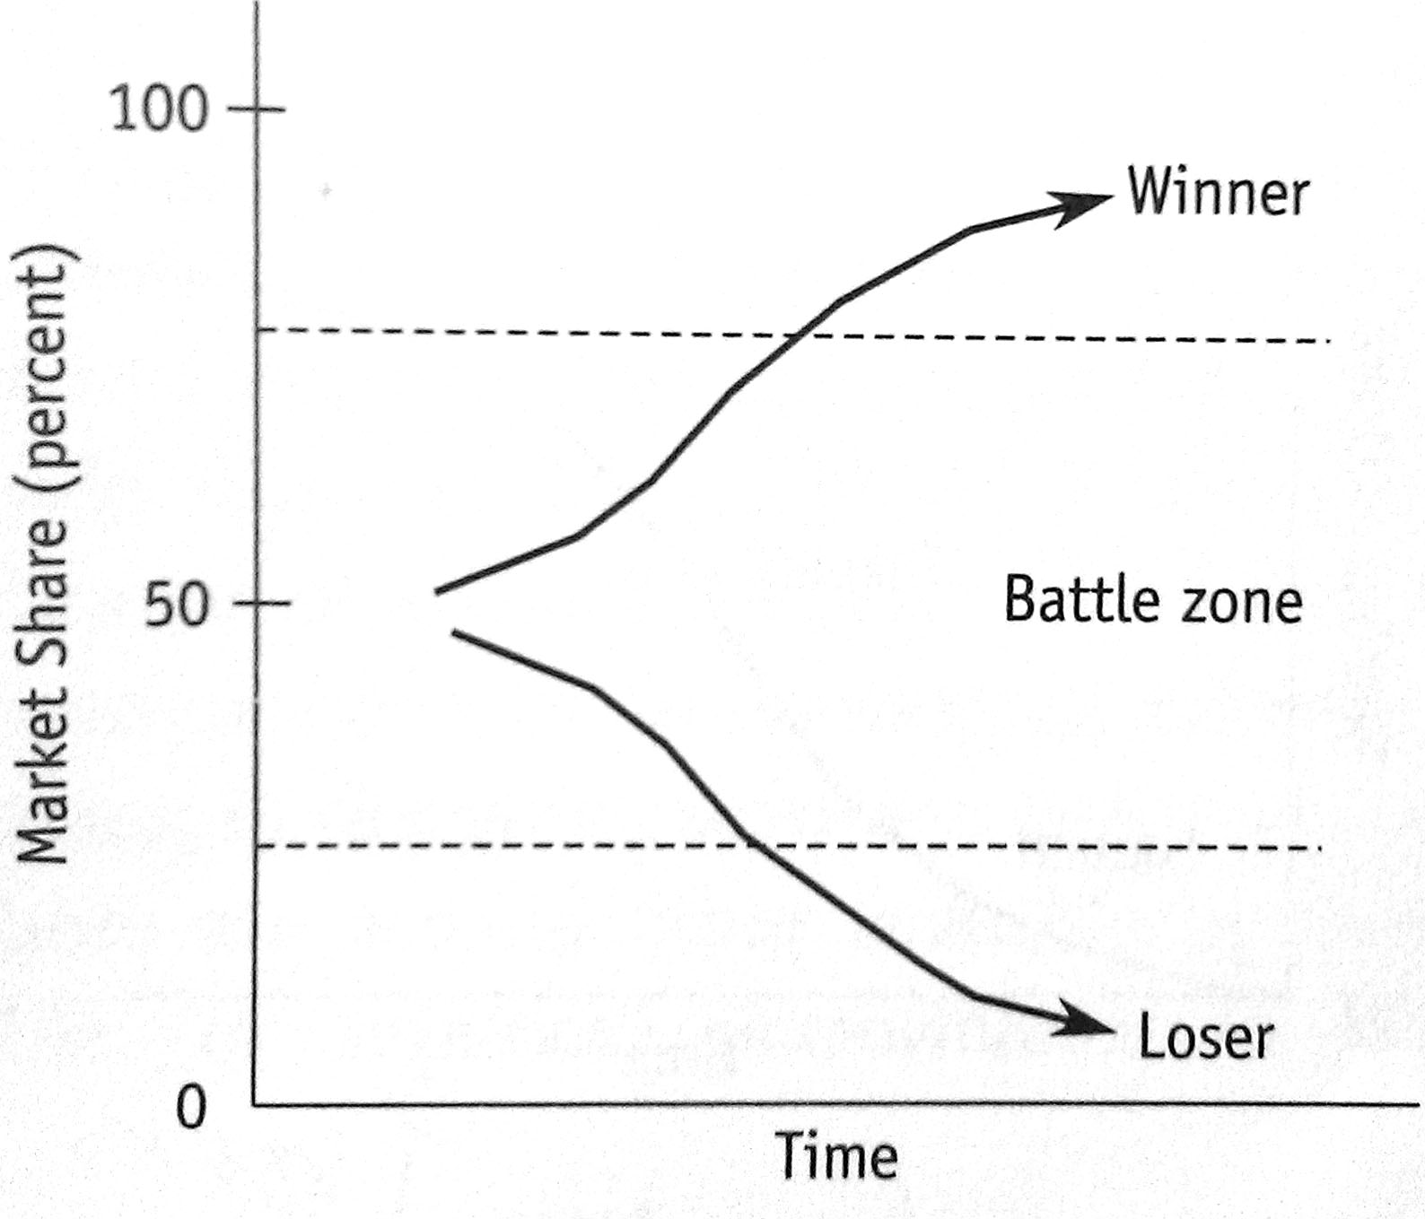
Characteristics of Network Economies
The Key Point: The value of a network depends on the number of other people connected to the network
Bigger is better!
Positive Feedback:
Success creates more success
Makes the strong stronger
and the weak weaker (negative feedback)
Creates demand-side economies of scale

Slide 6
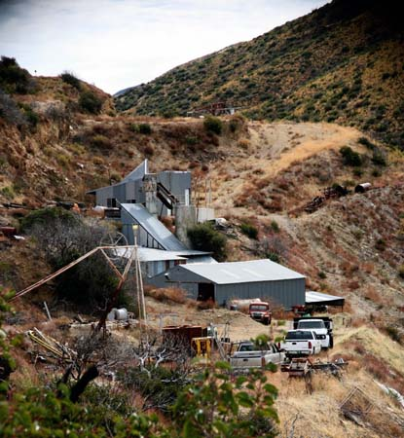
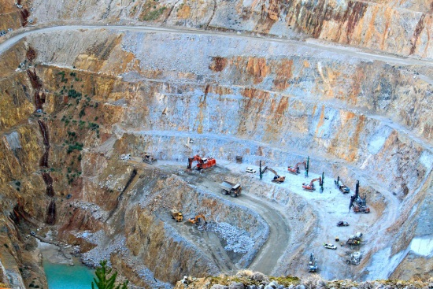
Economies of Scale
Supply-side economies of scale: a producer’s average cost per unit falls as the scale of output is increased
These benefits dissipate as scale increases
Demand-side economies of scale: the value of the product to the user increases with the number of users
These benefits only increase as the market gets larger!

Slide 7
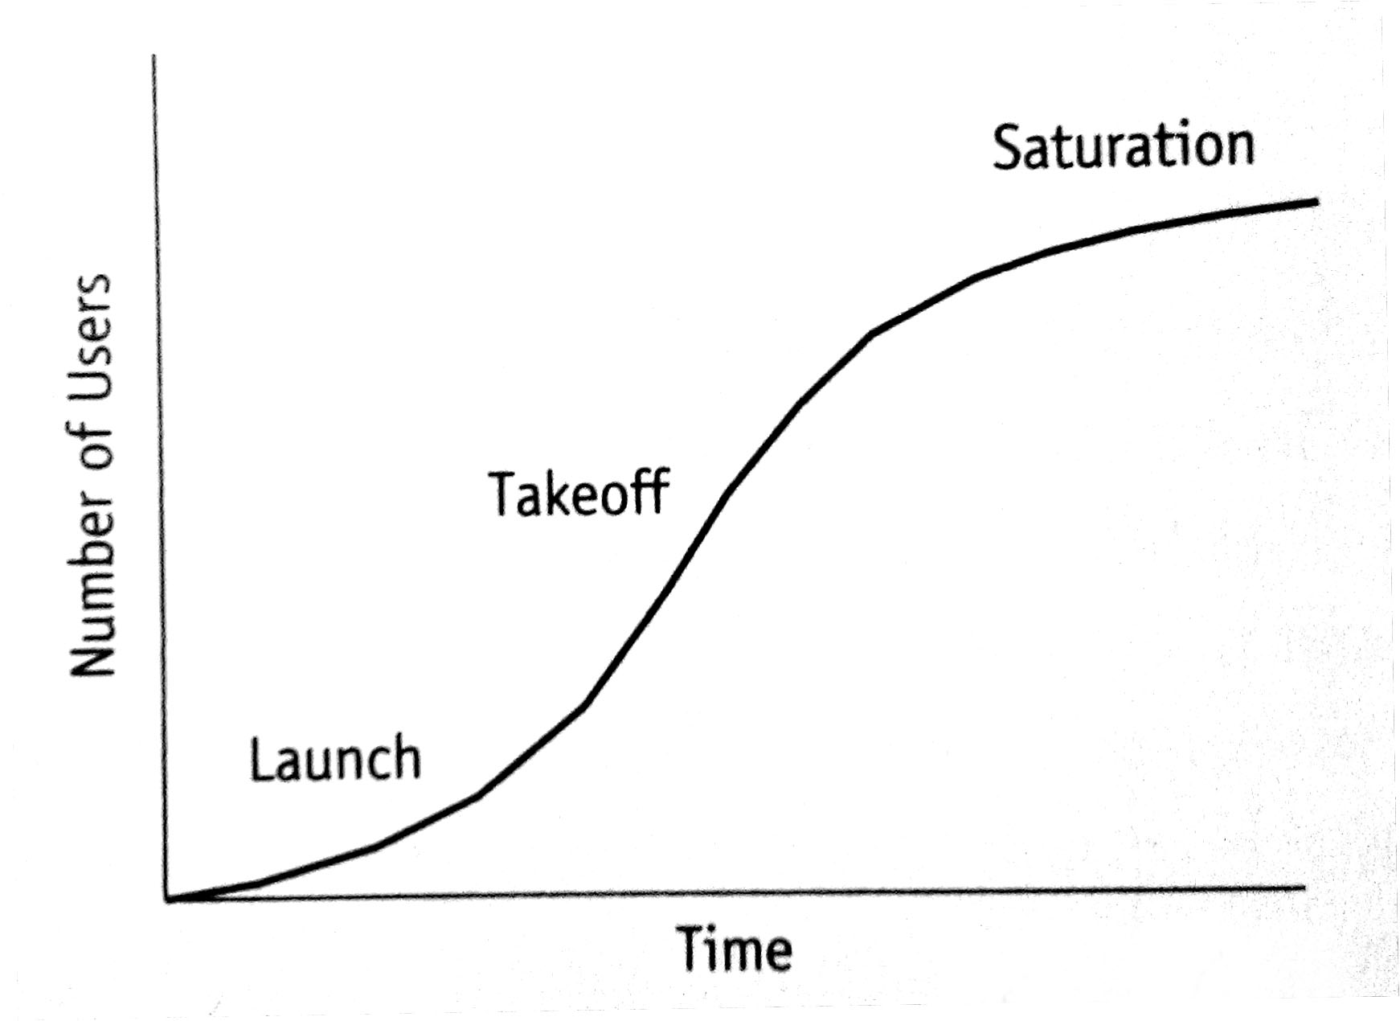
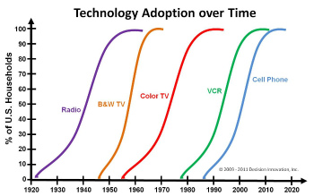
Adoption and Critical Mass
Critical Mass: the minimum amount of money or number of people required to start or sustain an operation, business, process, etc.
S-shaped adoption curve typical for new technology
When two or more firms compete in a market where there is strong positive feedback, only one will emerge a winner
Economists call such a winner-take-all market tippy

Slide 8
Tippy Markets
Examples:
1980s: VHS vs. Betamax
1990s: Wintel vs. Apple
2000s: Facebook vs. MySpace
Strong scale economies on either the demand side or the supply side will make the market tippy
The outcome of these tippy markets may hang in the balance for years or be quickly reached
Firms may benefit from a “double whammy” of supply-side and demand-side economies of scale

Slide 9

The Tipping Point
Gladwell - “The Tipping Point is the biography of the idea… that the best way to understand the emergence of fashion trends, the ebb and flow of crime waves, or the rise in teen smoking… is to think of them as epidemics. Ideas and products and messages and behaviors spread just like viruses do…” on networks

Slide 10
Modeling the Rate of Adoption of Innovation
Biological approach – an epidemic model – random encounters cause transfer of information (analogy with catching disease)
Once information has been transmitted there is a fixed probability of the potential new customer deciding to buy the innovation
A few early adopters, then an epidemic
Lastly the few laggards adopt, so reach saturation in the market
Rate of adoption follows a bell-shape so cumulative proportion is an S-shape

Slide 11
The Cumulative Path of Adoption for an Epidemic Model
Greenhalgh & Rogers, 2010

Slide 12
Economic Model of Diffusion
Introduce prices, costs of adoption, tastes
Only adopt when net gain is positive, taking account of all these factors
Formally differentiate customers by variety of taste and cost characteristics (indexed by Z)
Distribution of Z is bell-shaped (e.g. Normal)
As product price falls (or costs of adoption fall) then over time those with less favorable Z values will find it worthwhile to adopt
Again cumulative rate of adoption S-shaped

Slide 13
How Characteristics (index Z) Determine the Rate of Adoption
Greenhalgh & Rogers, 2010

Slide 14
Product Diffusion
Android, WinPho7, iPhone4... What Grills Faster?

Slide 15
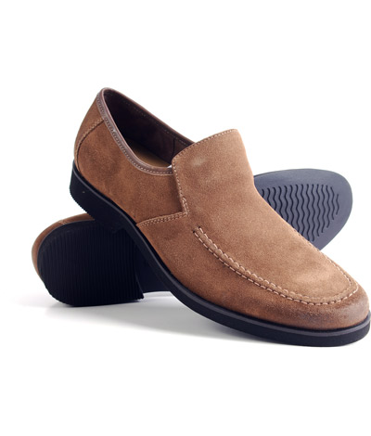
A Tipping Point Example
Hush Puppies:
Almost dead in 1994
In 1995, Hush Puppies suddenly became “hip” in lower Manhattan
Tenfold increase in sales by ’96
No advertising or marketing budget
Claim: “viral” fashion spread from NY teens to designers

Slide 16
Metcalfe’s Law
Rule of thumb to estimate the total value of a network
If there are n people in a network, and the value of the network to each of them is proportional to the number of other users, then the total value of the network is proportional to:
n x (n-1) = n² – n
If the value to a user is $1 for each other user then
a network of size 10 has a value of ~$100
a network of size 100 has a value of ~$10,000
A tenfold increase in the size of the network leads to a hundredfold increase in its value

Slide 17
Switching Costs
Switching Costs: The costs (monetary and/or transaction) associated with changing a supplier, system, or product
Switching costs give firms some form of market power over their customers, and thus create the potential for monopoly profits
Note: switching costs are borne by both the consumer and the suppliers

Slide 18
Lock-In
Lock-In: When a customer is dependent on a vendor for services or products because the switching costs of changing to another vendor are too high
Lock-in is a dynamic concept
A customer is only locked-in by the choices they make
Brand Selection
Sampling
Entrenchment
Lock-In

Slide 19
Lock-in and Competition
When there is lock-in, customers are more valuable – you own the customer
The value of a locked in customer is equal to total switching costs
For example: Suppose switching from SAP to PeopleSoft could cost the customer $10 million, then SAP can extract up to $10 million in additional charges from the customer
The supplier is a monopolist after the customer’s choice is made (ex post)
Because a locked-in customer is so valuable, much of the action in these markets is competition for customers
This means that suppliers are competitive before the customer’s choice is made (ex ante)

Slide 20
Lock-in and Customers
Firms seek to maximize a stream of discounted revenues from their customers, both existing and future
A common strategy is to offer a low entry price to capture new customers and to charge a higher price to existing customers
E.g., Cable TV offers discounted rates for an initial period
TV shows show fewer commercials earlier on in a show than later when customers are “hooked”
However, with competition firms face a tradeoff:
Invest in market share by charging a low price that attracts new customers or
Harvest profits by charging high prices to existing customers at the risk of loosing them

Slide 21
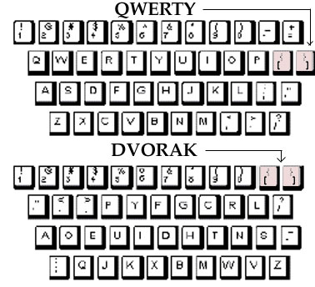
Collective Switching Costs
A company introducing a new and incompatible product into a market with strong network effects must overcome the combined switching costs of all users, the collective switching costs
However, positive feedback can be impossible to overcome
Dependent on increase in value
Also, on magnitude of switching costs
Example: QWERTY keyboard

Slide 22
How Firms Develop Critical Mass
Markets with strong network effects exhibit “Schumperterian” competition
Firms face a tradeoff between openness and control
Consumer expectations are vital to obtaining the critical mass necessary for growth – branding and track record matter
When adoption is sequential, we see early instability and later lock-in
Because early adoptions influence later ones, long-term behavior is determined largely by early events, accidental or strategic
Thus, early adopters preferences matter more!
Firms use penetration pricing to lock-in early adopters, “bargain-then-ripoff”

Slide 23
Social Welfare Implications
Incompatibility (typical in a tippy market) often reduces efficiency and harms consumers because:
Consumers either face segmented markets with low network benefits, or a tipped market with less product choice
A tipped market looses the option value that the inferior product might become superior later on

Slide 24
Social Welfare Implications
Outcomes in winner-takes-all markets are typically biased in favor of networks that are efficient early on and in favor of established firms on which expectations focus
Large firm’s predatory behavior can eliminate small firms from the market
Thus, incompatibility can harm competition
Large firms may prefer that their products are incompatible with their rivals and may use intellectual property to enforce this – Apple again!
Firms may deliberately create incompatibility by misusing intellectual property protection

