Slide 1
EBGN 320 – Economics and Technology
Innovation Incentives and Spillovers
March 20, 2013

Slide 2
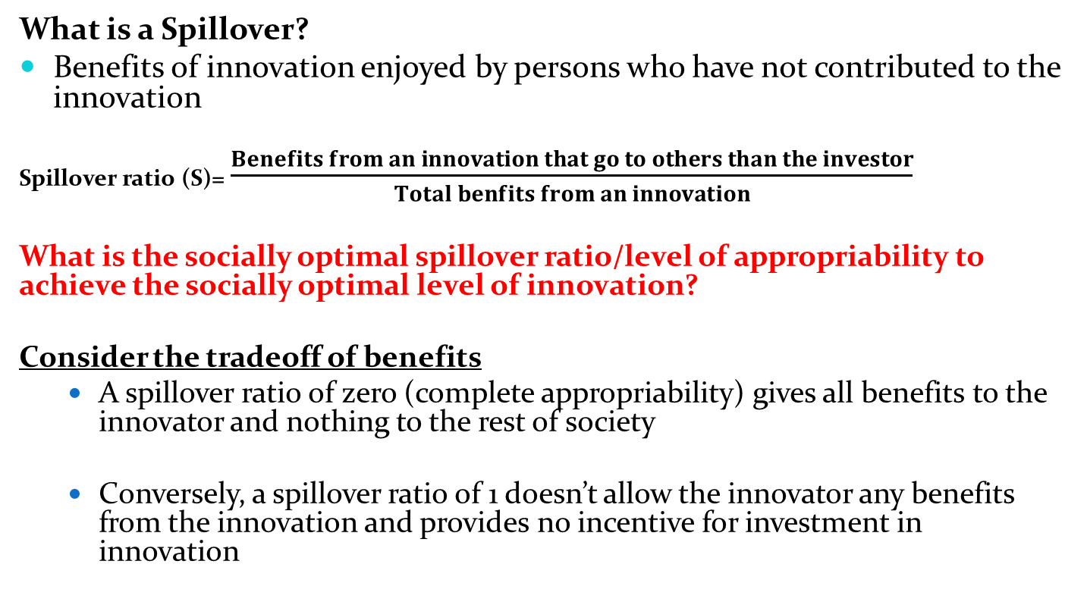
Spillover Ratio
What is a Spillover?
Benefits of innovation enjoyed by persons who have not contributed to the innovation
Spillover ratio (S)= $\frac{Benefits from an innovation that go to others than the investor}{Total benfits from an innovation}$
What is the socially optimal spillover ratio/level of appropriability to achieve the socially optimal level of innovation?
Consider the tradeoff of benefits
A spillover ratio of zero (complete appropriability) gives all benefits to the innovator and nothing to the rest of society
Conversely, a spillover ratio of 1 doesn’t allow the innovator any benefits from the innovation and provides no incentive for investment in innovation

Slide 3
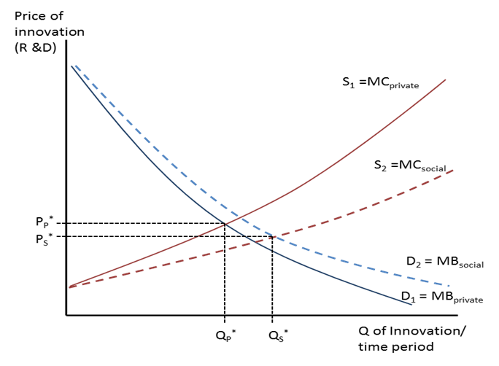
Spillover Externality
Let’s go back and look at the innovation market:
What is the main reason we assume there are externalities present and the private curves would lead to a sub-optimal level of innovation?
The spillover ratio is too large without intervention, providing disincentive to invest in innovation

Slide 4
Spillover Ratio
There exists a trade-off between an increased flow of invention and the distribution of the benefits to others (which result in higher overall living standards for everyone, not just the innovators); which means there is a tradeoff between the number of innovations actually produced and the standard of living of a majority of the population
If the spillover ratio is too high, there must be projects that promise positive net benefits to society that no private industry will carry out because they are not profitable
There appears to be a range for the spillover ratio that achieves the socially optimal level of innovation

Slide 5
Optimal Spillover Model
Each innovation I requires a given unrecoverable sunk cost C(i) and results in a discounted benefit to society of B(i) (so that all future benefits are included), meaning that the economy should carry out any innovation with positive societal net benefits (carry out any project where B(i) – C(i) > 0)
However, with the spillover ratio, private enterprise will only undertake the projects where B(i)(1-S) – C(i) > 0, so there are a number of projects that would prove beneficial to society that are never undertaken
For the simplest version of the model assume S is fixed at some percentage and C(i) = C, where innovations are indexed in descending order of incremental gross benefit (so that B(1) > B(2) …> (B(?) )

Slide 6
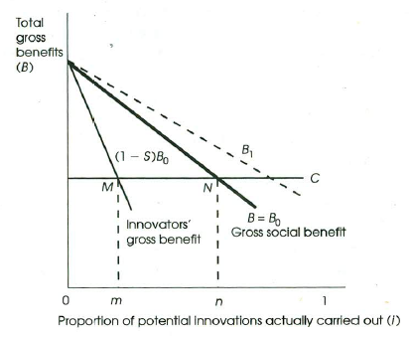
Optimal Spillover Model
What is the socially optimal proportion of innovations that ought to be carried out?
What is the level actually carried out by the private market?

Slide 7
Optimal Spillover Model
What happens if the spillover ratio increases?
If the spillover ratio increases then the innovators gross benefit curve shifts further down
m*

Slide 8
Optimal Spillover Model
As presently constructed the model shows all spillovers as bad, so how might the graph be altered to show that spillovers themselves contribute to productivity and innovation, and, consequently add to the total benefits society gets from innovation?
C*
m*
n*
n*

Slide 9
How can spillovers themselves add to productivity and the level of innovation in reality?
The spillovers from innovation trigger further innovation since:
They cut down on the need for - and the expenses involved in - the design of duplicate technology by competing firms
Technical advance is cumulative, with one step facilitating the next (would we need electricity transmission systems without the ability to harness electricity for useful purposes?)
“We are like dwarfs sitting on the shoulders of giants. We see more, and things that are more distant, than they did, not because our sight is superior or because we are taller than they, but because they raise us up, and by their great stature add to ours." John of Salisbury (12th Century, used by Isaac Newton)
Spillovers increase the number of inventors who can work effectively from the base provided by the new technology
Spillovers increase worker productivity by way of increased nutrition, education, and tools to work with

Slide 10
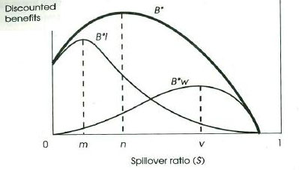

How would a change in the spillover ratio change total net benefits?
Assume there are two groups in an economy; the innovators (i) and the non-innovating workers (w) (i.e. the rest of society)
We graph the total net benefits ($\int_{0}^{X }{B\left(i\right)− C}$ where X is the profit-maximizing proportion of potential innovations actually carried out from the previous graph) as a function of the spillover ratio to determine the socially optimal level of the spillover ratio
Note: that B*w is given by SB* and the B*i is given by (1-S)B*

Slide 11
Class Activity
At what spillover ratio is the economic pie the largest? Is this the same S where the innovators are happiest? What about the workers?
Who wants a high spillover ratio? Who wants a small one?
Do innovators obtain the max benefit at a spillover ratio of zero? Do workers obtain a max benefit at an S of 1? Why (i.e. Why does the B* curve take the shape it does, increasing at first, then decreasing, and reaching 0 before S = 1)?

Slide 12
Answers 1 & 2
At what spillover ratio is the economic pie the largest? Is this the same S where the innovators are happiest? What about the workers?
When S = n, innovators have greatest benefit at S = m, and workers at S = v
Who wants a high spillover ratio? Who wants a small one?
Workers want a higher S and innovators a lower S

Slide 13
Answer 3
Do innovators obtain the max benefit at a spillover ratio of zero?
No; innovators have a max benefit at S > 0 because spillovers themselves lead to more innovation and therefore more benefit, and because workers see increased productivity with higher levels of nutrition and education (which they couldn’t get if they received none of the benefits of innovation).
Do workers obtain a max benefit at an S of 1? Why (i.e. Why does the B* curve take the shape it does, increasing at first, then decreasing, and reaching 0 before S = 1)?
No; workers have a max benefit at S < 1 because when the spillover ratio climbs too high there is no incentive to innovate for innovators, which makes the whole economic pie smaller, even though their share is getting larger
Note that society would always want the spillover ratio to be between m and v (m ≤ S ≤ v), no matter who it believes it should help receive a better share (the workers or the innovators)
Also note that moving anywhere between a spillover ratio of m and v means that one group is getting better off at the expense of the other and that total benefits are maximized at S = n

Slide 14
More Questions on Spillover Ratio
Where on the graph do you think the USA’s spillover ratio is (at n? below m? above v?)?
Where do you think it would be without intellectual property protection?
If you don’t believe the USA is at the optimal spillover ratio what do you think it should do to move the economy toward the optimal spillover ratio?
Do you think that other economies have different spillover ratios?
How much do you think the spillover ratio impacts the level of innovation in an economy?

Slide 15
Spillover & CD
What is the real spillover ratio in the USA?
Baumol estimates that S = 0.75 - 0.8, a number that is surprisingly high
Does the economy engage in too much or too little creative destruction?
If it is too much this might imply there is another externality (i.e., spillovers) driving the social marginal cost curve of innovation back to the left and making the socially optimal level of innovation lower than expected, where if it is too little then there would be reason to believe the optimal level of innovation is even higher

Slide 16
Creative Destruction vs. Spillovers
CD may encourage too much innovation
R&D spending can be excessive if identical or similar projects are undertaken independently by different firms
Firms making the investment in R&D are often not the ones that suffer the loss associated with the new innovation. This can lead to overinvestment.
Spillover externalities work in the opposite way to CD externalities
Spillovers are a disincentive to investment
CD externalities are most likely the smaller of the two effects so we can assume that society would like more innovation not less

Slide 17
Policy Implications
What can policy makers do to impact the natural spillover ratio?
If S is greater than desired level (most likely scenario):
Provide public sector assistance to help cover some or all of the sunk costs of innovation
Note that if S were different for different projects (which would make sense) that it makes more sense for the government to get involved in R&D projects that have the highest spillover ratios, e.g., basic research
Increasing patent times and other intellectual property laws
Increase the amount of resources devoted to the enforcement of existing patent and other intellectual property laws
Relax anti-trust laws related to R&D consortiums
Help foster high-technology clusters

