Slide 1
EBGN 320 – Economics and Technology
Innovation and Economic Growth
March 25, 2013

Slide 2
Economic Growth
Fundamental macroeconomic questions
Can economic growth be sustained in the long run?
What determines long run growth?

Slide 3
Economic Growth
Today
Introduction – trends in growth
Neoclassical (Exogenous) growth models
Wednesday
Endogenous growth models
The convergence debate

Slide 4
Introduction
Economic growth: growth in GDP per capita
From 1870 – 1990:
U.S. production has increased by a factor of 58
African countries’ production has only increased by a factor of 3
Note: small differences in growth rates can have a great affect over time
2% growth per year => GDP p.c. increases 7.4 fold in 100 years
0.6% => GDP per capita increase 1.8 times in 100
72 / growth rate = no. of years to double, hence China’s 10% p.a. implies 7.2 years

Slide 5
The very long run
Growth of GDP per capita (average annual percentage changes)
 | 1500-1820 | 1820-1900 | 1900-2000
OECD |  | 1.2 | 2.0
Non-OECD |  | 0.4 | 0.6
World | 0.04 | 0.8 | 1.9
Source: Boltho and Toniolo (1999, Table 1) OECD refers to North America, Western Europe, Japan, Australia and New Zealand.

Slide 6
USA, UK and Ireland
Growth of GDP p.c: USA=2.2%, GBR=2.0%, Ireland=3.7% (but post-93, 8.5%)
GDP per capita is US$ 1996 constant prices. Source: Penn World Table 6.1

Slide 7
China and India
Growth: pre-90 China 3.7%, India 4.4%. 1990-2000: China 7.0%, India 4.4%
Source: Penn World Table 6.1

Slide 8
Brazil, S. Korea, Philippines
Source: Penn World Table 6.1 (http://pwt.econ.upenn.edu/aboutpwt.html)

Slide 9
GDP per capita growth not everything
Focusing on ‘economic growth’ does neglect health, the environment, education, etc.
UN’s Human Development Index (HDI) gives equal weight to life expectancy, education and GDP per capita http://hdr.undp.org/en/reports/global/hdr2011/
GDP measures aggregate value added – whether coal power station or wind farm
Ben Friedman (2005), The Moral Consequences of Economic Growth argues growth is important for ‘stable’ societies

Slide 10
Neoclassical Growth Theory
Developed by Nobel prize winner Robert Solow (1956), but similar paper also published by Trevor Swan in the same year
Concerned about the long term or “trend” in per capita income
Based on Ricardo’s diminishing returns to K (capital)
An economy with a low capital-labor ratio will have a high marginal product of capital
If a constant fraction of income generated by new capital is saved then it can be used to purchase more capital
Over time, capital per worker will rise, but the marginal product of capital will fall
The return to new capital will fall until it just covers the cost of replacing worn out equipment
At this point, the economy enters a steady state with an unchanging standard of living

Slide 11
Neoclassical Growth Theory
Solow examined the period form 1909 – 1949
He concluded that 19% of growth was a result of increases in the capital stock
81% to another factor he called “technical change”
Later neoclassical growth models included knowledge as human capital increasing the contribution of capital (k + hk) to 80%
However, no explanation of what determines technical change -> innovation exogenous!

Slide 12
Neoclassical growth model
Model growth of GDP per worker via capital accumulation
Key elements:
Production function (GDP depends on technology, labour and physical capital)
Capital accumulation equation (change in net capital stock equals gross investment [=savings] less depreciation)
Questions:
How does capital accumulation (net investment) affect growth?
What is role of savings, depreciation and population growth?
What is role of technology?

Slide 13
Solow-Swan equations
Solow-Swan analyze how these two equations interact
Y and K are endogenous variables; s, δ and growth rate of L and/or A are exogenous (parameters)
Outcome depends on the exact functional form of production function and parameter values

Slide 14
Neoclassical production functions
Solow-Swan assume:
diminishing returns to capital or labour (the ‘law’ of diminishing returns), and
constant returns to scale (e.g. doubling K and L, doubles Y)
For example, the Cobb-Douglas production function
Hence, now have y = output (GDP) per worker as function of capital to labour ratio (k)

Slide 15
GDP per worker and k
Assume A and L constant (no technology growth or labour force growth)

Slide 16
Accumulation equation
If A and L constant, can show
This is a differential equation. In words, the change in capital to labour ratio over time = investment (saving) per worker minus depreciation per worker
Any positive change in k will increase y and generate economic growth. Growth will stop if dk/dt=0

Slide 17
Graphical analysis of
(Note: s and δ constants)

Slide 18
Solow-Swan equilibrium
GDP p.w. converges to y* =A(k*)^{α}. If A (technology) and L constant, y* is also constant: no long run growth

Slide 19
What happens if savings increased?
Raising saving increases k* and y*, but long run growth still zero (e.g. s1>s0 below)
Call this a “levels effect”
Growth increases in short run (as economy moves to new steady state), but no permanent ‘growth effect’

Slide 20
What if labour force grows?
Population growth reduces equilibrium level of GDP per worker (but long run growth still zero) if technology static

Slide 21
Golden rule
The ‘golden rule’ is the ‘optimal’ saving rate (s_{G}) that maximises consumption per head
Assume A is constant, but population growth is n
Can show that this occurs where the marginal product of capital equals (δ + n)

Slide 22
Graphically find the maximal distance between two lines

Slide 23
… over saving
Economies can over save. Higher saving does increase GDP per worker, but real objective is consumption per worker.

Slide 24
Solow’s surprise
Solow’s model states that investment in capital cannot drive long run growth in GDP per worker
Need technological change (growth in A) to avoid diminishing returns to capital
Easterly (2001) argues that “capital fundamentalism” view widely held in World Bank/IMF from 60s to 90s, despite lessons of Solow model
Policy lesson: don’t advise poor countries to invest without due regard for technology and incentives

Slide 25
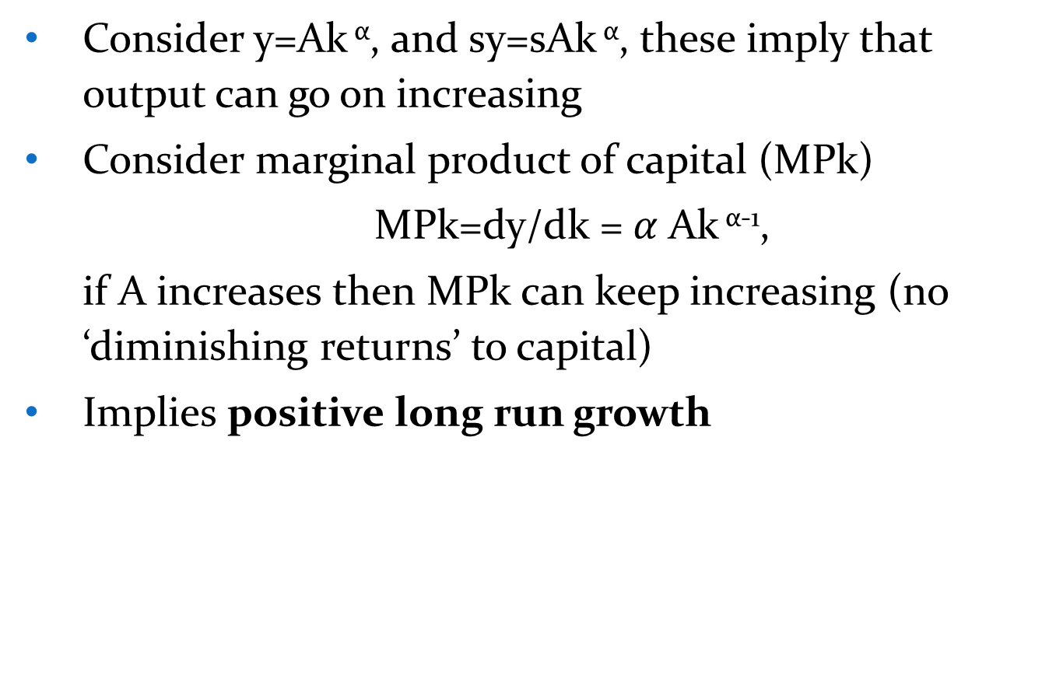
What if technology (A) grows?
Consider y=Ak ^{α}, and sy=sAk ^{α}, these imply that output can go on increasing
Consider marginal product of capital (MPk)
MPk=dy/dk =$α$Ak ^{α-1},
if A increases then MPk can keep increasing (no ‘diminishing returns’ to capital)
Implies positive long run growth

Slide 26
…. graphically, the production function simply shifts up
Output per worker increases due to:
Direct technology effect
Capital accumulation effect

Slide 27
The innovation process
Figure 1.1 Greenhalgh and Rogers (2010)

Slide 28
Summary of Solow-Swan
Solow-Swan, or neoclassical, growth model, implies countries converge to steady state GDP per worker (if no growth in technology)
If countries have same steady states, poorer countries grow faster and ‘converge’ by adopting foreign technology
call this classical convergence or ‘convergence to steady state in Solow model’
Changes in savings ratio causes “level effect”, but no long run growth effect
Higher labour force growth, ceteris paribus, implies lower GDP per worker
Golden rule: economies can over- or under-save

