Slide 1
EBGN 320 – Economics and Technology
Venture Capital
April 1, 2013

Slide 2
“Start-up” Companies
Typically small and young firms started by entrepreneurs leaving universities or corporations
Few tangible assets
High levels of uncertainty – particularly in high-tech
High risk of failure, but
Chance of high rewards
Asymmetric information - Large differences between what the entrepreneur and the investors know

Slide 3
Financing Young Firms
Potential sources of capital for young firms:
Debt – Borrow cash and pay back with interest
Friends, family, credit cards, etc.
Bank loans
Equity – Trade shares of ownership for cash
Angel investors – Rich individuals
Strategic investors – Corporations
Venture capital – Investment funds
Venture capital: Independent, professionally managed, dedicated pools of capital that focus on equity or equity-linked investments in privately held, high growth companies

Slide 4
The Role of Venture Capital (VC)
Venture capital firms target firms that have high growth potential but also high risk of failure and have difficulty raising capital
Banks and other traditional sources of capital are often limited in their ability to charge a high enough interest rate to justify the risk of investment in such young firms
Traditional sources of equity may be reluctant to invest a firm because they are unsure of how the money will be spent as they have no say in the business
Such an agency problem would occur when the manager engages in wasteful expenditure, e.g., lavish offices
VC fills a gap in the capital markets by providing funding to start-ups while expecting to see a ten times return from their investment over a short period (3-10) years

Slide 5
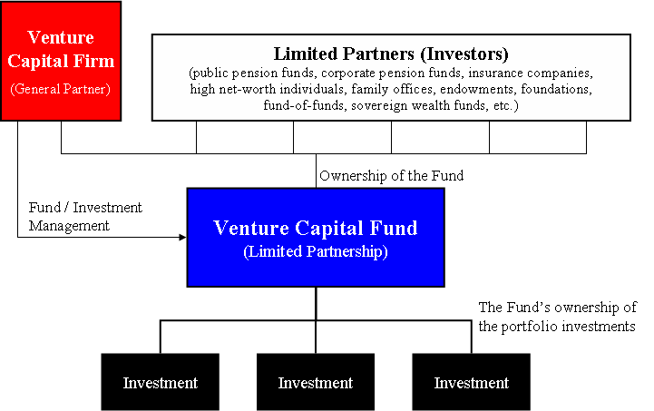
What are VCs?

Slide 6
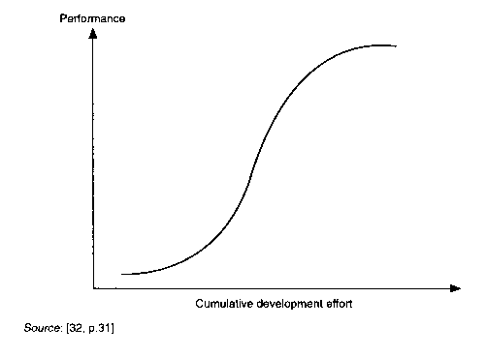
How VCs Operate
A VC typically focuses on a particular industry, e.g., high-tech, life-sciences, clean energy
VC focuses on the middle of the technology S-Curve
VCs rarely provide seed money
VCs focus on growth stage
VC firms are mostly private funds and so are exempt from many SEC regulations
Firms are often partnerships or limited partnerships
General partners manage the fund
Investors are limited partners with no management power

Slide 7
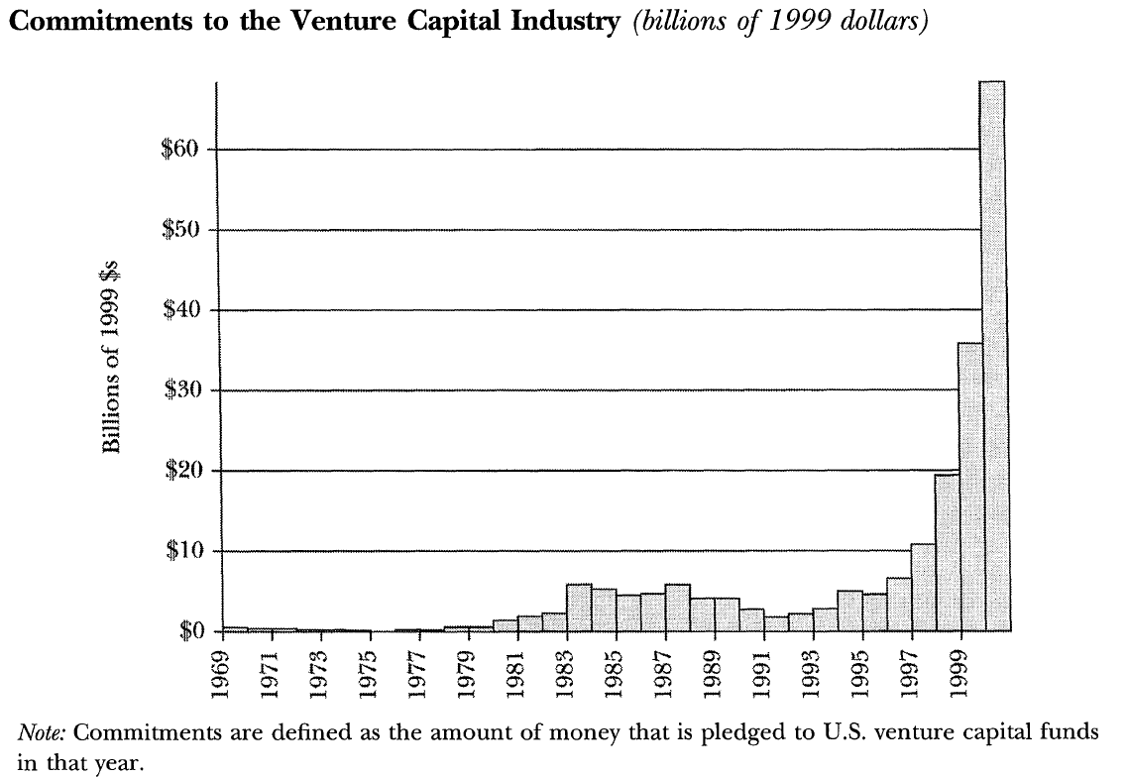
Historical Investment in VC

Slide 8
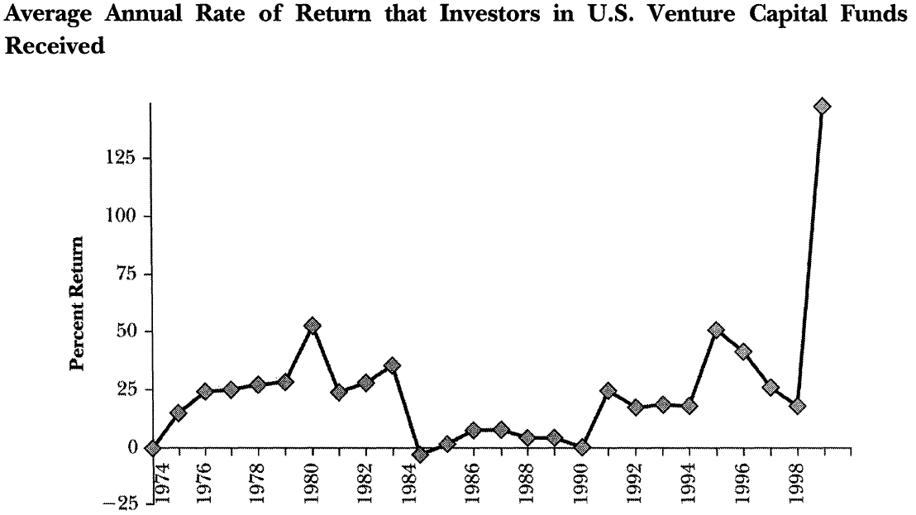
Historical Returns to Investment from VC

Slide 9
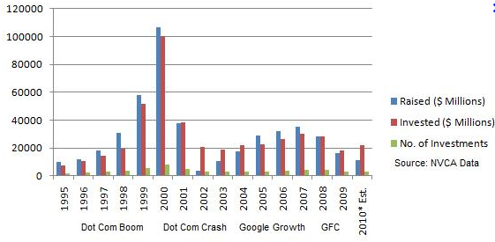
Recent Investment in VC

Slide 10
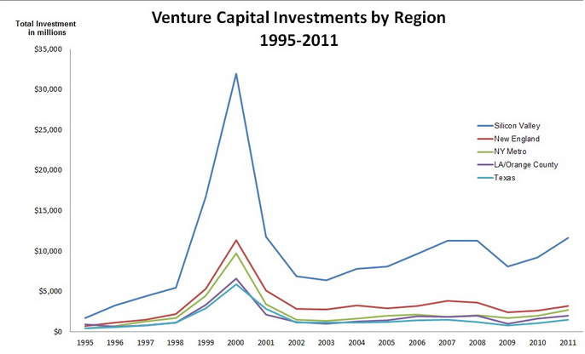
Geographic Spread of VC Investment

Slide 11
Venture Capital Cycle
Raise Funds
Invest Funds in Firms
Monitor Firms and Add Value
Sell Firms, Close Fund, and Return Investment

Slide 12
Fundraising
Bulk of investors are institutional and tax-exempt, e.g., pension funds, university endowments
Investors expect a typical return of 25-35%
General partners invest 1% of the capital
VC firms typically charge a 2% management fee and partners keep 30% of the funds return for themselves
This creates the incentives that investors like!
A VC general partner can expect very high compensation for his efforts
The same effort by a middle-manager in a corporation would not receive anywhere near the same reward

Slide 13
Monitoring
VC firms can take a number of steps to add value to or monitor a firm, they can:
Release cash to the firm in stages
Syndicate with other VC firms for second opinions and to share risk
Hire better executives for the firm
Sit on the board of the companies in which they invest
Control future compensation, e.g., stock options
Hold the right to any assets in the event of firm failure
Walk away from the failing firms

Slide 14
Exiting Venture Capital Investments
Investments can be terminated by:
VC can walk away
Firms can be acquired or merged with by other established firms
Initial public offering (IPO)
This is the most profitable option!
Sell shares in the firm to the public
Share prices are rarely under-priced
VC firm can time this to happen at the height of the market during a boom to maximize the value of their fund
VC cannot “cash-out” too quickly
Once the fund is closed, investors receive their return in cash or shares and the VC initiates another fund

Slide 15
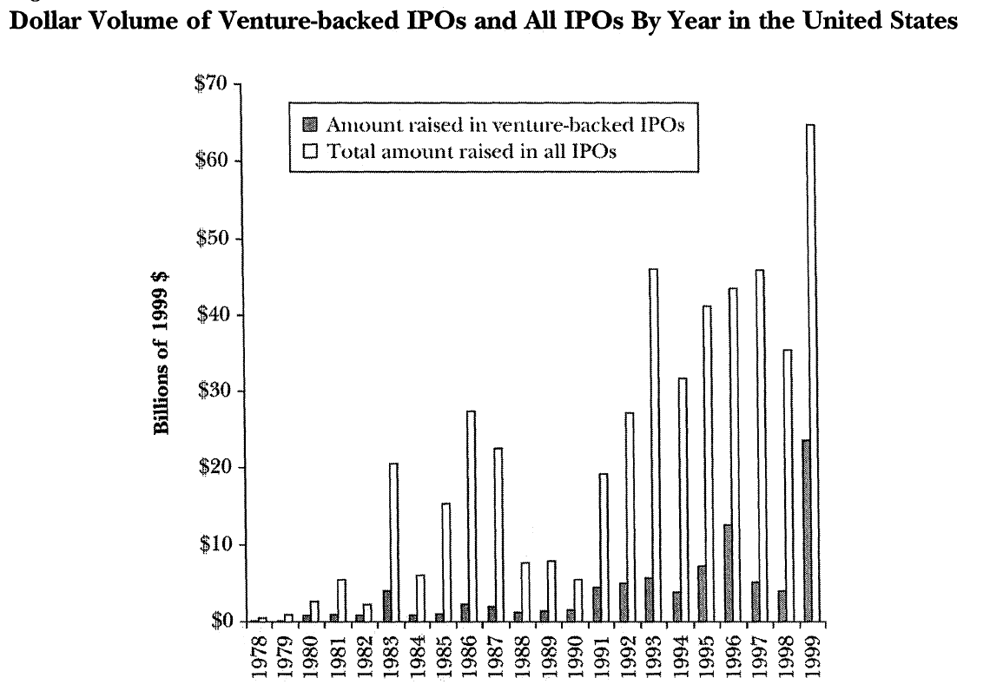
IPOs

Slide 16

The be continued…
Short video on what VCs look for:
https://www.youtube.com/watch?v=K8g52xaShus
Next time: VC and innovation

