Slide 1
EBGN 320 – Economics and Technology
Venture Capital, Innovation and Growth
November 12, 2012

Slide 2
Venture Capital and Growth
What role does venture capital (VC) play in America’s growth?
How should the government interact with the venture capital industry to enhance growth?

Slide 3
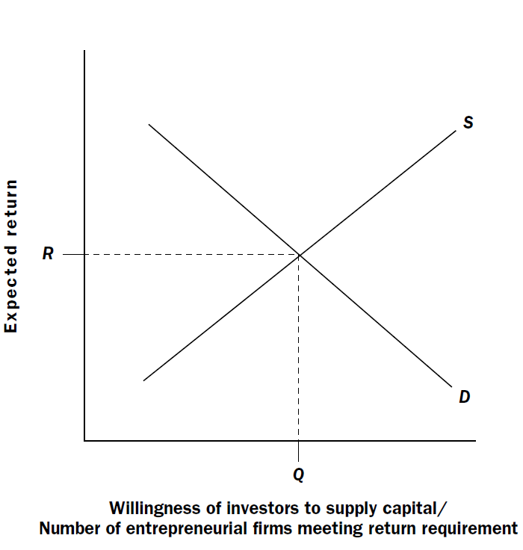
The Cyclical Nature of VC
A simple framework for the VC market
Supply?
Funds from investors (pension funds, etc.)
Depends on expected return from VC fund against other potential investments
Demand?
The number of entrepreneurial firms seeking funding

Slide 4
The Cyclical Nature of VC
What happens if we have many sudden technological breakthroughs in a high-tech industry?
We get a demand shock – many new firms seeking capital
VC may be slow to respond or sticky
Expected Return
SS
SL
R₂
R₃
R₁
D2
D1
Q1,Q2
Q₃
Quantity of Capital

Slide 5
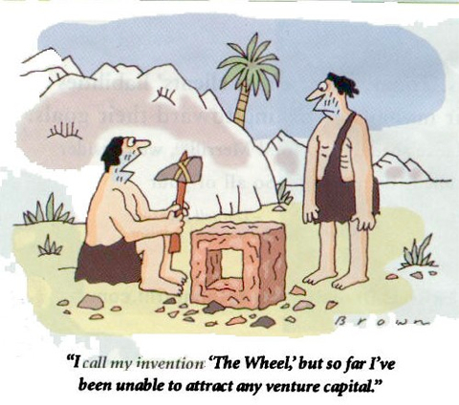
Why is VC sticky?
The structure of VC funds
Information Lags

Slide 6
Why is VC sticky?
The structure of VC funds
Unlike traditional equity (stocks) that have high liquidity (they can be bought and sold quickly for cash), VC funds are structured in a way that only allows contributions during at the beginning of a fund and only returns investments when the fund closes
This makes it difficult for investors to respond quickly to changing market conditions
Investors are often locked into staged payments to the fund even when the market in very poor, e.g., After 1987 stock market crash VC investment continued to increase and peaked in 1989!
Established VC firms are reluctant to expand their business or accept more money than they can manage effectively
New VC firms are slow to enter the market because the business must be learned through an apprenticeship

Slide 7
Why is VC sticky?
Information Lags
It is difficult for investors to know what the state of a market is when they try to observe it ,e.g., internet related technology was very profitable in the mid 1990s but many investors failed to enter the market until the late 1990
Part of this problem arises because VC firms do not report the market-value of the companies they invest in but their book-value, thus even though a company may be growing and increasing in value this will not be seen until the company is sold
Stickiness can lead to underinvestment/overinvestment in a technology sector

Slide 8
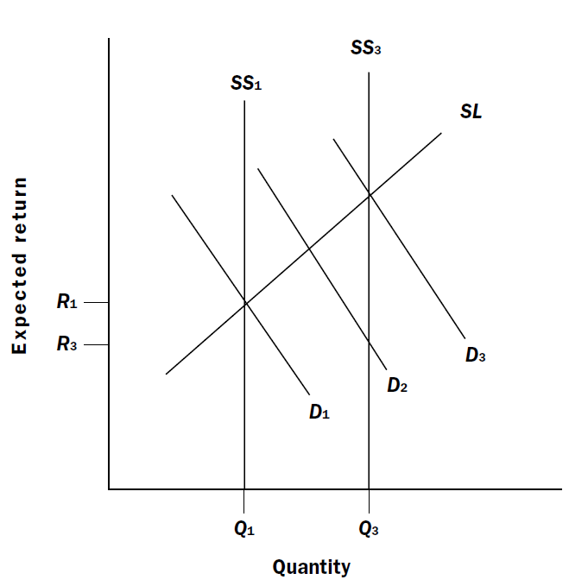
Why does VC Overreact?
VC fails to account for the impact of competitors (they overestimate demand!)
VC firms may be overloaded with investment
Overinvestment leads to poor returns for VC!

Slide 9
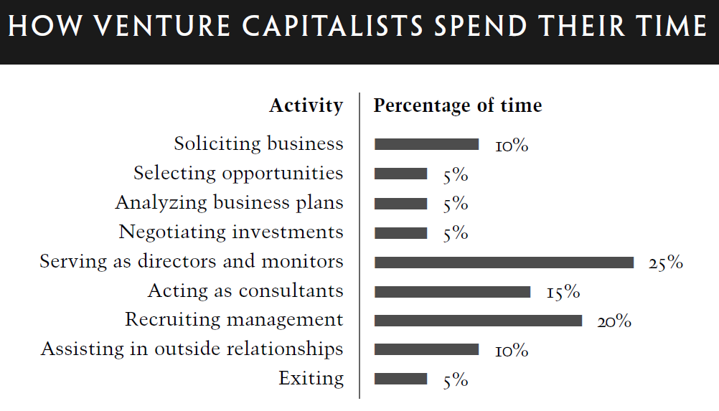
VC Overload
Institutional investors try to maintain a fixed ratio in their portfolios and may overinvest in VC as a consequence, this results in:
VC investing more capital per start-up and more capital upfront rather than staging investments
This limits the VCs power to steer the firm
Less synchronization with other VC firms on projects
Management overload
Rapid sector growth =>
high investment =>
bad returns!

Slide 10
Consequences for Innovation
VC has a role to play in alleviating investment related problems of
Moral hazard – when the risks of an action are fall on another than the one performing the action
Information asymmetries – the gap between what the entrepreneur knows and what investors know
Do VC firms encourage innovation or do innovative firms just look to VC for capital?
Lack of good data makes it difficult to accurately asses VCs contribution to growth, however some studies indicate that it has an overall positive contribution
Firms with VC backing tend to bring products to market faster than others (Hellman and Purri, 2000)
A dollar of VC tends to be 3-4 times more potent in stimulating patenting (Lerner 2000) than other sources of capital
1983-192 VC less than 3% R&D but responsible for ~8-10% growth (Lerner 2000)

Slide 11
Policy and VC
VC tends to pool in popular investment areas, leading to duplication, bidding wars and many times poor performance that can scare away investors for a period
VC tends to be least effective during boom periods and most effective during cold periods
Government polices should thus focus on:
Providing support to technology areas that are not currently popular with VC firms – avoid funding same areas leading to overinvestment!
Provide follow up funding to firms already funded by VC during periods when inflows to VC are falling

