Slide 1
EBGN 320 – Economics and Technology
Innovation and globalization
April 8, 2013

Slide 2
What is globalisation?
“The increased interdependence of economies across the world”
Dimensions of globalization include trade, technology, finance and labor migration
Rise of Internet and falling costs of transport and communications make it easier/cheaper for firms of any size to gain access to foreign markets
Firms may export their products, source inputs from abroad, outsource part of their production
Financial flows lead to investment in any country
Most importantly, technology transfers across boundaries can be increased

Slide 3

World trade in historical perspective
International trade as a proportion of world GDP has risen very rapidly in last forty years
World Trade/GDP ratio:
1970 13% -> 1990 20% -> 2005 28%
These trends differ greatly from historical levels of trade/GDP:
1870 5% -> 1914 8% -> 1930 5%
Large rise in trade between rich countries
Countries with high growth rates often experienced rapid growth in trade

Slide 4


Theories of trade and growth
Theory of comparative advantage
Product cycle models
Learning by doing models
Technology catch-up models

Slide 5
Comparative Advantage
Theory of comparative advantage, Ricardo 18th Century
Countries specialize in their area of comparative advantage, e.g., natural resources, climate
Geographical variety led to differences in productivity
HOS model (Heckscher, Ohlin, Samuelson)
Factor endowments (capital and labor) led to differences in productivity
Identical production technology
Both models are static – once specialization is reached growth will stop!
This is similar to the neoclassical growth model

Slide 6
Product Cycle Models
Vernon ,1966
Every product progresses through three stages:
New product – Suited to advanced countries
Maturing product
Standardized product – suited to developing countries
Posner, 1961
Trade between advanced countries explained by demand for variety of similar goods

Slide 7
Learning by doing models
Young, 1991
Incorporates spillovers – depends on the size of the industry
Spillovers confined within a region – Tacit knowledge!
Advanced economies focus on high-growth new tech products
Developing economies focus on low-growth industries
Result: Divergence of GDP per capita between advanced and developing economies!
Note: Developing economies are still better off!

Slide 8
Catch-up models
Gerschenkron, 1962
Developing economies look to develop products to leap-frog into the product space
Two aspects to consider:
The size of the technology gap
The absorptive capacity of the follower
Poor countries may have an absorptive capacity of zero!
Governments may need to protect new infant industries, but this is controversial as it may lead to trade barriers

Slide 9
Poorer countries : technological catch-up models
Assume growth rate of technology (A_{i}) in a poorer country depends on technology gap with leading country (e.g. (A_{usa} – A_{i})/A_{i})
Further, assume that the ability to learn, absorb and implement overseas technology is a critical factor. Call this absorptive capability, φ
This ‘model’ implies growth of follower country is ‘pulled up’ to level of leader country (convergence in growth rates of technology)

Slide 10
Implications of technological catch-up models
Assume growth in A drives growth in GDP per capita
Then technological catch-up model implies:
poorer countries grow faster initially
but converge to growth rates of leader
poorer countries have lower level of technology (and GDP p.c. in ‘steady state’)
higher absorptive capability (φ) ⇒ faster short run growth & higher long run level

Slide 11
Graphical illustration
Assuming φ>0, poorest countries grow fastest. Converge in growth rates to g (lead country growth rate). Do not converge in levels. Note this model could apply to recent China/India growth, but implies decline in their growth rates in future.

Slide 12
Catching-up and falling behind
Above model predicts all poor countries catch-up but many show very low growth rates (Africa)
To avoid this, can assume some countries have φ =0, or that very poor countries find lead country technology inappropriate (i.e. can’t learn from it)
Either will modify the model to allow countries to ‘fall behind’ – and be closer to empirical realities
More formal endogenous growth models also include ‘catch-up’ idea. They model as:
Firms in poorer countries invest in imitating products or technologies in lead countries
Costs and benefits of imitation drive growth (as in R&D models)

Slide 13
What determines absorptive capability?
Appropriate ‘institutions’
Accessibility to overseas technology
involves business, educational, trade, FDI links with other countries
influenced by geography and transport
Ability to learn
includes broad human capital, but also specialist language and technical skills
schooling, higher education, training, management
Incentives to implement new technologies
combination of institutional and macroeconomic factors that allow firms to invest
stable inflation, interest rates; taxation system; property rights

Slide 14
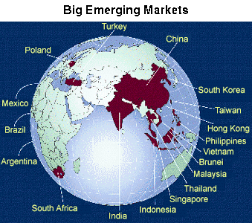
International financial flows
Long-term foreign direct investment flows
E.g., build a factory
Short-term capital flows (shares, bonds, etc)

Slide 15
Private capital flows into emerging markets and developing countries

Slide 16



Foreign direct investment (FDI):
“If the lights were to go out in California, Dublin would maintain Google worldwide.” Nelson Mattos, Vice-President of Engineering for Google EMEA
In 2003, Google opened its EMEA (Europe, Middle East, and Africa) Head Quarters in Dublin. Google’s largest operation outside of the US, it employs over 1,700 staff from 40 different countries.

Slide 17
Google Ireland
Benefits of locating in Ireland:
Favorable labor market
Strong ICT and engineering professionals
Capital investment relief
Corporate tax rate
88% of sales outside US through Dublin office
Google Ireland licenses technology from Google headquarters in USA to avoid paying high US taxes
Google paid 0.14% tax in Ireland over seven years – Google transfers 80% of global profits to Bermuda which has no corporate tax! They saved 2 billion last year!
Research opportunities and collaborations

Slide 18
Foreign direct investment (FDI):
Effect of FDI for the host country:
FDI should directly raise domestic productivity (i.e. GDP p.w.), and some of this retained in domestic economy (suggests ↑ rate of economic growth)
FDI may transfer skills or knowledge to domestic firms (suggests ↑ growth)
FDI may increase competition for domestic firms (↑ or ↓ economic growth)

Slide 19
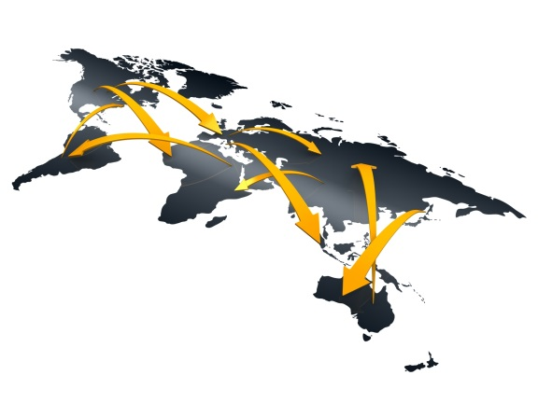
Short term financial flows
Controversy over role of short term flows
Positive effects: ease capital market constraints and raise competition in financial markets
Negative effects: focus on short run, introduce instability (via asset prices and exchange rates)
Stiglitz (2000): capital market liberalization needs to be done slowly and with care. Asian crisis reduced growth rates. China and India less affected, both had capital controls
Credit crunch and collapse of confidence in global banking supports Stiglitz

Slide 20
Trade openness and growth
There are four key mechanisms at work in models of trade and growth
Trade increases potential market size (via exports)
Increasing market size ⇒ more profits and, possibly, ‘scale effects’ (↑ growth)
Trade increases domestic competition (via imports)
Increasing competition ⇒ less profits (↓ growth) … although there may be an incentive effect (↑ growth)
Trade and factor price equalisation (FPE)
FPE, if it holds, ⇒ marginal product of capital equal across countries (diminishing returns reflect world averages, growth rates convergence)
Dynamic comparative advantage (DCA)
A changing pattern of comparative advantage over time due to changes in factor endowments or technology

Slide 21
International aspects of intellectual property rights
Historically each country choose IPRs
This gives incentive to ‘free ride’ on others inventions
Solution was introduction of “national treatment” (i.e. give foreigners same rights as domestic inventors) in 19th Century by various international agreements
However, “national treatment” on its own leads to sub-optimal length of protection (since we assume countries ignore welfare in other countries).
Solution is introduction of TRIPs, but this also means poorer countries have to pay more

