Slide 1
EBGN 320 – Economics and Technology
Versioning
April 22, 2013

Slide 2
The next two weeks…
Today – Versioning
Wednesday 24th – Macroeconomic Policies (Greenhalgh Chapter 12)
Friday 26th– Final discussion, last assignment due
Monday 29th– Exam review
Wednesday May 1st – Natural resource economics & technology
Final Exam – May 8th

Slide 3
Product Personalization
Customer information is valuable: When you know more about your customer, you can design and price products in ways that better match consumer needs
To extract maximum value:
Personalize your product to the customer
Price discriminate based on customer information, e.g., purchase history, location, browsing data
But why price discriminate?

Slide 4
Customer Information
How can firms collect information about their customers?
Registration and billing, e.g., NY times uses information to set ad rates
Observation – websites can monitor clickstreams and cookies and use demographics based on customer location
Pay users to provide personal information with a free service, discount card, or coupon/rebate

Slide 5
Personalized Pricing
AKA - First degree price discrimination
Charge each customer what they are willing to pay (WTP)
If products are highly tuned to customer needs then you have a lot of pricing flexibility
Marketing:
Vendor may offer different prices as a form of market research to measure demand, e.g., Britannica
The internet makes market research cheap. E.g., a firm can offer a discount to every 20th customer to estimate response to price changes
For example: Airline seat auctions allow airlines to:
Fill plane with capacity and capture the WTP of customers
Estimate the demand for their products

Slide 6
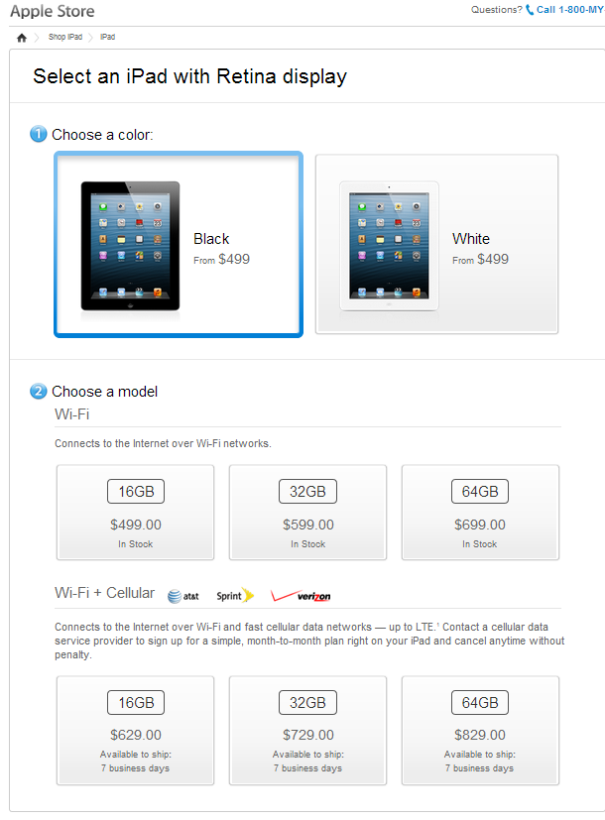
Versioning Products
Versioning – AKA 2nd degree price discrimination
You know nothing about your customer so you offer them a menu of product choices
Customers “self-select” into a product category
How do the iPad version prices relate to their cost of production?

Slide 7
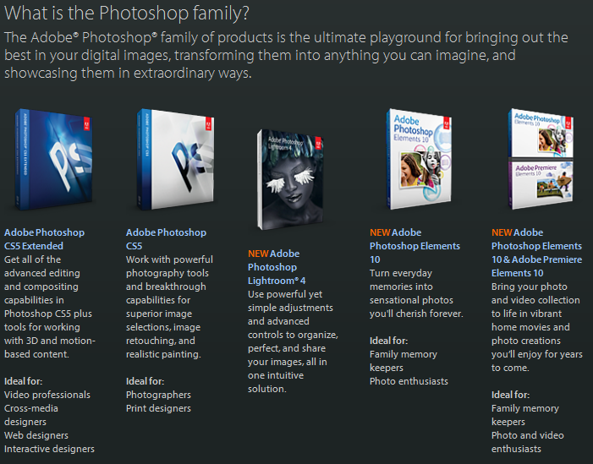
Versioning Products
To maximize profits:
Tailor a number of versions to match the needs of different customers
Accentuate the needs of different groups so each customer selects the version for their needs

Slide 8
Versioning Information
“Information is like an oyster: it usually has the greatest value when it is fresh” – Varian, Goolge Economist
Versioning is very product-specific!
Approaches to Versioning Information:
Delay the release of additional versions of the information
For example, hardcover books vs. paperback books
Especially relevant for strategic information – e.g., stock quotes
Differentiate the user interface
Simple version for casual users – pro version for experienced users
Also provides an opportunity for product lock-in
Differentiate the product features based on speed, detail, flexibility, capability
Use annoyance to encourage users to pay
“nagware”, “bloatware”, etc..
Provide product support in levels – e.g., dell XPS instant phone support
Sell different versions online and offline – e.g., newspapers

Slide 9
Value-Subtraction
Unlike physical products where a high end version will cost more to produce than a low end version, low priced information products typically cost more to produce than high priced versions because of value-subtraction
The low cost option will have some features turned off
For example – demo versions of software often do not allow the user to save their work
A drawback to this approach is that a user can sometimes turn these features back on – e.g., Android rooting, CPU overclocking, BMW power/speed limiting chip upgrade

Slide 10

Goldilocks Pricing
Behavioral Economics: combines psychology, with neo-classical economic theory because….
…people are not always rational!
Great interest from the business world in this area at the moment especially in Behavioral Finance
Many popular books on the subject, e.g., Blink by Malcom Gladwell
Field pioneered by Kahneman & Tversky
People often rely on heuristics (rules of thumb) when making decisions
Firms can take advantage of this to steer the consumer towards the product version they wish to sell

Slide 11
Behavioral Economics Example
A rare disease has broken out, which is expected to kill 600 people. There are two possible programs to combat it, but they cannot both be used. The consequences of each are known:
200 saved with certainty
600 saved with a probability of .33
Which would you choose? Why?

Slide 12
Behavioral Economics Example
A rare disease has broken out, which is expected to kill 600 people. There are two possible programs to combat it, but they cannot both be used. The consequences of each are known:
400 die for certain
600 die with a probability of .67
Which would you choose? Why?

Slide 13
Behavioral Economics Example
Framing Effect & Prospect Theory!
If decision is framed in terms of gains: People are risk avoiders
If decision is framed in terms of losses: People are risk takers
Subjective Value
Losses
Gains

Slide 14
Goldilocks Pricing
Simonson and Tversky (1992)
Two groups of consumers were asked to choose microwave ovens
One group was offered a choice between two ovens, an Emerson priced at $109.99 and a Panasonic priced at $179.99
The second group was offered these ovens plus a high-end Panasonic priced at $199.99
By offering the high-end oven, Panasonic increased its market share from 43% to 73%
The sales of the mid-priced Panasonic oven increased from 43% to 60% apparently because it was now the “compromise” choice

Slide 15
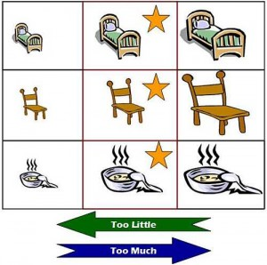
Goldilocks Pricing
Extremeness Aversion: – psychological phenomenon where consumers try to avoid extreme choices
McDonalds Drink Sizes: (why?)
small=16 oz medium=24 oz
Large=28 oz
This is why a company would sell a $100,000 BBQ grill
A “gold version” may offer instant access to tech support at not extra cost to the firm – e.g., dell XPS

