Slide 1
EBGN 320 – Economics and Technology
Technology and Mineral Resources
May 1st, 2013

Slide 2


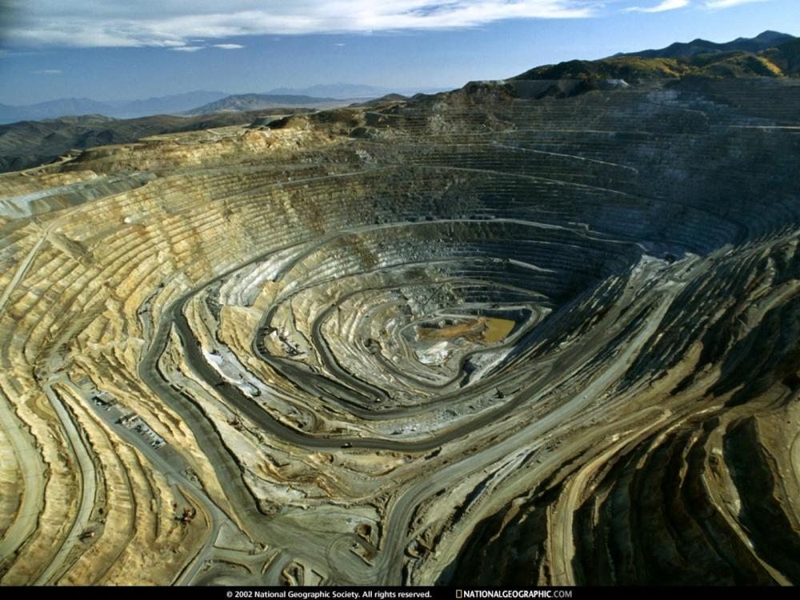
Resource Scarcity
Given that natural resources are scarce, what are the implications for humanity?

Slide 3
Historical Perspective
1700s – Malthus, population growth -> famine!
1950s – Paley Commission studies availability of non-renewable resources
1960s – Resources For the Future forecasts the dangers of running out
1972 – The Limits to Growth - Meadows
1992 – The Limits to Sustainability
Change in thinking from running out to damaging environment

Slide 4
Economic Exhaustion
Fixed Stock Paradigm assumes physical exhaustion of the natural resource
Peak oil theory - Hubbert
Opportunity Cost Paradigm implies economic exhaustion of the resource
Economic Exhaustion: Scarcity leads to a price signal that encourages substitution away from the scarce good towards a less scarce good which results in never reaching physical exhaustion, e.g., UK coal mines were closed by Thatcher in the 1980s even though there were not close to depletion
Thus, recovery is a matter of costs not physical availability!

Slide 5
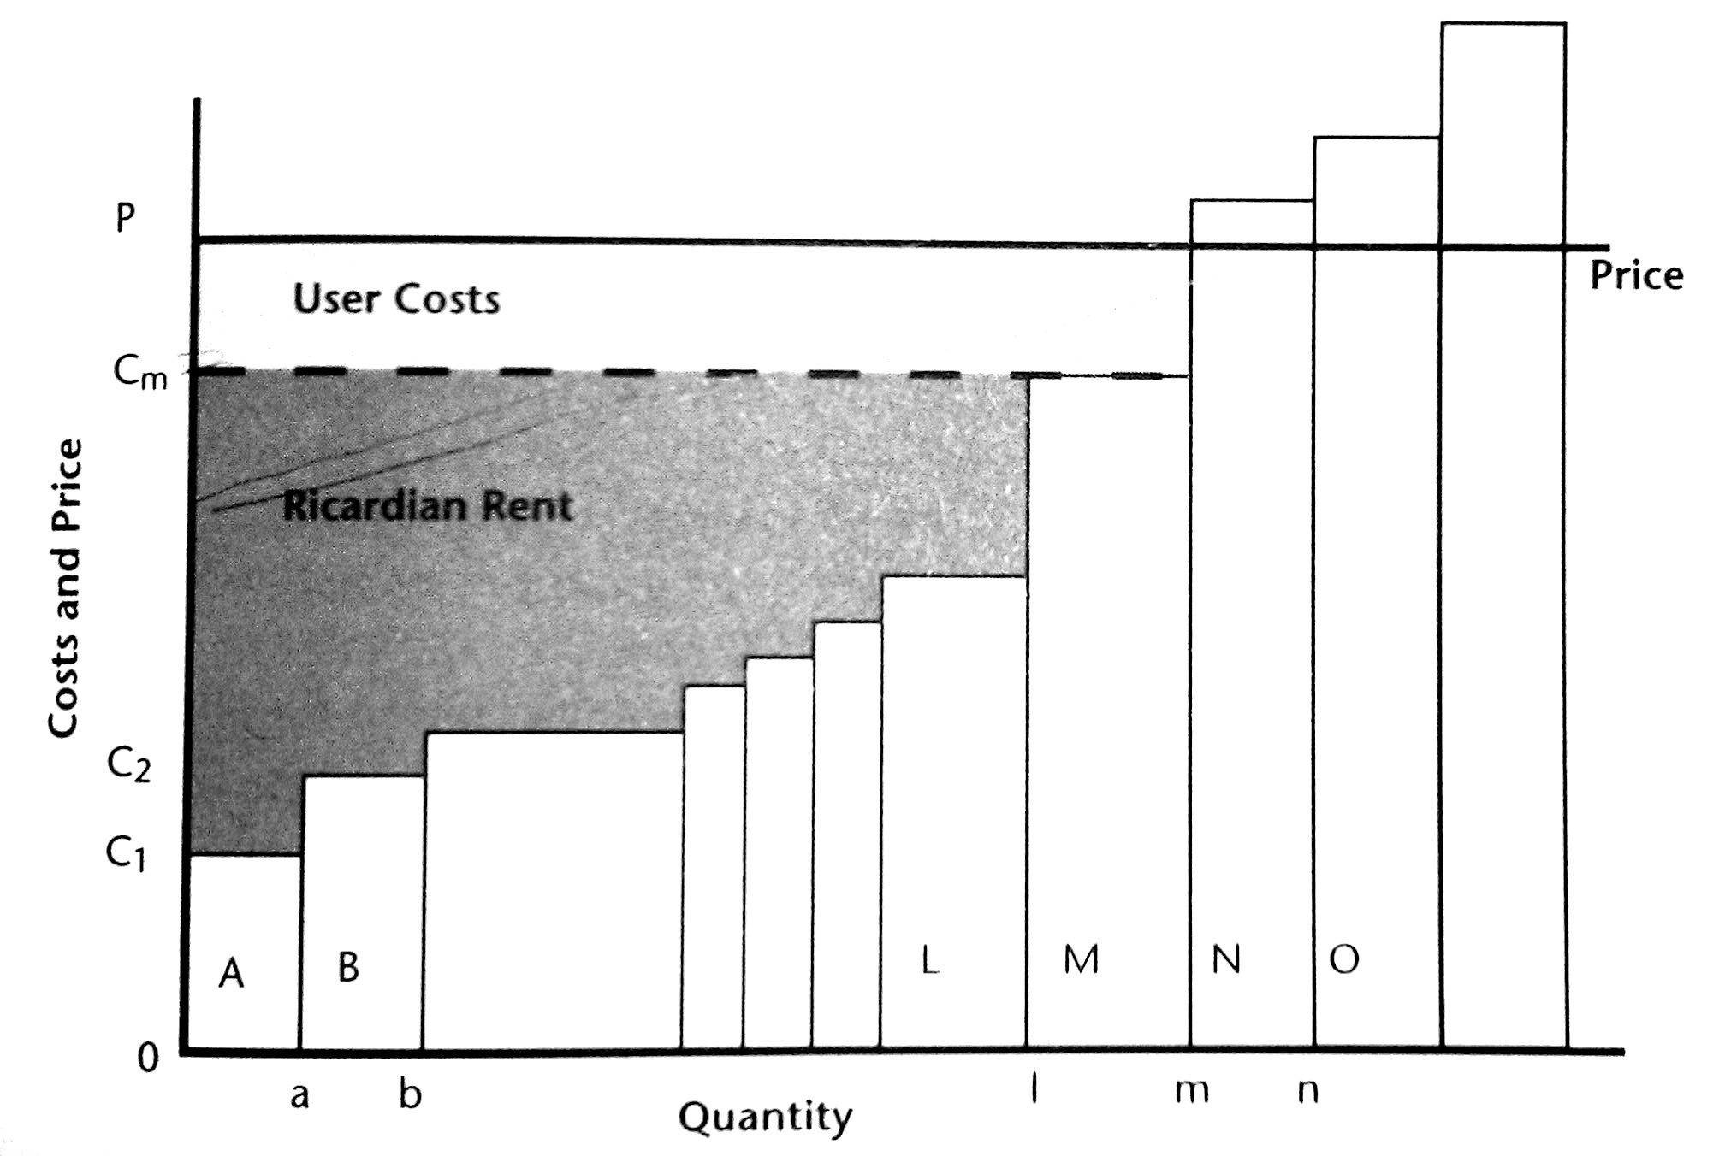
Mineral Supply
Ricardian Rent – Premium for higher quality deposit
Hotelling Rent – Cost associated with using up the resource – The value of future lost profits

Slide 6
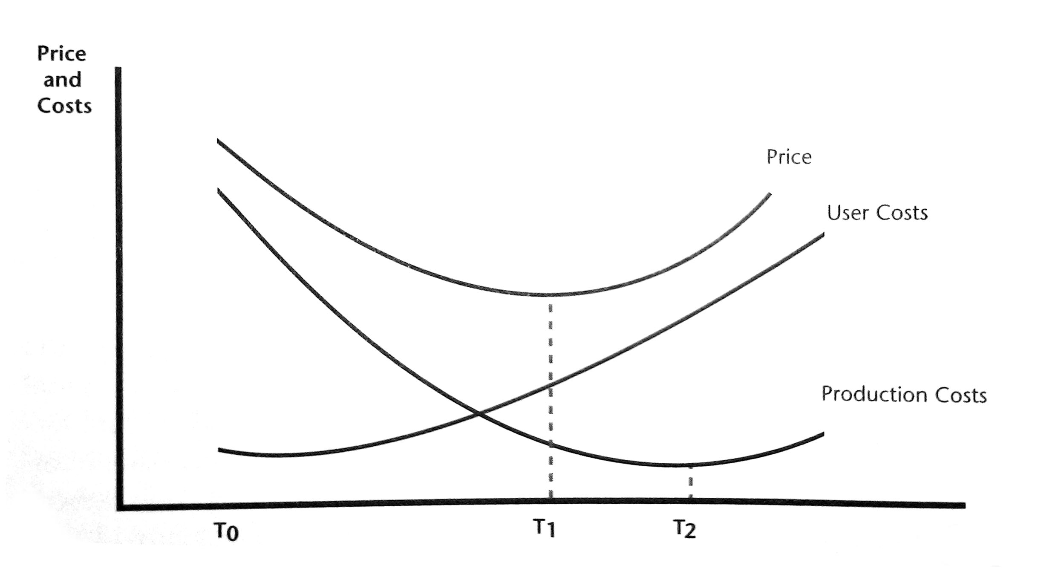
Mineral Prices
One idea is that as we run out of the resource the user costs should rise and so will the price of the resource

Slide 7
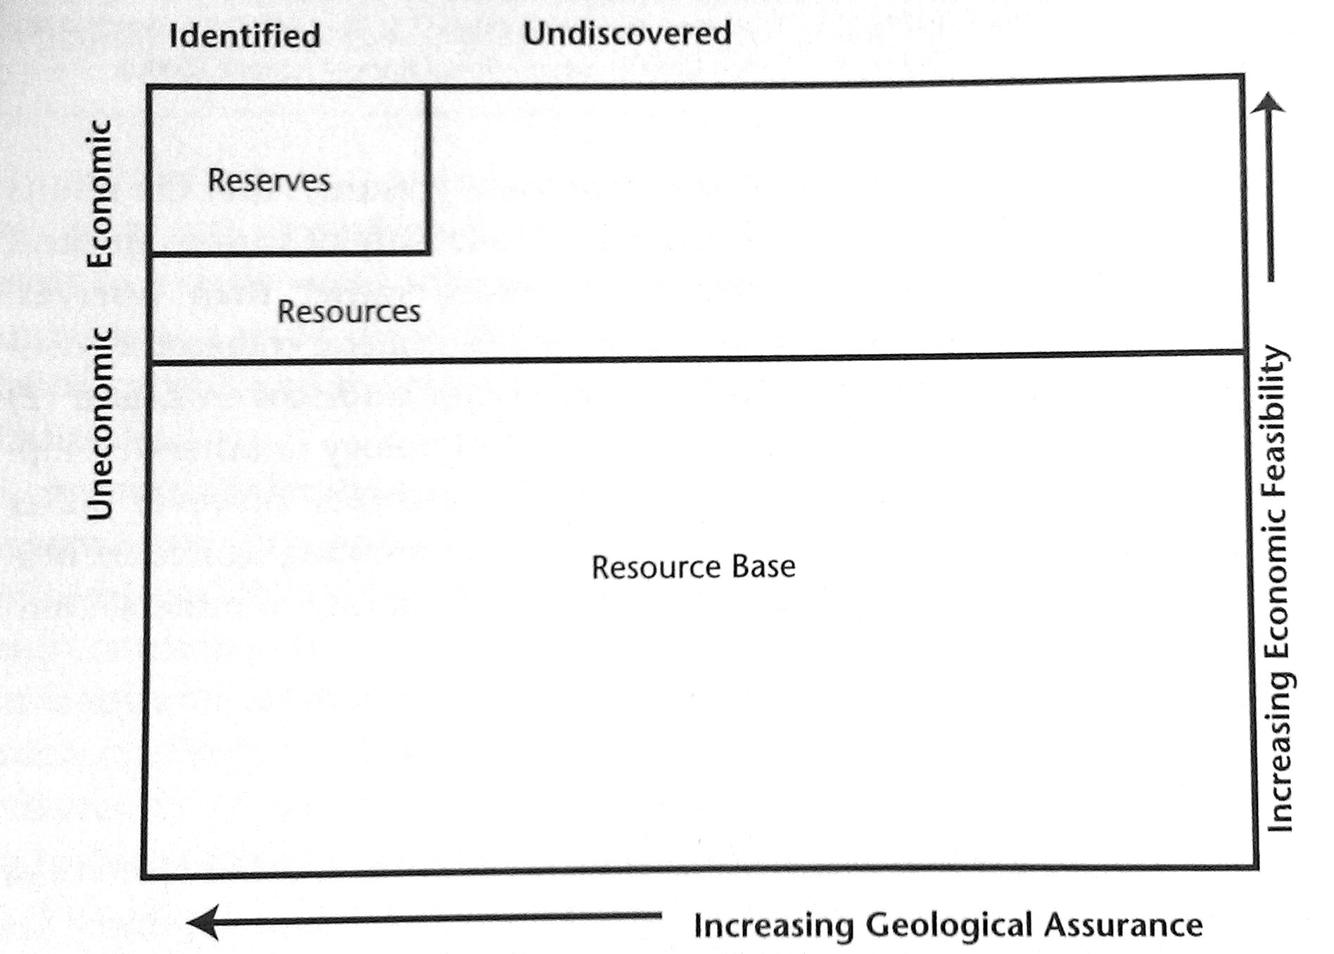
The Resource Base
McKelevy Box

Slide 8
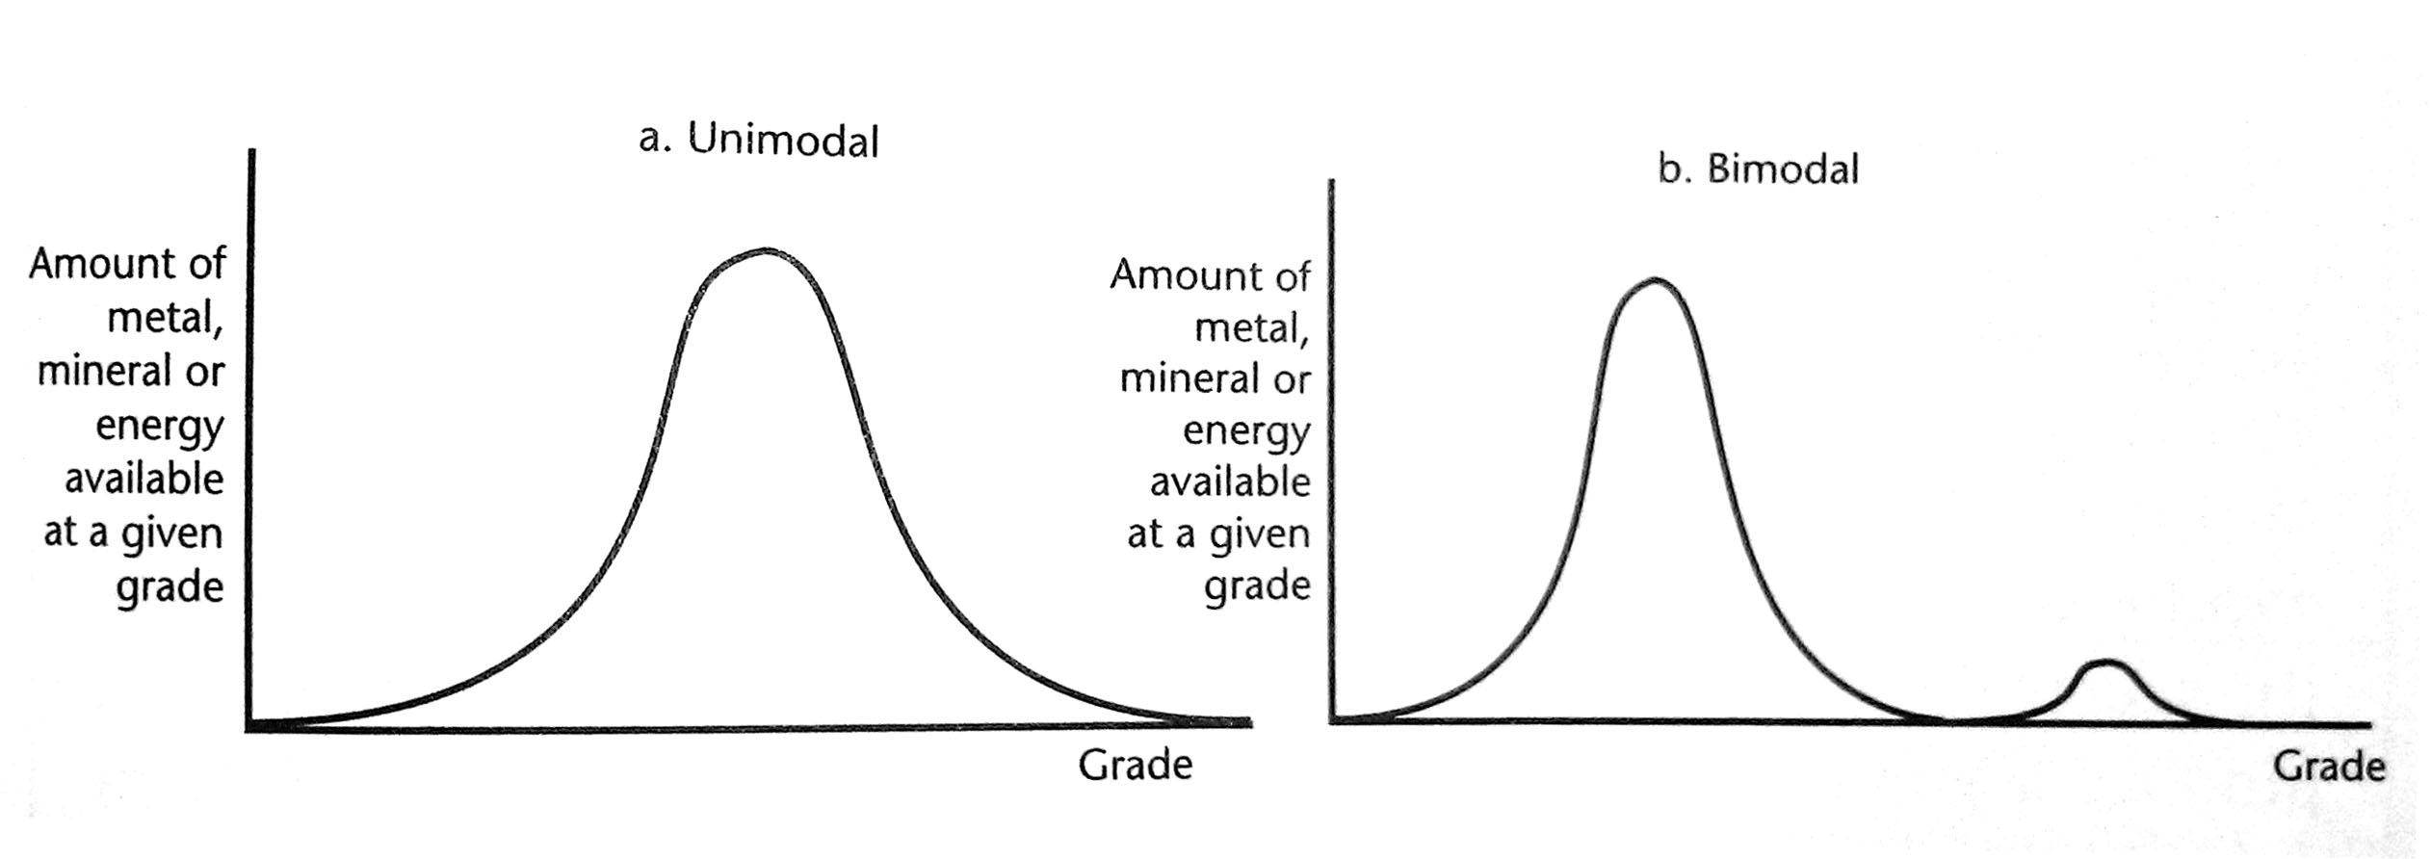
The Skinner Hypohesis
Two possible relationships between mineral grade and the resource base

Slide 9
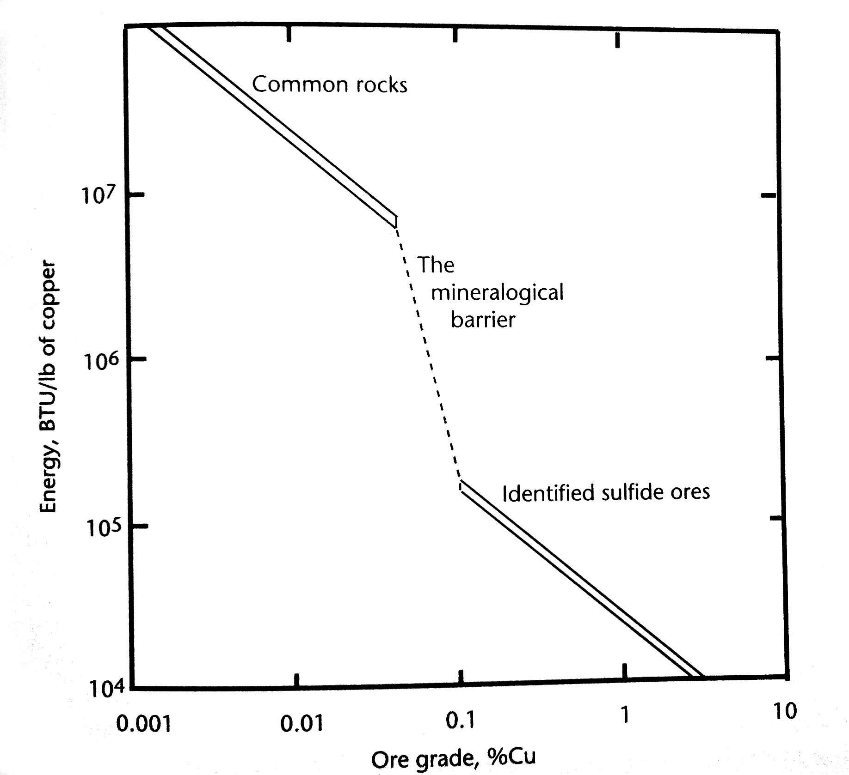
Discontinuity of Supply
The costs associated with moving from one mineral source to another depends on the size of the mineralogical barrier

Slide 10
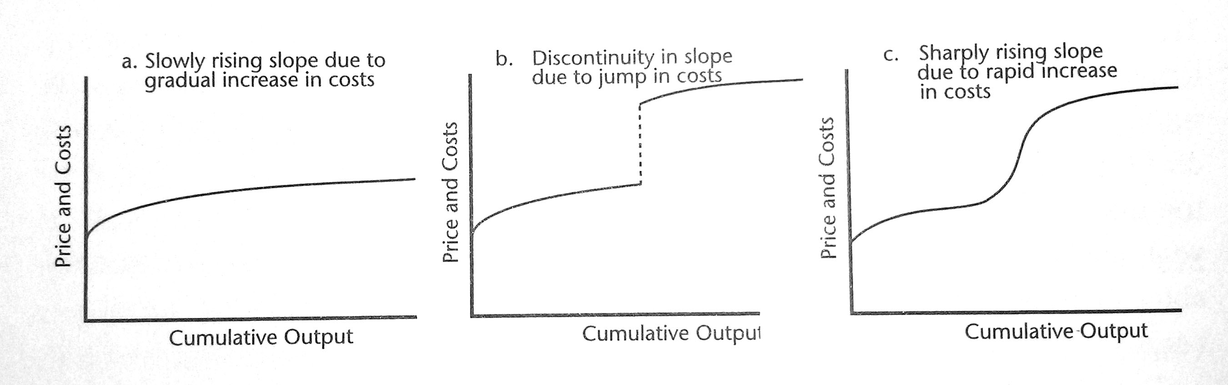
Long Run Supply
Possible long run supply curves

Slide 11
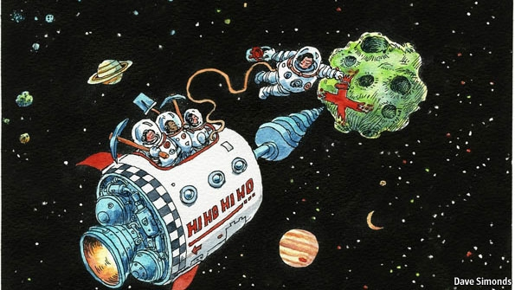
Mining Asteroids for Gold and Platinum
Planetary Resources
The founders include film director and explorer James Cameron as well as Google's chief executive Larry Page
Multi-billion-dollar plan would use robotic spacecraft to squeeze minerals such as platinum and gold out of the rocks
http://www.economist.com/node/21553419

Slide 12
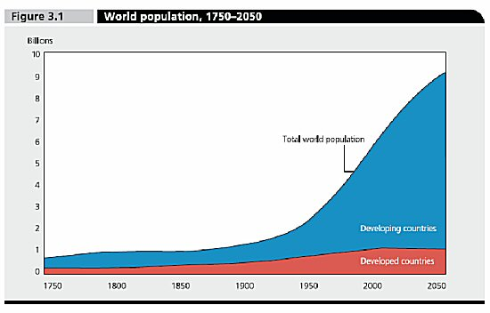
Demand
What about the increasing demand on natural resources from the developing world?

Slide 13
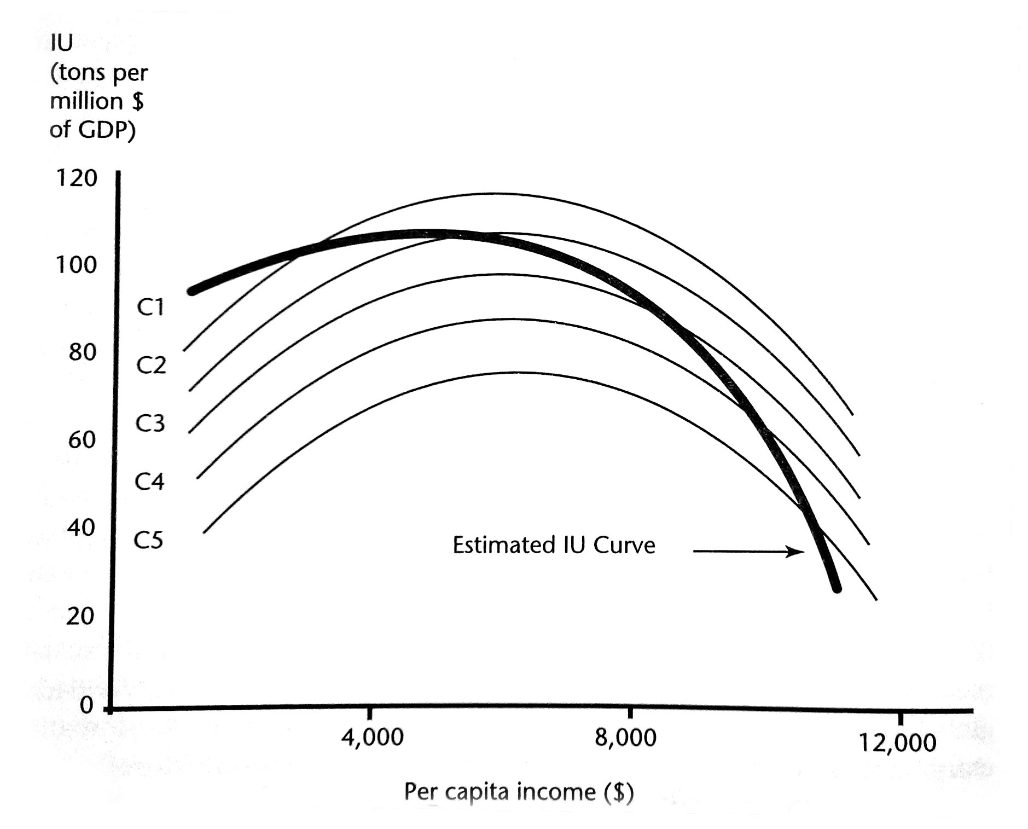
Intensity of Use
Developing economies use less mineral resources as the infrastructure of the country matures

Slide 14
Sustainability
Solow’s constant consumption model
Capital stock = manmade capital, human capital and natural capital
How do we best maintain sustainability?
Act in ways that at least maintain the capital stock
Depends on one’s view of how well natural capital can be substituted by the other forms of capital
Weak sustainability – Perfect substitution
Manufactured capital of equal value can take the place of natural capital
Strong sustainability– Imperfect substitution
Must maintain a certain level of natural capital, e.g., air and water!

Slide 15
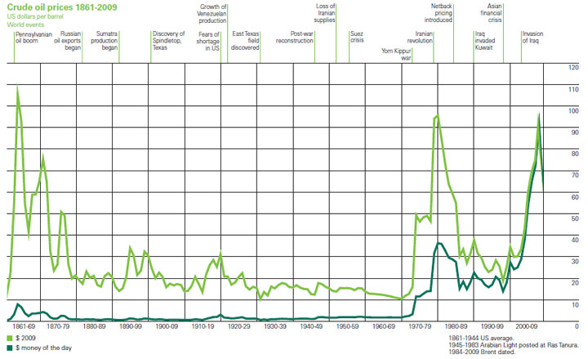
Technology and the Long Run
Technology improvements decrease extraction costs and therefore can increases mineral reserves
Historically, technology improvements have offset any cost increases due to depletion and this has kept prices relatively stable for most mineral resources, but..
The future is not necessarily like the past!

Slide 16
Conclusion
Technology plays a crucial role in the long run availability of natural resources
The ability of technology to continue to offset the rising costs of moving to poorer grade resources depends on the rate of diminishing returns to innovation

