Slide 1
EBGN 320 – Economics and Technology
Oligopoly and Investment Risk
February 11, 2013

Slide 2
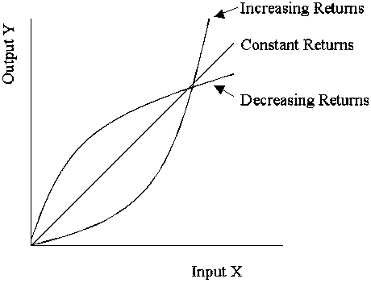
Oligopoly and R&D
We know that oligopoly is fertile ground for innovation…..
Do you think oligopolistic markets are common?
YES
Examples: Airlines, Coke & Pepsi, Bananas (Chiquita, Dole, & Del Monte), Microsoft and Google, Apple and Samsung, etc.
Why?
Many industries exhibit increasing
returns to scale
If oligopolies are prevalent why are economists so focused on perfect competition?
Most of what we learn from competitive markets still applies (about costs, entry and exit, and efficiency)
Oligopoly is more complicated, still a hot research area

Slide 3
Oligopoly and R&D
Most innovation comes from the routine R&D of large oligopolistic firms
Why?
Most innovation is not of the truly ground-breaking variety
It is smaller improvements upon ground-breaking innovations
Innovation, not price-setting, is the main competitive weapon of the high-tech oligopolistic firm
Innovation has become far from random since R&D has become a normal part of the operations of the high-tech firm, much like sales, marketing, and production
Routine R&D reduces the firms’ risk of innovating
Routine innovation is the rational response of the oligopolistic firm to creative destruction

Slide 4
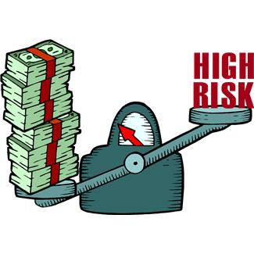
Innovation is Risky
How do firms avoid risk?
Diversifying
Sharing risk with others→ Collaboration
How much should be spent on R&D?
Until the marginal expected returns to R&D are equal to returns from other types of investment (marketing, sales, etc.)

Slide 5
Class Activity
Question #1:
A firm is spending 10% of its expenditures on marketing, 10% on sales, and 10% on R & D. Is too much or too little being spent on R&D?
Answer: We don’t know! The rate of return (ROR) needs to be equal across the portions of the company, not the share of expenditures
Question #2:
If E(ROR) from R&D is 4%, from marketing is 6%, and sales 4%, what should the firm do?
Answer: Spend a greater share of expenditures on marketing until the E(ROR) is equal across all

Slide 6
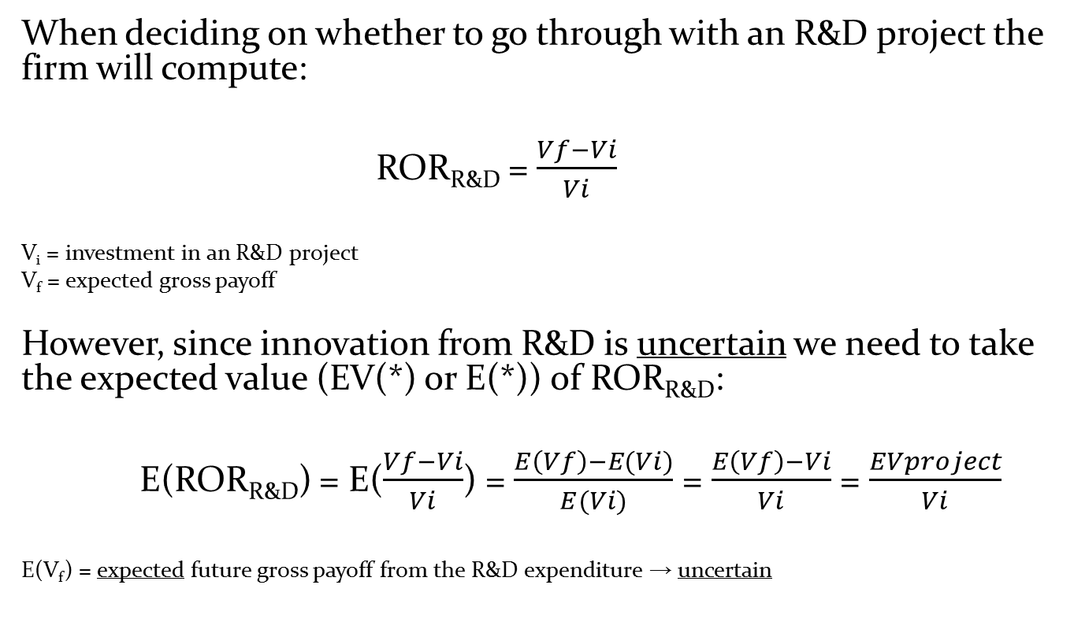
Rate of Return
When deciding on whether to go through with an R&D project the firm will compute:
ROR_{R&D} = $\frac{Vf−Vi}{Vi}$
V_{i} = investment in an R&D project
V_{f} = expected gross payoff
However, since innovation from R&D is uncertain­ we need to take the expected value (EV(*) or E(*)) of ROR_{R&D}:
E(ROR_{R&D}) = E($\frac{Vf−Vi}{Vi}$) = $\frac{E\left(Vf\right)−E(Vi)}{E(Vi)}$ = $\frac{E\left(Vf\right)−Vi}{Vi}$ = $\frac{EVproject}{Vi}$
E(V_{f}) = expected future gross payoff from the R&D expenditure → uncertain

Slide 7
Rate of Return
How might the firm get E(V_{f}) to compute E(ROR_{R&D}) so that it can make its decisions?
Example:
A firm thinks there are 3 possible outcomes for a given $10 million R&D project:
Option | Outcome | Probability | Expected Net Payoff
Option 1 | Failure | 50% | -$10 million
Option 2 | Moderately Successful Innovation | 30% | $1 million (say = “normal” economic profit (∏=0))
Option 3 | Highly Successful Innovation | 20% | $50 million

Slide 8
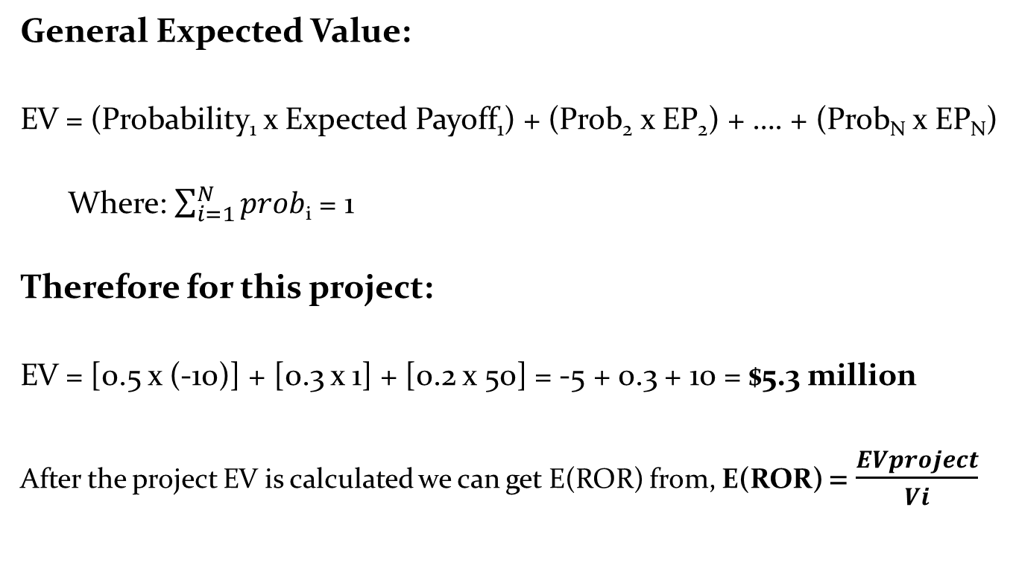
Rate of Return
General Expected Value:
EV = (Probability₁ x Expected Payoff₁) + (Prob₂ x EP₂) + …. + (Prob_{N} x EP_{N})
Where: $\sum_{i=1}^{N}{prob}$_{i} = 1
Therefore for this project:
EV = [0.5 x (-10)] + [0.3 x 1] + [0.2 x 50] = -5 + 0.3 + 10 = $5.3 million
After the project EV is calculated we can get E(ROR) from, E(ROR) = $\frac{EVproject}{Vi}$

Slide 9
Rate of Return
Should the company make the investment? What is the E(ROR) for the project?
Answer:
Technically yes, since EV > 0 but….
What if the failure of this project means the firm goes bankrupt? The firm has a 50% chance of going bankrupt. Would you go on with the project?
E(ROR) = 5.3/10 = 0.53 = 53%
Is an ROR of 53% good?
Yes, but there are other considerations…

Slide 10
Rate of Return
To make decisions this ROR would need to be compared to:
ROR of the next best alternative
The amount of risk of this project compared with its alternatives
The risk premium = E(ROR) – r where r=real interest rate
When comparing ROR from innovation with ROR from more certain investments the risk premium needs to be considered, so we expect the real rate of return to be equal across investment outlays
With certainty the risk premium = 0
When different RORs are observed this does not mean they are not equal in real terms

Slide 11
Rate of Return
Question:
What if your company has $10 million, and there is also the option to choose 5 smaller $2 million projects with the same probabilities of success and failure and proportional payoffs as above:
What is the EV of this option?
Which option would you choose? Why?
Answer:
EV of 2nd option is also $5.3 million, but….
The company would surely choose the 5 smaller projects over the 1 large project because diversification reduces the downside risk
What is the probability of bankruptcy now?
It goes down way down → the portfolio has lower variance = less risk
In fact, the firm may choose EV_{5 projects} even if EV_{1 project} >> EV_{5 projects}

Slide 12
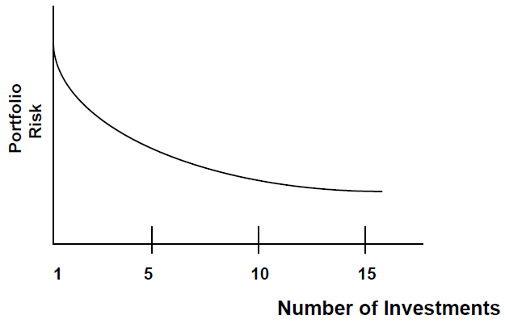
Diversification
Basic Assumption: Decisions are based on a trade-off between risk and return (see graph)
Return is measured by expected value
Risk is measured by the variance or standard deviation
Diversification works to reduce risk because returns of different investments do not move exactly together
Even in a two investment portfolio, a decline in the value of one investment can be offset by an increase in the value of the other investment

Slide 13
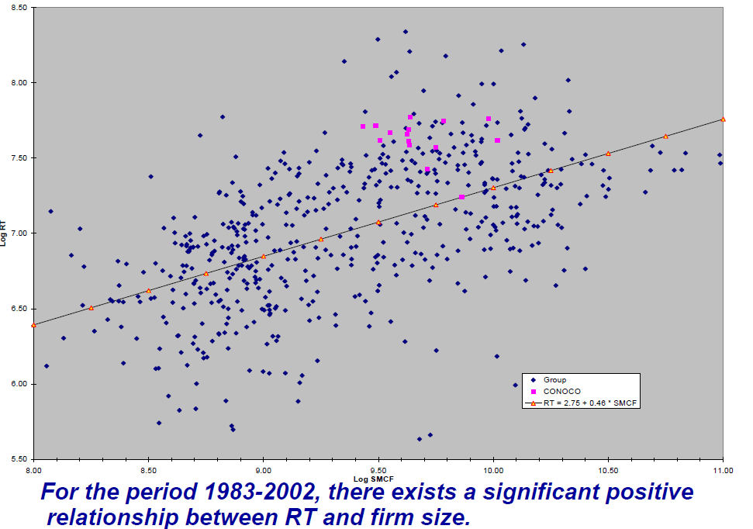
Risk Tolerance
Larger firms, as we often see in oligopolistic markets, will generally have a higher tolerance for risk and are more likely to undertake R&D with very high fixed “sunk” costs
Risk Tolerance vs. Firm Size for the Oil Industry (Walls, 2009)

Slide 14
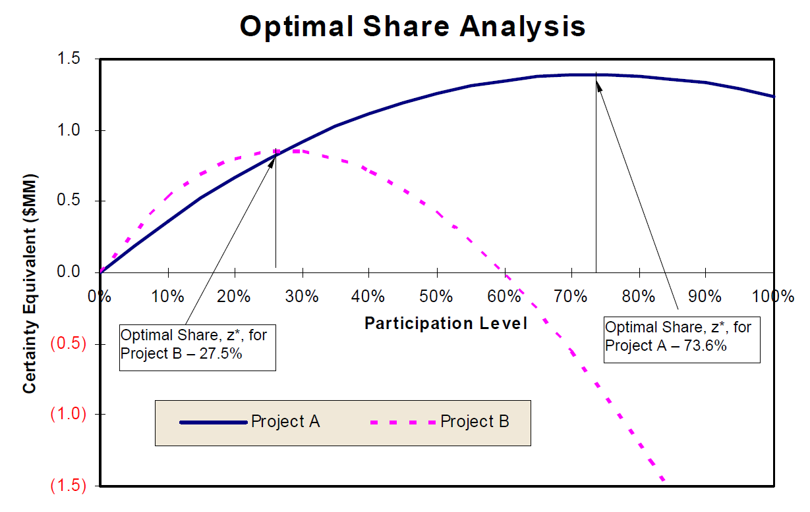
Risk Tolerance and Collaboration
However, at times R&D fixed costs and associated risk can be so high that no one company wants to bear all of the risk
Thus, rival companies may form a consortium to share the risk
See EBGN 560 Decision Analysis with Dr. Walls
(Walls, 2009)

