Slide 1
EBGN 320 – Economics and Technology
Oligopoly and Routinization of Innovation
February 13, 2013

Slide 2
For Friday 2/15/13
Read Greenhalgh chapter 4
Answer questions (3) & (7)
Additional readings
Can Russia create a new Silicon Valley?
The Nordic region is becoming a hothouse of entrepreneurship
Corporate Incubators: Industrial R&D and What Universities Can Learn from Them
Midterm Exam
Midterm exam: In class, Wednesday, 6 March 2013
Midterm review: Wednesday, 27 February 2013

Slide 3
Risk Aversion
Most people are risk-averse
In general, people don’t like risk, and they are willing to pay a price to avoid it (insurance!)
Risk comes from uncertainty, with certainty there is no risk
Example:
A friend offers to flip a coin. You will pay her $1000 if it is tails and she will give you $1000 dollars if it is heads. Will you take the deal?
NO?! You are risk-averse (if yes you are either risk-neutral or risk-loving)
What about if she will pay you $1050 and you still pay her $1000?
How much will she need to pay you for you to take the deal?
The extra is your risk-premium for the bet
Note: Wealth plays an important part in your decision to make this bet – Risk aversion should decrease with wealth, e.g., Many would feel better about investing money in the stock market if they were wealthier to begin with
What does this imply for our oligopolistic competition and innovation?

Slide 4
Risk Aversion
Rank the following in terms of risk aversion:
Governments, Individuals, Firms
Examples where we might see risk-loving behavior:
Corporations: Corporate leaders are not required to internalize the debt of a failed corporation so there is less risk for those making the decision than for the firm
Too much insurance: If someone owes more than their car is worth and has loan repayment insurance they might wreck the car intentionally
Less risk averse
More risk averse
Firms or individuals using government funds
Firms
Individuals

Slide 5
Oligopolistic Innovation
Oligopolistic competition transforms innovation from an entrepreneurial activity to a managerial activity
The routine innovation process tends to limit the resulting profits – contrasts with Schumpeter’s extraordinary profits
Why?
Risk-averse corporations hedge bets on innovation
If there are no barriers to entry/exit then:
Stream of innovations may not produce a profit
Could expect the same return on R&D investment as other investments
In competitive oligopoly market, firms must spend the profit-maximizing amount on innovation to survive
Any superior profit must be from inputs and personnel – they will claim rents, e.g., PhD salary

Slide 6
Pressure to Routinize Innovation
Firms routinize innovation to reduce risk:
Stock price affected by technology release results -> routine innovation reduces risk by providing consistency in timing and product success
Managers do not leave innovation to chance. They budget and hedge bets to produce consistent results. E.g., pharmaceuticals develop multiple drugs looking for at least a single success
Risk also bounded by arms race equilibrium
Firms reduce risk by creating joint ventures or technical cooperation (also cuts costs)
This cooperation is benign in terms of public interest, but hard to achieve because of anti-trust law
“Apple faces a June 3 trial date over civil allegations by the U.S. Department of Justice that it conspired with five publishers to raise the price of e-books and to fight the dominance of Amazon.com Inc.” Reuters, 13 Feb 2013

Slide 7
Empirical Evidence for Routinization
“The social gains from the initial innovation are typically smaller than those provided by the stream of incremental improvements” – Baumol, 2004
One could argue that the dogged manager is more socially beneficial than inspired entrepreneur
Some statistics:
In 1998, 75% of R&D activity by industry
Computer industry plowed back 13% total revenue into R&D in 1997
Drug companies plowed back 10.5% in 1997
$500 Billion in R&D for 27 OCED countries
85% spent in just 7 countries
43% in USA alone

Slide 8
Corporate approach to routinization
Routinization most notably in telecommunications, computer manufacturing, pharmaceuticals
Control with managers in complex bureaucracy
Bower article discuses dangers of bureaucracy
Discourages free-swinging approach to innovation
Rigid costs and standardized procedures
R&D must compete for funding against other departments in the firm
Management control the direction of the innovations
Firm may ask R&D to develop a list of inventions
E.g., Nike basketball shoe for China, Watt and the steam engine that needed a crank

Slide 9


Relevance of Sunk Costs
In oligopolistic markets economic profits under routinization might not tend to zero due to the treatment of sunk costs
For independent single innovations R&D is a sunk cost
The magnitude of the initial investment is irrelevant to the future success of the undertaking
For oligopolistic routine invention “prospectively sunk costs” do matter before they are incurred
The past sunk costs provide information on future decisions
Examples
Venezuelan government expropriated 174 companies in 2010
Investors will consider the pervious sunk costs when
making future investment decisions in that country
Facebook’s Zuckerberg described his “biggest mistake” as
betting on the wrong technology. They “burned two years”
on a HTML5 mobile web-based technology.

Slide 10

Relevance of Sunk Costs
Routinization is a continuous process
Past results will affect future decisions
Success must be based on all the costs including the sunk costs
The most innovative firm may not be the most profitable (Xerox GUI)

Slide 11
Sunk Costs And Non-Zero Profits for Oligopolies
Innovation too important to be left to chance
“sunk” costs now impact decision making
E(∏)_{R&D} = that of other routinized outlays
Profit Earning Mechanism
Routinization of Innovation
Limit Resulting Profits
Expected Econ ∏- risk premium = 0
Uncertainty in R&D projects results in variation in profits:
For some firms ∏ > 0, for some ∏ = 0, and for some ∏ < 0 (with perfect competition and certainty for all firms ∏ = 0)
When E(∏) can still be > 0:
High sunk costs in the innovation process provide a barrier to entry
The higher the sunk costs, the higher the cost of entry and exit and the more likely positive ∏ can be sustained

Slide 12
Sunk Costs And Non-Zero Profits for Oligopolies
Sunk costs create a barrier to entry that allows the possibility of positive profits to the industry
Minor sunk costs force profits to zero (perfect competition)
Major sunk costs = barrier to exit -> high risk of entry
Incumbents may use strategic counter-measures to squash any challenges to their market
Ricardian rent model for next best firms – Profit(Rent) proportional to the investment in R&D
Profits stable as long as new firms discouraged (e.g., OPEC $70 barrel oil discourages investment in green tech.)
Many routine innovation industries not very profitable, auto, computer, fashion
Contradicts Schumpeterian view that investment in innovation is a reliable source of economic profits

Slide 13
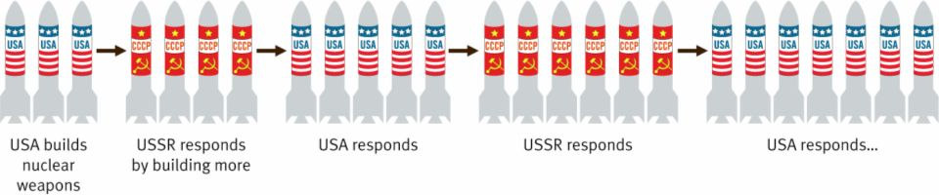
R&D Arms Races within Oligopoly
The arms-race model:
Profit maximizing firm will adopt the quantity of R&D at which marginal profit yield is zero
Magnitude of profit depends on behavior of industry firms – e.g., level of competition
No firm wants to fall behind

Slide 14
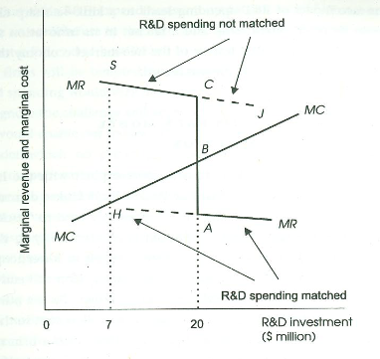
The Arms-Race Model
Once a given equilibrium in R&D spending is reached in an industry, there is no incentive for a firm to reduce R&D spending, and little incentive to increase R&D spending unless a highly promising breakthrough is expected
Note: ∏ is maximized where MR = MC → profit is maximized where the curves meet

Slide 15
The Arms-Race Model
Norm for R&D expenditures = temporary equilibrium
Spoiler firm could increase R&D spending but should expect a reaction
This should result in reduced industry profits
We should observe long periods of stable R&D spending with occasional sudden increases in spending
This is a ratchet like process where R&D spending does not slip back
Note: R&D spending may slip back a little during recession

Slide 16
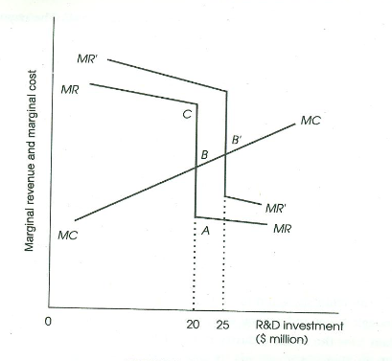
The Ratchet Mechanism
Once one firm increases R&D spending, the other firms in the industry are likely to follow suit, resulting in a new equilibrium at a higher level of R&D expenditures

Slide 17
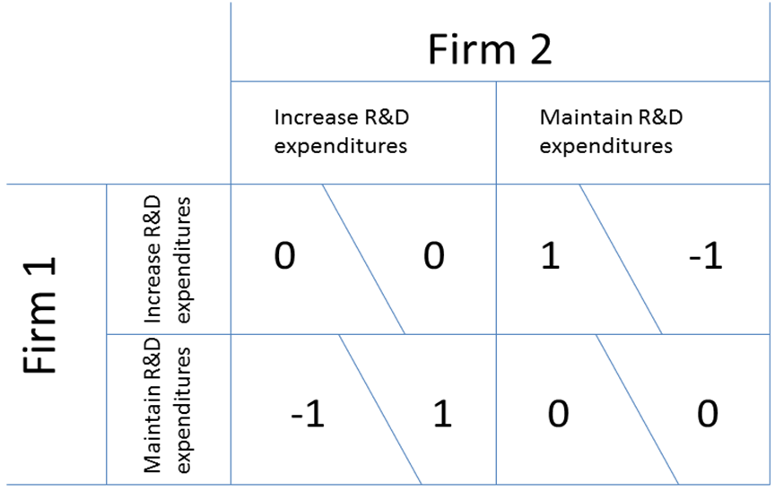
Arms-Race Game Theory Model
Both firms will choose to increase expenditures in every period because they know the other firm will do the same
If there is an established equilibrium where both maintain expenditures, it can be maintained until the expected payoffs from both firms are positive so there is incentive to be on the upper-left box
Firms are indifferent between both maintaining and both increasing

Slide 18
Arms-Race Model Conclusions:
The R&D spending norm within an industry can be expected to increase from time to time, but never expected to decrease
Oligopolistic competition results in ever-growing R&D expenditure that leads to increased growth at an increasing rate
Free-market economies are better at generating innovation - and consequently growth - than other economic systems because of this arms race

Slide 19
Technical Change and GDP
Things that magnify the contribution of technical change to GDP
Creative knowledge accumulation
Public-good property of innovation (Spillovers)
Steady R&D spending leads to GDP growth
Increases in R&D spending lead to faster rate of GDP growth
Eventually, diminishing returns to R&D might halt technical change contribution to GDP growth

