Slide 1
EBGN 320 – Economics and Technology
Market Structure Review
January 14, 2013

Slide 2
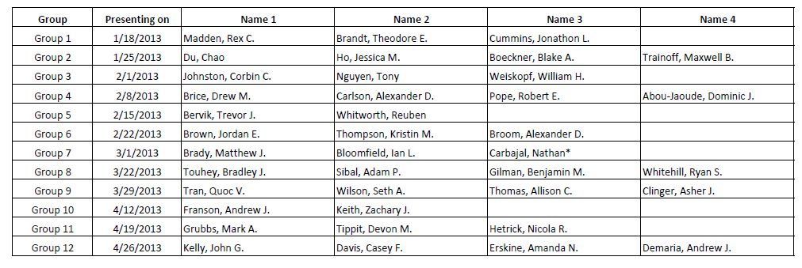
Friday Presentations
Additional readings posted on Blackboard under “content” tab
Still needing a group: Horvath, Tornes

Slide 3
Market Structures
More competitive
Less competitive
Perfect Competition | Oligopoly | Monopoly
Large # firms | Few firms | One firm
Homogeneous product | Heterogeneous (Autos) or Homogeneous (Steel) product | -
No barriers to entry/exit | High barriers to entry/exit | Barriers to entry. E.g., patent, economy of scale
Horizontal demand curve | Downward sloping demand curve | Downward sloping demand curve
Price taker, Profits(Π)=0 | Price setter , Π≥0 | Price setter , Π>0
P=MC=MR | MR=MC | MR=MC
Efficient outcome |  | Inefficient outcome
- | Strategic competition | No competition
Perfect knowledge | Incomplete knowledge | Proprietary knowledge

Slide 4
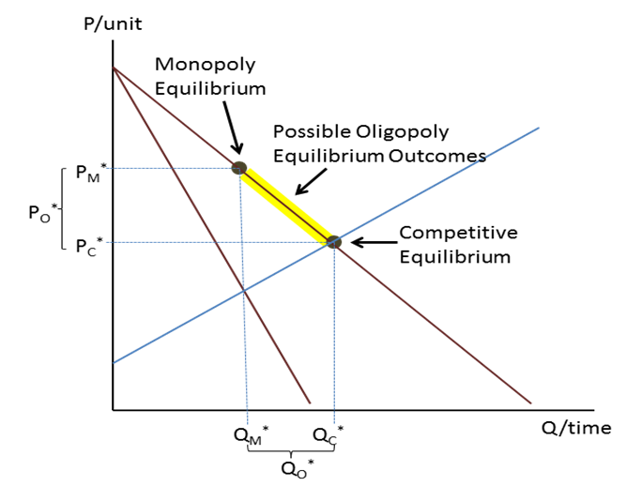
Market Structures

Slide 5
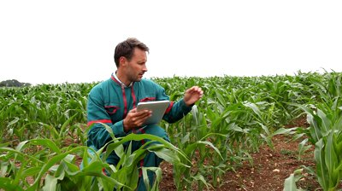
What type of firm innovates?
(a) Perfectly competitive firm?
Example: Corn Farmer
What if one farmer comes up with a better way of cultivating or weeding or harvesting?
(Remember by assumption there is equal access to inputs and technology. Therefore competitors quickly adopt the new technology too.)
Supply increases
Price drops until ∏=0 again
The innovative farmer’s reward is lower prices, profits are still zero, and she/he incurred the cost of the innovation
Therefore there is no (or little) incentive for the perfectly competitive firm to innovate
Why? complete inappropriability
Appropriability: the environmental factors that allow an innovator to capture the profits generated by an innovation

Slide 6
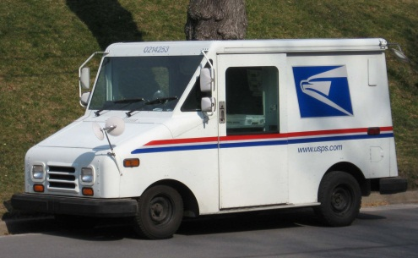
What type of firm innovates?
(b) Stable Monopoly (natural or legislated)?
Monopolists are only constrained by demand and their own costs because they have market power (∏_{m} > 0)
There is little incentive for the monopolist to innovate; they already make positive economic profits
Monopolies do engage in basic research when they can recoup their research and development (R&D) outlays

Slide 7

What type of firm innovates?
(c) Oligopolistic firm?
Few firms
High barriers to entry
Interdependence of firms
Oligopoly is fertile ground for innovation since firms use innovation as a competitive tool to secure market power→ ∏>0
What happens if oligopolies don’t innovate?
Market power is generally competed away from market entry (making future expected profits E(∏) = 0)
Note: high sunk/fixed costs may provide a sufficient barrier to entry even in the long run
Products become obsolete and markets disappear
Oligopolies must innovate or die!

Slide 8
Class Activity
Say for some reason there is not complete inappropriability (note that this is relaxing the assumptions of the perfectly competitive market as not all firms have equal access to tech)
Draw the following progression of events within the perfectly competitive S-D framework for the corn market on one graph,
Period 1: before corn innovation
Period 2: one corn innovator brings corn to market (but other farmers aren’t using innovation) making her a lower cost corn producer
Period 3: all corn farmers are using the corn innovation
What happens to equilibrium over the 3 periods?
What happens to the profit of the innovative farmer over the 3 periods?
Is there incentive for the innovative farmer to carry out the cost of the innovation?
What are the welfare implications from the changes?

Slide 9
Class Activity
MC₁
(1)
MC₂
$/Bushel
P₁*
P₂*
Innovative farmer’s supply
MC₃
P₃*
D
Q₁*
Q₂*
Q₃*
Bushels of Corn
(2) P₁*>P₂*>P₃*
Q₁*<Q₂*<Q₃*

Slide 10
Class Activity
(3) What happens to the profit of the innovative farmer over the 3 periods?
(4) Is there incentive for the innovative farmer to carry out the cost of the innovation?
Π_{It} =TR_{It} - TC_{It} =TR_{It} –(VC_{It} + FC_{It}) where I: innovative farmer
Period 1: ∏_{I1} = 0 by definition of a perfect competitive market
When ∏=0 that means the farmer is earning the same profit as she would under the next best alternative (e.g., growing wheat)
Note: if economic profit = 0, that does not mean accounting profit = 0
Period 2: ∏_{I2} = ?
Profit depends upon the fixed/sunk costs of the innovation (R&D, etc)
Assuming the fixed costs of the innovation are also incurred in period 2 the farmer only goes through with the innovation if the decrease in variable costs exceeds the increase in fixed costs for this period (therefore only if it is expected ∏_{I2} > 0)
Period 3: ∏­_{I3} = 0
We are at the new long run competitive equilibrium where the profits from all firms is zero

Slide 11
Class Activity
(5) What are the welfare implications from the changes?
MC₁
$/Bushel
MC₂
P₁*
P₂*
MC₃
P₃*
D
Q₁*
Q₂*
Q₃*
Bushels of Corn

Slide 12
Class Activity
NOTE:
If there is appropriability for more than one period the farmer will have more than one period as a low cost producer (relative to the other farmers) and is more likely to be able to recoup the costs of the innovation and achieve positive profits, and therefore, is more likely to incur the costs of the innovation to begin with
Society is better of w/ the innovation, but the farmer will not incur the costs of the innovation if expected profits during the appropriability period are not expected to be positive
If there is no period of appropriability (as in perfect competition) there is no incentive to innovate
This is still a model of certainty (where the farmer knows the cost of the innovation and the profits she will receive after the innovation is implemented)
Is this realistic?
NO - there is a great deal of uncertainty (risk) associated with innovation

