Slide 1
EBGN 320 – Economics and Technology
The Market for Innovation
January 16, 2013

Slide 2
Market supply

Slide 3
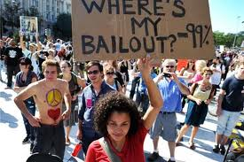


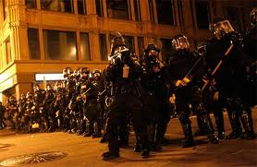
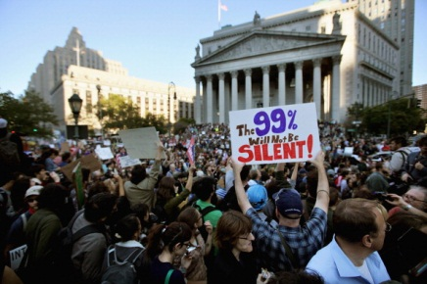
The growth miracle of free-enterprise?

Slide 4
Market failure
Market failures result in markets that are not efficient, examples:
Monopoly
Externalities
Public goods
Governments can intervene to correct or partially correct market failures by,
Regulating the monopoly
Making firms and consumers internalize externalities
Taking control of and providing public goods
These interventions move the market towards the efficient outcome

Slide 5
The market for innovation: How much innovation is optimal for society?
S₁=MC_{private}
Price of Innovation (R&D)
S₂=MC_{social}
P_{p}*
P_{s}*
D₂=MB_{social}
D₁=MB_{private}
Q_{p}*
Q_{s}*
Quantity of Innovation / time period

Slide 6
How much innovation is optimal for society?
S_{P} < S_{S} A number of R&D projects that society wants are NOT undertaken by the private market for one or more of the following reasons:
The innovation provides no financial incentive to private firms because of
Inappropriability
There is no private market for the innovation (think about going to the moon)
Private firms are risk averse
High fixed costs of R&D provide an entry barrier to the innovation market

Slide 7
How much innovation is optimal for society?
D_{P} < D_{S} → Private demand for innovation is less than the social demand for innovation, which also includes demand from the government (ex. military innovations)
This means positive externalities exist in the innovation market; this market failure means that:
Q_{P}* < Q_{S}* → The level of innovation that takes place in the private market is less than the level at the efficient social outcome
P_{S}* < P_{P}* → On the margin the R&D costs per innovation are less at the social optimum than at the private equilibrium

Slide 8
Innovations and market failure
Four cases of market failure to consider:
New knowledge underlying innovation as a public good
Innovation as a private good with positive externalities
Indivisibilities, uncertainty, and capital markets
Patent races and duplication

Slide 9
Knowledge as a public good
What is a public good?
It is a non-rival good
Use of the good does not reduce the goods availability to others, e.g., a mathematical theorem, a lighthouse
It can be non-excludable too – “Pure public good”
E.g., Air, Oceans
Basic research can often be considered a public good, e.g., university research that has a wide variety of potential applications

Slide 10
Knowledge as a public good
What is the marginal cost of an extra user of a public good once it has been provided?
Zero!
Efficient allocation calls for prices = MC = zero!
At this price profit driven firms will not seek to innovate
If firms can charge a price above MC then some users of the good will be excluded resulting in an inefficient market

Slide 11
Knowledge as a public good
How can the market failure of underinvestment in R&D when knowledge is a public good be corrected?
“In a free enterprise economy the profitability of invention requires a suboptimal allocation of resources.” – Arrow, 1962
Allow property rights over the innovation that results from the application of the new knowledge, e.g., patents, copyright, etc.
Government can provide the public good – or at least encourages its provision
Government funding of basic R&D
Provide tax breaks and subsidies to firms in near-market R&D

Slide 12
Innovation as a private good with positive externalities
Knowledge created during near-market applied R&D might be considered as a private good with positive externalities
Why a private good?
They have gained intellectual property rights (IPRs) to the knowledge or they have not shared their knowledge and hold a trade secret
What are the positive externalities?
Spillovers - the firm cannot charge all the beneficiaries of its innovation

Slide 13

Indivisibilities, uncertainty, and capital markets
What are indivisibilities?
Large fixed costs associated with R&D
With large fixed costs to create new knowledge a firm will be unlikely to undertake an innovation if they cannot charge a price above the competitive market equilibrium to cover these costs

Slide 14
Indivisibilities, uncertainty, and capital markets
Uncertainty may lead to underinvestment in innovation if a firm cannot spread its risk out across a number of R&D investments
Financiers are likely to underinvest in R&D because they will have incomplete knowledge of the innovation and cannot price the risk correctly
How can firms deal with these problems?
Collaborate and share the risk!
Joint ventures are becoming increasingly common in many industries

Slide 15
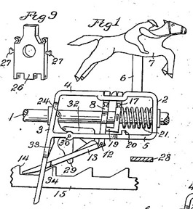
Patent races and duplication
Firms may engage in ‘patent races’ for a new technology
This duplication of effort results in an inefficient allocation of resources (capital, labor) and is thus a market failure
Again, firms can deal with this by sharing technology and establishing technology consortiums and joint ventures

Slide 16
Example: uncertain social supply of innovation
Actual MC_{Social} is at the low confidence interval
The government has funded a number of projects or helped firms reduce risk so that the innovation market is at the expected social optimum
Low Confidence Interval - MC_{social}
S=MC_{social}
Price of Innovation (R&D)
High Confidence Interval - MC_{social}
P_{act}*
DWL
P_{exp}*
D=MB_{social}
Quantity of Innovation / time period
Q_{act}*
Q_{exp}*
Q_{expected}* > Q_{actual}*
We get too much innovation because the government is funding too many R&D projects that are producing innovations society doesn’t actually want, and the wasted money is shown as deadweight loss

Slide 17
Uncertain social supply of innovation
Although it is seems fairly certain that the private market supplies too little innovation, it is hard to say how much the government should intervene to supply the actual socially optimal level of innovation under uncertainty.
The Static S-D model and Innovation
In real life, we often find firms that are not acting like the profit maximizers we assume with the perfect competition S-D model.
In the static S-D model there is no need for the firm to spend money on R&D because they only optimize over one period - the period in question. The benefits from R&D and innovation come in future, but the costs come today.
The model can’t account for why a firm, oligopolistic or otherwise, would invest in innovation for a future period
A dynamic model is needed

