Slide 1
EBGN 320 – Economics and Technology
Capitalism and Innovation
February 6, 2013

Slide 2
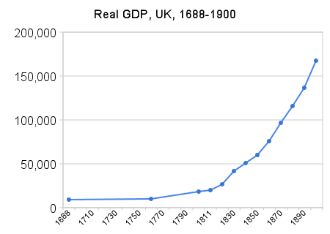
The Miracle of Capitalism
1st Ind. Rev.
2nd Ind. Rev.
Vertical axis: Real GDP in millions of 2008 GB pounds

Slide 3

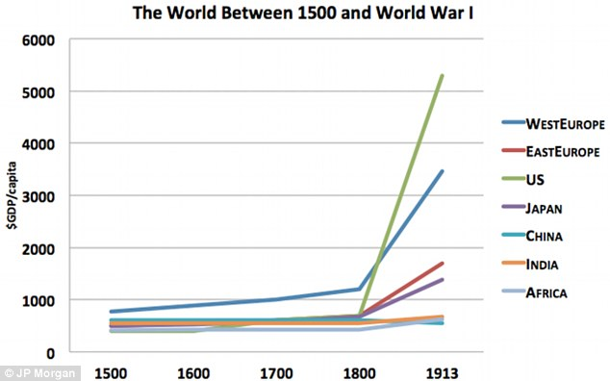
Capitalist Growth

Slide 4
Why has capitalism been relatively efficient at fostering innovation, and therefore, growth?
Because capitalism has all of the following attributes:
Oligopolistic competition
Routinization of innovation
Productive entrepreneurship
The rule of law
Technology selling & trading
In other economic systems these are absent or weaker

Slide 5
The Substantial but Imperfect Growth Efficiency of Capitalism
Textbooks suggest that free-market economies are characterized by a tendency toward static efficiency...
Static efficiency of capitalism – Firms are driven by market forces to use the most economical of the available methods of production and to supply the product mix best suited to consumer demands
… but these free market economies are also distinguished by extreme violation in the growth process
Efficiency in the growth process is violated by capitalism because of spillovers (externalities)
Gains from innovation that go to others that have not contributed to the innovation
Thus, theory would suggest that free-markets would produce far from optimal growth!

Slide 6
The Substantial but Imperfect Growth Efficiency of Capitalism
“The main achievement of the capitalist economy is its spectacular and unrivaled growth performance”- Baumol, 2002
Capitalist growth process does not quiet meet the requirements of economic efficiency, but it may be closer than economic theory indicates
Including the beneficial distributive consequences of spillovers in the model leads to something close to optimality
Rental of technology (licensing) moves us closer to efficiency

Slide 7
Incorporating Growth Analysis into Main Stream Economic Theory
Traditional microeconomics focuses on price competition and sidelines innovation
But, in technology sectors, innovation is the primary weapon of competition
A firm’s outlay on innovation (R&D) is just another investment decision and so can be treated with capital and investment theory
Key idea is to treat innovation as routine and predictable as any investment and not as a “Eureka!” type occurrence

Slide 8
The Growth Promoting Attributes of Capitalism
Reasons for capitalist growth only addressed by Marx and Schumpeter
Features of innovation in the free-market economy
Capitalism is unique not in invention but in innovation
Invention is a life and death matter for many firms
Pressure on corporations to routinize innovation
Innovation stimulates further innovation
Market incentives for rapid dissemination
Profit motive or greed harnessed to work efficiently serves the public interest – (Smith’s invisible hand)

Slide 9
Capitalist Growth
Extraordinary growth of capitalism attributed to the pressures on the business firm to innovate
In no other economic system has the standard of living been raised nearly as much
Three components to this remarkable growth:
Fierce competition
Routinization of innovation
2/3 of R&D in U.S. through business firms
Competitive pressures to disseminate proprietary technology voluntarily

Slide 10
Routine vs. Independent Innovators
Most revolutionary ideas from independent innovators
They then create firms and routinize innovation
Product improvement
Increased reliability
Enhanced user-friendliness
Search for new uses

Slide 11
Inefficiency of Capitalist Growth
Though capitalism has been more effective than other systems at fostering innovation, there are also problems that lead capitalism to the sub-optimal level of innovation:
Benefit Spillover: Others share therefore investors unlikely to devote the socially optimal quantity of resources
Other Externalities: Loss of older assets e.g. Netscape Navigator ousted by Google
Proprietors’ Withholding Technological Information – Secret patent
Inappropriate License -Fee Levels
Rent Seeking and Destructive Entrepreneurial Activity – Litigation, criminal pursuits
“Winner Take All” Patent Races – Increased risk, duplication of effort, lost second place invention, Betamax vs. VHS video format

Slide 12
Inefficiency of Capitalist Growth
Within capitalism the voluntary dissemination of technology information by firms takes care of much of these issues on its own through:
Licensing of innovation to others
Firms have strong incentives to disseminate their technology
The technology is profitable to rent at the right price
Building consortia with competitors and makers of complimentary goods

