Slide 1
EBGN 320 – Economics and Technology
Dissemination of Technology and Collaboration
February 27, 2013

Slide 2
Collaboration between innovative firms
Remember that firms mitigate risk by
Diversifying investments and
Sharing risk→ Collaboration!!
In today’s high technology markets it is widely accepted that innovation happens only through collaboration
Recently, a consortium comprising Apple, EMC, Ericsson, Microsoft, Sony and RIM pooled together to purchase the patent portfolio of Nortel Networks for $4.5 billion
Innovate of Die → Collaborate or Die

Slide 3
Why must firms collaborate or die?
Technical complexity often goes beyond the capacity of a single firm
A firm may not have the capability to bring innovation to the market on their own
Cost and risk: by sharing costs firms share risk
Financial Services Technology Consortium
Product design & development may be fully digital and completely networked
Network may be global so highly successful innovations are portable and move fast

Slide 4
Four types of R&D collaboration:
With Competitors
Horizontal collaboration
With Suppliers
Vertical collaboration
With Customers
Vertical collaboration
With Universities and Research Centers
Institutional collaboration
Positive spillovers from vertical collaboration are greater than for horizontal collaboration (though all are positive)
Spillovers from university and research centers stimulate the most collaboration
The larger the R&D firm the more likely it is to engage in collaboration

Slide 5
Innovation and dissemination
Innovation and quick dissemination of technology are both critical to economic growth
but…
… there is an idea that there is a conflict between innovation and dissemination
unless….
….there are incentives to voluntarily disseminate proprietary technology

Slide 6
Empirical evidence
Empirical evidence over the last century:
New patents have increased dramatically (from 15.3 US patents granted per million worldwide population in 1963 to 28.2 US patents/million world pop in 2009)
The interval between the introduction of a new innovation and competitive entry has decreased dramatically (from 33 years in 1900 to 3 years in the 1980’s (Agarwal and Gort 2001))
How can this be if innovation and dissemination are completely contradictory?
Voluntary dissemination is the most prominent way these contradictory statistics can be reconciled
Technology Licensing
Technology Sharing Consortiums

Slide 7
Incentives for voluntary dissemination
Technology license markets:
Proprietary technology/patent rights are just another input to production
Though a patent is a bottleneck input (an especially scarce input that is indispensable to moving the production process forward) that can only be used by other firms during the patent protection period through the purchase of a technology license (assuming rule of law)
Like other inputs a firm can choose to:
Use the input
Rent the input
Do both
Firms will choose the most profitable option

Slide 8
Technology licensing
Can firms actually make more profits by selling the rights to the technology?
If the buyers of the technology license are more efficient users of the technology they often are willing to pay more for the license than the selling firm can hope to earn in profits if they use the technology themselves
Example: Think of a small film production company that made a good movie, they need the larger production companies to market the film and will sell the rights to the larger companies

Slide 9
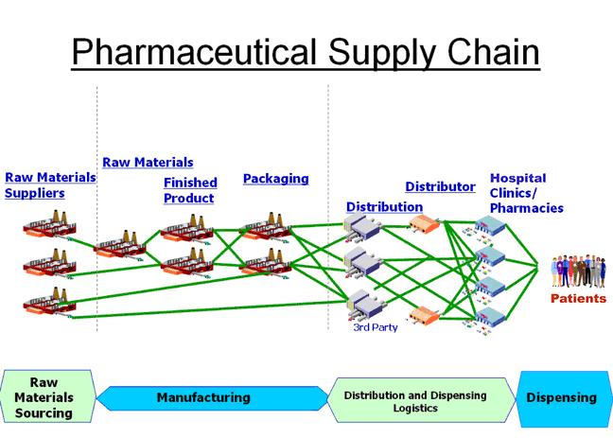
Technology licensing
Licensing of technology is more likely in the case of small firms that don’t have the supply chain, capital raising, and marketing capabilities of larger firms

Slide 10
Technology licensing
Why don’t firms copy technology?
Speed of technological change and cost encourages firms to seek “friendly transfer”
Cost and delay in “reverse engineering” typically significant making procurement of a license the more attractive option

Slide 11
Technology licensing
Even if a firm sells a license it may take the buying firm a substantial amount of time to receive the license, learn how to use the technology, install the necessary equipment, and organize the requisite marketing to use the license so that the innovating firm still retains a degree of protection and the early-entry advantage
In fact, many R&D firms never intend to market their innovations to the final customers themselves, and generate all of their revenues by selling the licenses of their patents to other firms
Immersive Labs
The selling of technology licenses helps to preserve the inventors’ reward while also allowing others to use that technology
Benefits both the buyer and the seller of the license
Most of all it benefits society as prices for new products are driven down through competition and more efficient production

