Slide 1
EBGN 320 – Economics and Technology
Patents and Innovation
January 21, 2013

Slide 2
For Friday 1/25/2013
Chapter 2 of Greenhalgh and answer questions (2), (3), and (4)
Readings
Apple versus Samsung
Why There Are Too Many Patents in America
Who Owns the Genome?
Patent Trolls Eat Startups First
Group 2: Chao, Ho, Boeckner, Trainoff

Slide 3
Intellectual Property Rights
The Congress shall have Power …. To promote the Progress of Science and useful Arts, by securing for limited Times to Authors and Inventors the exclusive Right to their respective Writings and Discoveries; - U.S. Constitution - Article I, Section 8, Clause 8
Main types of intellectual property
Patents
Trade marks
Copyright

Slide 4
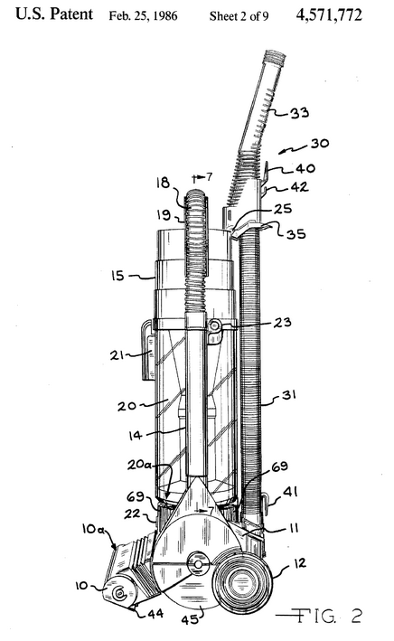
Patents
Patent: A grant made by a government that confers upon the creator of an invention the sole right to make, use, and sell that invention for a set period of time
To qualify for a patent the invention must meet three conditions:
Novelty
Nonobviousness
Suitability for industrial application

Slide 5
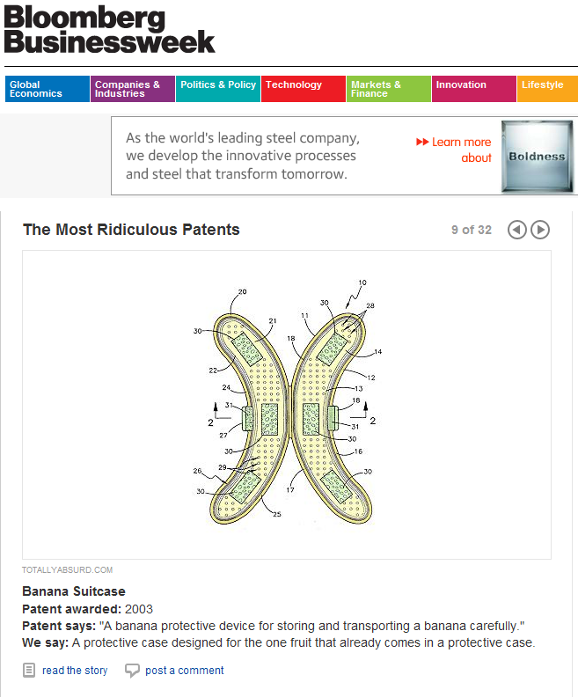
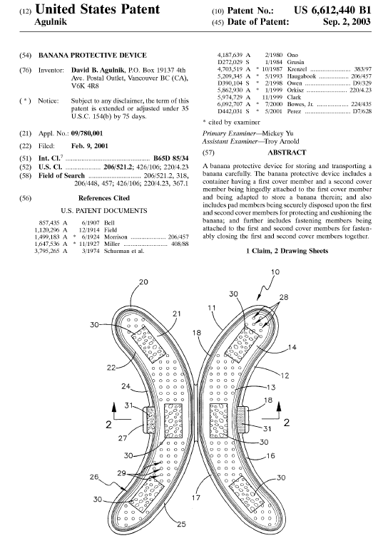
What can you patent?
http://www.bananaguard.com/

Slide 6
Patent Law
In the 1970s, concern that the US was lagging behind other countries in innovation led to a series of strengthening amendments to patent law
Strengthened protection
Easier enforcement
Longer patent terms
Extension to software, biotech, and business methods
Business method example: (U.S. Pat No. 5,960,411) Amazon.com “1-click” system that allows customers to bypass address and credit card forms because Amazon can get this information from their account.
The result was a surge in the number of patent applications from the early 1980s to the present day

Slide 7
Patent Theory
A drastic process innovation – Greenhalgh, Figure 2.1

Slide 8
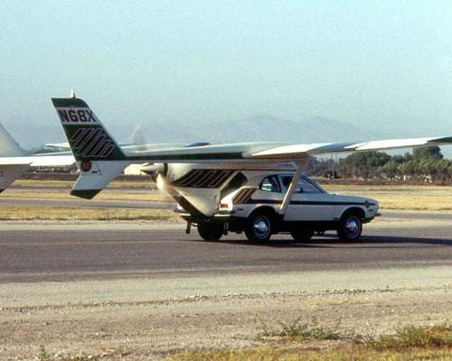
A drastic product innovation!

Slide 9
Patent Theory
Stronger patents stimulate innovation, encourage firms to disclose their inventions and facilitate efficient technology transfer
New research questions this relationship between patents and innovation
Possible inverted U curve for patent strength
Where is the USA on this curve?
Social Welfare
Strength of Patent Law

Slide 10
The Patent System Tradeoffs
Effects on: | Benefit | Cost
Innovation | Creates an incentive for R&D Promotes the diffusion of ideas | Innovation may be under utilized Impedes the development of new ideas and inventions Raises transaction costs
Competition | Facilitates the entry of new small firms with limited assets Allows trading of inventive knowledge and markets for technology | Creates short-term monopolies, which may become long term in network industries
Hall (2007)

Slide 11
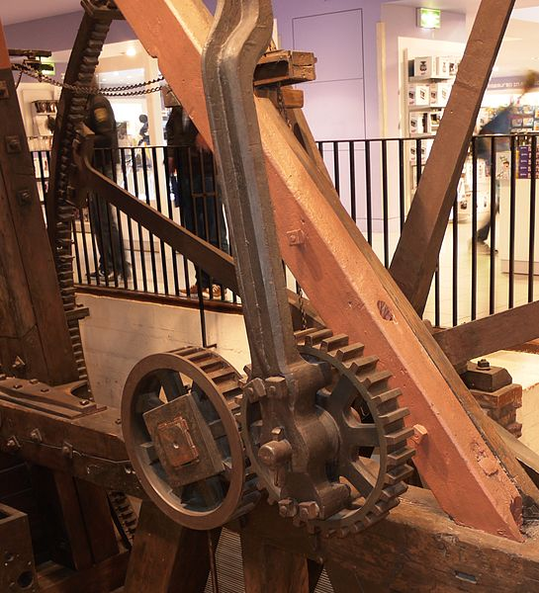
Social Costs of Patents
Innovation may be under utilized
A firm may not even develop a patent and prevent others from doing so e.g., Watt engine could not use crank!
Patents impedes the development of new ideas and inventions – An inventor is both a leader and a follower
Patents raise transaction costs
Legal costs of infringement can be very high
1991 - $1 billion or 27% of R&D expenditures!
How are these costs mitigated?
Licensing agreements!
Previous Research
Current
Research
Future Research
Requires these patents
Patents may prevent

Slide 12
Social Benefits of Patents
Disclosure: When filing for a patent, a firm must disclose detailed information about the invention
Benefits of Disclosure:
Free access to technology information for all
Rapid diffusion of technology after 20 years
Less duplication
Inspires new ideas and workarounds
Disclosure carries spillover risk for the filing firm
Firms may forgo the patent process with another option to recovery their sunk costs of R&D
Trade secret - Keep the innovation secret
Rely on lead time, first mover, advantage in getting their product to make

Slide 13
Strategic Patenting
Strategic Patenting: use of the patent system to attain a strategic advantage over technological rivals
Strong patent law encourages strategic patenting
Strategic patenting:
Encourages cross-license agreements and “patent-pools”
Avoids costly litigation
Creates barriers to entry requiring entrants to hold a portfolio of patents
Large firms tend to have an advantage over small firms as the cost of litigation falls more heavily on the small firm

Slide 14
Patents and Tech Transfer
Strong patent law also encourages technology transfer through licensing
Licensing may also come with trade secrets and know-how (tacit knowledge)
Strong patent law also encourages vertical specialization as small firms can improve on licensed technology

Slide 15
Leahy-Smith America Invents Act (AIA)
Changes the patent process from the present "first-to-invent" system to a “first-to-file“
Allows, third-parties to comment on applications during the patenting process
Critics state that the change in the law will suit larger companies over independent inventors
Passed on September 16, 2011, will apply from March 16, 2013

