Slide 1
EBGN 320 – Economics and Technology
The Entrepreneur, The Rule of Law and Innovation
January 28, 2013

Slide 2

Significance of the Entrepreneur
Entrepreneur = Independent Innovator
“A bold and imaginative deviator from established business patterns and practices, who constantly seeks the opportunity to introduce new products and procedures, to invade new markets, and to create new organizational forms.”- Baumol, 2002
Contribution may be innovative but not productive for society
Most economic theory ignores entrepreneurs – hard to define their contribution to growth, but entrepreneurs vital for economic growth

Slide 3
Entrepreneur as an Allocated Resource
Rise and fall of growth often anecdotally linked to number of entrepreneurs
“It is [the] set of rules, and not the supply of entrepreneurs, that undergoes significant changes from one period to another, and helps to dictate the ultimate effect on the economy via the allocation of entrepreneurial resources” – Baumol, 2002
Entrepreneurs go where the money is
“Industry and Empire from 1750 to the Present Day” (1969):“It is often assumed that an economy of private enterprise has an automatic bias toward innovation, but that is not so. It has a bias only towards profit.” -Eric Hobsbawm
Entrepreneur allocation depends on “the rules of the game” at the time
In the Soviet economy, entrepreneurs sought party positions (Rent-seeking) and, as a result, invention was widespread but innovation was not

Slide 4
Incentives Matter!
What are the societal incentives that lead entrepreneurs to productive innovative activities?
Mores - attitudes about “acceptable” behavior
Good institutions
Transparent government
Checks and balances
Set of Laws and Rule of Law
Private property
Enforceable contracts
Security

Slide 5
Entrepreneurial Rent-Seeking
Rent-Seeking: capturing economic rent through exploitation of the economic or political environment, rather than by earning profits through economic transactions and the production of added wealth
Taking a piece of the economic pie instead of making the pie bigger
Examples of Rent-seeking and non-productive activities
Corruption/bribes
Unfair legislation
“Frivolous” lawsuits
Increased taxing of profits
Black markets
Violence
Lobbyists?
Lobbyists for the American auto industry helped get legislation passed that helped protect them from foreign competition for years (1970’s - 1990’s): what was the result? Lost competitiveness

Slide 6
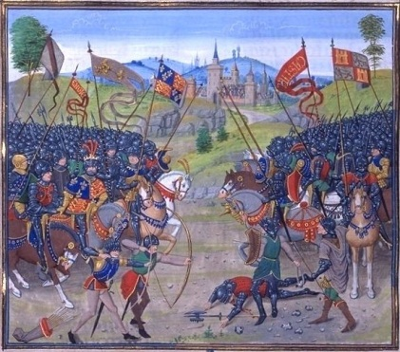
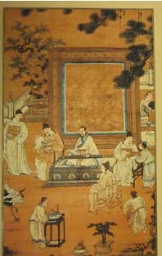
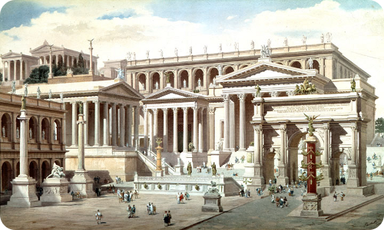
Discussion -10 Minutes
Consider the following societies:
“Serville” Europe
Ancient Rome
Medieval China
Each Group:
What institutional factors got in the way of innovation? Support with examples
How did England solve these problems to lay the foundation for the First Industrial Revolution?

Slide 7
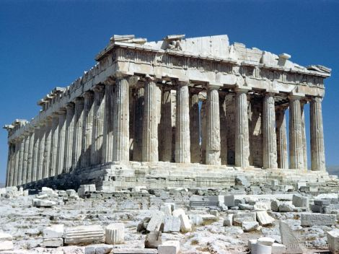
Barriers to classical innovation
Extent of slavery
Chasm between classes
Ascriptive hierarchy – people placed in a social position for qualities beyond their control, e.g., ethnicity
Low opinion of productive work
“No man can practice virtue who is living the life of a mechanic or laborer” - Aristotle

Slide 8

The Romans

Slide 9
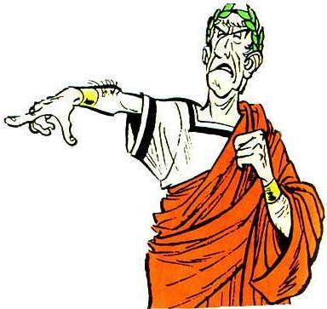
Ancient Rome
Invention was prolific, but innovation was not
Concrete, steam engine, gearing, water mills
Water mill discovered in 1st century BC, but not generally implemented until 5th century
Industry and commerce considered degrading
Romans sought wealth through rent-seeking and destructive enterprise,
Landholding
Waging war
Usury (money lending)
Bribery
Novelty discouraged and imitation promoted

Slide 10
Why not Medieval China? (618 ~ 1126 AD)
China had paper, moveable type, water wheel, gun powder, spinning wheel, hydraulic hammers, ship technology, etc..
Technical know-how was there, but there was little implementation
Why?
Monarch could claim property
Therefore, no investment in capital stocks
Where were the entrepreneurs?
Efforts spent on climbing ladder of imperial examinations (calligraphy, philosophy) to gain government positions
Officials sought bribes to pay for education
No sign of a competitive market where innovation is a primary weapon

Slide 11

Monasteries in the Middle Ages
In Europe in the Middle Ages, Nobles waged war for profit and
rent-seeking was prevalent, but there was a period of innovation!
12th and 13th centuries
Era of mechanical innovation exploded without a competitive market, water mills, metallurgy, clocks
Application of existing knowledge
Monopoly power enforced (granted by the king)
Invested in pursuit of monopoly power, e.g., water mills
Competition among religious abbeys was driving force especially for the Cistercian monasteries
Innovation allowed more time for prayer?
Expansion of order?
The monk “was the first intellectual to get dirt under his fingernails.” – Lynn White, professor of medieval history at Princeton

Slide 12
Institutional change in the Middle Ages
Middle Ages rulers were “Pauper Kings”
Little real power and bankrupt
As in Ancient Rome, commerce was considered disgraceful until..
1460s: England’s King Edward IV engaged in trade, Nobles followed
Magna Carta : no taxation without representation, sanctity of property
Battle for power between the kings and their nobles produces the rule of law
Real long term winners were the bourgeoisie (owners of capital)
Capitalism became respectable by Industrial Revolution
Capitalist success leads to industrialist power and stronger law
Growth of free-market produces more entrepreneurs that increase capitalist growth

Slide 13
Servile Europe
Servum: slave, serve, serf
In continental Europe, Serfdom prevalent until 1850s
80% of labor force in agriculture
Tennant farmers – paid rent as a portion of their harvest or with labor
Technically “free”, but tied to the land
How about the Nobility?
Nobles also resisted innovation
Feared change might curb their powers -> few progressive landlords
No competitive markets –> no battle for supremacy
Farms served own needs -conspicuous consumption –> No saving or investment
How was Britain doing?
GDP growth during First Industrial Revolution Britain (1730-1830) only 0.03%
Labor still with agriculture
Agricultural workers fought change, e.g., soil rotation
No incentive to change and, in fact, feared change

Slide 14
What changed?
What led to the miracle growth of the past one hundred and fifty years?
Modern growth fueled by technical change, but previous growth by institutional change (property rights, markets)
Mokyr
The British Industrial Revolution (1760-1830)
The Second Industrial Revolution (1860)
Third Industrial Revolution (close of 20th century)

Slide 15
Growth and knowledge
Modern economic growth based on growth of stock of useful or “tested knowledge” - Kuznets (1965)
New techniques (innovations )are created when useful knowledge is mapped onto a set of instructions
Romer’s recipe
Access to knowledge very important

Slide 16


Propositional vs. Prescriptive Knowledge
“what” knowledge vs. “how to” knowledge
right/wrong vs. successful/unsuccessful
discoveries vs. inventions
not patentable vs. patentable

Slide 17
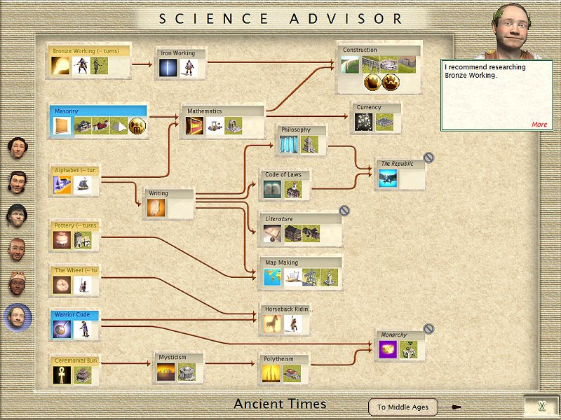
The Epistemic Base
The level of understanding
Fixed factor that is subject to diminishing returns to scale
Each innovation/technique has a minimum epistemic base
Thus, a widening epistemic base is a critical element in continued technological progress

Slide 18
The First Industrial Revolution (1760-1830)
New emphasis on “knowledge”
Epistemic base was more artisanal than scientific
Social access to science –> closer link to entrepreneurs
Increased productivity of textbooks, indices, etc.. fueled growth of epistemic base
Improved institutions reduced rent-seeking behavior
Did not run into diminishing returns as had happened with previous periods of innovation
However, social welfare did not improve much until mid-1840s

Slide 19
The Second Industrial Revolution (Began 1860)
Applied and theoretical research now complements
Aspirin – discovered in 1763, but the science not understood until 1970s
Electricity could not evolve without understanding the science
After 1850 R&D emerges – less experimental, more directed
Access to knowledge now cheaper and faster and international– Journals, universities, museums etc.
Use of statistical knowledge emerged – improved medicine
Larger epistemic base increases likelihood of major inventions
Expansion of British capital market fuels growth

Slide 20
A Third Revolution?
1914-1973 – few macroinventions (Nuclear power, antibiotics)
Wide epistemic base produced many microinventions
Less trial and error because of deeper understanding
Most productivity growth in 20th century from perfection of production techniques and process innovation
“American system of manufacturing”
Routinization
Modularization
Standardization
Miniaturization
Division of labor improvements – increased specialization
Governments encouraged innovation – defense spending on R&D
Strong venture capital markets emerged in 1980s and 1990s

