Slide 1
EBGN 320 – Economics and Technology
Creative Destruction
February 4, 2013

Slide 2
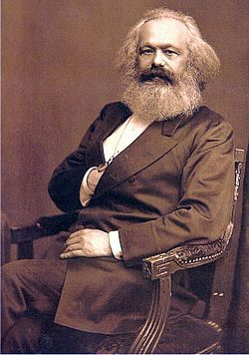
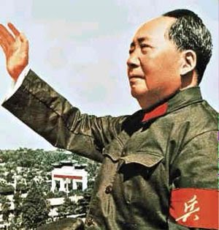


Karl Marx

Slide 3
Marxian Economics
The division of labor alienates workers from the product of their own labor
Only two classes – Bourgeoisie (Capitalists), Proletariat
Labor theory of value
Capitalists’ profits from workers supplying more labor than is necessary to pay the cost of hiring their labor-power
A few conclusions of Karl Marx
Predicted that capital will continually concentrate and centralize
Proletariat will eventually revolt against capitalists

Slide 4
Schumpeter on Marx’s Appeal
“Panting with impatience to have their innings, longing to save the world from something or other, disgusted with textbooks of undescribable tedium, dissatisfied emotionally and intellectually, unable to achieve synthesis by their own effort, they [the young] find what they crave for in Marx. There it is, the key to all the most interesting secrets, the magic wand that marshals both great events and small. ” - Schumpeter

Slide 5
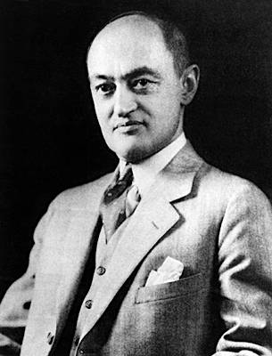
Joseph Schumpeter
Capitalism, Socialism and Democracy was published in 1942
Five parts:
The Marxian Doctrine
Can Capitalism Survive?
Can Socialism Work?
Socialism and Democracy
Historical Sketch of Socialist Parties

Slide 6
The “Problem” of Monopoly
Concern that monopoly is killing capitalism
But…
Presupposes an imaginary golden age of perfect competition
Output is up, prices are down and quality has improved
Greatest improvement in less competitive industries
“…big business may have more to do with creating that standard of life than with keeping it down” (p. 81)

Slide 7
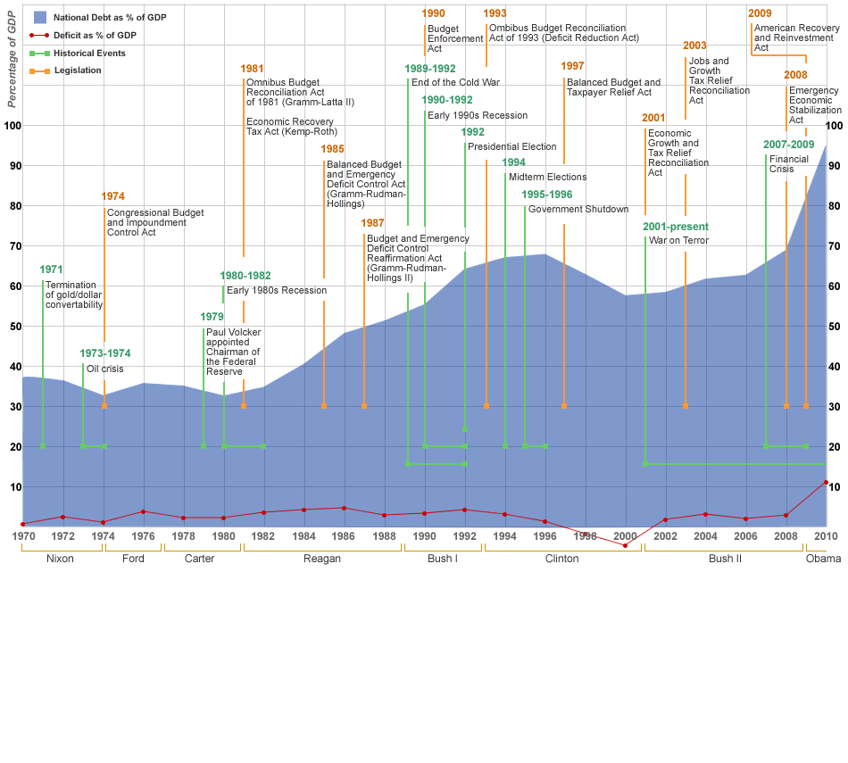
What’s the Problem?
Our economic models “are almost completely true” but “fragmentary”
Our economics is static
But our economy is dynamic

Slide 8
Dynamic vs Static Optimization
“A system - any system, economic or other - that at every given point of time fully utilizes its possibilities to the best advantage may yet in the long run be inferior to a system that does so at no given point of time, because the latter’s failure to do so may be a condition for the level or speed of long-run performance” (p. 83)

Slide 9
Capitalism’s Evolutionary Character
“Capitalism, then, is by nature a form or method of economic change and not only never is but never can be stationary. And this evolutionary character of the capitalist process is not merely due to the fact that economic life goes on in a social and natural environment which changes and by its change alters the data of economic action. . .
Nor is this evolutionary character due to a quasi-automatic increase in population and capital or to the vagaries of monetary systems. . .” (p. 82)

Slide 10
The Fundamental Impulse
“The fundamental impulse that sets and keeps the capitalist engine in motion comes from
the new consumers’ goods,
the new methods of production or transportation,
the new markets,
the new forms of industrial organization that capitalist enterprise creates.” (p. 82)

Slide 11

Creative Destruction (CD)
“the history of the productive apparatus…the history of transportation…the opening up of new markets… organizational development… illustrate the process of industrial mutation–if I may use that biological term–that incessantly revolutionizes the economic structure from within, incessantly destroying the old one, incessantly creating a new one. This process of Creative Destruction is the essential fact about capitalism.” (p. 83)

Slide 12
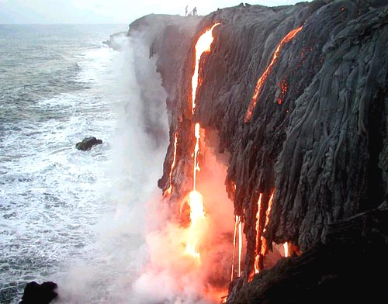
CD and Economics
“…the problem that is usually being visualized is how capitalism administers existing structures, whereas the relevant problem is how it creates and destroys them. As long as this is not recognized, the investigator does a meaningless job.” (p. 84)

Slide 13

Other People's Money (1991)

Slide 14
Other People's Money (1991)

Slide 15
What Really Matters
“But in capitalist reality as distinguished from its textbook picture, it is not that kind of competition which counts but the competition from the new commodity, the new technology, the new source of supply, the new type of organization (the largest-scale unit of control for instance)–competition which commands a decisive cost or quality advantage and which strikes not at the margins of the profits and the outputs of the existing firms but at their foundations and their very lives.”
(p. 84-85)

Slide 16
The Discipline of CD
“It is hardly necessary to point out that competition of the kind we now have in mind acts not only when in being but also when it is merely an ever present threat. It disciplines before it attacks. The businessman feels himself to be in a competitive situation even if he is alone in his field or if, though not alone, he holds a position such that investigating government experts fail to see any effective competition between him and any other firms…” (p. 85)

Slide 17
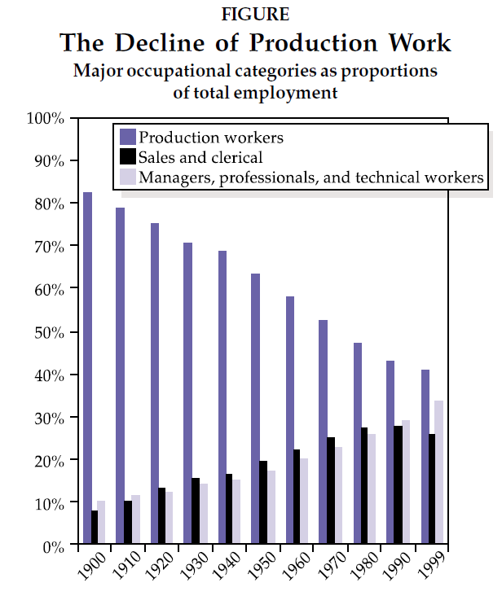
Economies & Economics
Perfect competition is he paradigm of the industrial economy
Focus on production
Monopoly threat to growth
Should creative destruction be the paradigm of the “new economy”?
Focus on innovation and information
Monopoly driver of growth

Slide 18

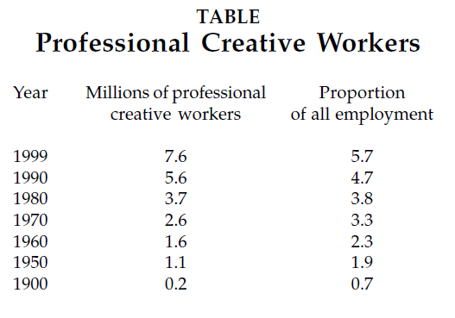
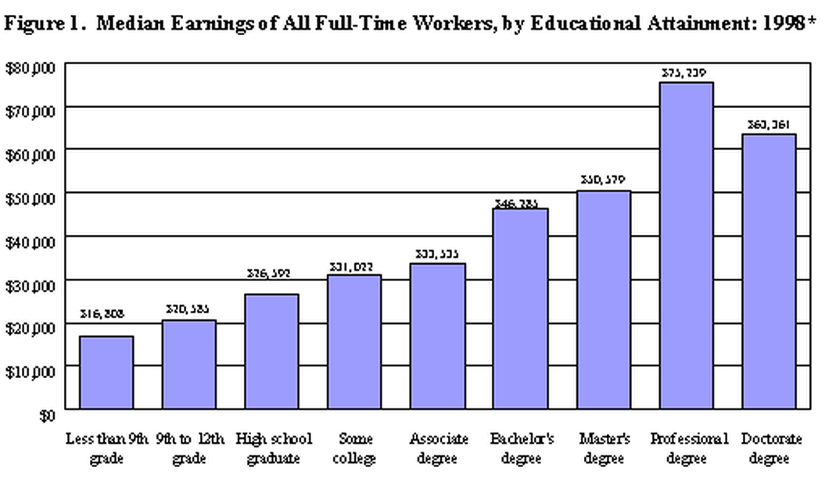
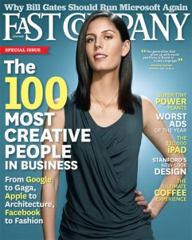
The Creative Class

Slide 19
Opposition to Creative Destruction
Being creative is risky
Creativity puts existing products at risk
Producers
Consumers – Network competition
Future creativity is hard to predict
Creativity is hard to value
Time – we only learn the true value over time
Measurement – Intangible creativity
Creative destruction may promote inequality
Creative types are rewarded
Sustains worldwide inequality – barriers to entry

Slide 20
