Slide 1
EBGN 320 – Economics and Technology
Introduction & Review – January 9, 2013

Slide 2






What is this course about?
Applying economic analysis to the understanding of the innovative process
We will focus on:
Determinants
Consequences
Market failure (are optimal resources devoted to innovation)

Slide 3
Some key questions
What drives innovation?
How does intellectual property influence innovation?
Which economic systems and market structures yield more or better innovations?
Does innovation replace jobs and lead to higher unemployment?
What role does innovation play in the wealth or poverty of a nation?
Is economic regulation good or bad for innovation?

Slide 4
What is the ‘economics of innovation’?
Microeconomics – understanding processes, including how incentives affect firms
Macroeconomics – ‘innovation’ drives economic growth.. and economic growth drives living standards, environmental, political…
Economic Policy – are there market failures in the innovation process and what, if anything, should the government do?
Business Strategy – this is not a course on advising firms how to innovate, but does include some insight into this
Notes:
<number>

Slide 5
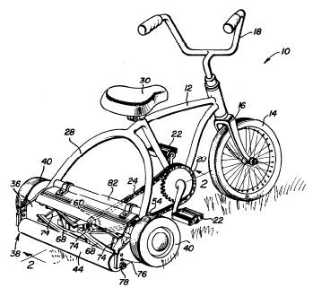

Invention and innovation
What do we mean by invention and innovation?
Invention: creation of an idea to do or make something (profitability not yet verified)
Innovation: new product/ process commercially valuable , i.e. successfully developed inventions
Notes:
<number>

Slide 6
Definition of innovation
Basic definition
Introduction of new ideas that add ‘value’ to a firm’s activities
OECD The Oslo Manual (1997, p.28)
introduction of a new product or a qualitative change in an existing product
process innovation new to an industry
the opening of a new market
development of new sources of supply for raw materials or other inputs
changes in industrial organization

Slide 7
Innovation and business
"Business has only two functions, innovation and marketing." - Peter F. Drucker (management consultant)
“Creativity is thinking up new things. Innovation is doing new things.” - Theodore Levitt (management guru)
“Innovation distinguishes between a leader and a follower.” - Steve Jobs
Notes:
<number>

Slide 8
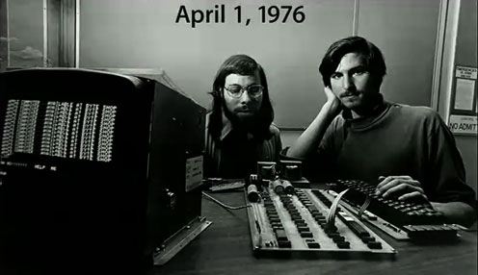
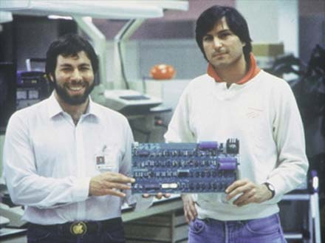
Steve the Inventor and Steve the innovator
“Innovation has nothing to do with how many R&D dollars you have. When Apple came up with the Mac, IBM was spending at least 100 times more on R&D. It’s not about money. It’s about the people you have, how you’re led, and how much you get it.” – Steve Jobs
"In the end, I hope there’s a little note somewhere that says I designed a good computer.“ - Steve Wozniak

Slide 9
Defining an innovation
Can be defined as new to
Firm
Market (industry)
World
Radical vs. incremental innovation
Radical (steam, internal combustion engine, computers, internet)
Incremental (constant improvements, e.g., faster computer, better cell phone)
Both important in driving economic growth

Slide 10
Product and process innovations
Product innovations
Products used by consumers
Microwaves, computers, mobile phones, etc.
Products use by firms
Shipping containers, computers, robots, etc.
Process innovations
Used by consumers
Fast food, air travel
Used by firms
Assembly lines, software
Notes:
<number>

Slide 11
The innovation process
Figure 1.1 Greenhalgh and Rogers (2010)
Notes:
<number>

Slide 12
Role of technology
What does new technology contribute to the economy?
Improves productivity leading to…
economic growth which means..
increased social welfare (standard of living)
Productivity: output produced per unit of input
E.g., labor productivity: output produced per hour of labor worked
How have you seen technology incorporated into economic models previously?

Slide 13
Production function
Starting point for developing a supply curve for a supply & demand model
Simple Cobb-Douglas production function
q = f(K,L) = AKαLβ
where,
K: capital (endogenous variable)
L: labor (endogenous variable)
A: technical progress (exogenous constant)
α, β: constants
q is the maximum output from a certain combination of inputs
Levels of production are necessarily technically efficient

Slide 14
What do we see in the real world?
q = f(K,L) = AKαLβ
If K and L are held constant we find that q increases over time →“A” must be increasing over time
Why?
Productivity must be increasing

Slide 15
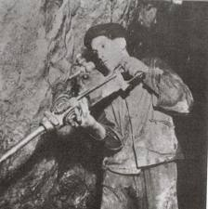
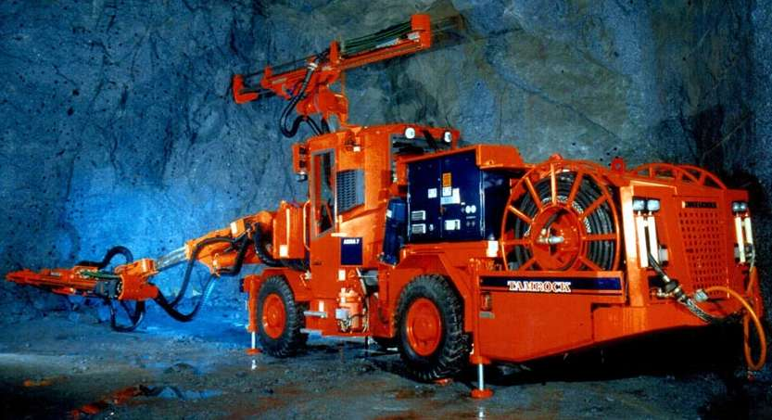
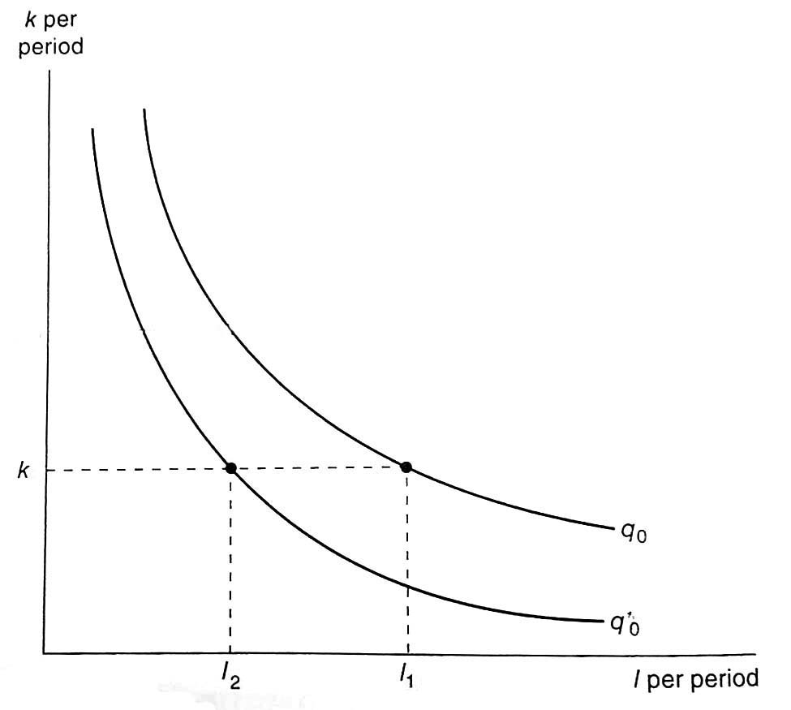
Production function example
Period 1: miners drill by hand q0 = A1KαLβ
Period 2: miners use new powerful boom type miners
q*0 = A2KαLβ
Less labor is required to produce the same output (q0 = q*0 ) in the second period. This results from an increase in “A” corresponding to technological improvement

Slide 16
What is “A”?
A = Exogenous technological progress (innovation)
In economics, technology is generally treated as an exogenous variable (especially in the past)
What does this mean?
We don’t know why labor productivity increased (why A1<A2)

Slide 17

Why is productivity increasing over time?
Innovation/Technological progress became known as the “black box” of economic theory
This view of technology as a “black box” is unsatisfactory
Much of our effort will be to peek inside the black box to understand why “A” increases over time

Slide 18
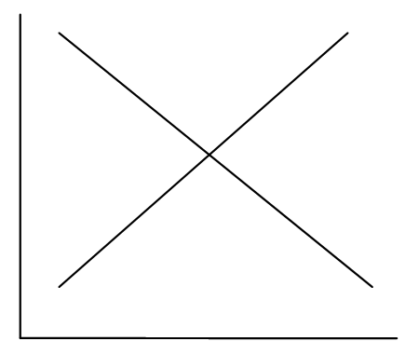
Microeconomics review
Can you label all the parts?
What does efficiency mean in this model?
What does equity mean in this model?
Assuming perfect competition, where will the market end up?
What is the invisible hand?

Slide 19
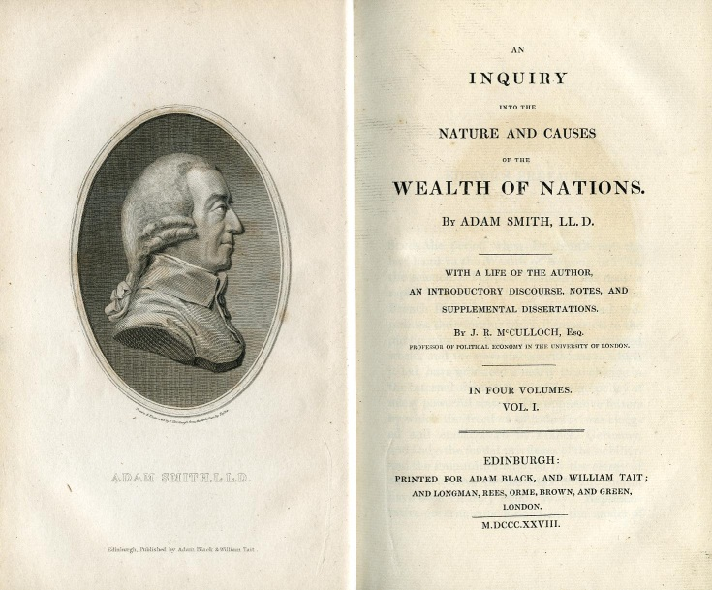
The Invisible Hand
Invisible Hand (Adam Smith, The Wealth of Nations in 1776): Markets tend to equilibrium on their own accord
…he(the individual) intends only his own gain, and he is in this, as in many other cases, led by an invisible hand to promote an end which was no part of his intention.…By pursuing his own interest he frequently promotes that of the society more effectually than when he really intends to promote it

Slide 20
The Invisible Hand
Note that the equilibrium that the market tends to move to does not necessarily have to be an equilibrium where social welfare is maximized
In fact, the perfectly competitive equilibrium is the only equilibrium achieved with the invisible hand that results in social welfare being maximized
Monopolistic and oligopolistic markets also have a stable equilibrium that the invisible hand leads them to, they just aren’t the equilibrium that maximize social welfare
Markets with “market failures” also have stable equilibriums, though they also don’t maximize social welfare

Slide 21
Economic models
Always ask:
What are the assumptions of the model?
How might the model perform if the assumptions are changed?

Slide 22
The Perfectly Competitive Market Model
Assumptions of Perfect Competition:
Large number of buyers and sellers
Homogenous (undifferentiated) product
Perfect information: all market participants know prices (input prices, output prices, etc.)
Equal access to inputs and technology
Firms are price takers (its actions cannot impact market price)
Transactions are costless
Certainty
Do all of these assumptions hold for high technology goods and services?

Slide 23
Perfect competition
Do all of the perfect competition assumptions hold for high technology goods and services?
NO, but do all of them hold for any market? No!
Are models useful if they don’t perfectly model real life or if all of their assumptions don’t hold?
YES, relevant conclusions and insights can still be drawn from models (once too many of the assumptions are not violated). The purpose of a model is to simplify the complicated real world to draw insights.

Slide 24
Assignments
For next Friday, read Greenhalgh Chapter 1
Homework will be posted later today
Additional readings for next week will be posted over the weekend
First group presentation next Friday!

