Slide 1
Git Branching
What is a branch?

Slide 2
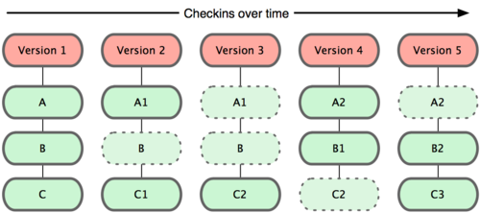
Review: Distributed - Snapshots
Files are stored by SHA-1 hash rather than filename
Stored in git database in compressed format
Must “checkout” from database into working directory to edit
In this example, files A, B and C are tracked

Slide 3
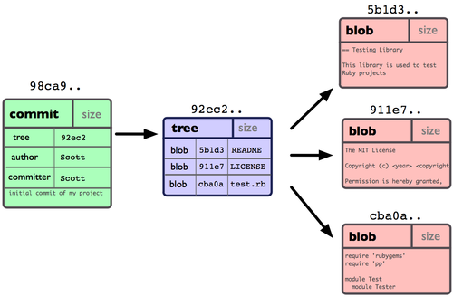
Example commit, 3 files

Slide 4
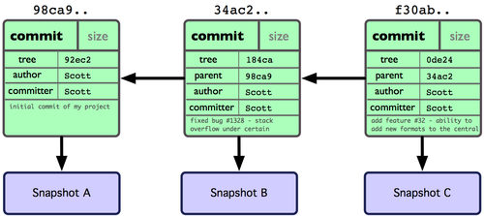
After 3 commits

Slide 5
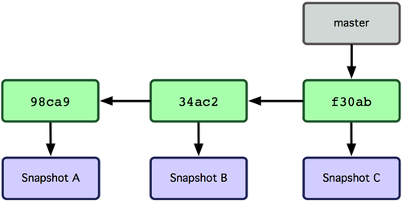
Default branch is master
master moves forward automatically when you commit

Slide 6
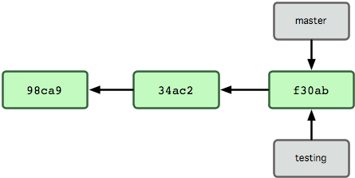
Add a branch
cmd: git branch testing
Why is creating a branch in git cheap and quick? Because it’s just creating a 40-character SHA-1 checksum of the commit it points to

Slide 7
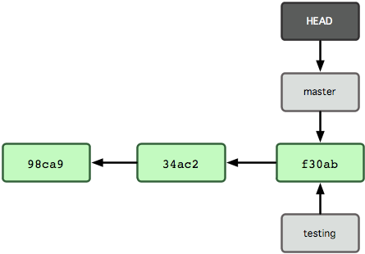
But you’re still on master
HEAD = pointer to current branch
NOTE: concept of HEAD is different from CVS

Slide 8
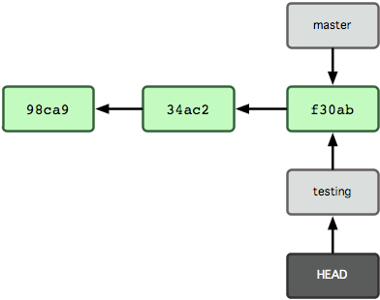
Use checkout to change
cmd: git checkout testing

Slide 9
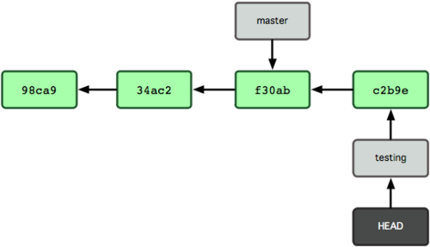
Make changes on that branch
edit test.rb (e.g., vim test.rb)
cmd: git commit –a –m ‘made a change’

Slide 10
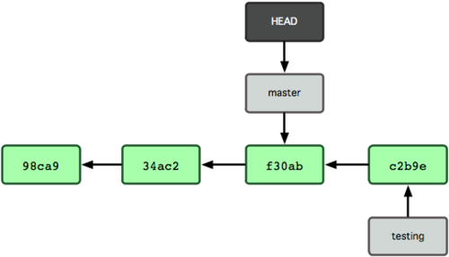
Switch back to master
cmd: git checkout master
NOTE: This also reverts files in your working directory (e.g., c:\mycode) back to master.
So edit to test.rb no longer in your working directory (but you haven’t lost it, as long as you committed before switching – remember it will be in your local database. But don’t delete .git!)

Slide 11
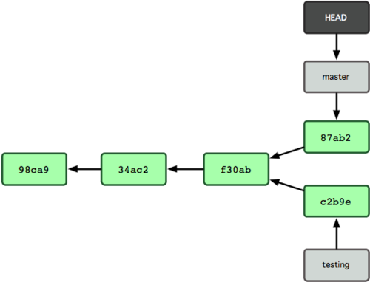
Change master branch
edit test.rb again
cmd: git commit –a –m ‘made other changes’

Slide 12
Basic Merging
No conflicts

Slide 13
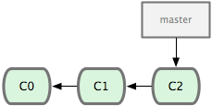
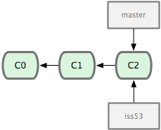
A branch/merge example
Start with master branch
cmd: git checkout –b iss53
NOTE: This creates branch and switches to it

Slide 14
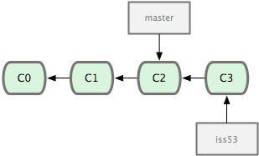
Update branch
$ vim index.html
$ git commit -a -m 'added a new footer [issue 53]'

Slide 15
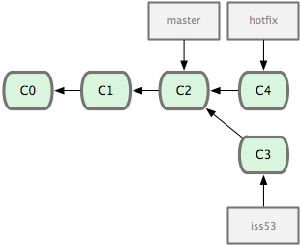
Need to switch to an urgent fix
git checkout master
git checkout –b hotfix
vim index.html
git commit –a –m ‘fixed broken code’
NOTE: git won’t let you switch to master if you have uncommitted changes that conflict with the code you’re checking out. So you should have a clean slate before you switch (stash and amend can deal with this – later topics)

Slide 16
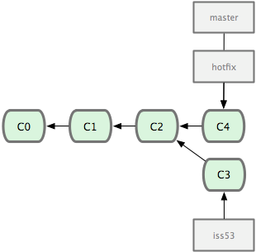
Now merge hotfix and master
git checkout master
git merge hotfix
This will be a “fast forward” merge – because branch was directly upstream, git just moves pointer forward.

Slide 17
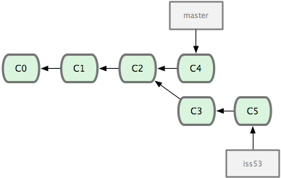
A little cleanup, then return to issue 53
git branch –d hotfix
git checkout iss53
vim index.html
git commit –a –m ‘finished footer’
Be careful with branch –d. OK in this example, just a duplicate pointer. May not always be the case.
Note that work done on hotfix is not part of iss53 branch.

Slide 18
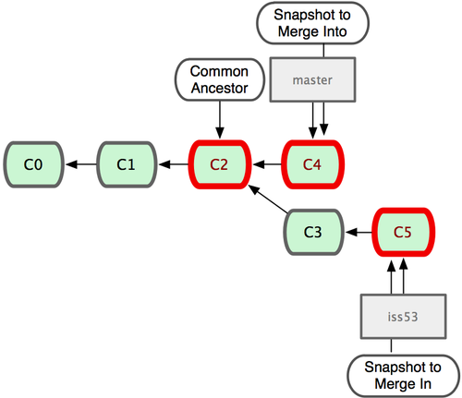
Basic merge
$ git checkout master
$ git merge iss53
Merge made by recursive.
README | 1 +
1 files changed, 1 insertions(+), 0 deletions(-)
git identifies the best common ancestor to use for merge

Slide 19
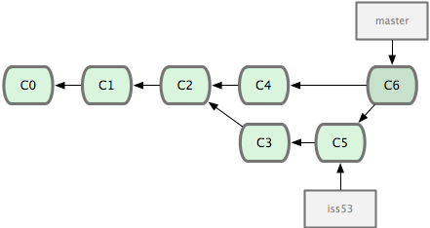
Basic Merge result
master now includes hotfix and iss53
Remove iss53 if you want: git branch –d iss53

