Slide 1
Half & Full Adder / MUX & DEMUX
Group C-FA25-BCS-C
Group Members:
Muffaser Naeem FA25-BCS-167
Amna Usman FA25-BCS-137
Isbah Waheed FA25-BCS-039
Sabahat Akbar FA25-BCS-153
Aleeza Mujeeb FA25-BCS-009

Slide 2
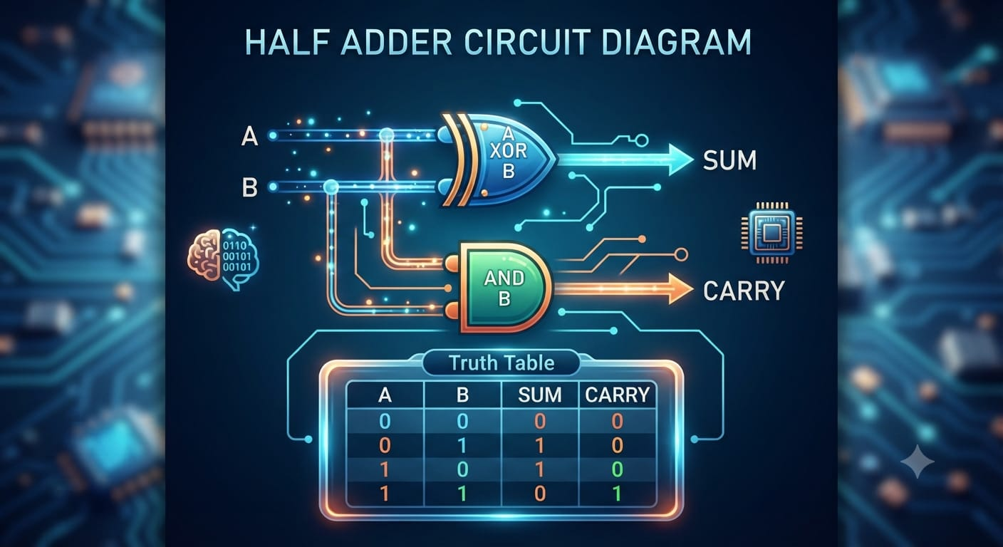
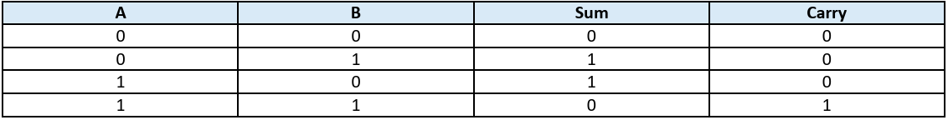
HALF ADDER
Definition
• A Half Adder is a combinational circuit used to add two binary bits.
• Inputs: A and B
• Outputs: Sum and Carry
Logic Equations
Sum = A ⊕ B | Carry = A · B
Example:
1 + 1 = 10₂ → Sum = 0, Carry = 1
Quick Trick:
HALF = A + B only

Slide 3
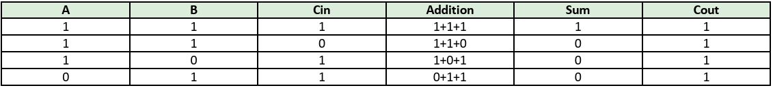
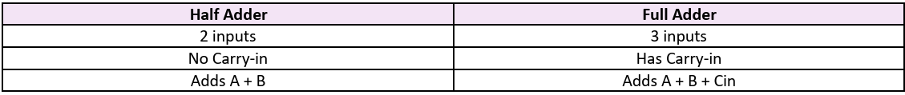
FULL ADDER
Definition
• A Full Adder adds three binary inputs.
• Inputs: A, B and Carry-in (Cin)
• Outputs: Sum and Carry-out (Cout)
• It can handle the carry coming from a previous addition.
Logic Equations
Sum = A ⊕ B ⊕ Cin
Cout = AB + ACin + BCin
Key Example: 1 + 1 + 1 = 11₂ → Sum = 1, Carry-out = 1
FULL = A + B + Previous Carry

Slide 4
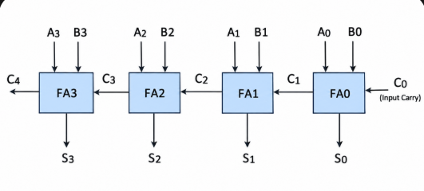
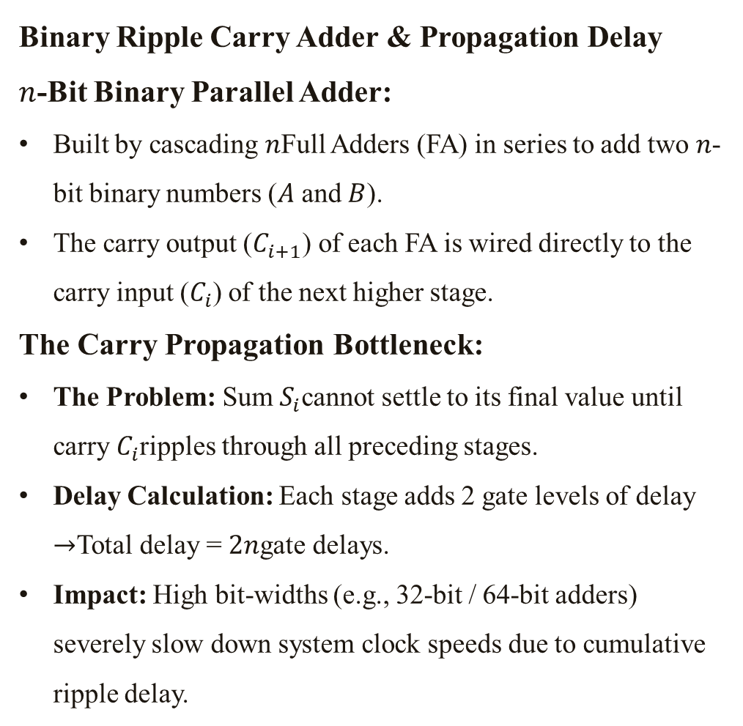
Binary Ripple Carry Adder & Propagation Delay
Binary Ripple Carry Adder & Propagation Delay
$n$-Bit Binary Parallel Adder:
Built by cascading $n$Full Adders (FA) in series to add two $n$-bit binary numbers ($A$ and $B$).
The carry output ($C_{i+1}$) of each FA is wired directly to the carry input ($C_{i}$) of the next higher stage.
The Carry Propagation Bottleneck:
The Problem: Sum $S_{i}$cannot settle to its final value until carry $C_{i}$ripples through all preceding stages.
Delay Calculation: Each stage adds 2 gate levels of delay $→$Total delay = $2n$gate delays.
Impact: High bit-widths (e.g., 32-bit / 64-bit adders) severely slow down system clock speeds due to cumulative ripple delay.

Slide 5
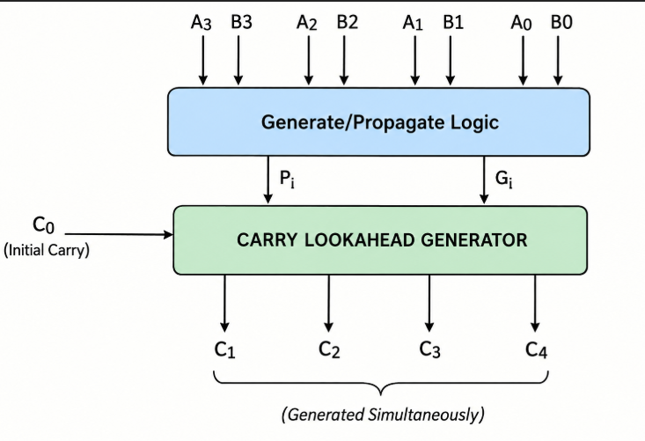
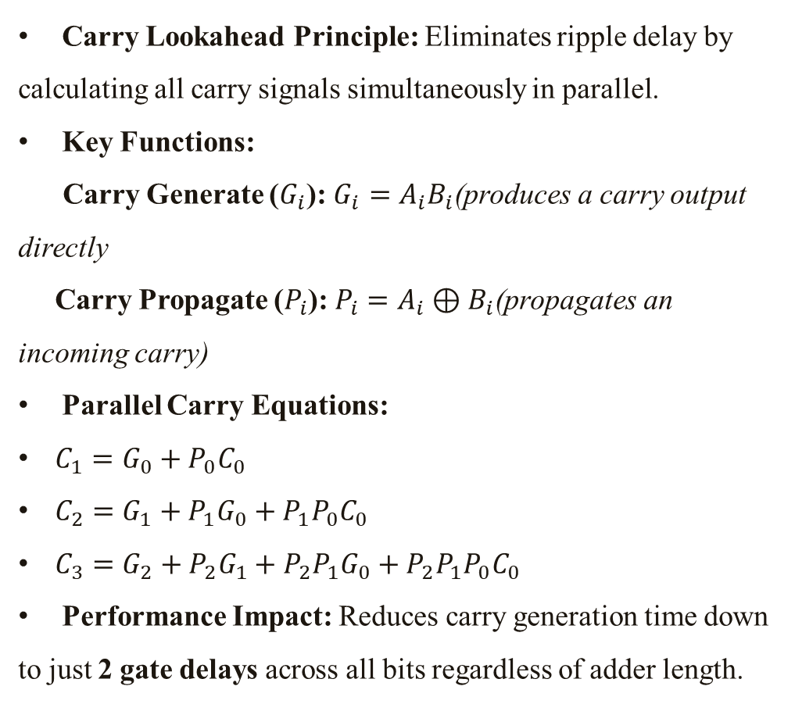
Fast Addition via Carry Lookahead Logic
Carry Lookahead Principle: Eliminates ripple delay by calculating all carry signals simultaneously in parallel.
Key Functions:
  Carry Generate ($G_{i}$): $G_{i}=A_{i}B_{i}$(produces a carry output directly
  Carry Propagate ($P_{i}$): $P_{i}=A_{i}⊕B_{i}$(propagates an incoming carry)
Parallel Carry Equations:
  $C_{1}=G_{0}+P_{0}C_{0}$
  $C_{2}=G_{1}+P_{1}G_{0}+P_{1}P_{0}C_{0}$
  $C_{3}=G_{2}+P_{2}G_{1}+P_{2}P_{1}G_{0}+P_{2}P_{1}P_{0}C_{0}$
Performance Impact: Reduces carry generation time down to just 2 gate delays across all bits regardless of adder length.

Slide 6
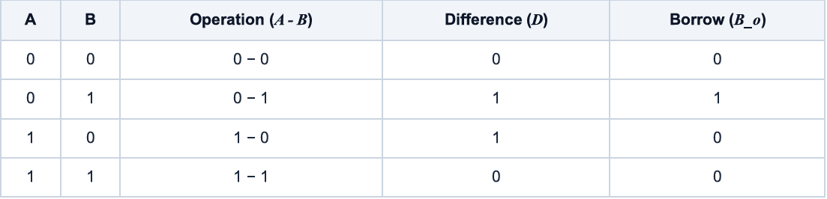
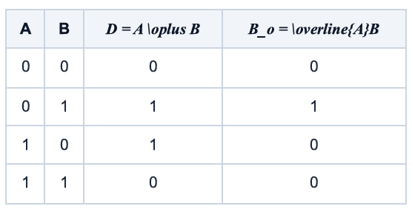
What is a Binary Subtractor?
A subtractor is a combinational circuit that performs binary subtraction, generating two primary outputs: Difference (D) and Borrow (B_o). A borrow is triggered when the subtrahend bit exceeds the minuend bit (e.g., 0 - 1 requires a borrow of 1 from the next higher position).
Half Subtractor
Difference (D) 0 1 1 0 Borrow (B_o) 0 1 0 0 A Half Subtractor handles subtraction for two 1-bit numbers: minuend A and subtrahend B, without taking an incoming borrow from a previous stage.

Slide 7
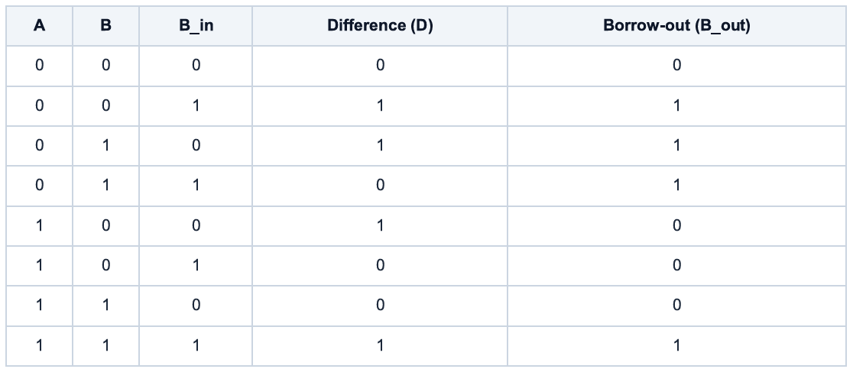
Full Subtractor
A Full Subtractor processes three 1-bit values: A (minuend), B (subtrahend), and an incoming borrow B_{in}. It is critical for multi-bit subtraction where lower positions pass generated borrows
Multi-Bit Binary Subtractor
For n-bit numbers, multiple Full Subtractors (FS) are cascaded. The borrow-out of one stage feeds directly as the borrow-in (B_{in}) of the next higher bit position, forming a ripple-borrow configuration from LSB to MSB.
Cascade Flow: FS_0 (LSB) → FS_1 → FS_2 → FS_3 (MSB)

Slide 8
Understanding Overflow
Overflow happens when an arithmetic result exceeds the representable range for a given fixed-width bit architecture. Unsigned Subtraction
Indicated by a final active borrow. Signifies that the minuend was strictly smaller than the subtrahend.
Signed Two's-Complement Overflow Occurs in subtraction (A - B) when operands have opposite signs and the result sign differs from operand A.

Slide 9

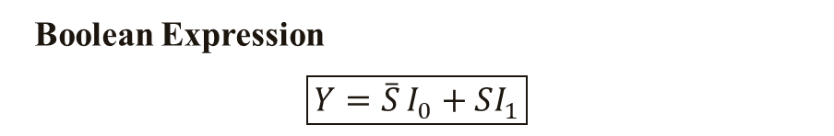
MULTIPLEXER: THE DIGITAL SELECTOR
MULTIPLEXER (MUX)
A Multiplexer is a combinational circuit that selects one input from multiple inputs and forwards it to a single output.
Select S | Selected Input | Output
0 | I₀ | Y = I₀
1 | I₁ | Y = I₁
Think of MUX as a Digital Switch
I₀ ─────┐
I₁ ─────┤
I₂ ─────┤──► MUX ───► Y
I₃ ─────┘ ▲
│
Select Lines
Boolean Expression
$$\boxed{Y=\overset{‾}{S}I_{0}+SI_{1}}$$
How Does It Work?
When:
S = 0
$$Y=I_{0}$$
When:
S = 1
$$Y=I_{1}$$
2-to-1 MUX
A 2:1 MUX contains:
2 Data Inputs: I₀, I₁
1 Select Line: S
1 Output: Y

Slide 10
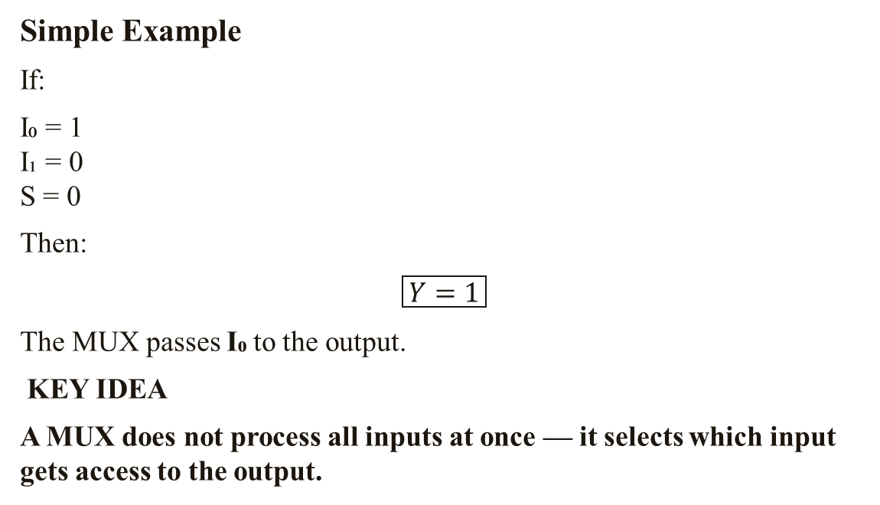
Simple Example
If:
I₀ = 1
I₁ = 0
S = 0
Then:
$$\boxed{Y=1}$$
The MUX passes I₀ to the output.
KEY IDEA
A MUX does not process all inputs at once — it selects which input gets access to the output.

Slide 11
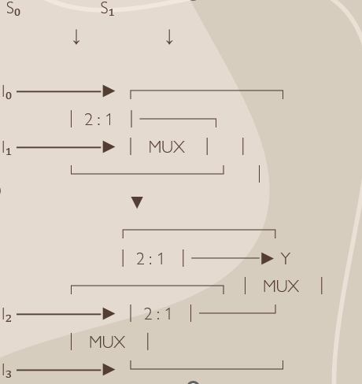
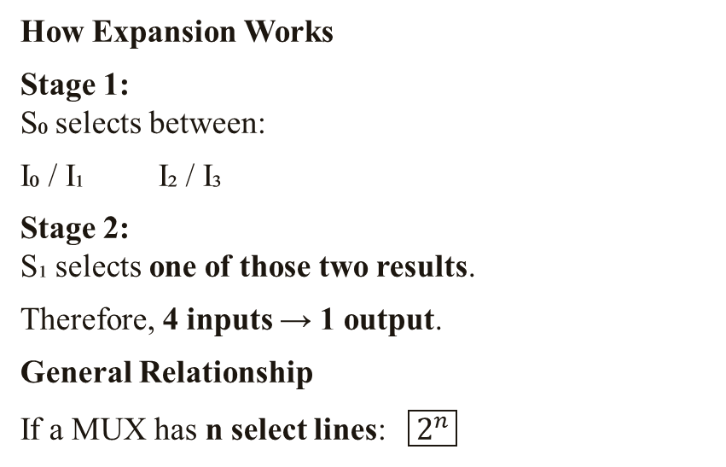
MUX EXPANSION
Building a Larger MUX from Smaller MUXs
A larger MUX can be constructed by combining smaller MUXs.
MUX Selection
S₁ | S₀ | Selected Input
0 | 0 | I₀
0 | 1 | I₁
1 | 0 | I₂
1 | 1 | I₃
4-to-1 MUX using Three 2-to-1 MUXs
How Expansion Works
Stage 1:
S₀ selects between:
I₀ / I₁ I₂ / I₃
Stage 2:
S₁ selects one of those two results.
Therefore, 4 inputs → 1 output.
General Relationship
If a MUX has n select lines: $\boxed{2^{n}}$

Slide 12
Examples:
Select Lines | Inputs
1 | 2
2 | 4
3 | 8
4 | 16
KEY TAKEAWAY
MUX Expansion allows us to build large selection circuits using smaller MUXs.

Slide 13
MUX (Multiplexer) Logic
A Multiplexer (MUX) is a digital circuit that selects one input from multiple inputs and sends it to a single output.
How does MUX work?
A MUX has multiple data inputs.
It has select lines that decide which input will be selected.
Only the selected input appears at the output.
Therefore, a MUX is also called a Data Selector.
Example: 4-to-1 MUX
4 Inputs: I₀, I₁, I₂, I₃
2 Select Lines: S₀, S₁
1 Output: Y
Main Idea: Many Inputs → MUX → One Output
S₁ | S₀ | Selected Input
0 | 0 | I₀
0 | 1 | I₁
1 | 0 | I₂
1 | 1 | I₃

Slide 14
Tri-State Logic
A Tri-State device is a digital circuit that can produce three possible states:
0 → LOW
1 → HIGH
Z → High Impedance
What is High Impedance (Z)?
High impedance means the output is electrically disconnected from the circuit.
It is like the device is saying:
“I am not sending 0 or 1 right now.”
Enable Control
A Tri-State buffer uses an Enable (EN) signal:
Why is it useful?
Tri-state logic allows multiple devices to share the same communication line (bus) without interfering with each other.
Main Idea:
Enable ON → 0 or 1
Enable OFF → Z
Enable | Output
1 | Input is passed to output
0 | Output becomes Z

Slide 15
THANK YOU

