Slide 1

LiLa – Library of Labs
A simple to use tool to
build interactive 3D
for Open Wonderland
Oktober 2011
Co-funden by the community programm eContentplus

Slide 2
white_dune
A simple to use tool to
build interactive 3D
for Open Wonderland

Slide 3
What is needed for a useful
“Open Wonderland Builder” ?
“Usual 3D” == “virtual labs” ?
X3D: interactive realtime 3D standard
Working with “white_dune”
What are the next steps ?

Slide 4
What is needed for a useful
“Open Wonderland Builder” ?
The absolute minimal tools are:
  text editor
  java Development Kit (JDK)
  ant
or
  a Integrated Development Environment
like “netbeans” that integrates
text editor, JDK and ant

Slide 5
What is needed for a useful
“Open Wonderland Builder” ?
Other usefull features:
  3D Modelling:
create/change 3D objects
  animation tool:
let the 3D objects move/change
  interaction tool:
react to user input without (much) code

Slide 6
“Usual 3D” == “virtual labs” ?
traditional 3D Modellers focus on movies
(3D modelling, animation, no interaction)
traditional 3D game tools (“level editor”)
are specific to its games (3D modelling
for architecture, “place monster here”)
traditional GIS (Geo Information System)
3D tools usually do not support animation

Slide 7
“Usual 3D” == “virtual labs” ?
What would a programmer use to build
a 2D virtual labs tool in a simple way ?
A 2D-GUI builder:
arrange interaction elements freely
in a window
    buttons
    sliders
    text input fields
interaction lead to callback programs

Slide 8

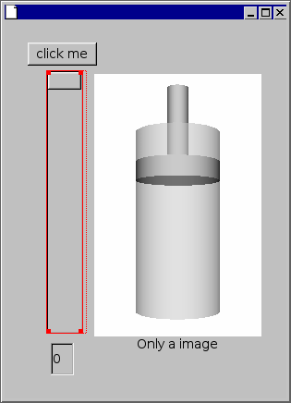
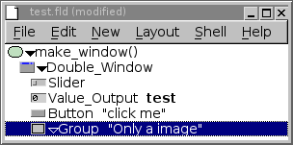
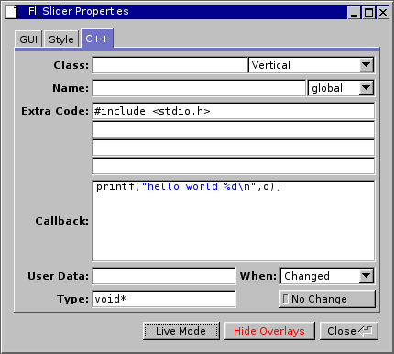
“Usual 3D” == “virtual labs” ?
2D GUI builder (typical example: “fluid”)
GUI element creation
fluid main program
interactive placement
of GUI elements
callback program input
parameter

Slide 9
X3D: interactive realtime 3D standard
X3D is a 3D fileformat like Collada
(almost) compatible to VRML97
Wonderlands choice before Collada
Unlike Collada it supports interaction
ISO Standard, but neither supported
by SUN, Google nor secondlife

Slide 10
X3D: interactive realtime 3D standard
Several Webbrowser plugins exist
Simple URL, any HTTP-Server
“In browser” multiuser servers exist
(since more than a decade)
Shown in Mozilla or Chrome without
any additional software via WebGL

Slide 11
X3D: interactive realtime 3D standard
A X3D file has 2 different commands
    Nodes
      Shapes (graphical objects)
      Interpolators (animation)
      Sensors (interaction or TimeSensor)
      Script (programing)
      Misc (a lot of other node types)
    ROUTEs
Information ways for data (events)
From node1.eventOut to node2.eventIn
Events are typed (e.g. SFBool, MFFloat)

Slide 12
X3D: interactive realtime 3D standard
Typical ROUTE examples:
Animation: TimeSensor → Interpolator → Node
Interaction (e.g. Button): (Touch)Sensor → Script → Node
Data display: TimeSensor → Script → Node (Text)
Slider: PlaneSensor → Node (Transform: moves object)
→ Script → Node
Mouseclick starts animation (more complex example):
TouchSensor → TimeSensor →Interpolator → Node

Slide 13
Working with “white_dune”
White_dune is
  a graphical editor for X3D/VRML97
  a simple (NURBS based) 3D modeller
  a 3D animation tool
  a (commandline) X3D compiler
  a program with 3 different GUI's
  a program with a GUI for children to
  create their first 3D animation
  a rapid development tool for
open wonderland

Slide 14
Remember the 2D GUI builder
GUI element creation
fluid main program
interactive placement
of GUI elements
callback program input
parameter

Slide 15
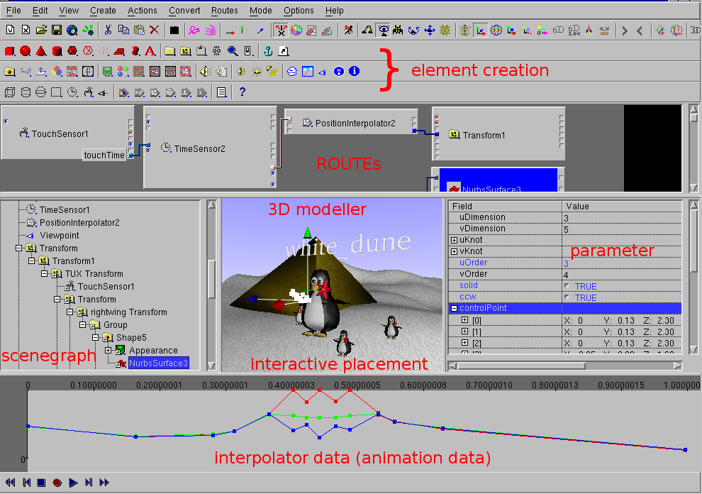
Working with “white_dune”
Where is the callback ?

Slide 16
Working with “white_dune”
There is no callback for each node in X3D
Instead:
  create a new “Script” node/show in RouteView
  create a new ROUTE from Sensor node
  create a new ROUTE to target node
  events of a Script node are created
on mousedrag of the ROUTE
  add callback code to it's “url” field
    most X3D use ecmascript (“javascript”)
    white_dune adds java for wonderland

Slide 17
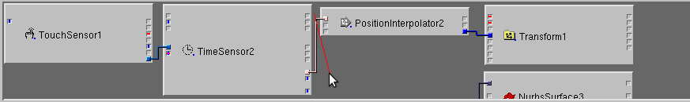
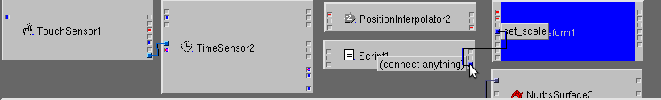
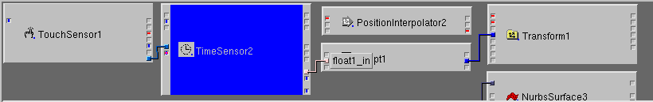
Working with “white_dune”
Cut old ROUTEs
Create new ROUTEs

Slide 18
Working with “white_dune”
Add callback code:
  select script node
  use actions → URL edit
  a texteditor is started
(or a other tool at your choice)
  header define the language
  headers in the X3D/VRML97 standard:
    “ecmascript:” or “javascript:”
    “class:”
  X3D tools may add additional languages
e.g. perl, basic, shared library, DCOM

Slide 19
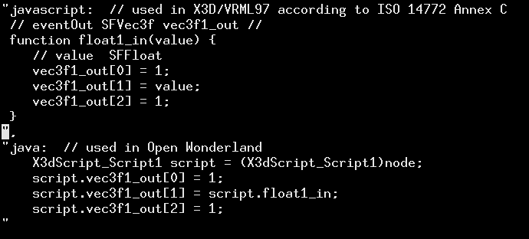
Working with “white_dune”
simple interpolator replacement example
please note the “ signs ...

Slide 20
Working with “white_dune”
… please note the “ signs
write \”string\” instead of “string” in the code
otherwise you can build a script
  extract the java code part
  replace “\ with “
  plant the code into a java class
  use a tool like eclipse
  after tool exit extract code and
reconstruct the original encoding

Slide 21
Working with “white_dune”
2 language solution for rapid prototyping:
major parts can be build with X3D tools
a X3D browser loads a X3D file very much
faster than Wonderland (re)loads a module
reuse parts of X3D scripting/interaction

Slide 22
Working with “white_dune”
Too much (225) commands in X3D
What is implemented (wonderland export) ?
  most important VRML97 nodes (36/55)
  typical output from other 3D Modellers
  all X3D surface nodes (22/25) except:
    trimmed NURBS (NURBS with holes)
    skin and bones human animation
    NurbsSwungSurface
  all VRML97 interpolators (animation)

Slide 23
Working with “white_dune”
too much (225) commands in X3D
Most important not implemented (yet):
  multitexturing
  light
  sound
  a lot of Sensor nodes (10/15)
  morphing animation of polygons with
more than 4 edges (impossible ?)

Slide 24
Working with “white_dune”
X3D is organised in components
a tool do not need to support all of them
Not implemented components (wonderland export)
  Rigid body physics
  H-Anim (human animation)
  Shaders (GPU programming)
  EnvironmentalSensor
  Layering
  ParticleSystems (particle source)
  Texturing3D (Volume based rendering)
  etc...

Slide 25

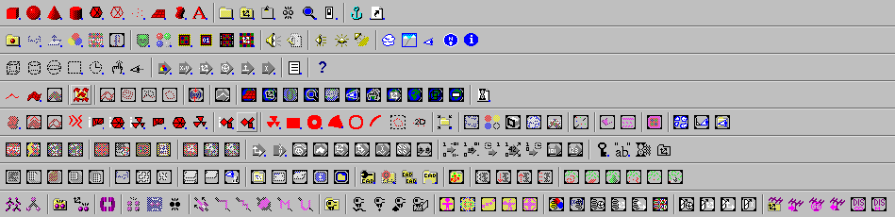

Working with “white_dune”
Nodes supported by the Wonderland exporter are marked with a small blue point
ImageTexture
(supported)
PixelTexture
(unsupported)
the wonderland icon has also a small blue thing at the lower right edge too

Slide 26
Working with “white_dune”
What events are supported ?
There are 3 event types
  eventIn: send data to node
  eventOut: send data from node
  exposedField: eventIn, eventOut
  and field (“parameter”)
All exposedFields of supported nodes should be supported.

Slide 27

Working with “white_dune”
What events are supported ?
Supported eventIn/eventOut are marked
in the ROUTE view window
(only sensors and interpolators)
blue: support by the Wonderland export
red: not supported by the Wonderland export, but often used
lilac: support by the Wonderland export and often used

Slide 28
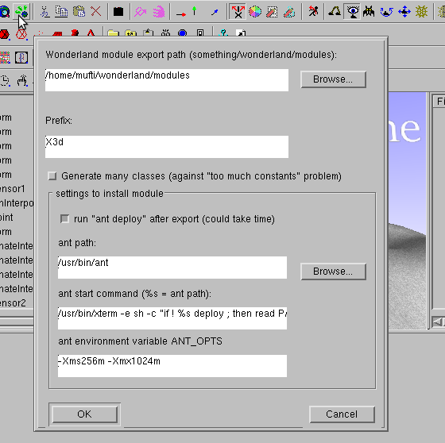
Working with “white_dune”
Installing a module
Wonderland reloads module after “ant deploy”

Slide 29
Working with “white_dune”
white_dune creates folder for filename.x3d
wonderland/modules/exportX3d/filename
write_dune creates in this folder
  the sources
  a “build.xml” file for ant
  a nbproject folder for netbeans
  image/data for the “insert object” window
  texture files of the scenegraph
only the scenegraph data is overwritten
exported source can be used as a start point

Slide 30
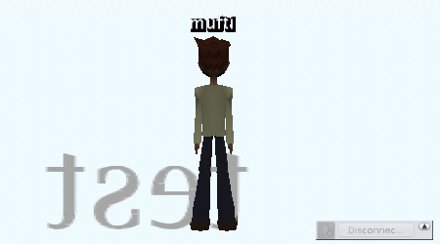
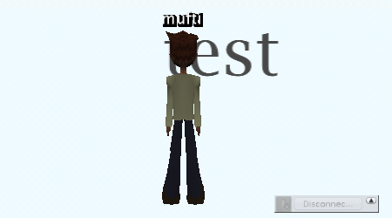
Working with “white_dune”
Problems:
  Text rendering
    3 ways in JME
    1 in wonderland
    when changing: first shown backwards, also slow
  grayscale PNG textures not shown
  can natively show only triangle and quad
    NURBS animation triangulates automatically
    5+ edges per polygon morphing not supported
    (impossible ?)
    triangulate first, then do morphing animation
  Text input causes navigation

Slide 31
What are the next steps ?
Time is limited, what's most needed ?
  multitexture ?
  more Sensor nodes ?
  special Wonderland extensions ?
    persistent data store
    2D user interface
  human animation ?
  trimmed NURBS ?
  more support for line based nodes ?
(no interaction possible in wonderland)
  (try to) fix rendering problems of Text ?

Slide 32








Universität Stuttgart (Coordinator) | Germany
Technische Universität Berlin | Germany
Oracle Germany (formerly Sun) | Germany
Technische Universiteit Delft | Netherlands
Linköpings Universitet | Sweden
Universität Basel | Switzerland
Universidad Politécnica de Madrid | Spain
Aristotle University of Thessaloniki | Greece
University of Cambridge | UK
Computational Modelling Cambridge Ltd | UK
MathCore Engineering AB | Sweden

