Slide 1

Philadelphia… a city about to boom?
Mid-term Report
Image credit: World Cities, (YouTube license) https://www.youtube.com/watch?v=GnKJ-_DspMI

Slide 2
Introduction
A two-part submission…
Part 1 – mid-term
Part 2 – final report
Examine economic growth using standard indicators
Employment
Population
Explore other dimensions
Socioeconomic categories
Labor Industries
???
Compare
With cities in the same geographic region
With cities of the same population size
Conclude…
… is Philadelphia on the verge of an economic boom?

Slide 3
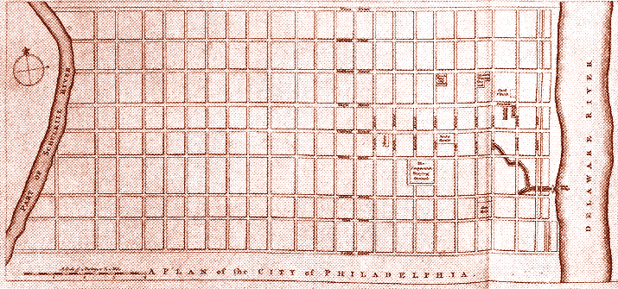
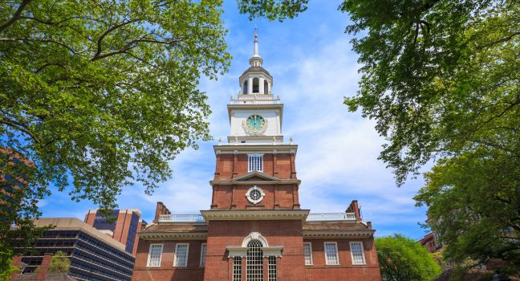
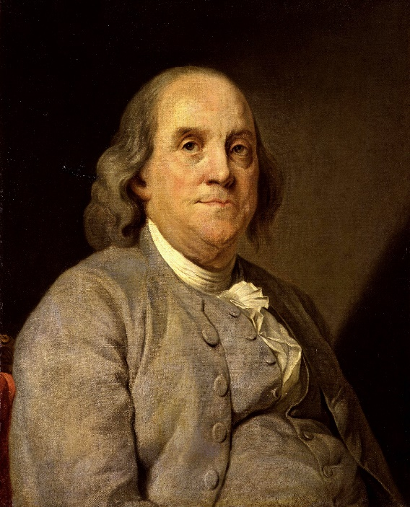
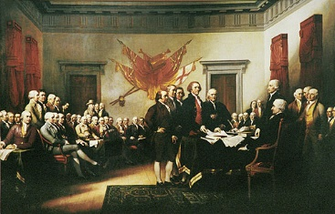

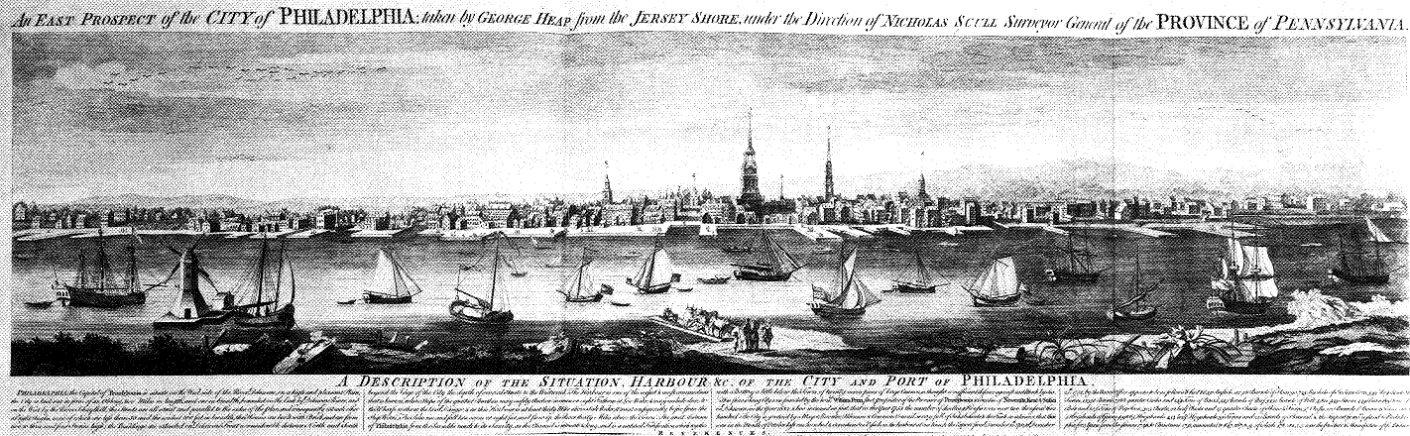






History

Slide 4
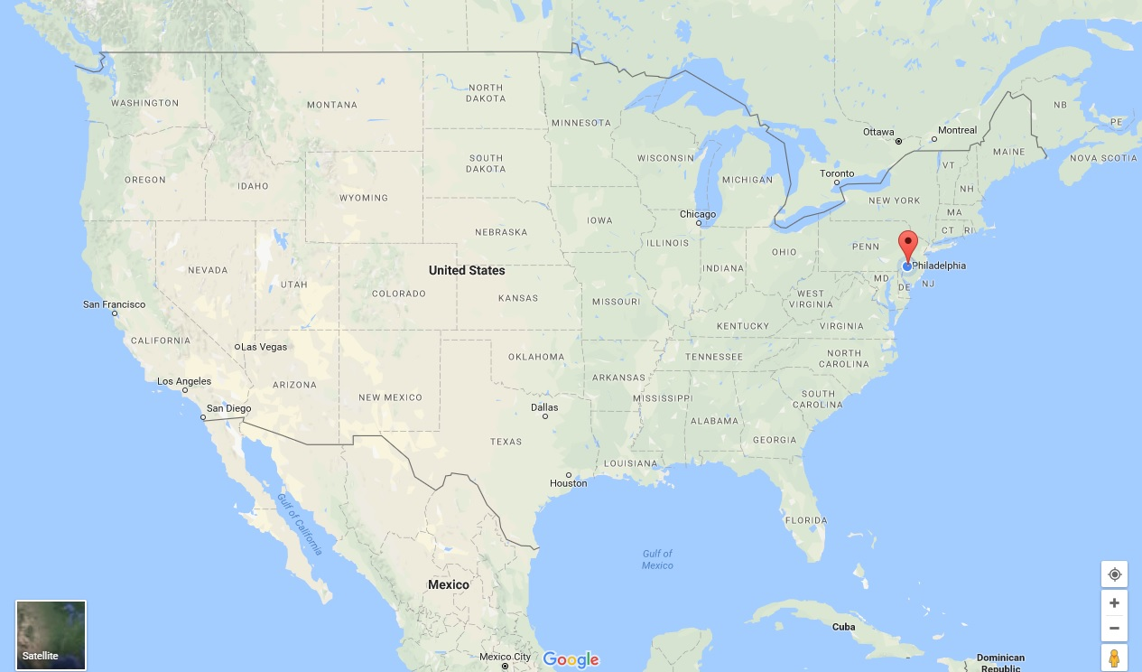
The Demographic Landscape
Philadelphia is…
A city of 1.568 million people (2016 estimate)
The 6th most populous city in the United States
Centrally located on the Mid-Atlantic coast
The 5th busiest port on the Atlantic (25th busiest total)
Philadelphia has…
500,000 fewer inhabitants than its peak in the 1950s-1960s
One of the lowest job growth rates at 1.1%*
A higher unemployment rate (5.9%) than the national average (4.3%)
The highest adult poverty rate (25%), and child poverty rate (38%)*
The lowest median income at $41,201*
… a bright future! ☺
* = of the 25 largest, most populous American cities [source: ccd]

Slide 5
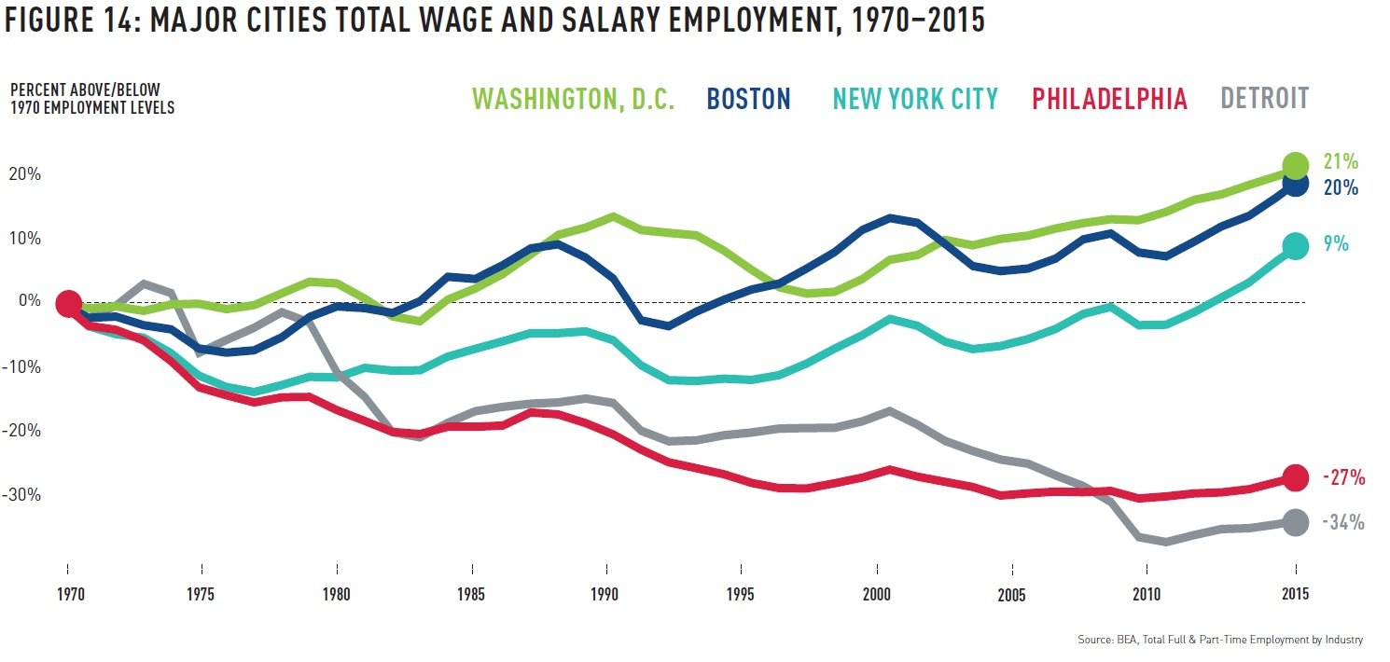
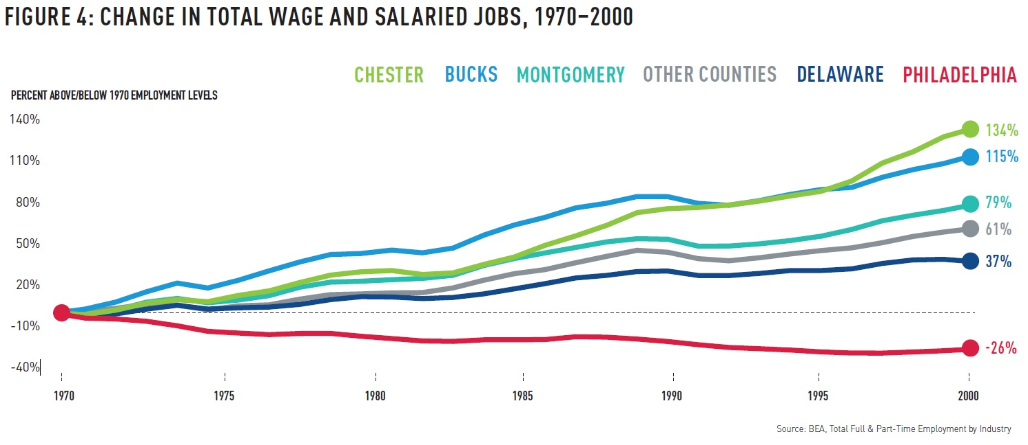
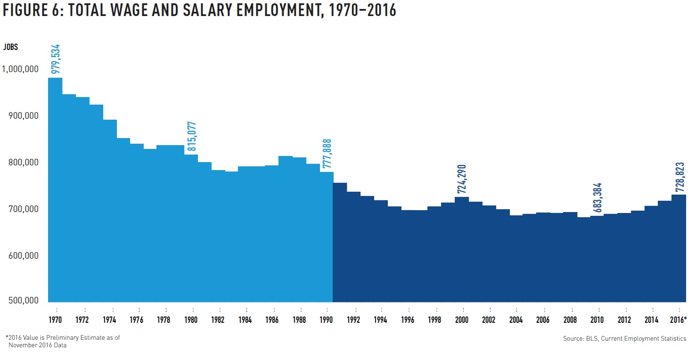
Center City Reports
Philadelphia: An Incomplete Revival

Slide 6
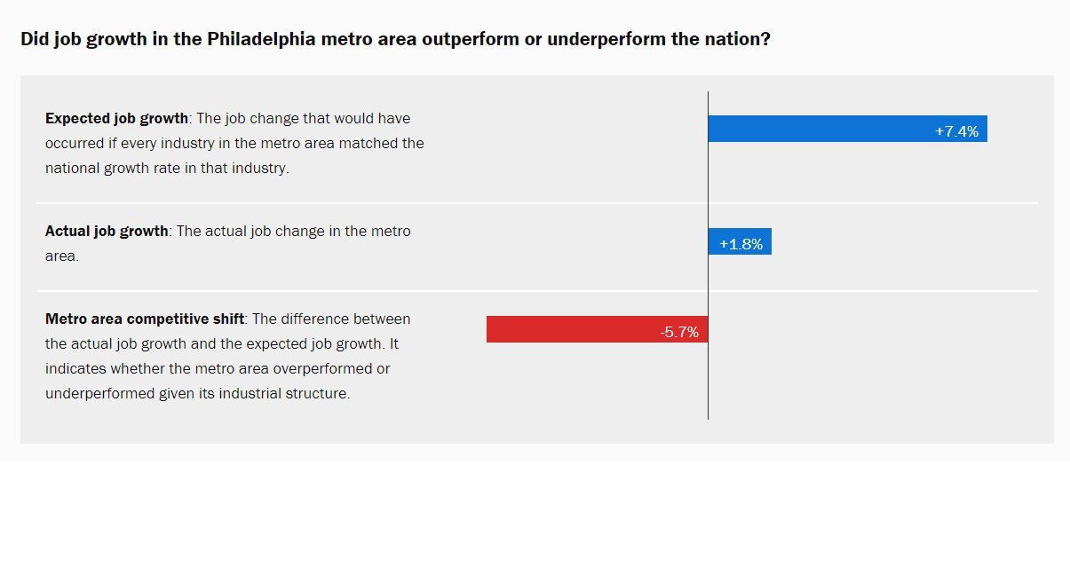
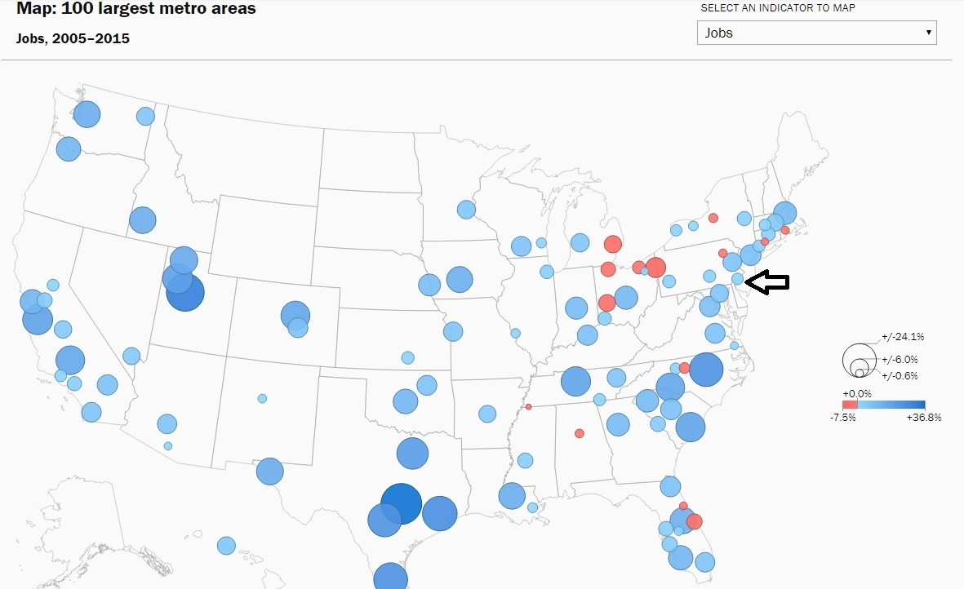
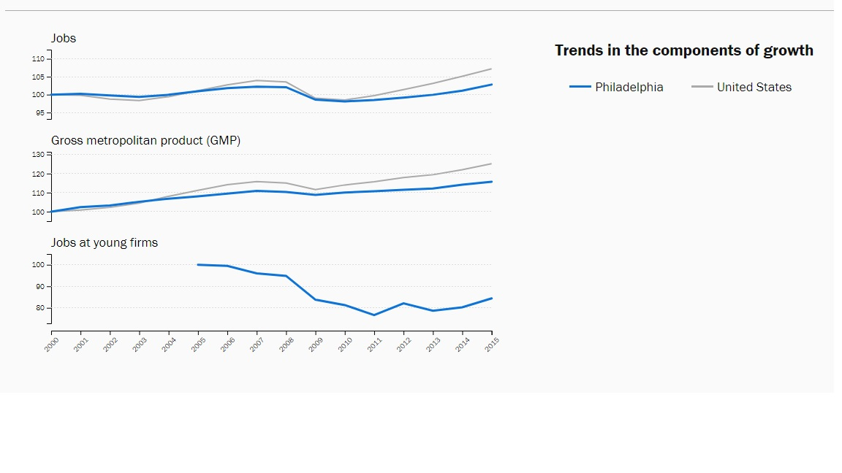
Brookings
Metro Monitor 2017 (Philadelphia)

Slide 7
Acquiring some data
Data Sources
Population: U.S. Census
Employment: U.S. Bureau of Labor Statistics
Methods:
Direct Download
API

Slide 8
Making the data useful (for this project)

Slide 9
Examining the economic indicators

Slide 10
Slide 9

Slide 11
Slide 10

Slide 12
Slide 11

Slide 13
Slide 12

Slide 14
Slide 14

Slide 15
Slide 14

Slide 16
Slide 15

Slide 17
Slide 16

Slide 18
Slide 17

Slide 19
What’s next?

Slide 20
Thank you!

