Slide 1

Philadelphia… a city about to boom?
Mid-term Status Report
Image credit: World Cities, (YouTube license) https://www.youtube.com/watch?v=GnKJ-_DspMI

Slide 2
Introduction
Examine economic growth using standard indicators
Employment
Population
Explore other dimensions
Socioeconomic categories
Labor Industries
???
Compare
With cities in the same geographic region
With cities of the same population size
Conclude…
… is Philadelphia on the verge of an economic boom?
Part 1 – mid-term
Part 2 – final report

Slide 3
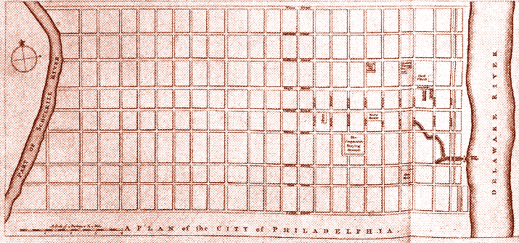
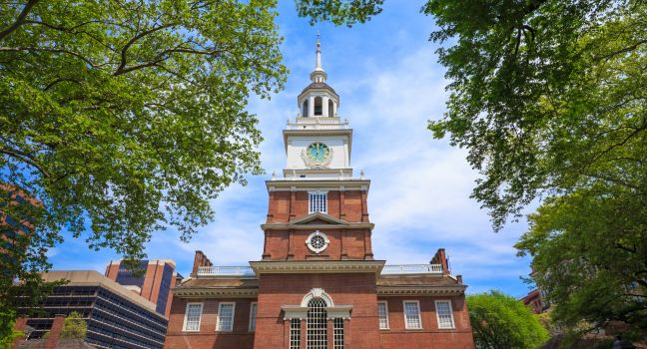
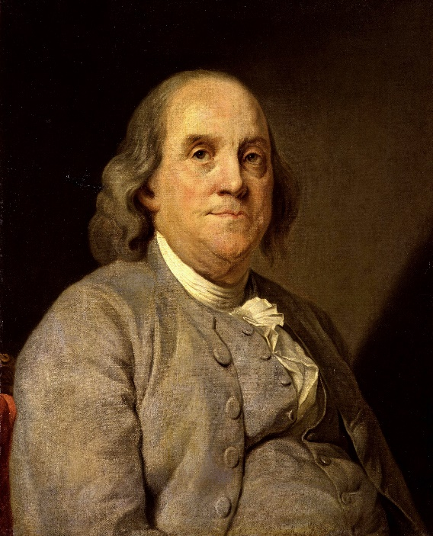
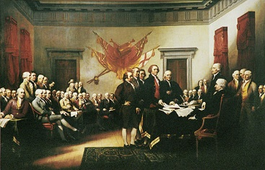
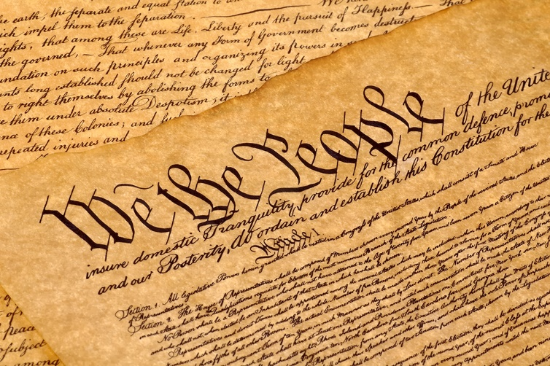
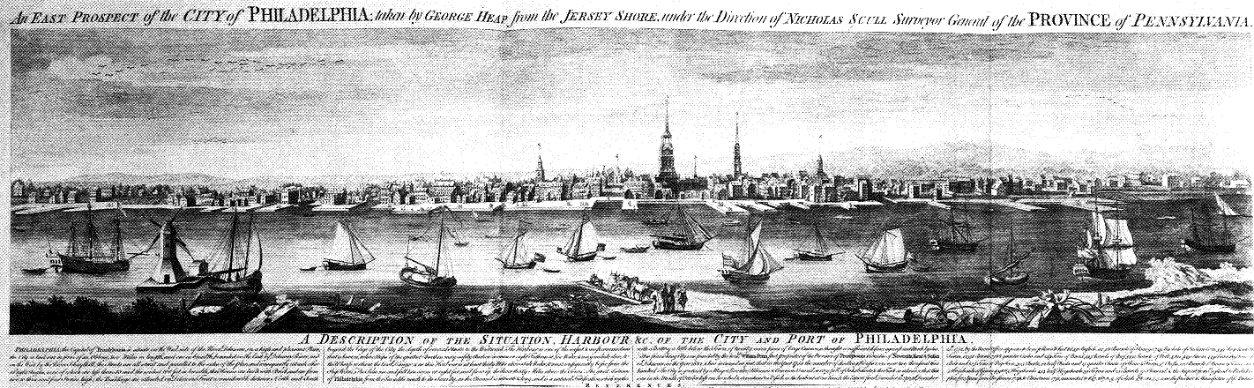






History

Slide 4
Slide 3

Slide 5
Slide 4

Slide 6
Slide 5

Slide 7
Slide 6

Slide 8
Slide 7

Slide 9
Slide 8

Slide 10
Slide 9

Slide 11
Slide 10

Slide 12
Slide 11

Slide 13
Slide 12

Slide 14
Slide 14

Slide 15
Slide 14

Slide 16
Slide 15

Slide 17
Slide 16

Slide 18
Slide 17

Slide 19
Conclusions…

Slide 20
Thank you!

