Slide 1

Philadelphia… a city about to boom?
Mid-term Report
Michael Uftring
Indiana University
I-590 Data Visualization
Fall, 2017
Image credit: World Cities, (YouTube license) https://www.youtube.com/watch?v=GnKJ-_DspMI
Notes:
The Great Recession is almost 10 years behind us. We hear and read reports of economic growth and prosperity. The goal of this project is to evaluate and asses the economic outlook for Philadelphia by looking back into recent history and trying to look forward into the future.

Slide 2
Introduction
A two-part submission…
Part 1 – mid-term
Part 2 – final report
Examine economic growth using standard indicators
Employment
Population
Explore other dimensions
Socioeconomic categories
Labor Industries
Compare
With cities in the same geographic region
With cities of the same population size
Conclude…
… is Philadelphia on the verge of an economic boom?
… are all population groups benefiting?
Notes:
We will explore several data categories and layers of demographics, and provide a comparison with other cities. The goal is to determine if there is a big boom in Philadelphia’s future. This type of project turns out to be a rather big undertaking, so it will be submitted in two parts.

Slide 3
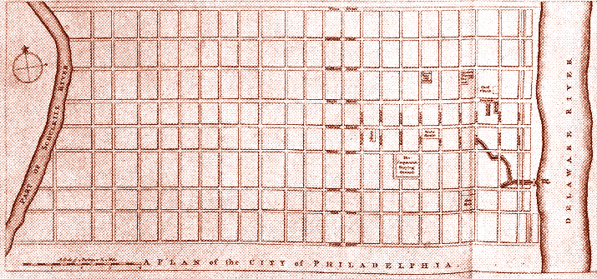


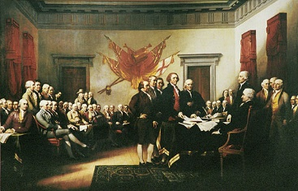

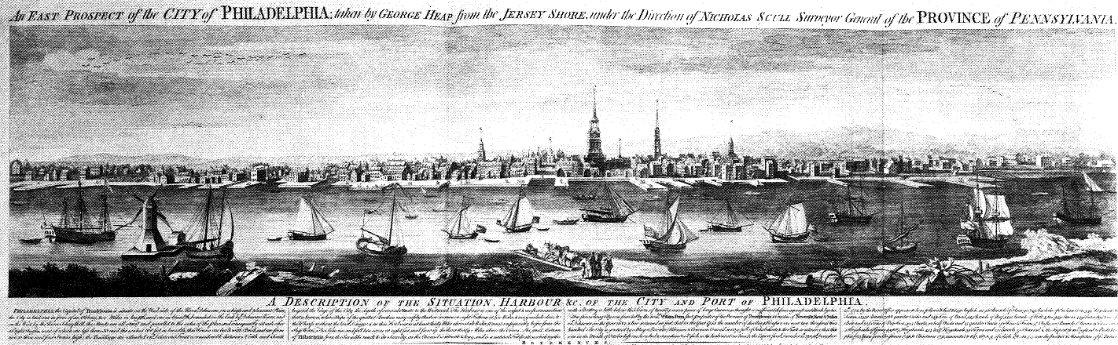






History
Notes:
Philadelphia has a very rich history, from Colonial times to the current day. This city is the home of several large national corporations and world-class universities. There is a depth and breadth of talent and leadership here. The economic ground here appears fertile!

Slide 4
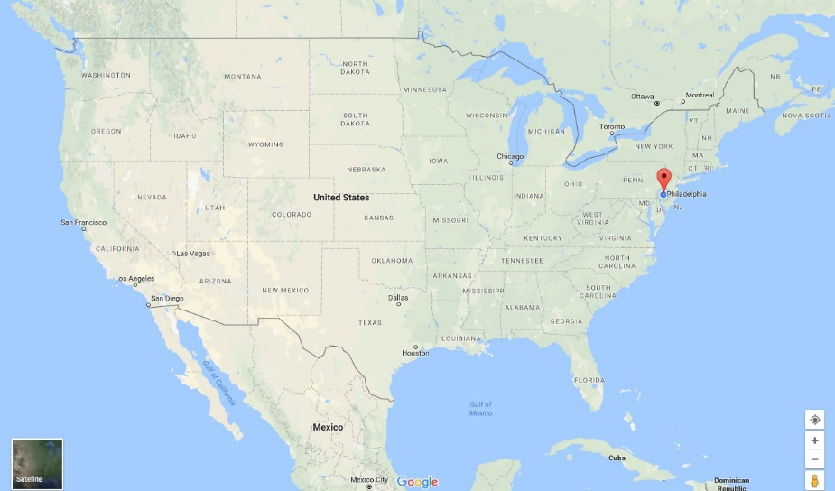
The Demographic Landscape
Philadelphia is…
A city of 1.568 million people (2016 estimate)
The 6th most populous city in the United States
Centrally located on the Mid-Atlantic coast
The 5th busiest port on the Atlantic (25th busiest total)
Philadelphia has…
500,000 fewer inhabitants than its peak in the 1950s-1960s
One of the lowest job growth rates at 1.1%*
A higher unemployment rate (5.9%) than the national average (4.3%)
The highest adult poverty rate (25%), and child poverty rate (38%)*
The lowest median income at $41,201*
… a bright future! ☺
* = of the 25 largest, most populous American cities [source: ccd]
Notes:
Philadelphia is one of the largest cities in the United States, with very busy sea port and rail yards. Like many large cities with a heavy industrial history, the twentieth century brought a lot of change – job loss, population decline, higher taxes, and widespread poverty.

Slide 5
Examining economic indicators
Objective:
Use employment and population figures across a span of time as indicators/predictors of growth
For Philadelphia
And some other cities
… in the same geographic region
… of about the same size (w.r.t. population)
Why?
To see
(1) how is Philadelphia doing overall, economically?
(2) … compared to national figures?
(3) … compared to “similar” cities?
And try to determine if a “big boom” is in Philadelphia’s future!
Notes:
The goal is to answer the question: is a big boom in Philadelphia’s future? There is no shortage of data, and there are many existing reports and regular news reports and articles. We aim to sift through much of this, and create some visualizations to help make our own prediction.

Slide 6
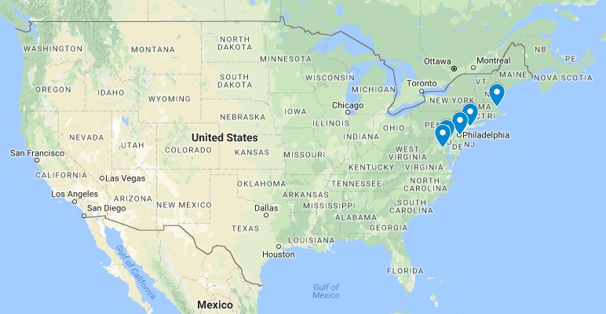
Compared to… two different goups
Geo-Regional Comparison
Boston
New York City
Philadelphia
Baltimore
Washington, DC
Population Size Comparison
Phoenix
Philadelphia
San Antonio
San Diego
Dallas
City | 2016 Population | Difference | % Difference
New York City | 8,537,673 | 6,969,801 | 444.5%
Los Angeles | 3,976,322 | 2,408,450 | 153.6%
Chicago | 2,704,958 | 1,137,086 | 72.5%
Houston | 2,303,482 | 735,610 | 46.9%
Phoenix | 1,615,017 | 47,145 | 3.0%
Philadelphia | 1,567,872
San Antonio | 1,492,510 | -75,362 | -4.8%
San Diego | 1,406,630 | -161,242 | -10.3%
Dallas | 1,317,929 | -249,943 | -15.9%
San Jose | 1,025,350 | -542,522 | -34.6%
* [wikipedia] List of United States cities by population - https://en.wikipedia.org/wiki/List_of_United_States_cities_by_population
Notes:
We will compare Philadelphia with cities that are in its neighborhood. And we will compare Philadelphia with cities of roughly the same population size. This creates two rather diverse groups considering: population, location, industry, demographics, and personality.

Slide 7
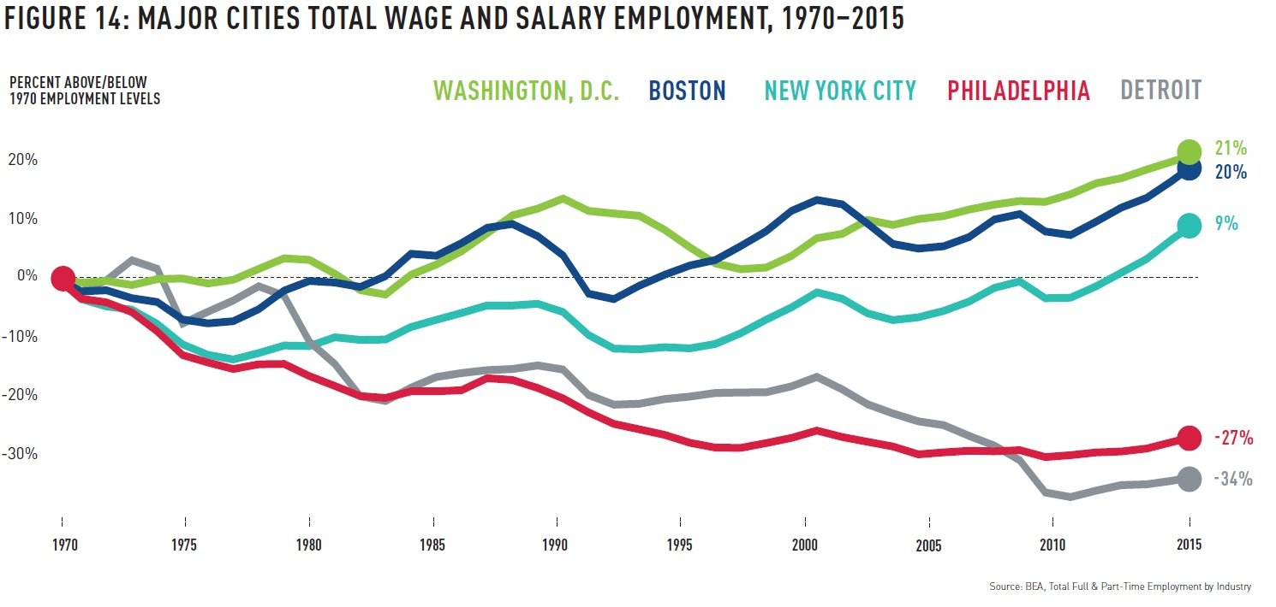
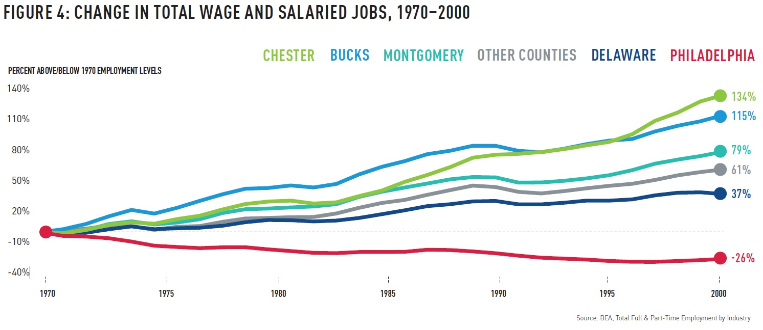
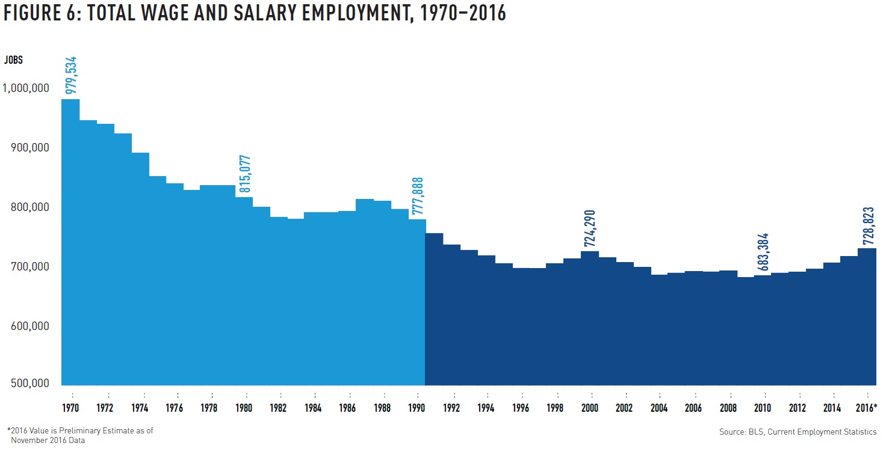
Center City Reports
Existing,
related works
Philadelphia: An Incomplete Revival
[ccd] Center City Reports, Philadelphia: An Incomplete Revival - https://www.centercityphila.org/research-reports/philadelphia-an-incomplete-revival
Notes:
I drew inspiration from Philadelphia: An Incomplete Revival. It provides a lot of background and economic history. The report paints a bleak picture, but hints at a bright sun rising over the horizon. I like how this line chart compares employment over a 45 year span.

Slide 8
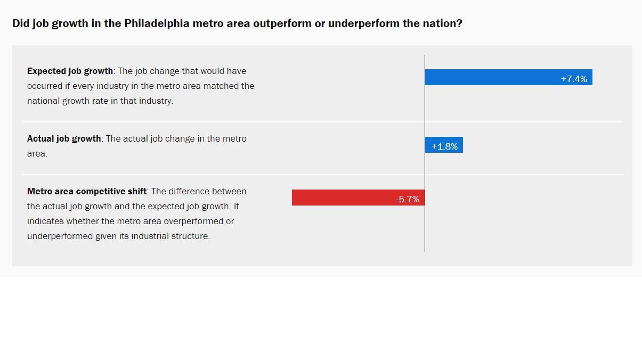
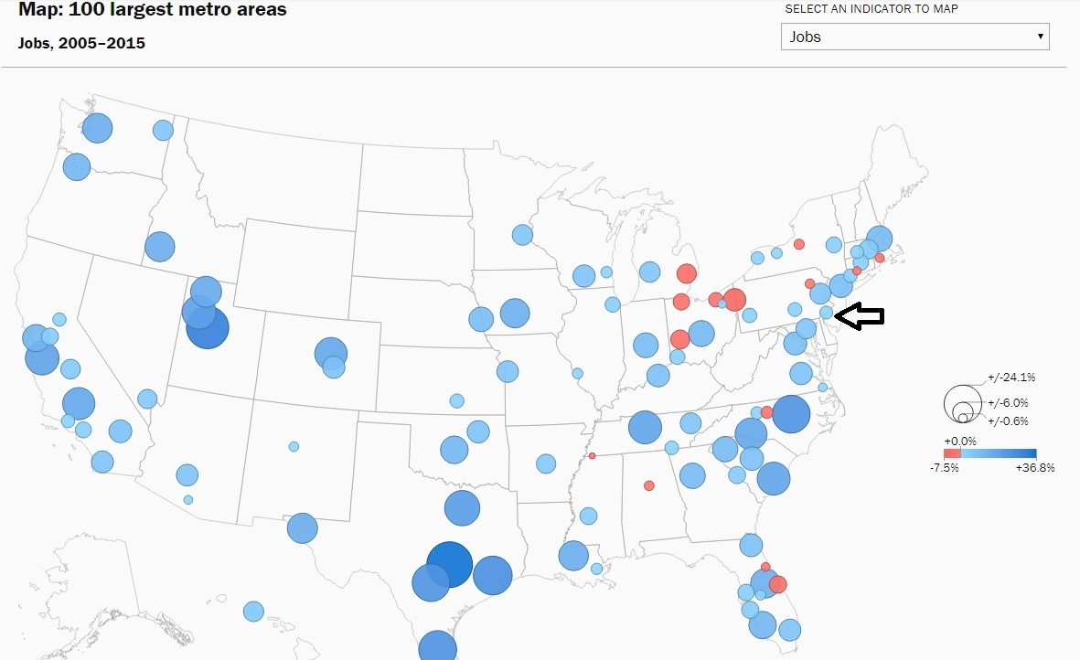
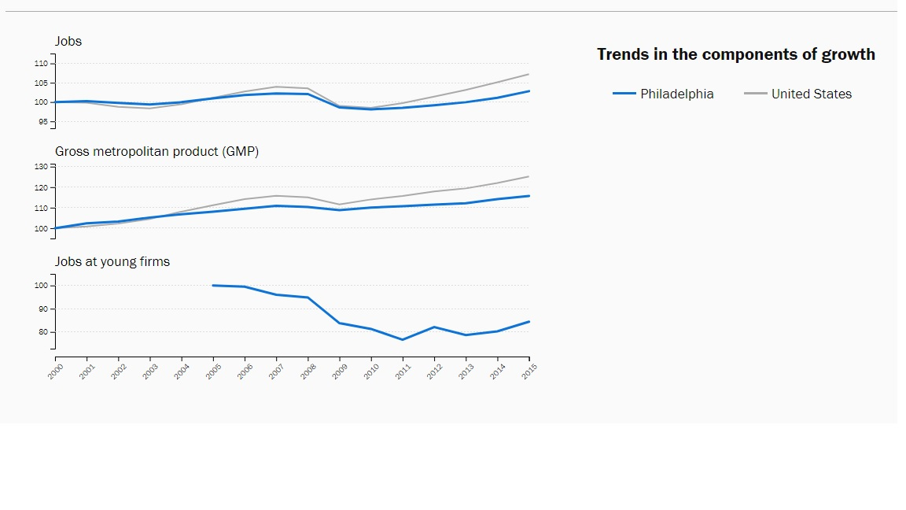
Brookings
Existing,
related works
Metro Monitor 2017 (Philadelphia)
[brookings] Brookings Institute, Metro Monitor (2017) - https://www.brookings.edu/research/metro-monitor-2017/
Notes:
The Brookings Institute is well known for their economic and political reporting. I found these stacked line charts interesting, especially their use of a shared x-axis. The map is cool, but clicking on the circles did not reveal any additional detail.

Slide 9
Acquiring some data
Data Sources
Population: U.S. Census Bureau [census] - http://census.gov
Employment: U.S. Bureau of Labor Statistics [bls] - http://www.bls.gov
City Demographics: Wikipedia (several pages)
Methods
Download
API
External tools*
Manually extracted from HTML forms
Data formats
Comma Separated Values (CSV)
JavaScript Object Notation (JSON)
* [wikipedia2csv] Convert Wikipedia Tables to CSV - http://wikitable2csv.ggor.de/
Notes:
The major sources of data are government agencies. The data came in different formats, and multiple ways. The API approach is really nice because it allows for tailoring queries to get exactly what is needed. This was helpful when exploring and scaling out from concept to project.

Slide 10
About the data sets
The data sets are time-series data
They typically represent a measured observation at specific times
Bureau of Labor Statistics (BLS) provides:
Unemployment Rate (as a %)
Unemployment (number)
Employment (number)
Labor Force (number)
Census Bureau provides:
Population (number)
… nationally
… by location (city, state)
Demographics (gender, race)
The best visual representation is usually line chart
Show the change in value over time
We also use bar charts to compare the same measure across a spatial dimension
City and National values for a specific measure, for a specific time period
Notes:
Economic and Population data are time-series. The best visual presentation for time-series is often a line chart because it shows the historical trend from which we can begin to make projections. We use bar charts for comparing summarized values across cities.

Slide 11
Making the data useful (for this project)
Objective: Make the data (mostly) Tidy*
Principles:
Each variable forms a column.
Each observation forms a row.
Each type of observational unit forms a table.
Problems faced:
Column headers are values, not variable names.
Multiple variables are stored in one column.
Variables are stored in both rows and columns.
* [wickham] Tidy Data, Hadley Wickham, Journal of Statistical Software
Notes:
So far the data for this project has not been particularly messy, but it is definitely not tidy. We are aiming to adhere to the principles of Tidy Data as best as possible, and as such have employed transformations and twists, melts and merges in multiple places.

Slide 12
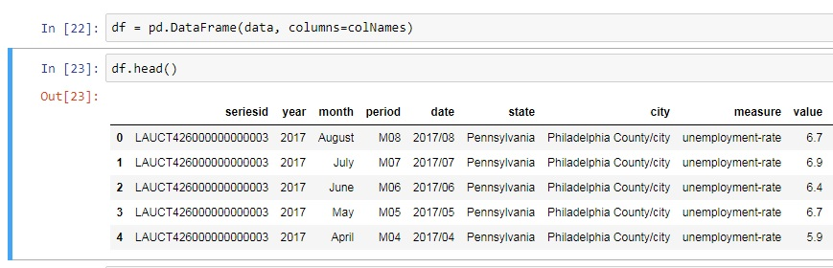
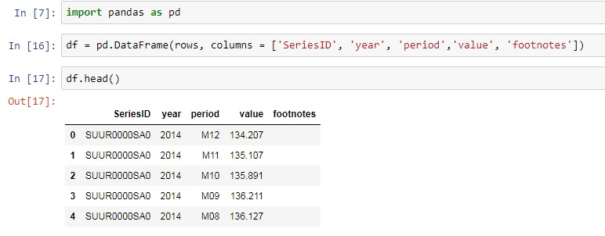

A Tidy Data exercise
Bureau of Labor Statistics (BLS) data
Obtained by API, provided in JSON format
Problems:
Multiple variables are stored in one column.
Single variable is stored in multiple columns.
The BLS SeriesID encodes many data items
The data set type/name
Some data attributes
The location (for geo based data)
The Measured value (metric name)
Created lookup tables to map encoded values
{'Results':
{'series': [
'seriesID': 'SUUR0000SA0',
{'data': [
{'footnotes': [{}],
'period': 'M12',
'periodName': 'December',
'value': '134.207',
'year': '2014'},
{'footnotes': [{}],
'period': 'M11',
'periodName': 'November',
'value': '135.107',
'year': '2014'},
Notes:
The Bureau of Labor Statistics SeriesID field is a classic case of Multiple Variables Stored in One Column. The sequence presented here shows how we took the raw JSON, extracted the observations, parsed and decoded the SeriesID, and transformed this mess into Tidy Data.

Slide 13
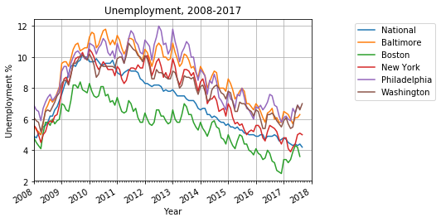
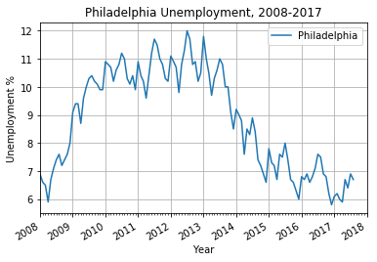
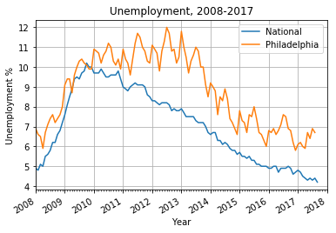
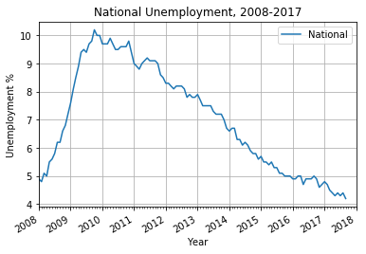
Unemployment Rate % time-series
We can plot unemployment percentage over time to get some perspective on how the nation and cities are doing
Philadelphia numbers, also looks OK
National numbers, looks OK
National and Philadelphia numbers, nice
National and 5 cities, uh oh… looks messy!
Notes:
The objective of line charts for time-series data is to gain perspective into the trends. Some of the charts look nice, and we can show some comparisons. But once we add a few too many time-series, it gets kind of messy. We need a better way to present time-series effectively in a group.

Slide 14
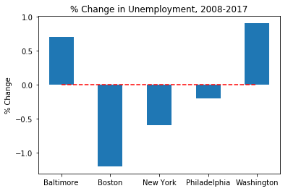
Change in Unemployment over time
We want to see how well cities have bounced back from the Great Recession of 2008-2009, so we compare the unemployment % values before and after (i.e., now)
Negative values indicate unemployment is lower now than before the Great Recession
Some cities are doing better
Notes:
The “incomplete revival” positioned percent change in unemployment rate from before The Great Recession and now as an indicator of revival. I thought this was insightful and would be a good measure to include in this report, especially when comparing Philadelphia with other cities.

Slide 15
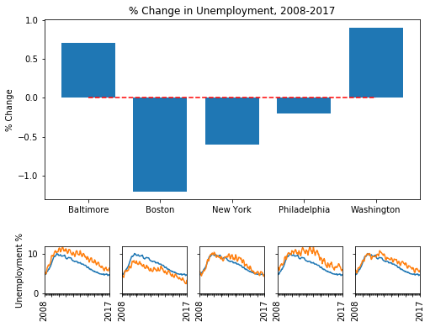
Comprehensive Geo-Regional View
The objective is to show two things:
Net overall change
The trend over time
Philadelphia …
is better off than before the Great Recession, but is higher than the National unemployment rate
is in the middle of this group
had longer sustained unemployment from the Great Recession.
The other cities more closely followed the national trend.
Boston appears to be the best performing:
greatest diff since before the Great Recession
unemployment rate is lower than the national average
Time-series legend:
Blue line: National Unemployment
Orange line: City’s Unemployment
Notes:
I like presenting unemployment rate in a line chart. But remember, the line chart with six of these time-series was really messy. Here with the percent change in unemployment bar chart we use small multiples for the time-series of unemployment rate of each city.

Slide 16
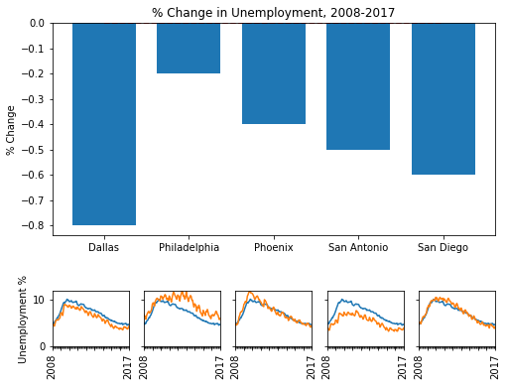
Comprehensive Population Size View
Well, what’s happened here?
Philadelphia is the worst performing in this group.
smallest % change
the only city over the national average
San Antonio appears to be best performing in this group
consistently below the national unemployment rate
about 0.5% lower unemployment than before the Great Recession
Time-series legend:
Blue line: National Unemployment
Orange line: City’s Unemployment
Notes:
Plotting each time-series with the national rate serves two purposes: first, to compare each city with the national rate; and second, the inclusion of the common element provides a means to help compare across cities without having explicit plots. The national rate acts like an additional axis.

Slide 17
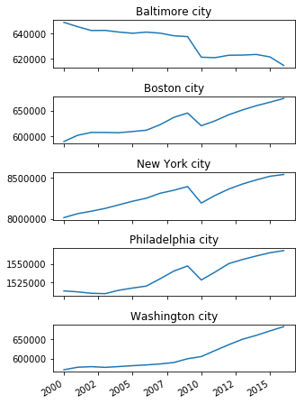
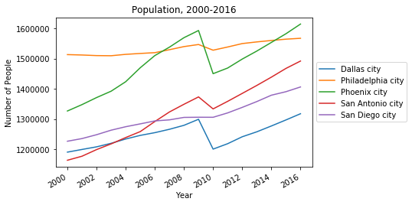
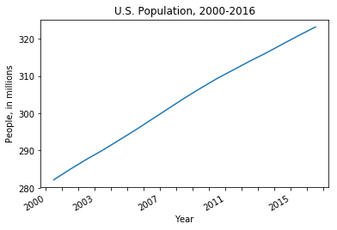
Are City Populations on the Rise or Decline?
CCD “incomplete revival” notes patterns and trends in Philadelphia’s population changes
The National Population is always trending up and up!
City populations fluctuate
Geo-regional View
Population Size View
Notes:
Most cities follow the general population trend: up. However, the industrial cities saw a major dip in population as manufacturing jobs vanished. The “incomplete revival” report discusses this and other factors which shaped Philadelphia’s current economic landscape.

Slide 18
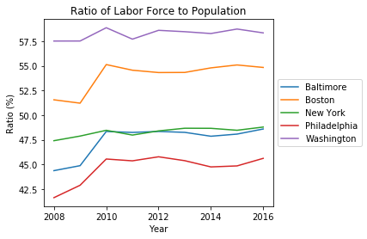
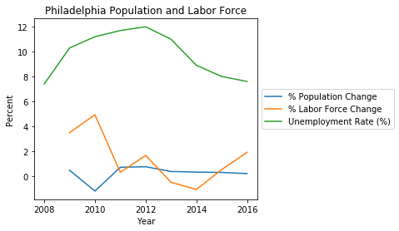
How does population relate to employment?
The Ratio of Labor Force to Population gives an indicator of how much of the population is participating in employment.
For Philadelphia
In 2010: there is a drop in Population, and a corresponding spike in Labor Force.
Age of departing population
Population entering workforce
In 2013-2014: the decrease in Labor Force is equal to the Population increase, yet the Unemployment Rate dropped over 2%
More population demographic changes
Job relocations?
In 2015-2016: Labor Force growth outpaces population growth
Labor force (Current Population Survey)
The labor force includes all persons classified as employed or unemployed in accordance with the [Bureau of Labor Statistics] definitions
Notes:
It seems logical to think that as the population shifts, the labor force would follow. However, there are less visible factors affecting the big picture. So, this is an incomplete picture. We cannot draw too many conclusions from just population and employment alone.

Slide 19
What have we learned so far?
Philadelphia’s rebound from the Great Recession of 2008-2009
City population is up 1.8%, even after an exodus of almost 20,000 people in 2009-2010
However, the rate of population increase is lower compared to other cities in the same size spectrum
Unemployment is just 0.2% higher than the pre-recession level
The number of unemployed is 14.3% higher than pre-recession level
But the number has been steadily declining since 2012
The number of employed is 11.2% higher than pre-recession level
Only in 2011 was there a dip in the number of employed
The job creation rate is outpacing population growth
Notes:
Philadelphia has been through a lot of tough times. The post-industrial era has been a mixed bag of population changes, economic changes, and rebuilding starts and stops. The indication is that we have bounced back from the Great Recession, which is a good starting point for what’s next.

Slide 20
What’s next? (in Part 2)
Add in additional data dimensions, to get a broader perspective
Race, Ethnicity
Labor force characteristics: industries, sub-industries
Incorporate City revenue data (sources, % contributions)
The working hypothesis is that some cities are more business and consumer friendly because of their tax structures and revenue models [ccd].
Draw final conclusion… is Philadelphia on the verge of something great?
Provide an application like Brookings Metro Monitor
Allow selection of “base” city for comparison
Choose “nearest neighbors”
Choose “closest in size”
Present visualizations
Photo/Image Credits, copyright or property of the following:
Wikimedia Foundation (Creative Commons), ushistory.org, Fodors Travel, Joseph Duplessis, U.S. Constitution Center, John Trumbull, Comcast Corporation, Aramark Companies, Tasty Baking Company, University of Pennsylvania, Temple University, Drexel University
Notes:
Additional dimensions of data need to be explored. We need to understand more of the underlying social picture, as well as labor force characteristics and government policy. The Brookings Metro Monitor dashboard is inspiration for this project’s ultimate submission.

