Slide 1

Philadelphia… a city about to boom?
Mid-term Report
Michael Uftring
Indiana University
I-590 Data Visualization
Fall, 2017
Image credit: World Cities, (YouTube license) https://www.youtube.com/watch?v=GnKJ-_DspMI

Slide 2
Introduction
A two-part submission…
Part 1 – mid-term
Part 2 – final report
Examine economic growth using standard indicators
Employment
Population
Explore other dimensions
Socioeconomic categories
Labor Industries
Compare
With cities in the same geographic region
With cities of the same population size
Conclude…
… is Philadelphia on the verge of an economic boom?

Slide 3
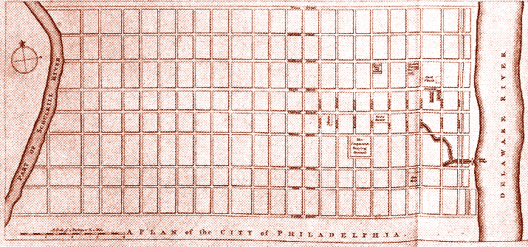




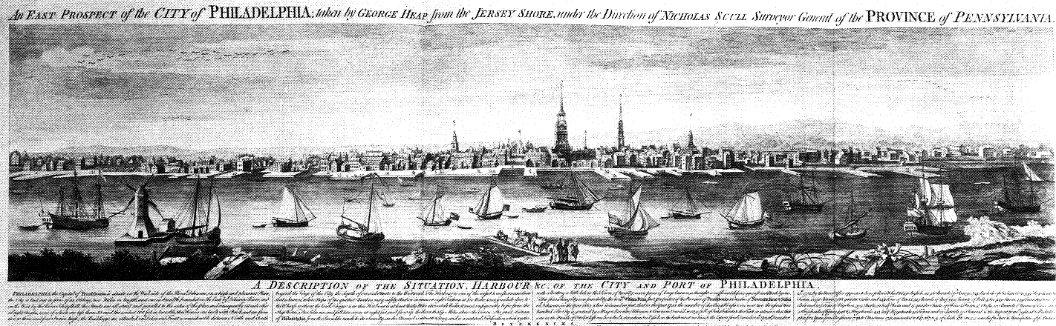






History

Slide 4
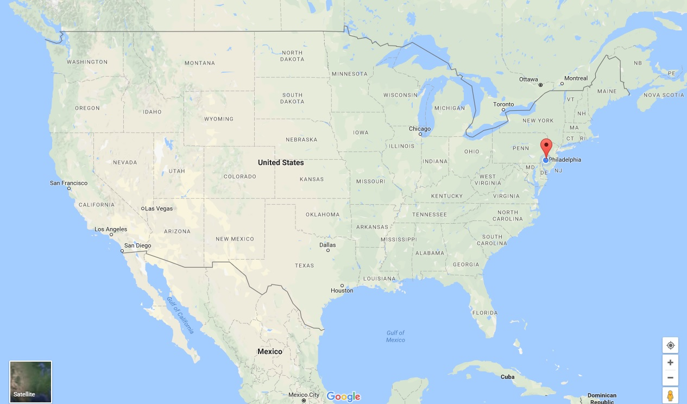
The Demographic Landscape
Philadelphia is…
A city of 1.568 million people (2016 estimate)
The 6th most populous city in the United States
Centrally located on the Mid-Atlantic coast
The 5th busiest port on the Atlantic (25th busiest total)
Philadelphia has…
500,000 fewer inhabitants than its peak in the 1950s-1960s
One of the lowest job growth rates at 1.1%*
A higher unemployment rate (5.9%) than the national average (4.3%)
The highest adult poverty rate (25%), and child poverty rate (38%)*
The lowest median income at $41,201*
… a bright future! ☺
* = of the 25 largest, most populous American cities [source: ccd]

Slide 5
Examining economic indicators
Objective:
Use employment figures across a span of time as an indicator of
For Philadelphia
And some other cities
… in the same geographic region
… of about the same size (w.r.t. population)
Why?
To see
(1) how is Philadelphia doing overall, economically?
(2) … compared to national figures?
(3) … compared to “similar” cities?
And try to determine if a “big boom” is in Philadelphia’s future!

Slide 6
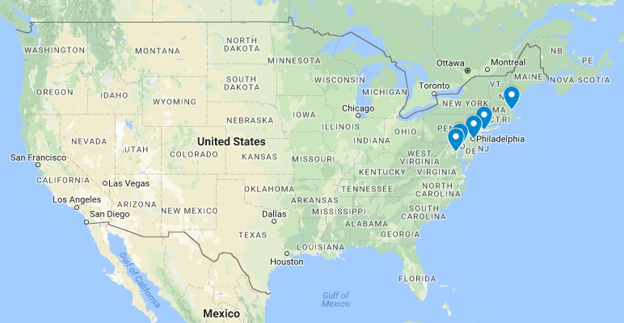
Compared to…
Geo-Regional Comparison
Boston
New York City
Philadelphia
Baltimore
Washington, DC
Population Size Comparison
Phoenix
Philadelphia
San Antonio
San Diego
Dallas
City | 2016 Population | Difference | % Difference
New York City | 8,537,673 | 6,969,801 | 444.5%
Los Angeles | 3,976,322 | 2,408,450 | 153.6%
Chicago | 2,704,958 | 1,137,086 | 72.5%
Houston | 2,303,482 | 735,610 | 46.9%
Phoenix | 1,615,017 | 47,145 | 3.0%
Philadelphia | 1,567,872
San Antonio | 1,492,510 | -75,362 | -4.8%
San Diego | 1,406,630 | -161,242 | -10.3%
Dallas | 1,317,929 | -249,943 | -15.9%
San Jose | 1,025,350 | -542,522 | -34.6%
* [wikipedia] List of United States cities by population - https://en.wikipedia.org/wiki/List_of_United_States_cities_by_population

Slide 7
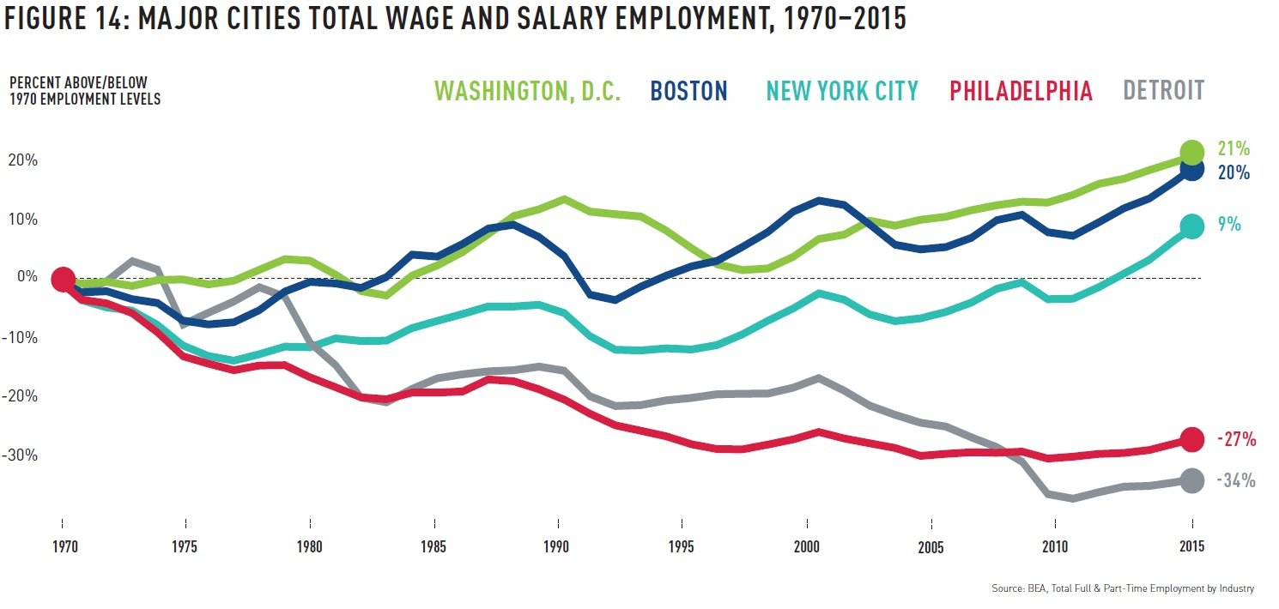
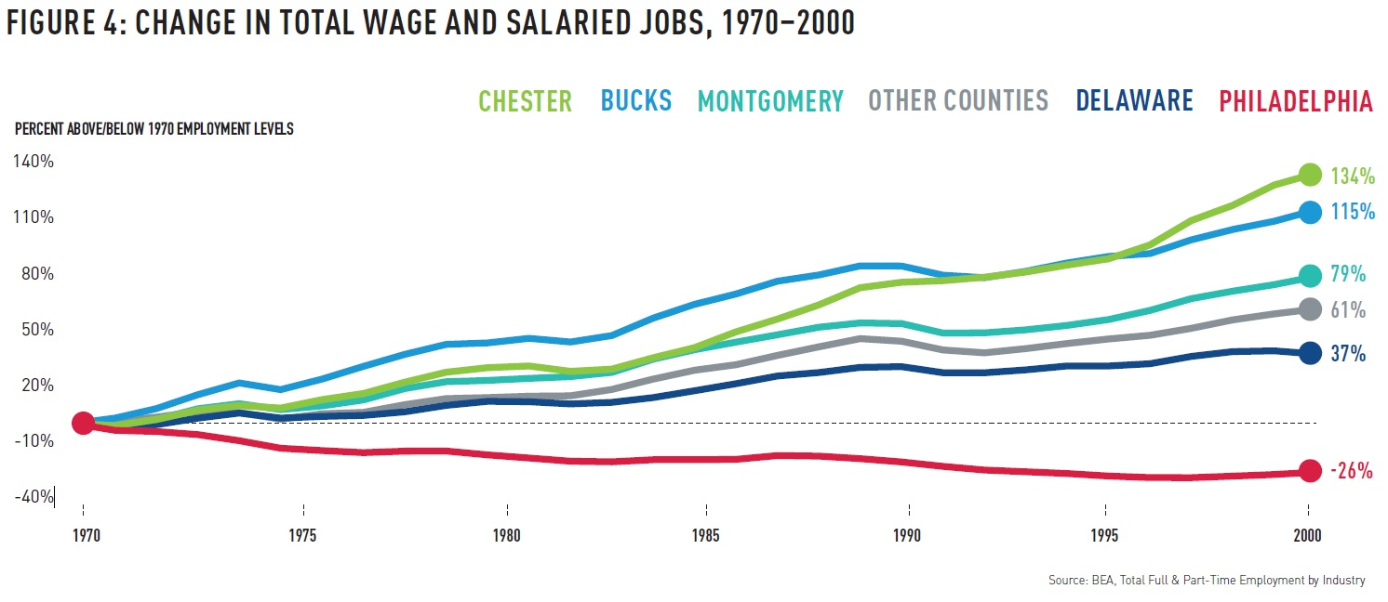
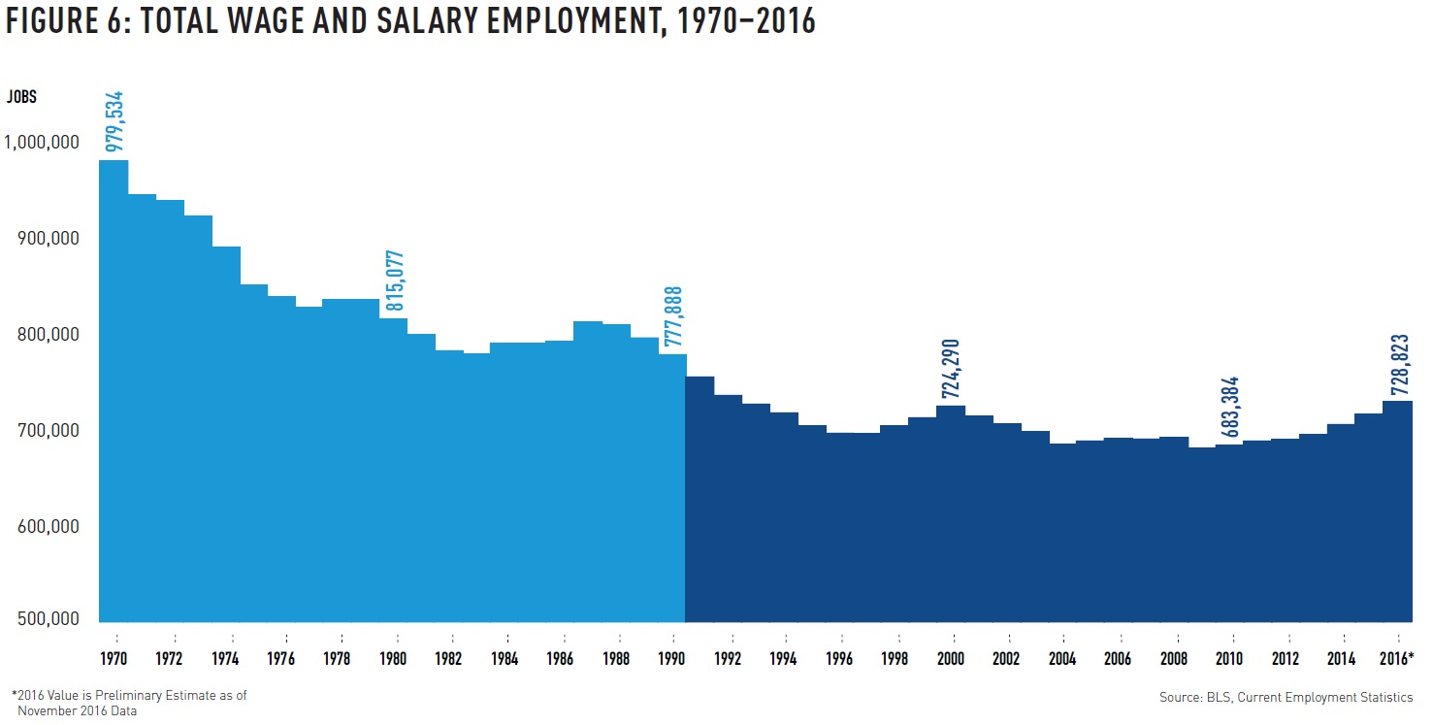
Center City Reports
Existing,
related works
Philadelphia: An Incomplete Revival
[ccd] Center City Reports, Philadelphia: An Incomplete Revival - https://www.centercityphila.org/research-reports/philadelphia-an-incomplete-revival

Slide 8
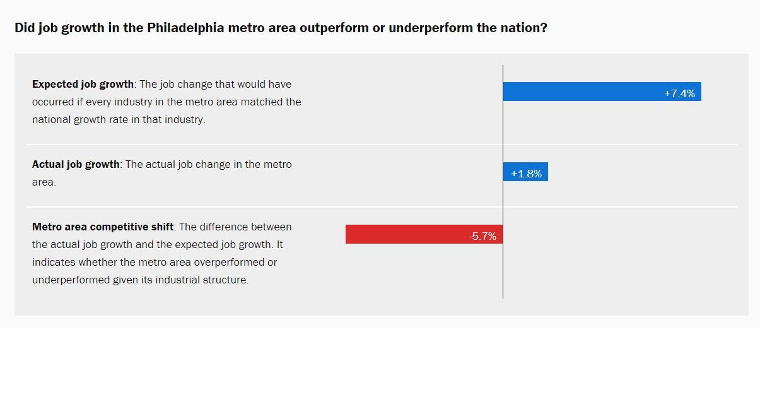
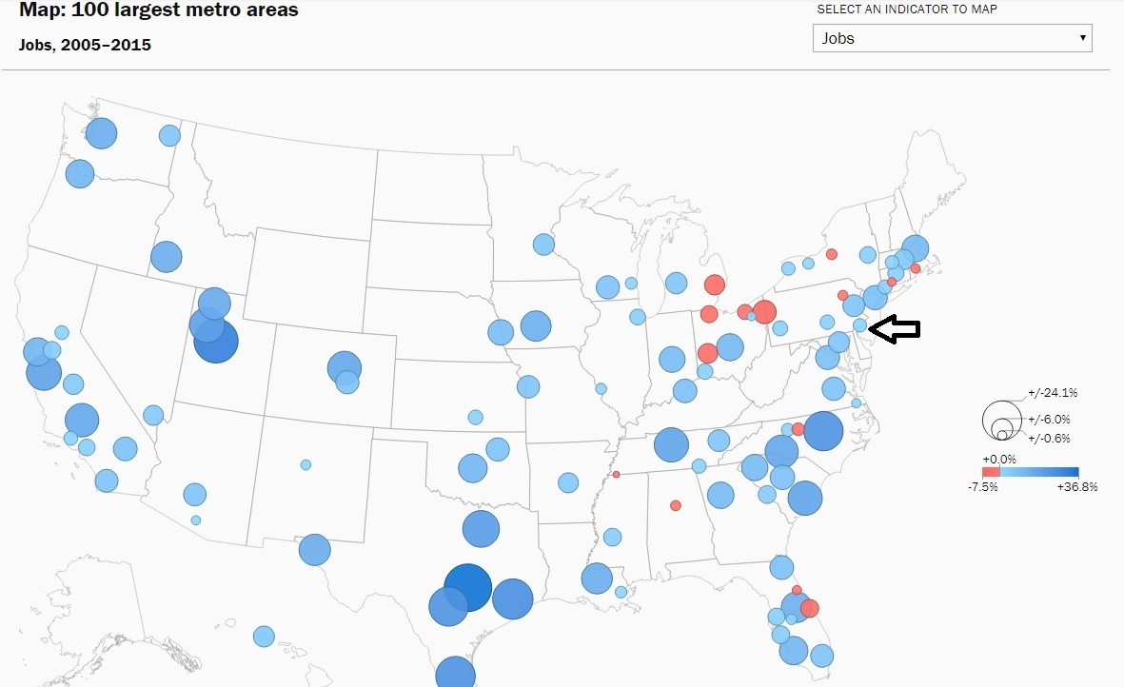
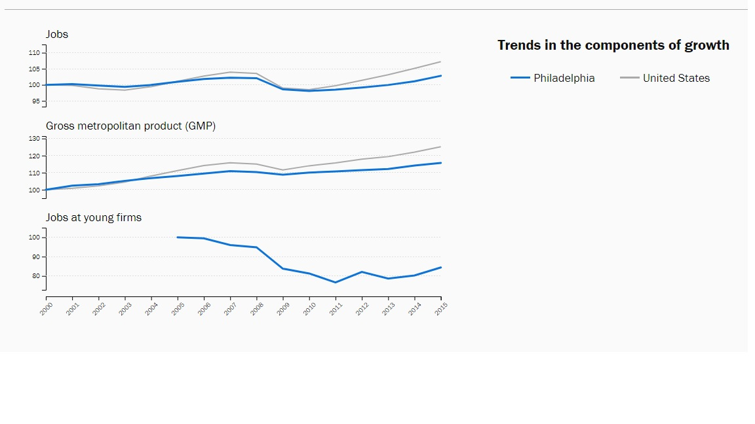
Brookings
Existing,
related works
Metro Monitor 2017 (Philadelphia)
[brookings] Brookings Institute, Metro Monitor (2017) - https://www.brookings.edu/research/metro-monitor-2017/

Slide 9
Acquiring some data
Data Sources
Population: U.S. Census Bureau [census] - http://census.gov
Employment: U.S. Bureau of Labor Statistics [bls] - http://www.bls.gov
City Demographics: Wikipedia (several pages)
Methods
Download
API
External tools*
Manually extracted from HTML forms
Data formats
Comma Separated Values (CSV)
JavaScript Object Notation (JSON)
* [wikipedia2csv] Convert Wikipedia Tables to CSV - http://wikitable2csv.ggor.de/

Slide 10
About the data sets
The data sets are time-series data
They represent a measured observation at particular times
Bureau of Labor Statistics (BLS) provides:
Unemployment Rate (as a %)
Unemployment (number)
Employment (number)
Labor Force (number)
Census Bureau provides:
Population (number)
… nationally
… by location (city, state)
The best visual representation is usually line chart
Show the change in value over time
We also use bar charts to compare the same measure across a spatial dimension
City and National values for a specific measure, for a specific time period

Slide 11
Making the data useful (for this project)
Objective: Make the data (mostly) Tidy*
Principles:
Each variable forms a column.
Each observation forms a row.
Each type of observational unit forms a table.
Problems faced:
Column headers are values, not variable names.
Multiple variables are stored in one column.
Variables are stored in both rows and columns.
* [wickham] Tidy Data, Hadley Wickham, Journal of Statistical Software

Slide 12
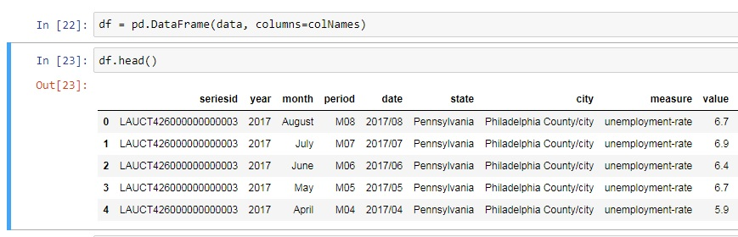
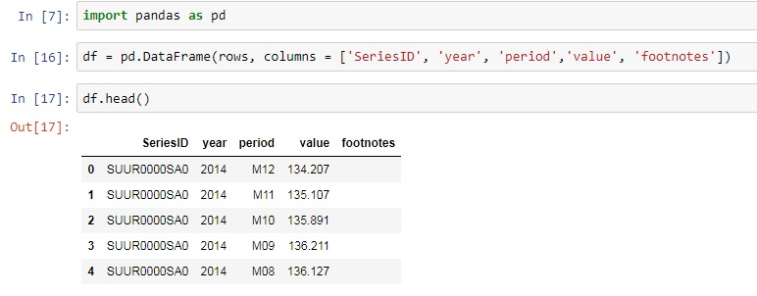

A Tidy Data exercise
Bureau of Labor Statistics (BLS) data
Obtained by API, provided in JSON format
Problems:
Multiple variables are stored in one column.
Single variable is stored in multiple columns.
The BLS SeriesID encodes many data items
The data set type/name
Some data attributes
The location (for geo based data)
The Measured value (metric name)
Created lookup tables to map encoded values
{'Results':
{'series': [
'seriesID': 'SUUR0000SA0',
{'data': [
{'footnotes': [{}],
'period': 'M12',
'periodName': 'December',
'value': '134.207',
'year': '2014'},
{'footnotes': [{}],
'period': 'M11',
'periodName': 'November',
'value': '135.107',
'year': '2014'},

Slide 13
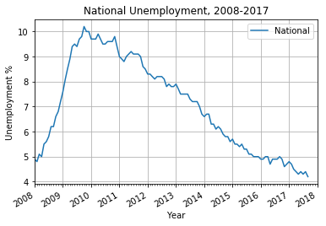
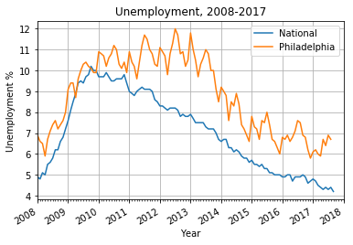
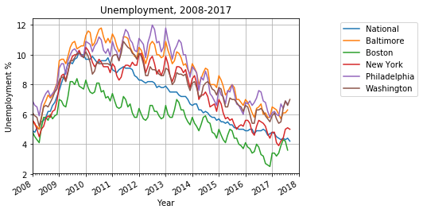
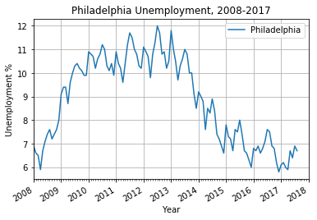
Unemployment Rate % time-series
We can plot unemployment percentage over time to get some perspective on how the nation and cities are doing
National and 5 cities, uh oh… looks messy!
Philadelphia numbers, also looks OK
National and Philadelphia numbers, nice
National numbers, looks OK

Slide 14
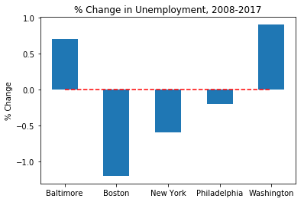
Change in Unemployment over time
We want to see how well cities have bounced back from the Great Recession of 2008-2009, so we compare the unemployment % values before and after (i.e., now)
Negative values indicate unemployment is lower now than before the Great Recession
Some cities are doing better

Slide 15
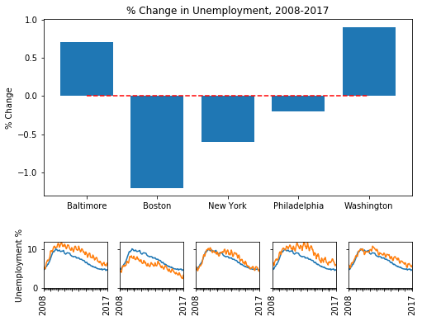
Comprehensive Geo-Regional View
The objective is to show two things:
Net overall change
The trend over time
Philadelphia …
is better off than before the Great Recession, but is higher than the National unemployment rate
is in the middle of this group
had longer sustained unemployment from the Great Recession.
The other cities more closely followed the national trend.
Boston appears to be the best performing:
greatest diff since before the Great Recession
unemployment rate is lower than the national average
Time-series legend:
Blue line: National Unemployment
Orange line: City’s Unemployment

Slide 16
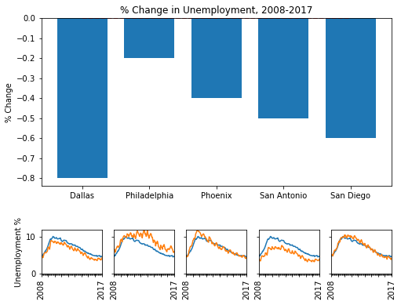
Comprehensive Population Size View
Well, what’s happened here?
Philadelphia is the worst performing in this group.
smallest % change
the only city over the national average
San Antonio appears to be best performing in this group
consistently below the national unemployment rate
about 0.5% lower unemployment than before the Great Recession
Time-series legend:
Blue line: National Unemployment
Orange line: City’s Unemployment

Slide 17
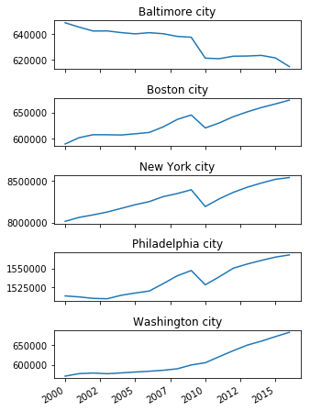
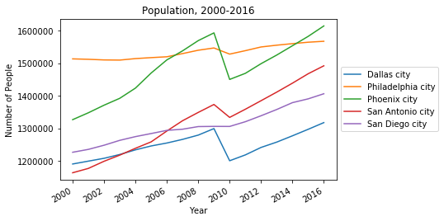
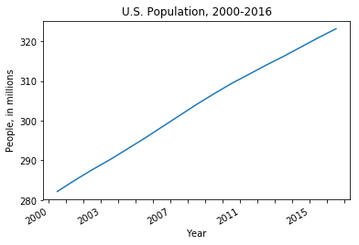
Are City Populations on the Rise or Decline?
CCD notes on Philadelphia population changes
National Population, 2000-2016
City populations, 2000-2016
Geo-regional View
Population Size View

Slide 18
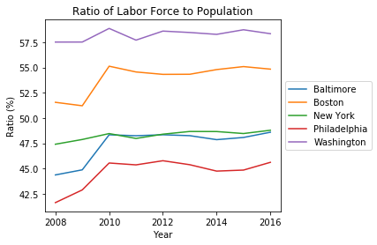
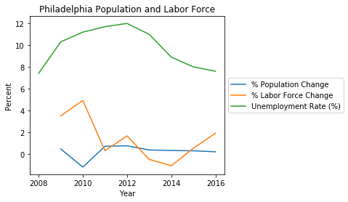
How does population relate to employment?
The Ratio of Labor Force to Population gives an indicator of how much of the population is participating in employment.
For Philadelphia
In 2010: there is a drop in Population, and a corresponding spike in Labor Force.
Age of departing population
Population entering workforce
In 2013-2014: the decrease in Labor Force is equal to the Population increase, yet the Unemployment Rate dropped over 2%
More population demographic changes
Job relocations?
In 2015-2016: Labor Force growth outpaces population growth
Labor force (Current Population Survey)
The labor force includes all persons classified as employed or unemployed in accordance with the [Bureau of Labor Statistics] definitions

Slide 19
What have we learned so far?
Philadelphia’s rebound from the Great Recession of 2008-2009
City population is up 1.8%, even after an exodus of almost 20,000 people in 2009-2010
However, the rate of population increase is lower compared to other cities in the same size spectrum
Unemployment is just 0.2% higher than the pre-recession level
The number of unemployed is 14.3% higher than pre-recession level
But the number has been steadily declining since 2012
The number of employed is 11.2% higher than pre-recession level
Only in 2011 was there a dip in the number of employed
The job creation rate is outpacing population growth

Slide 20
What’s next? (in Part 2)
Add in additional data dimensions, to get a broader perspective
Race, Ethnicity
Labor force characteristics: industries, sub-industries
Incorporate City revenue data (sources, % contributions)
The working hypothesis is that some cities are more business and consumer friendly because of their tax structures and revenue models [ccd].
Draw final conclusion… is Philadelphia on the verge of something great?
Provide an application like Brookings Metro Monitor
Allow selection of “base” city for comparison
Choose “nearest neighbors”
Choose “closest in size”
Present visualizations
Photo/Image Credits, copyright or property of the following:
Wikimedia Foundation (Creative Commons), ushistory.org, Fodors Travel, Joseph Duplessis, U.S. Constitution Center, John Trumbull, Comcast Corporation, Aramark Companies, Tasty Baking Company, University of Pennsylvania, Temple University, Drexel University

