Slide 1
A REPORT ON THE STATE OF HORTICULTURAL EXPORTS IN KENYA, 2015

Slide 2
Problem
Agriculture is the backbone of the Kenyan economy. As Mckinsey Consultants, we have been tasked by our clients (World Food Program), to analyze the exportation of horticultural products in Kenya in the year 2015. This is to help in getting the average amount of different commodities exported per month and the value they give to the country. The analysis results will help the World Food Organization advice the farmers on which products give the most value to the economy.
Objective
The main aim is to identify the variation of export of each horticultural product i.e. flowers, fruits and vegetables within the months of the year 2015, extracted from the provided dataset. This will help in analyzing the exportation of horticultural products in the year and what value they are bringing to the Kenyan economy.

Slide 3
Project Plan
Phase | Time | Resources | Risk
Business understanding | 1 hour | Given Data set Data analyst | Data could be inaccurate
Data Understanding | 1 hour | Given Data set Data analyst | Data could be inaccurate
Data preparation and Data cleaning | 4 hours | Given Data set Data analyst | Duplication of data
Data Analysis | 2 hours | Given Data set Data analyst | Inaccurate data
Conclusion | 30 minutes | Given Data set Data analyst | Economic changes
Recommendation | 30 minutes | Given Data set Data analyst | Economic changes

Slide 4
Data Sourcing
The dataset used in this project comprises data collected between January 2015 to December 2015. This data is enough for our study and no additional data is needed for this project.
The dataset needed is listed below:
Monthly horticultural exports between January 2015 and December 2015 - (http://www.opendata.go.ke/datasets/monthly-horticultural-exports-flowersfruits-and-vegetables-between-january2015-to-december2015/data)
The data collected was sourced from the Kenya Open Data website - (http://www.opendata.go.ke/)

Slide 5
Data quality
Most of the columns have complete data. However, there are missing values on the ‘Values of goods exported’ column. This mostly affects a specific commodity. In addition to missing values, the same column has data in type string. This makes it difficult for data analysis as most of the research questions are dependent on this column
Data Preparation and Cleaning
Checked for missing values.
Checked for null values in the ‘Values of goods exported’ columns and replacing them with 0.00
Checked for duplicates - No duplicates observed.
Changed the column names to workable column names that could be understood and changed them to lowercase.
Converted data types to relevant data types - date changed to datetime format.
Removed leading text on relevant columns- removing the KES. from the ‘Values of goods exported’ column
Dropped the ‘OBJECTID’ column as it was not relevant to the analysis.

Slide 6
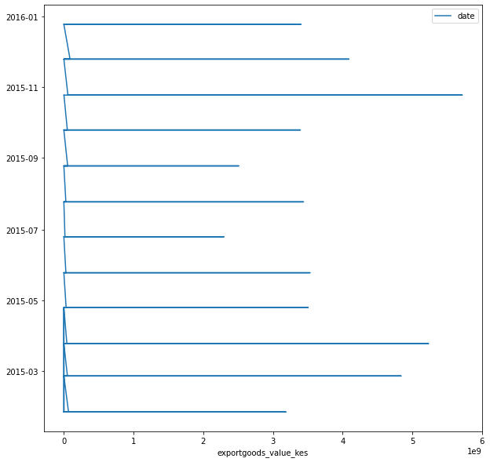
Monthly Export Values Trend

Slide 7
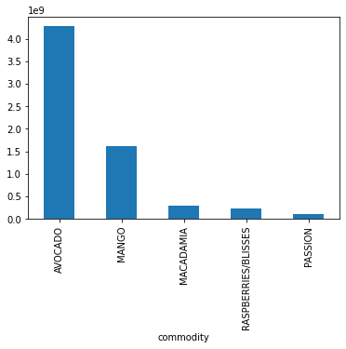
Most Valuable Fruits(values in billions)

Slide 8
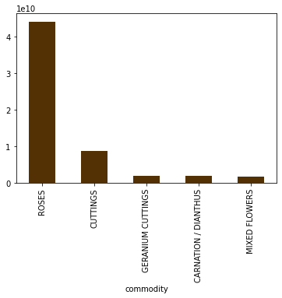
Most Valuable Flowers (values in tens of billions)

Slide 9
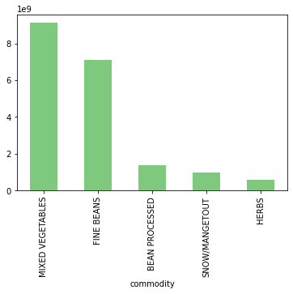
Most Valuable Vegetables (values in billions)

Slide 10
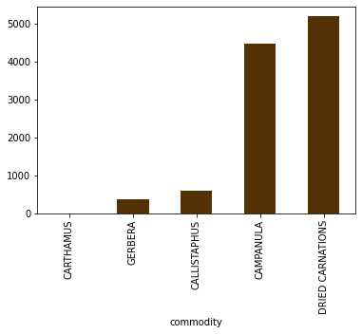
Least Valuable Overall (value in thousands)

Slide 11
Recommendations
Advise the farmers to focus on the months that have the most value of exportation by increasing the production during that month.
Advise farmers to put less resources on the months with the least value of exportation as putting so much effort into such months will guarantee a loss.
Advise the farmers to put more effort on commodities that have the most export value as this will guarantee a lot of profit.
Advise the farmers to put less effort on commodities that do not sell at all or have the least export value.
Advise the farmers to plant according to the demands of a specific month. They should consider the commodity with the most value in different months and focus on them.

Slide 12
Evaluation
According to our business success criteria which was to identify the months which had the high number of commodities exported and what value they give the country and also to identify the months with the least exports and range the types of commodities according to the amount exported, we have been able to figure that out. We have the months with the most and the least value of export and the value of different commodities, monthly and overall.
This has been a success and the World Food Organization has insight on the state of horticultural exports in Kenya during the year 2015 and they can use this to advise the farmers accordingly and better the Kenyan economy.

