Slide 1
FACE RECOGNITION SOFWARE FOR CAPTURING THE CLASS ATTENDANCE OF STUDENTS.
CYRIL MUGADA
B135/16224/2018
SUPERVISOR : Mrs. JENNIFER JEPKOECH

Slide 2
Introduction
Attendance Register is a toll to record regularity of students on a day-to-day basis in a learning institution .(SHABBIR BHIMANI, 2020)
Face Detection and Recognition process by being able to detect and recognize specifically human fontal faces from an input any.
The need for the most effective student engagement is very important to find out the attentiveness and concentration of the students.
Face recognition algorithms then processes images by extracting features and analyzes the patterns and comparing them to find the intended face from those in the database.

Slide 3
Background study
In today’s world the branch of artificial recognition, Facial recognition has a quick uptake in today’s world and it is being integrated in day to day life.
Some of this fields include; mobile technology, education m financial institutions and other major fields.
Woody Bledsoe assisted by Charles Bisson in the year 1964-1965 began working to make computer recognize human faces. The two developed a manual way of marking various landmarks on a human face such as mouth size, nose length and eye centers.
This was done by mathematical rotations by computers to compensate for the variations in poses .
Face recognition was advanced in the 1970’s extended the work including 21 specific makers including hair color and other basic face features in order to produce an automated face recognition, this year led to advancement of RAND tablet technology.

Slide 4
Background study
In the 80/90s face recognition was further developed by using linear algebra to solve the facial recognition problem. Over the year it has grown and become one of the most advance field in Artificial intelligence.
In the 2000s facial recognition became commercially available and also prototype technologies. In 2006 there was a major boost in the technology by introduction of Face Recognition Grand Challenge (FRGC) to support existing face recognition effort in the United States .
Using the already made Open CV libraries, face re cognition Algorithms and available modes of attendance I will be able to capture student facial and register students as attendance of a class. The system will be good in running an institution and increasing productive.

Slide 5
Problem statement
This study and project is being carried out to address the concerns that will be highlighted in this section. With a few in the introductory part on the effective and efficient methods used by instructors use to take class attendance during a class session.
Douglas Ahlers, Bernie DiDario, Michael Dobson, in 2006 gave the idea of participation global positioning framework. This structure comprises of character labels, with remote correspondence abilities, for every participant and the scanners for recognizing the participant's labels as they go into in that dispensed room.
Previously and in some current institution, the attendance registers were and are physically maintained on paper or books. All this is tiresome and contains errors (dishonesty and carelessness).
Previously and in some current institution, the attendance registers were and are physically maintained on paper or books.

Slide 6
Objectives
The aim of the system is to develop a student automated attendance software that will be able to capture, process student images, recognize and generate student attendance in a classroom automatically using face recognition, and face land mark estimation algorithms.
objectives
Review the literature of exciting works in the field of face recognition in relation to automation of capturing class attendance.
Design the face recognition using face recognition and face land mark estimation algorithms to come up with a working software.
Test the system and validate the output from the system.

Slide 7
Justification
A teacher will be able to tell if a student was able to attend the required classes , but with the face detection and recognition system in place, it will be easy to tell if a student is actually present in the classroom or not.
This system will not only improve classroom control during lectures, it will also possibly detect faces for student attendance purposes of the required percentage for student to sit for an examination.
Keeping a daily record of student attendance is instaructors' and school administrators’ duties but this will be automated their for easing their work.
Also improve on the previous challenges faced by developers in the papers reviewed in the next slides.

Slide 8
Literature survey
Fingerprint Based recognition system: This method of recognition requires a portable fingerprint scanner to be configured with the student’s figure (chengesheng yuan, 2021)
They are not suitable for physically challenged people
The system also requires additional equipment which are expensive, inconvenient, and complex and need additional hardware integration.
Another disadvantage is unhygienic palms and figures. Leading to spread of diseases such as Covid 19
Radio Frequency Identification system: RFID system are used to register class attendance of students The student is required to carry and Identity card containing a strip that has that students frequency to record their attendance for that specific day (sheng wu,20021).
RFDI has a lot of securities issues
The initial setup cost for the RFDI and the basic maintenance are quite high and would require a lot of funds
RFID systems have limited capabilities. RFID systems cannot scan multiple items simultaneously

Slide 9
Literature survey
Iris Recognition System: This type of system requires that the student to stand in front of eye scanner or camera, to a mark the attendance (kennedy okopujie,2020)
The first one is the system is expensive.
Another concern is that the student has to be steady inform of the iris scanners and to avoid any sudden movements.
The paper proposed a method of developing a comprehensive embedded class attendance system using facial recognition with controlling the door access. The system is based on Raspberry Pi that runs on (Linux) Operating System installed on micro SD card. The Raspberry Pi Camera, as well as a 5-inch screen, are connected to the Raspberry Pi. (Omar abdul. Rhnan salim ,2018)
so expensive to create and required a lot of funding and maintenance.

Slide 10
Methodology
Data source.
Images used during this development will be from an internet source and some captured locally
Tools and Technologies.
I will use different libraries from python language to develop this software.
I will use face recognition which is a using the “dlib” library,
I will use OpenCv which is an open source machine learning and computer vision library. It is used in more advance CPU intensive applications.
For the Graphical user interface I am going to implement it using PYQT5.

Slide 11
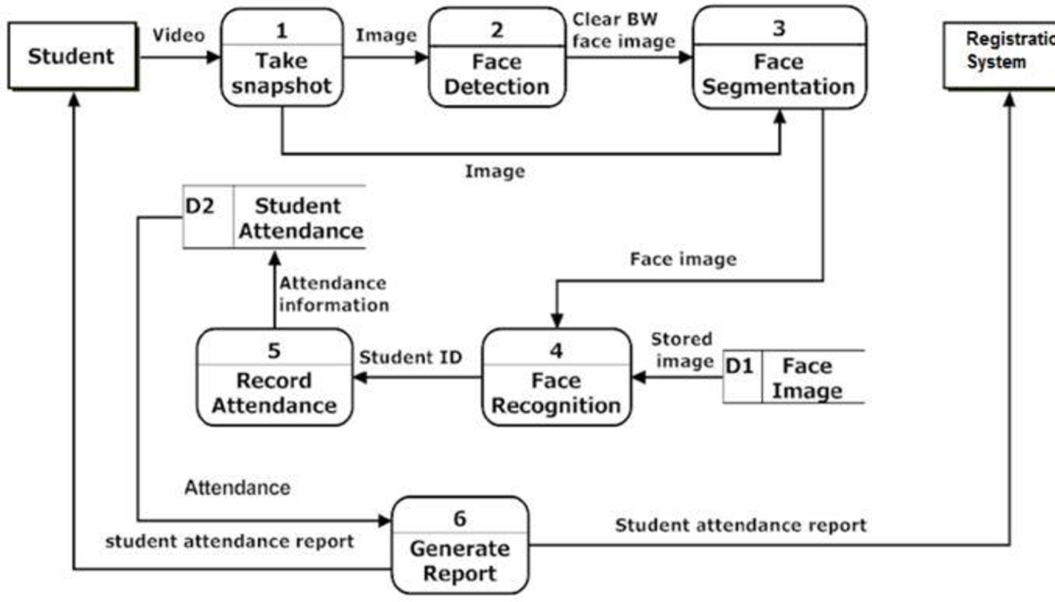
Methodology
Work flow
Image Acquisition
To get the optimal image, we are using a database that contain images captured from laptop cameras or a smartphone camera.
The aim of this stage in to convert the image into grayscale image, after the conversion all types of operations are done afterwards in the next stages.

Slide 12
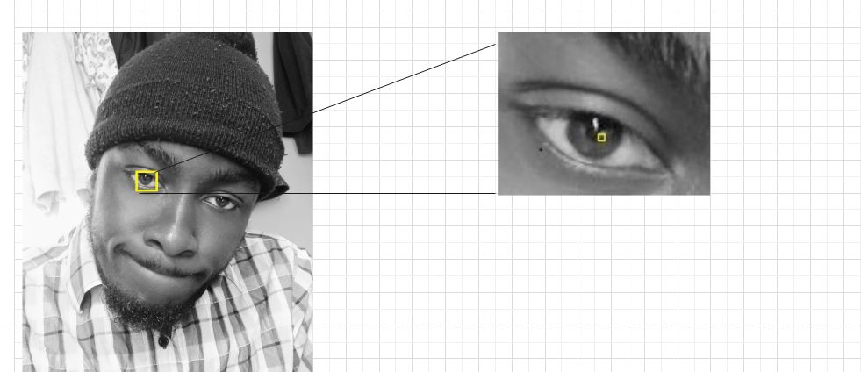
Methodology
Face Detection
In this stage the objective is to find the location and sizes of all objects in the image that belong to a given class. The recognition algorithm focus on the detection of the human face. The algorithm uses analogous solution to detect the image of person by matching it bit by bit.

Slide 13
Methodology cont
Face Recognition
Then we will check every pixel in our image, we will look each pixel as one and the ones directly adjusted to it and the surrounding pixels. Our objective in this phase is to find out how dark the current pixel and compare to pixel directly next to it and the others surrounding it. Then we draw direction to the pixels of the image that are getting darker and darker (gradients). Done using detection module
To find the required face in this HOG image, we look for image similar to HOG pattern that was analyzed and extracted from the different images used . Using the Face land mark estimation algorithm
This landmarks include; the top of the chin, shape of lips, size of nose and etc.

Slide 14
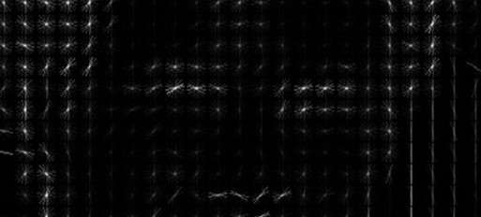
Methodology cont
Sample hog used

Slide 15
Methodology
Training Datasets
After this we will do a face encoding. This is the part used to tell faces apart. The best approach to this recognition is to directly compare the unknown face and the know faces of students that are already tagged.
The training will work in with 3 images and 3 phases at a time;
First capture and add a training image of known student
Secondly capture and add another picture of same known student
Last capture and add a picture of totally different student
The algorithm checks the three images through measurements currently generated by each image.
Retraining this algorithm a million times for hundreds of images of hundreds of different students.

Slide 16
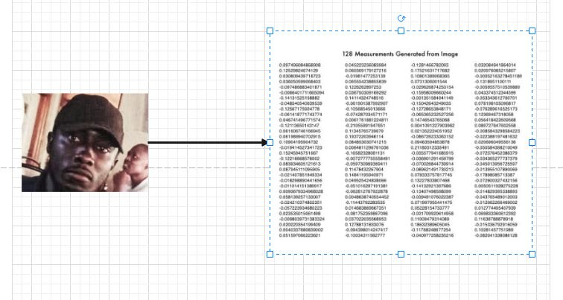
Methodology cont
Sample Image detected output that will be compared this the original image to get comparison with another real-time image

Slide 17
Methodology cont
Attendance Generation
Done using basic classification algorithm using a linear SVM classifier.
What will be required is to train the linear classifier to take the measurements of a new image and tell the know student, by finding the closest match.
Then finally we get the person name tagged image from the encoding.

Slide 18
Implementation
This window is used to capture students and allow for each student to enter their correct admission number or name.
Once enter the capture button store the data in a input folder that being our destination database where it will be fetched during recognition.

Slide 19
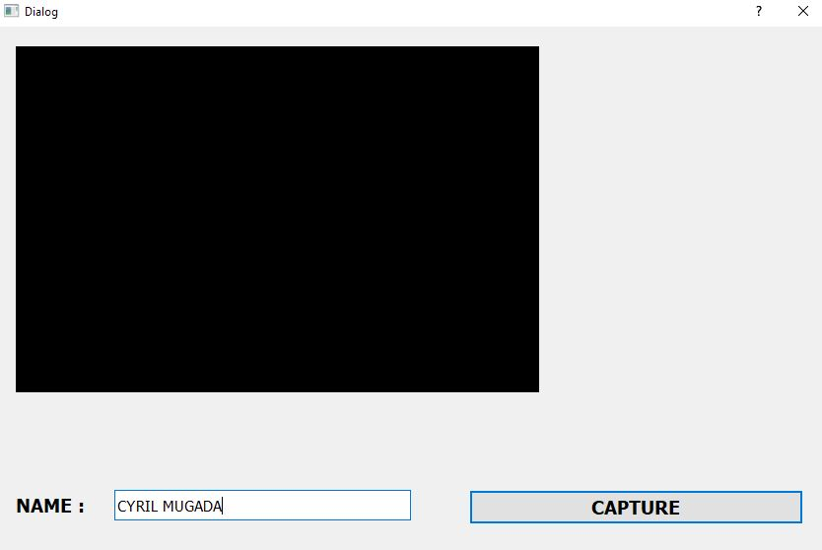
Implementation
window input

Slide 20
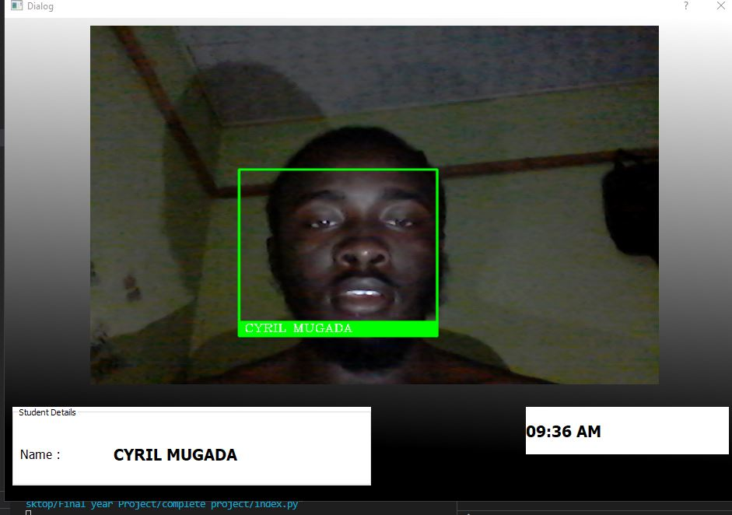
Implementation
This window is used to capture students in real-time and calls the encoding function for comparison to occur
Once the encoding is complete a Green box is drawn with the students name in the middle

Slide 21
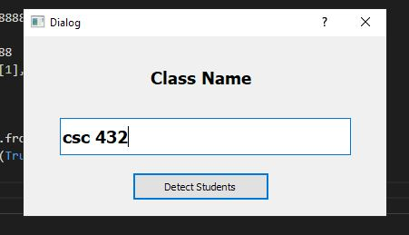
Implementation
Used to distinguish each unit or class. The excel sheet created are stored using this naming

Slide 22
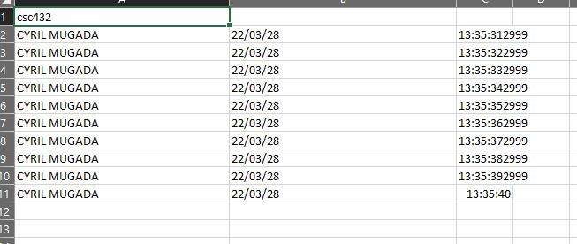
Implementation
Used to distinguish each unit or class. The excel sheet created are stored using this naming

Slide 23
Implementation

