Slide 1
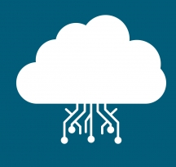
CLOUD
Solutions, Trends & Insights

Slide 2
CLOUD
Computing that relies on shared computing resources rather than having local servers or personal devices to handle applications.
Notes:
If you use your friends laptop for some processing but interact from your laptop that’s also considered as cloud computing

Slide 3
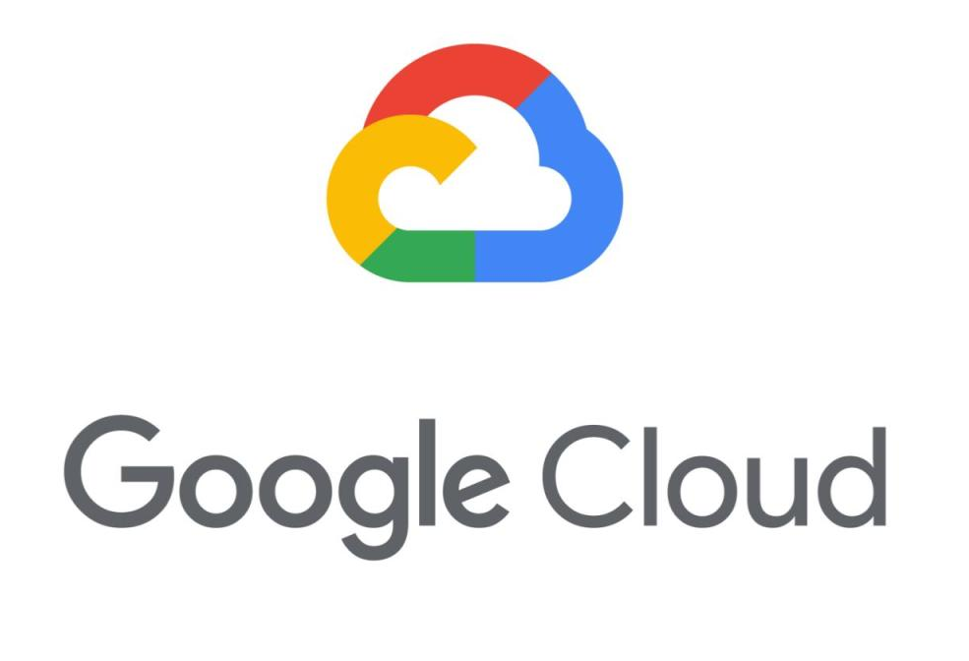
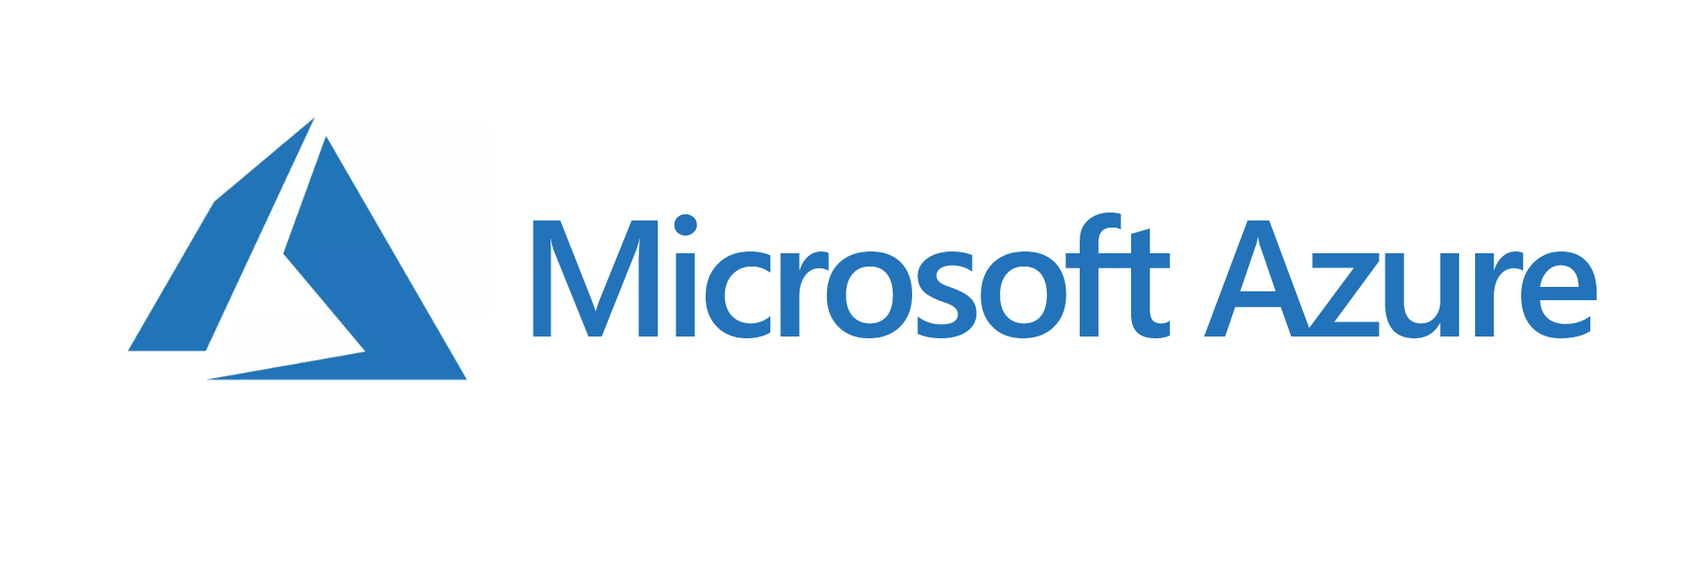

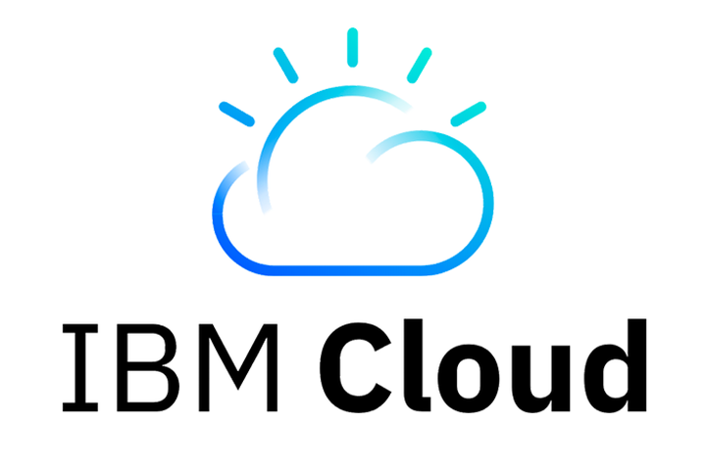
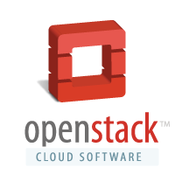
MARKET TREND

Slide 4
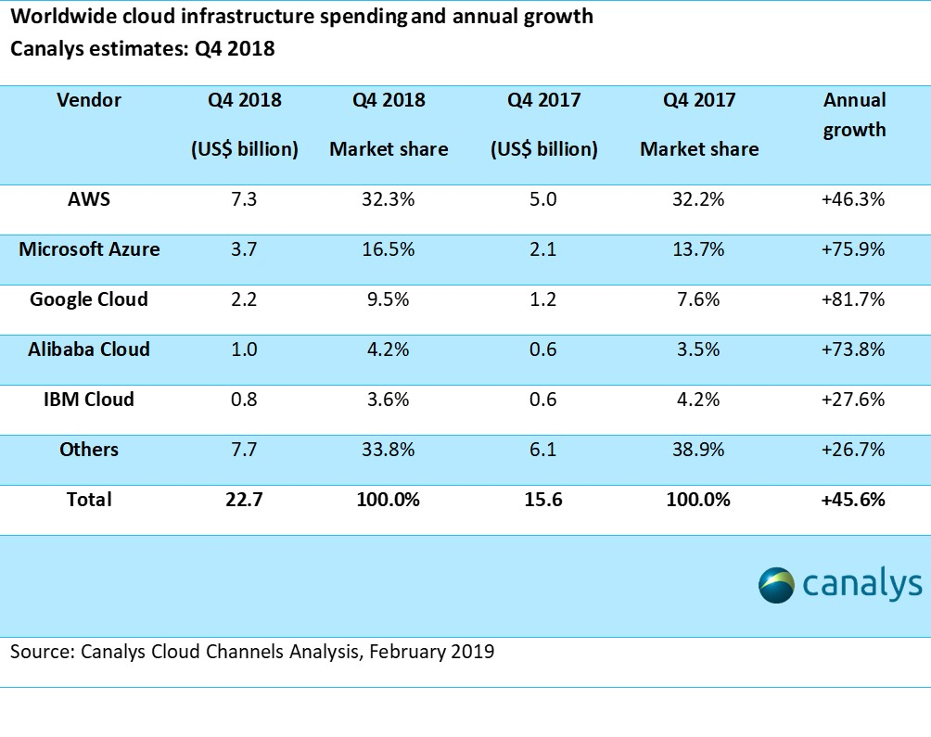
Notes:
Google Cloud: Saas | AWS: Iass & Paas

Slide 5
TYPES
SaaS
Google suite, MS Office online, Slack, Zendesk, GitHub, etc.
PaaS
AWS(Elastic Bean Stalk, Lambda), Google App Engine, RedHat OpenShift, Zoho Creator, PythonAnywhere, VMware Cloud Foundation, Oracle Cloud Platform, etc.
IaaS
AWS Cloud, Digital Ocean, Azure, RackSpace, GCE, HPE, IBM Cloud,Apache Cloud Stack, Openstack, etc.
Notes:
AWS Lambda
AWS Bean stalk
IBM
Salesforce
Azure Web APP
Oracle
Google app engine

Slide 6
WHY NOT CLOUD
Critical Data
Lesser value of the task
Privacy
**Cloud Security is one of the major concerns in present times.
Notes:
Bank transaction data

Slide 7
WHY CLOUD
Uptime
Scalability
Maintenance

Slide 8
CATEGORIES
Public Cloud
Private Cloud
Hybrid Cloud

Slide 9
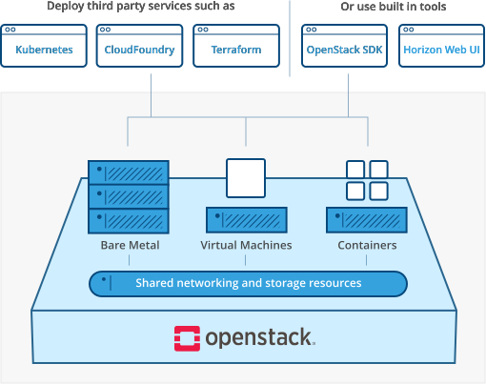
OpenStack
Best open source solution for private and public cloud.

Slide 10
CERTIFICATIONS
AWS Certified Solutions Architect
Microsoft Cloud Platform and Infrastructure (MCSE)
Google Certified Professional Architect
VMware Certified Professional (VCP)
Cisco Certified Network Associate (CCNA) Cloud

Slide 11
PROFESSIONAL CAREER
A lot of companies offer various positions like:
Cloud Software Engineer
Cloud Architect
Cloud Consultant
Cloud Security Expert

Slide 12
THANK YOU
Contact
Mugdha Adhav
Software Engineer at InfraCloud Technologies
www.github.com/mugdha-adhav
www.linkedin.com/in/mugdhaadhav
mugdha.adhav@gmail.com

