Slide 1
TravelBuddy
- Mugdha Kulkarni
- Shruti Mandke

Slide 2
Introduction
To make interactive, comprehensive and dynamic website for travelers which will guide them through their journey by facilitating them with various aspects (e.g. Flight bookings, Hotel bookings, Popular Attractions, etc.).
To work closely with Airlines, other tourism suppliers, affiliated bodies and relevant government agencies to promote tourism
To make website readable, responsive and controllable.

Slide 3
Project Overview
Web Analysis
Problem Definition
User Research
Information Architecture
Wire framing
Prototyping
Storyboarding
Usability Testing

Slide 4
Elements of User Experience
Business Objectives and User Needs
Functional Specifications and Content Requirement
Interaction Design and Information Architecture
Interface Design, Navigation Design and Information Design
Sensory Design

Slide 5
Improvements
Clumsy websites. Too much information dumped on the Home Page.
Make it more presentable.
Working on logical separation of categories to make web flow smoother and simpler.
User will get to access his older bookings to compare, if he wishes to keep records.
Suggestions based on user searches. More search oriented content flow.
Age wise options for user. Website should avoid showing unnecessary contents to user.
As the current location changes, application gives quick notifications to user what he has nearby like restaurants, beaches, clubs, weather forecast etc.
Provide online helpdesk support for users.

Slide 6
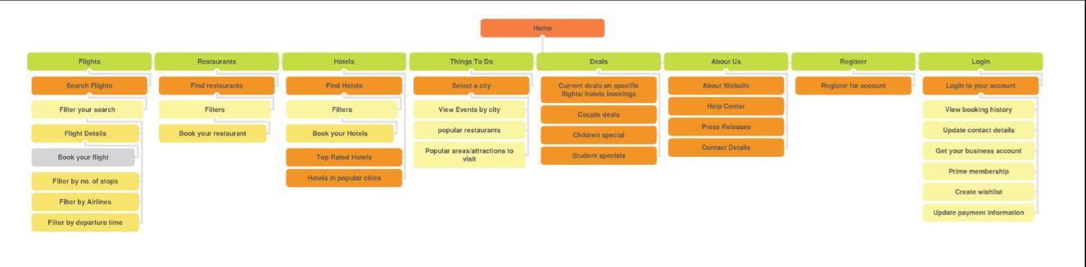
Information Architecture

Slide 7
Prototype:
http://mxnks9.axshare.com

Slide 8
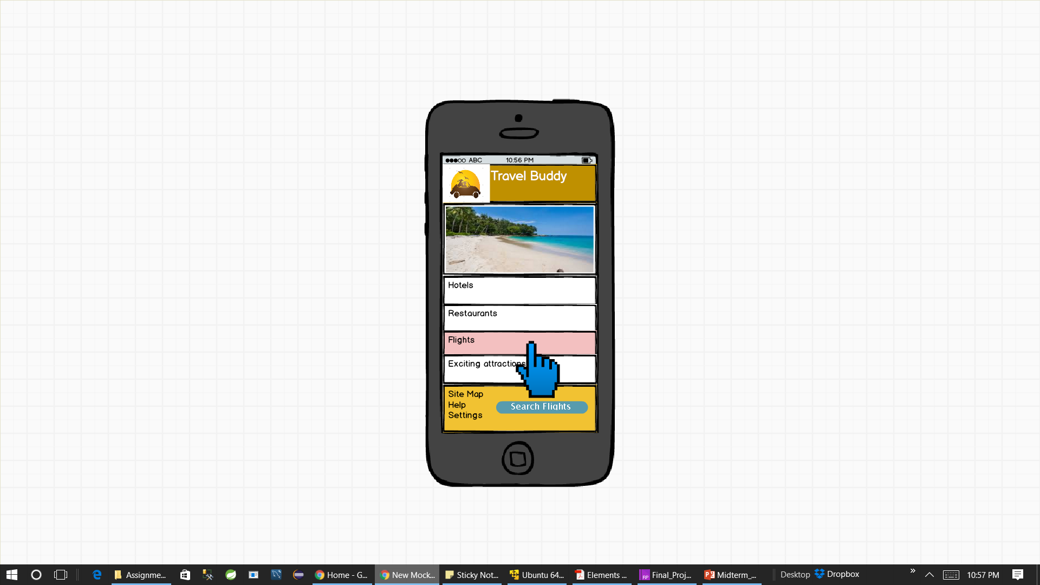
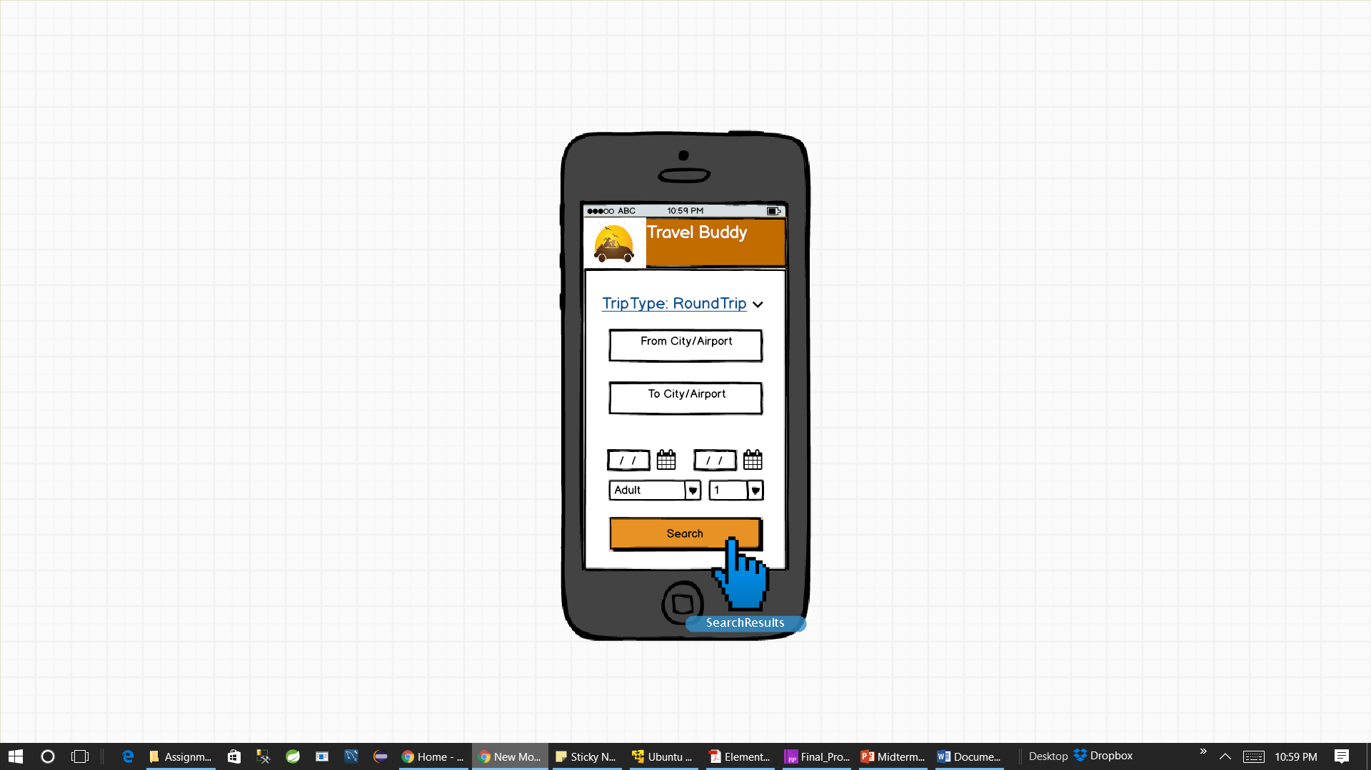
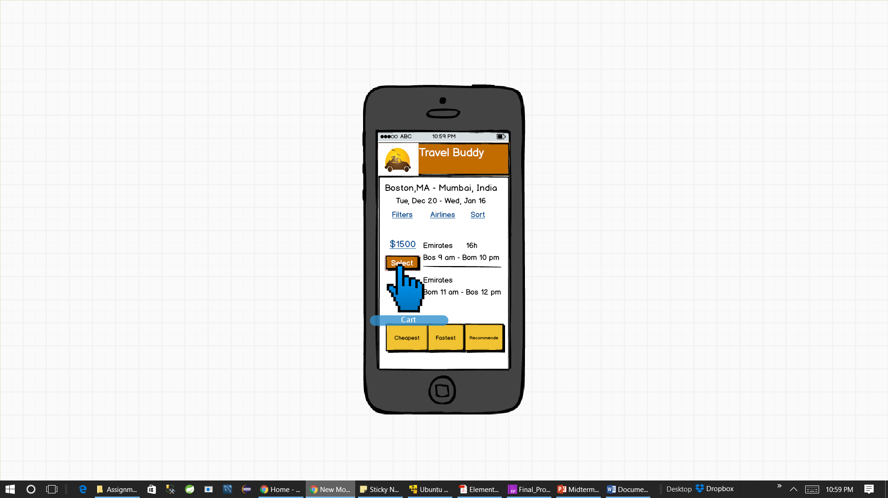
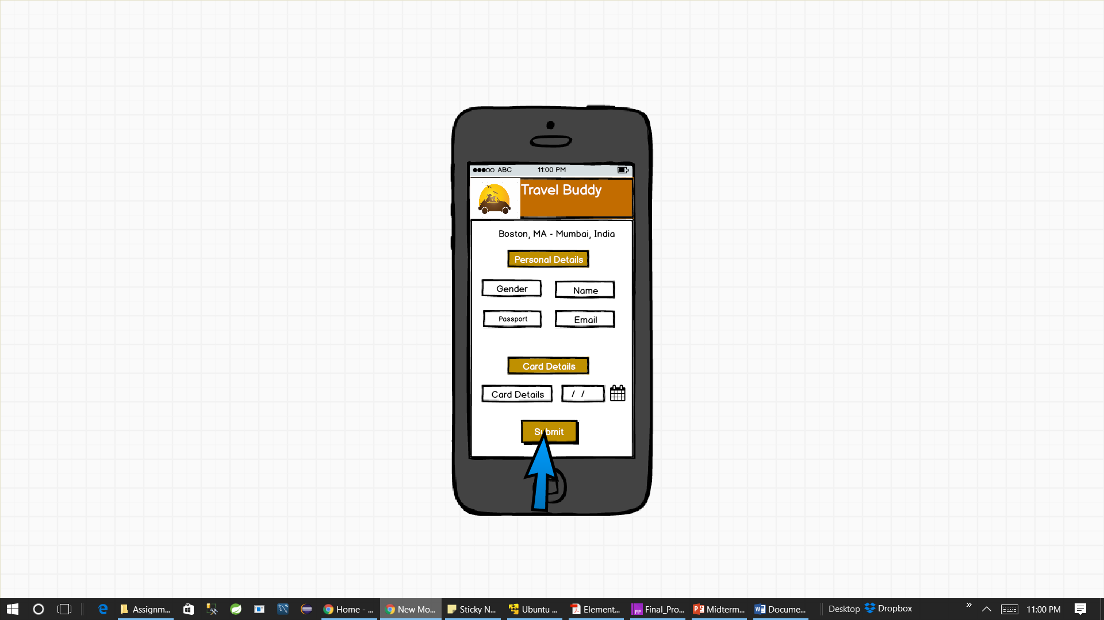
Mobile App:

Slide 9
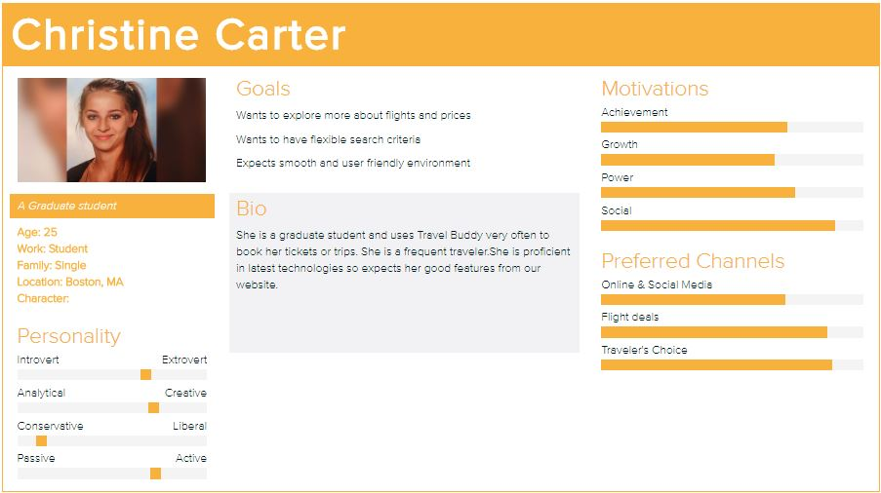
Personas

Slide 10
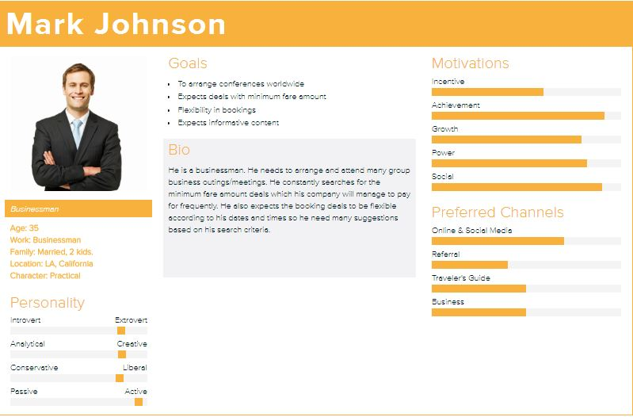
Personas

Slide 11

Storyboarding
Home Page
Flights
Restaurants
Home Page is the first page
and shows quality of website.
First impression is the best impression.
Home page can be accessed by all users.
Shows major events and functionality
the website supports
Hotels
View Nearby Events
Register

Slide 12

Flights
Search Flights
Search Flights
Apply search flights
View flight details
Accessible by all users
What airline should I select??
I want to take the fastest route
Layover

Slide 13
Usability Testing – Test Cases
Contact us/Reach Us
Search for shortest flight journey
Create your own business account
Search Sitemap
Book flight journey

Slide 14
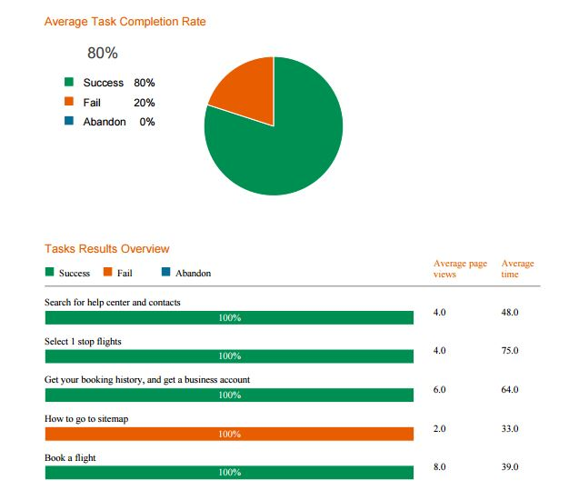
Usability Testing - Analysis

Slide 15
Card Sorting
Card sorting is a method used to help design or evaluate the Information Architecture of a site.
We created cards for each category and use case, and made applicants sort them according to their ideas and understanding.
We analyzed their performance and improved the Information Architecture of out prototype.

Slide 16
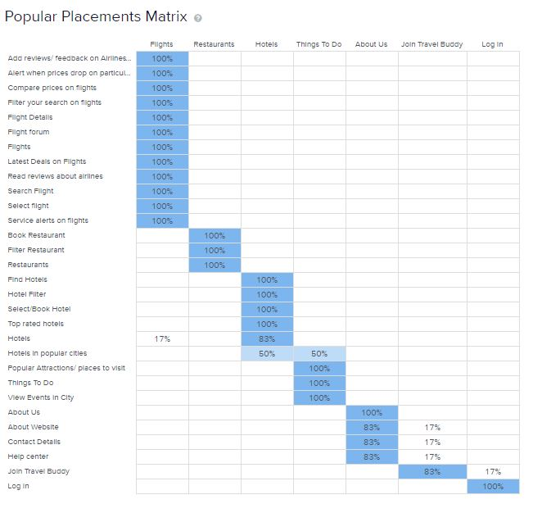
Card Sorting Analysis

Slide 17
Tree Testing (Reverse Card Sorting)
Tree testing is a usability technique to facilitate findability of topics in a website.
It is also known as reverse card sorting or card based classification.
We organized our website into hierarchy of topics and subtopics.
We created a few tasks and analyzed to see if users were able to navigate correctly.

Slide 18
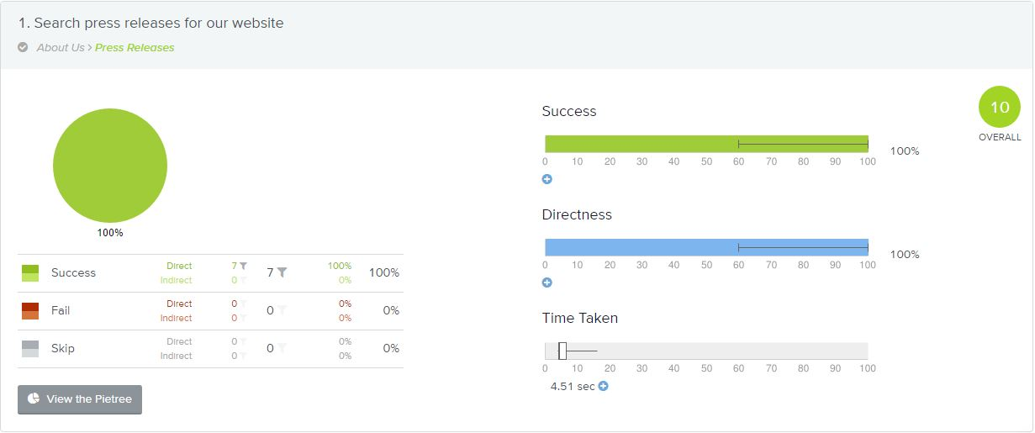
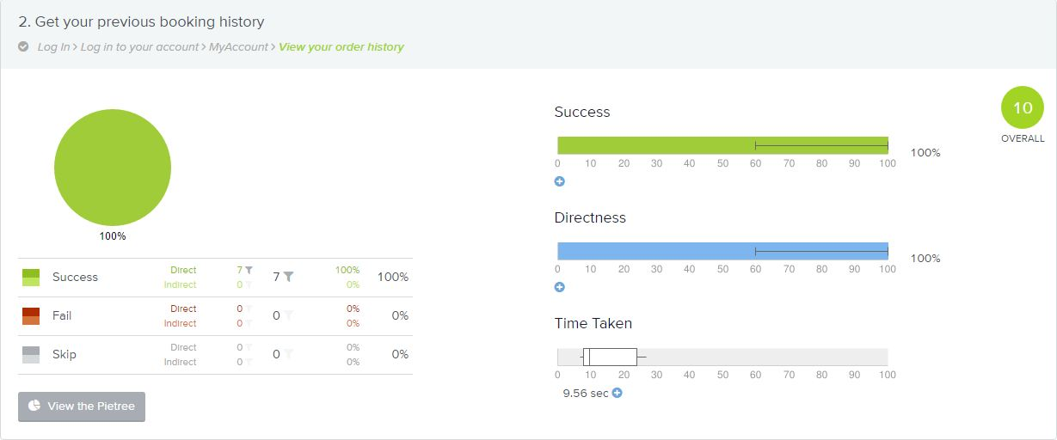
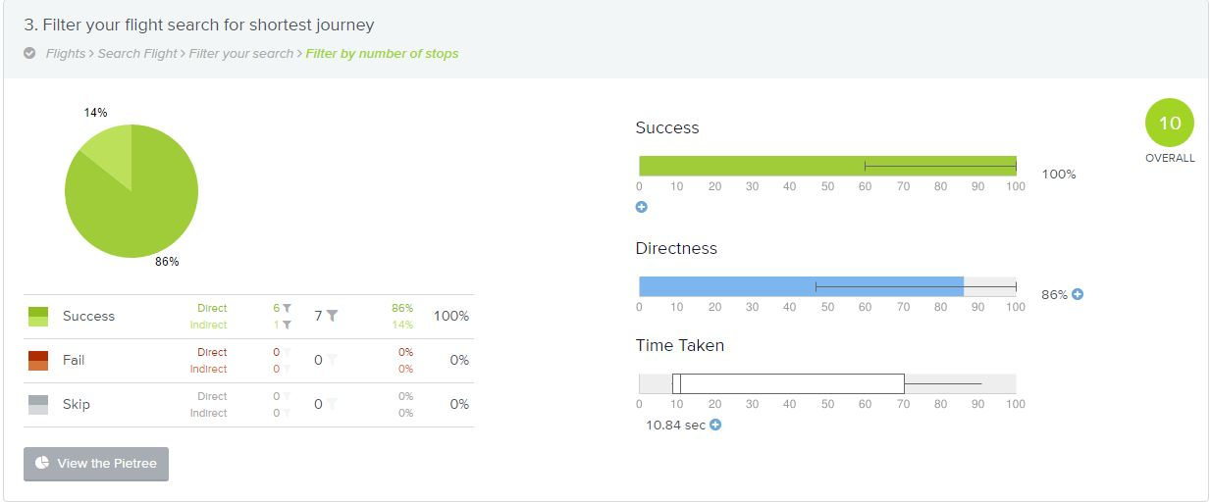
Tree Testing Analysis

Slide 19
Thank You!

