Slide 1

British Airways
Web Scrapping and Sentiment analysis

Slide 2
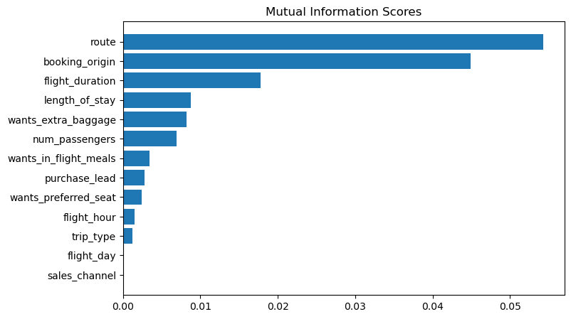
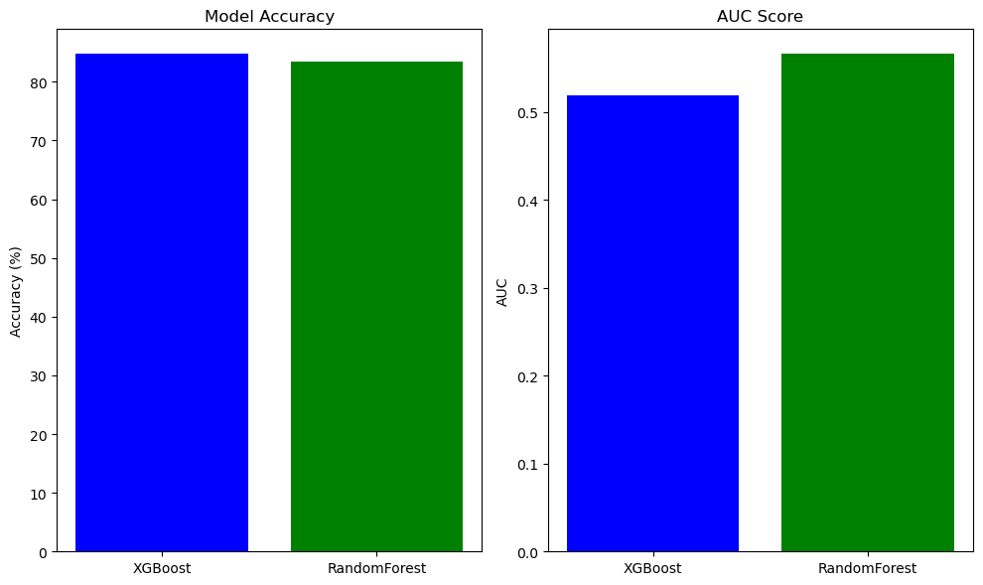
Predictive Model
Top 6 Features:
1. route
2. Booking_origin
3. flight-duration
4. length_of_stay
5. wants_extra_baggage
6. num_passengers
Models and Accuracy:
Random Forest Classifier:
ACCURACY: 83.36
AUC score: 0.5657818407546988
2. XGBoost:
ACCURACY: 84.72
AUC score: 0.5189398567740671

