Slide 1

CAR RENTAL PRICE ANALYSIS
An analysis of car rental prices using Java
Group Number: 8
By: Khushi patel(110127883), Manav patel (110127918), Mugdha Monga (110126303), Tanzeel khan (110126168)

Slide 2
Role of each member
Team Member | Roles
Mugdha Monga | Web Crawling, Data Validation
Tanzeel Khan | Web Parsing, Page Ranking
Manav Patel | Frequency Count, Spell Checking
Khushi Patel | Word Completion, Search Frequency

Slide 3
Roles and their description

Slide 4
Mugdha Monga: Web Crawling, Data Validation
Mugdha played a pivotal role in the project by leading the web crawling efforts. Using Selenium, she simulated user inputs for pickup and drop-off locations, dates, and times on various car rental websites, such as Avis, Budget, and Orbitz. Her meticulous work ensured the collection of comprehensive HTML pages containing all available car deals based on user preferences. Additionally, Mugdha was responsible for implementing robust data validation mechanisms, ensuring the accuracy and reliability of user inputs for further analysis.

Slide 5
Tanzeel Khan: Web Parsing, Page Ranking
Tanzeel excelled in web parsing and page ranking, contributing significantly to the project's data processing and analysis phase. Leveraging the Jsoup library, he efficiently parsed HTML pages, extracting essential data and mapping it to the "CarInfo" object. This recursive process was applied to all car deals, resulting in the creation of a structured JSON file, "filtered_car_deals.json." Tanzeel also implemented a sophisticated page ranking system using a Priority Queue, providing a meaningful order to the car deals based on their relevance.

Slide 6
Manav Patel: Frequency Count, Spell Checking
Manav brought expertise to multiple facets of the project. His contributions included implementing a frequency count mechanism using Jackson's ObjectMapper and Java's HashMap, providing insights into the popularity of different car deals. Additionally, Manav implemented a spell-checking feature using Trie data structure with insert and search operations, ensuring accuracy in textual data.

Slide 7
Khushi Patel: Word Completion, Search Frequency
Khushi's focus on enhancing user experience was evident in her roles. She implemented a word completion feature using a Trie data structure with an edit distance algorithm, offering users suggestions for search queries. Additionally, Khushi worked on search frequency functionality, employing a TreeMap to track and present the number of previous searches done for a specific keyword. Her contributions aimed at improving user interaction and search efficiency.

Slide 8

Outline of the project
Car rental price analysis is a project that aims to extract best deals from three different car rental websites and provide best deals and easy navigation to the user
The Three websites used here for demo are
Avis
Budget
Car Rental

Slide 9
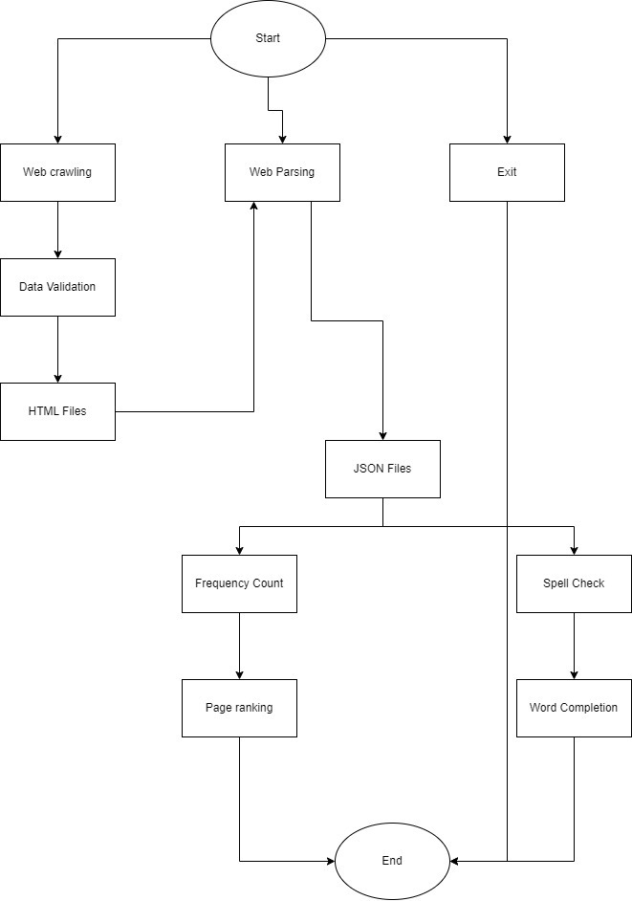

Slide 10
Features implemented
Web Crawling
HTML Parser
Page Ranking
Word Completion
Search Frequency
Data Validation Using Regex
Spell Checking

Slide 11
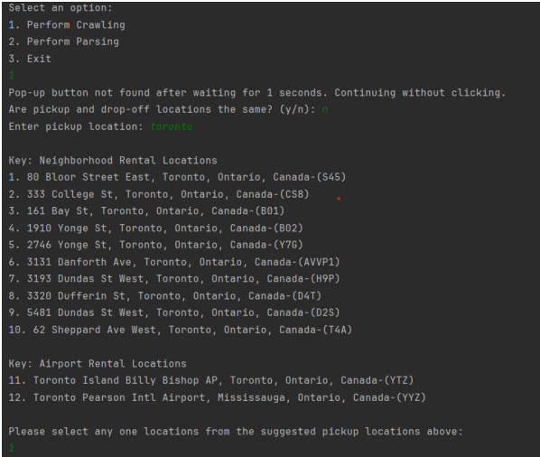
Feature Implementation
Web crawling systematically navigates websites for data extraction.
Used Selenium to imitate various user input of pickup location, drop-off location, pickup date, return date, pickup time, return time and used HashMap and lists to show the same city suggestion from website and let the user choose from the available city suggestion.
All three crawling class stores the .html page that is fetched from the website for all the available car deals based on the user preference: city, date, time
In "ByteBuds.java" file, where it initializes all the three websites driver to fetch data parallelly when user inputs his preferences (city, date, time).

Slide 12
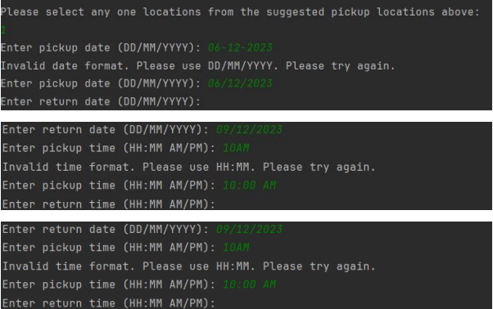
Feature Implementation
Data validation using regular expressions is performed to ensure the correct format of user inputs.
Four distinct Regex patterns validate car names, dates, times, and city names.
The implemented algorithm uses the Pattern class from the Java standard library to match input strings against the specified patterns.
The code prompts users to enter information for a car rental application, continuously validating inputs until correct formats are provided.

Slide 13
Feature Implementation
HTML Parsing involves extracting information from HTML files.
The implementation utilizes Jsoup for parsing and Jackson Objectmapper data extraction.
With jsoup parser it extracts the required data from the web elements and maps it to “CarInfo” object. It does this recursively for all the car deals in that html page, and it stores this data in three different text files: “avis_extracted_deals.txt”, “budget_extracted_deals.txt”, “orbitz_extracted_deals.txt”
In "ByteBuds.java" file, where it calls this parser class to process all *.html files available and show the best deals with different filters using the generated *.json files.

Slide 14
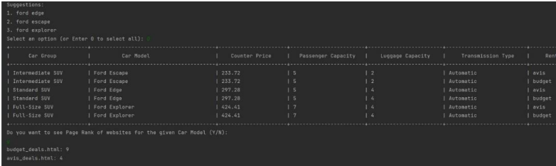
Feature Implementation
Page Ranking utilizes a basic ranking approach, primarily based on document frequencies.
It employs a map for page scores and a priority queue for sorting entries.
In "ByteBuds.java" file, inside the “filterByCarName” after user is displayed the car deals with filtered car models, he is asked to check page ranking for the given car model name. There Page Ranking class is used by giving it a keyword and then it displays the documents in a sorted ranking manner (top-to-down).

Slide 15
Feature Implementation
Search Frequency uses a TreeMap to track and sort the search frequency of car names.
It employs methods to incrementally update counts and sort the list by frequency.
Fetches the number of previous searches done for the particular keyword given.
In "ByteBuds.java" file, inside “filterByCarName” method, when user is asked to input a car model name to filter based on the car model. It reads the suggestion given by Word Completion and increases frequency count. Then gives the most searched car by user.
Word Completion implements a word completion system using a Trie data structure.
The Trie efficiently stores and suggests words based on user input. The algorithm calculates edit distances for sorting suggestions.
Fetches all the word with given prefix by traversing all the child from the returned node by “findNode”, then it uses Levenshtein Distance Calculation to sort the suggestion list with lowest edit distance being first.
In "ByteBuds.java" file, inside “filterByCarName” method, when user is asked to input a car model name to filter based on the car model. It displays the available car model names to help user with selections.

Slide 16
Feature Implementation
Spell Checking class utilizes a Trie to efficiently store and retrieve words for spell checking.
It initializes the tree nodes with the words that are given in the *.json file.
After initializing the tree, the search operation can be used to check if such word exits in the tree or not by passing a keyword.
In "ByteBuds.java" file, inside “filterByCarName” method, when user is asked to input a car model name to filter based on the car model. It is used to check if such word exits to filter the list.

Slide 17
Conclusion
Challenges:
Overcoming intricacies in web crawling, including handling dynamic elements and pop-ups.
Addressing complexities in data parsing and ensuring accurate extraction of information from HTML pages.
Web pages may contain noise, irrelevant tags, or misleading information that could affect the accuracy of the extracted data
Future Scope:
Enhancing the project's scalability to include additional car rental websites and diverse data sources.
Implementing advanced machine learning algorithms for personalized recommendations based on user preferences.

Slide 18
Project Acknowledgments
Professor Luis Rueda
For guidance, mentorship, and valuable insights throughout the project.
Graduate Assistant
Darpan Khanna
For aiding, support, and contributing to the success of the project.
Class Collaboration
Acknowledgment to the collaborative efforts of the entire class in sharing ideas and knowledge.

Slide 19
Thank you

