Slide 1
Design and Performance Evaluation of Free Space Optics and Fiber Optic Communication Systems
Sinhgad College of Engineering, Pune
Department of E&TC
B. E. E&TC
Group No: 80
Sponsored By DIAT
By,
Aditi Panganti B400230568
Mugdha Ganu B400230458
Sankalp Wasnik B400230661
Guide: Prof. (Ms.) S. S. Kamble
2025-26, Sem: II

Slide 2
Content
Introduction
Literature Survey
Aim and Objective
Block Diagram
Circuit Diagram
Components
Result and Discussion
Application
Conclusion and Future Scope
References

Slide 3
Introduction To Radio Over Fiber Communication System
In modern communication systems, the demand for high-speed, high-capacity, and reliable data transmission is continuously increasing. Free Space Optics (FSO) and Optical Fiber communication are two important technologies used to meet these requirements.
Optical Fiber communication transmits data through light signals inside fiber cables, offering high bandwidth, low loss, and stable performance over long distances. In contrast, FSO transmits data through the atmosphere without physical cables, providing easy deployment and cost-effective solutions.
However, the performance of both systems is affected by factors such as attenuation, transmission distance, and environmental conditions. Therefore, analyzing and comparing these technologies is essential to determine their efficiency and suitable applications.

Slide 4
Literature Survey
Several studies have investigated over optical fiber and Free Space Optics (FSO) technologies as potential solutions for high-speed and long-distance communication systems.
Optical Fiber Systems:
Optical fiber communication is widely used due to its high bandwidth, low attenuation, and long-distance transmission capability. Technologies like Wavelength Division Multiplexing (WDM) and advanced modulation techniques have significantly improved data rates and efficiency. Key challenges include dispersion, attenuation, and nonlinear effects, which impact system performance. Recent research focuses on coherent detection, digital signal processing (DSP), and machine learning to enhance performance and reliability.
FSO Systems:
Studies focused on FSO as an emerging optical wireless technology capable of achieving fiber-like data rates using laser-based free-space transmission. FSO systems are cost-effective, easily deployable, and immune to electromagnetic interference. However, environmental factors such as fog, rain, and atmospheric turbulence significantly affect link performance. To address this, researchers have proposed methods including adaptive modulation techniques, beam divergence control, and error correction coding to improve link stability and signal quality.

Slide 5
Literature Survey
Title | Authors | Publisher | Summary
Performance Analysis of Free Space Optical Communication System under Different Weather Conditions | Henniger H., Wilfert O. | IEEE Journal of Selected Topics in Quantum Electronics | Analyzes FSO system performance under atmospheric conditions like fog and rain; shows attenuation increases BER and reduces Q-factor.
Optical Fiber Communication Systems | John M. Senior | Pearson Education | Explains fundamentals of optical fiber communication, highlighting low attenuation and stable long-distance transmission.
Comparison of FSO and Optical Fiber Communication Systems Using Simulation | Sharma P., Kaur G. | IJARECE | Compares FSO and fiber systems using simulation; concludes fiber is better for long distance, FSO for short-range applications.
Design and Simulation of Optical Communication System Using OptiSystem | Singh S., Malhotra R. | IJERT | Demonstrates system design using OptiSystem with components like PRBS, NRZ, and MZM; evaluates performance using BER and eye diagrams.
Performance Evaluation of 10 Gbps Optical Communication System | Patel R., Verma A. | IEEE Conference | Studies high-speed (10 Gbps) optical systems at 193.1 THz; evaluates Q-factor and BER for performance analysis.
Analysis of Attenuation Effects in Free Space Optical Communication Systems | Andrews L.C., Phillips R.L. | SPIE Press | Discusses impact of atmospheric attenuation on FSO signal propagation and performance degradation.

Slide 6
Aim and Objective
Aim :-To analyze and compare the performance of Free Space Optics (FSO) and Optical Fiber communication systems using OptiSystem software by evaluating parameters such as Q-factor, Bit Error Rate (BER), and eye diagram under varying conditions of transmission distance and attenuation.
Objective :-
To design and simulate FSO and Optical Fiber systems using OptiSystem.
To analyze performance at 10 Gbps and 193.1 THz.
To study the effect of transmission distance and attenuation (3–15 dB/km).To evaluate parameters like Q-factor, BER, eye height, and threshold.
To compare both systems using eye diagram analysis.
To identify the more reliable system for long-distance communication.

Slide 7
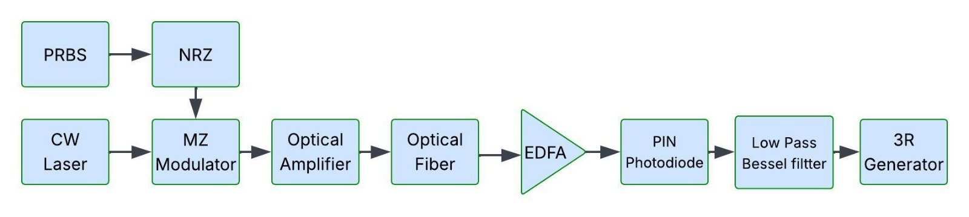
Block Diagram
Block diagram of Fiber Optic Communication System

Slide 8
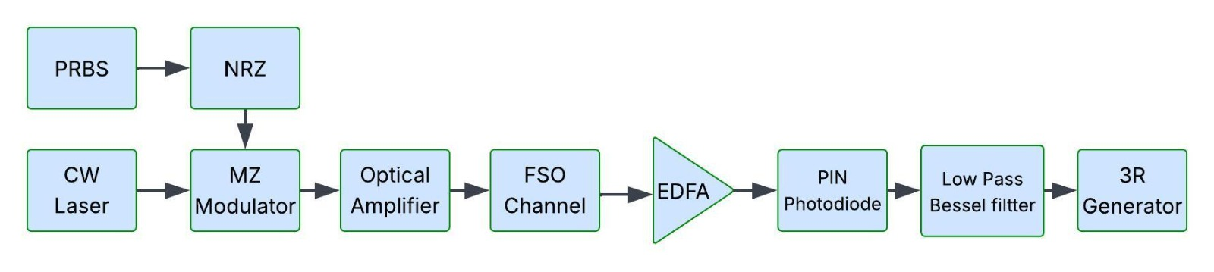
Block Diagram
Block diagram of Free Space Optical Communication system

Slide 9
Components Used
Pseudo-Random Bit Sequence Generator (PRBS): Generates a sequence of random binary bits (0s and 1s) that simulate the input digital data signal for testing the communication link performance
NRZ : Converts the binary bit stream into a continuous Non-Return-to-Zero (NRZ) electrical pulse signal, suitable for modulation.
CW Laser : Provides a continuous optical carrier signal with a specified wavelength and power, which is later modulated with the data signal.
Mach-Zehnder Modulator: Modulates the optical carrier with the electrical NRZ signal to produce an optical signal carrying the data.

Slide 10
Components Used
Optical Amplifier (EDFA) : Boosts the optical signal power to compensate for transmission losses before sending it through the FSO or Optical Fiber channel..
FSO Channel : Simulates a free-space optical transmission path where attenuation due to weather (like rain and fog) can be set to study its impact on signal quality.
Optical Fiber Link : Represents the radio-over-fiber path where optical signals travel through a fiber medium with certain length and dispersion characteristics.

Slide 11
Components Used
PIN Photodiode (Receiver) : Converts the received optical signal from each path (FSO and Optical Fiber) back into an electrical signal for further.
3R Regenerator : Performs Re-amplification, Re-shaping, and Re-timing of the received signal to restore its quality and reduce errors.
BER Analyzer : Calculates the Bit Error Rate (BER) by comparing transmitted and received bit sequences to evaluate system performance.
Optical power meter : An optical power meter is a device used to measure the power of optical signals in fiber optic systems.

Slide 12
Components Used
Eye Diagram Analyzer : Displays the eye pattern of the received signal, helping analyze timing jitter, noise, and signal quality visually.
Low Pass Bassel Filter :
Low-pass Basel filter allows signals with frequencies below a certain cutoff to pass while attenuating higher frequencies. It’s commonly used to remove high-frequency noise from signals.

Slide 13
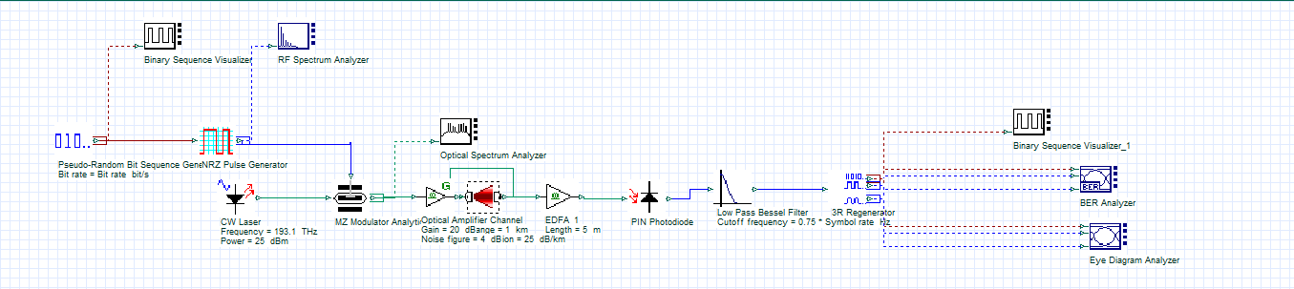
Circuit Diagram on OptiSystem
Circuit diagram of FSO system

Slide 14
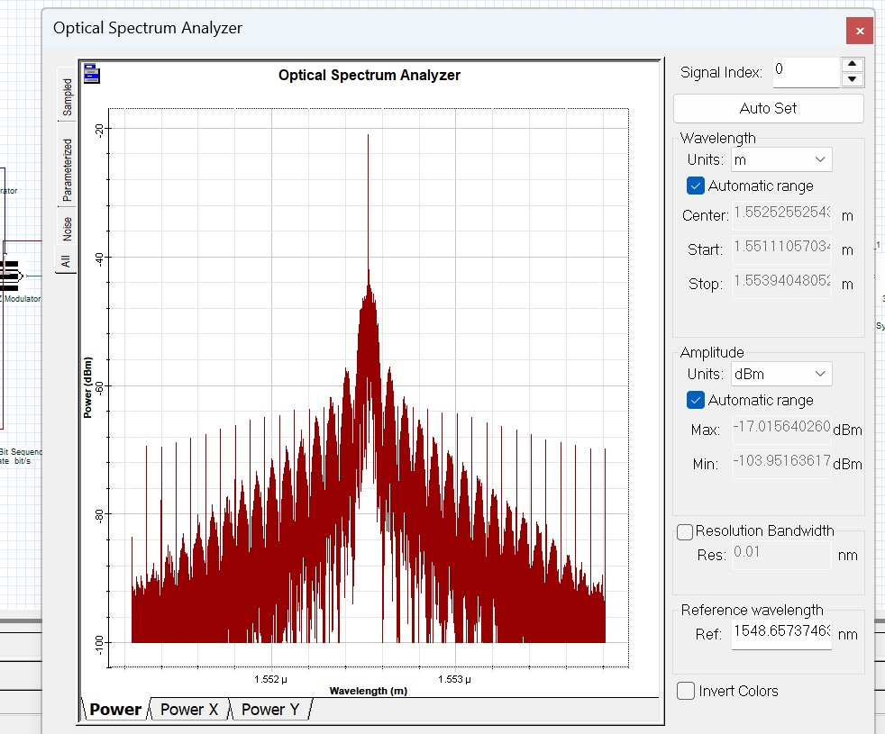
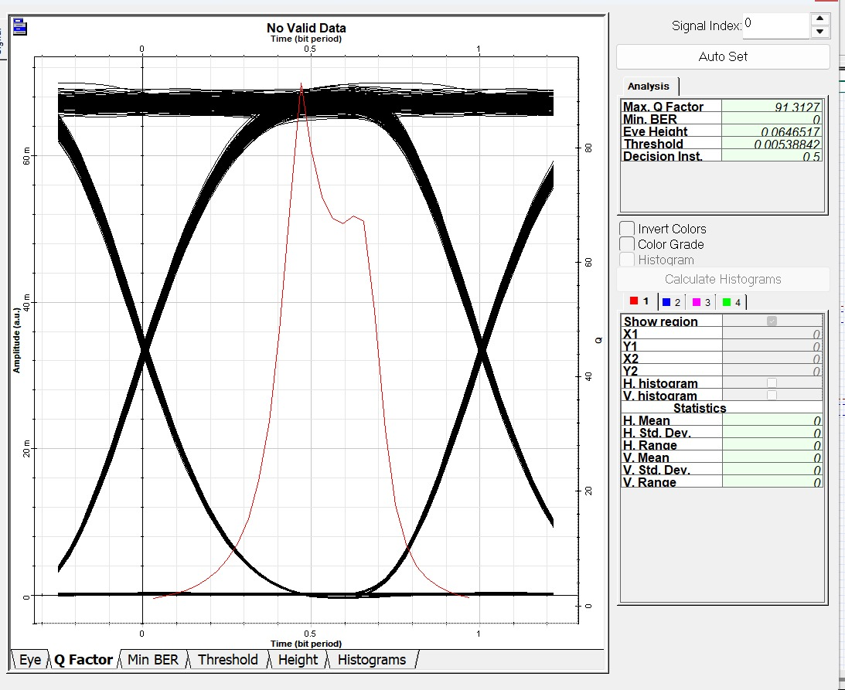
Simulation Result on OptiSystem :
FSO channel Results
FSO channel spectrum
EYE diagram

Slide 15
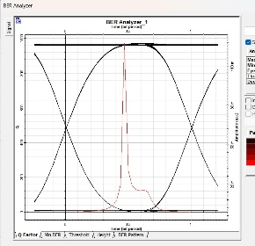
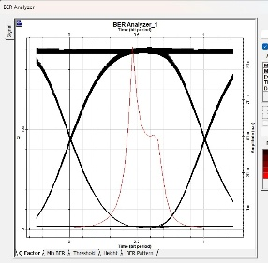
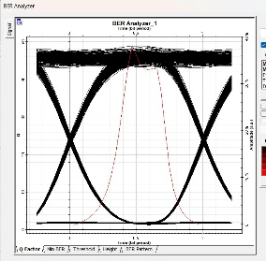
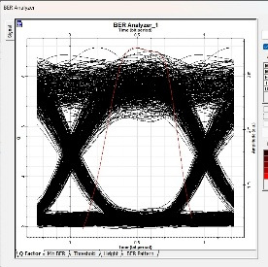
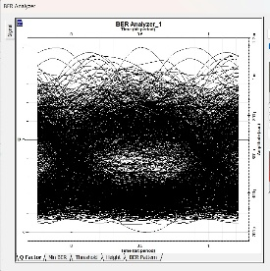
Simulation Result on OptiSystem :
FSO channel Results
Attenuation | Range (Km) | Max. Q factor | Min. BER | Eye Height (m) | Received Power (dBm)
3 dB/Km | 1 | 553.286 | 0 | 0.11758 | 22
 | 3 | 90.97 | 0 | 0.0642 | 16
 | 5 | 23.53 | 6.64142e-123 | 0.01085 | 10
 | 8 | 3.642 | 0.000121 | 0.00011 | 1
 | 10 | 0 | 1 | 0 | -5

Slide 16
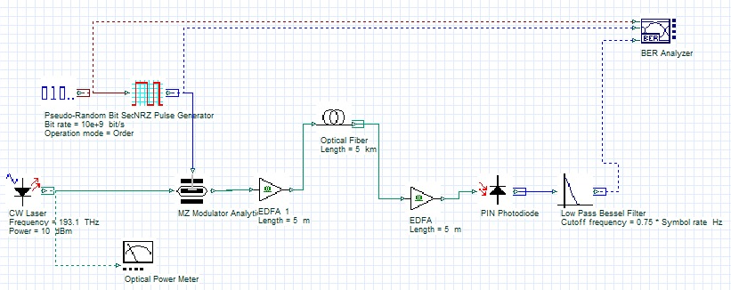
Circuit Diagram on OptiSystem
Circuit diagram of Fiber Optic system

Slide 17
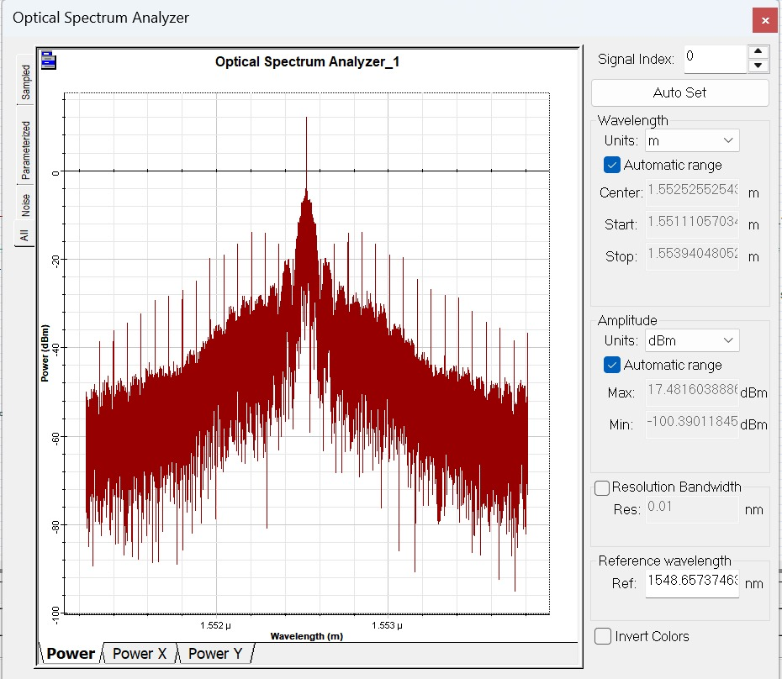
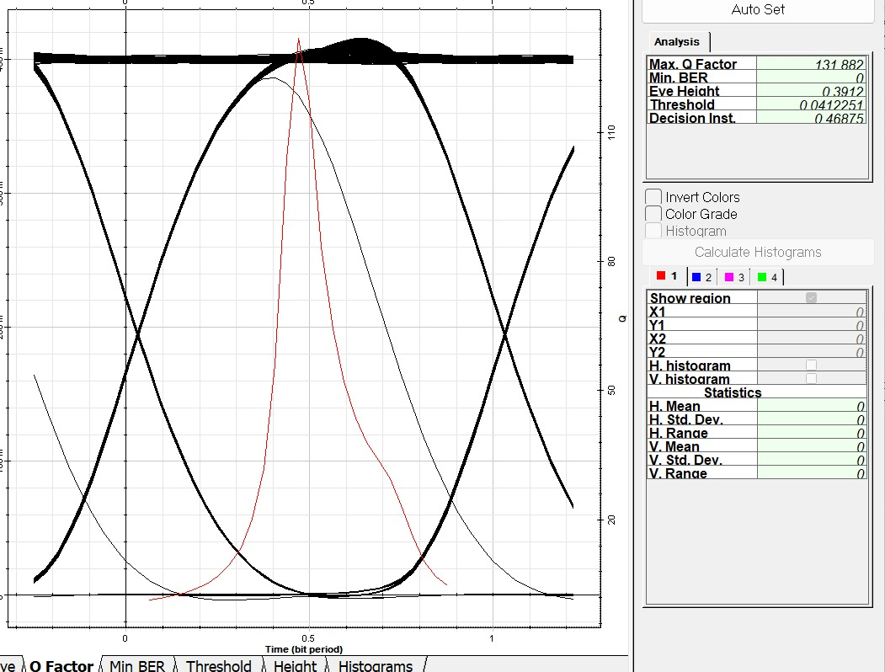
Simulation Result on OptiSystem :
Optical fibre channel Results
Optical fibre channel spectrum
EYE diagram

Slide 18
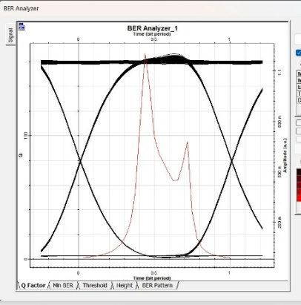
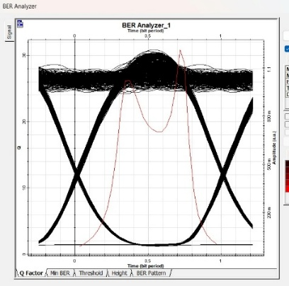
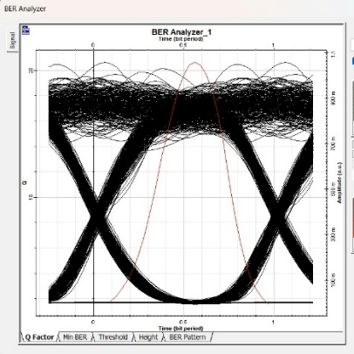
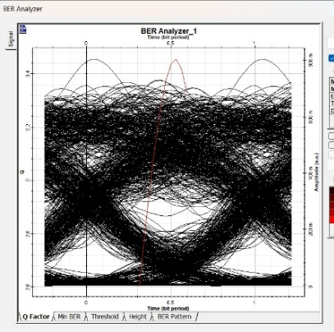
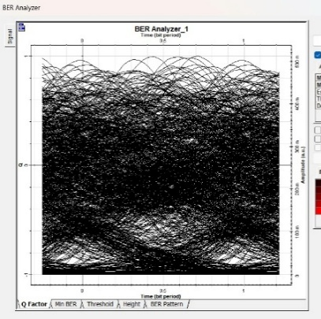
Simulation Result on OptiSystem :
Fiber optical channel Results
Attenuation | Range (Km) | Max. Q factor | Min. BER | Eye Height (m) | Received Power (dBm)
0.2dB/Km | 2 | 271.43 | 0 | 0.40607 | 24.6
 | 5 | 76.918 | 0 | 0.3653 | 24
 | 10 | 37.5327 | 1.15889e-308 | 0.30044 | 23
 | 20 | 17.37 | 4.28374e-68 | 0.21808 | 21
 | 30 | 5.63642 | 7.25109e-09 | 0.0935 | 19

Slide 19
Advantages & Disadvantages
Advantages
Optical Fiber
Very high bandwidth and data rate
Low attenuation → suitable for long distances
High reliability and secure communication
FSO
No physical cables required
Easy and fast deployment
Cost-effective for short distances
Disadvantages
Optical Fiber
High installation cost
Difficult to deploy in remote/rough areas
Maintenance can be complex
FSO
Highly affected by weather (fog, rain, dust)
Alignment issues
Limited transmission range

Slide 20
APPLICATION
Optical Fiber
Telecommunication networks
Internet backbone & broadband
Undersea and long-distance communication
FSO
Last-mile connectivity
Temporary communication links
Military and satellite communication

Slide 21
CONCLUSION :
Optical Fiber provides stable, reliable, and long-distance communication.
FSO offers flexibility and low-cost deployment but is weather-dependent.
Overall, Optical Fiber is more suitable for long-distance communication, while FSO is useful for short-range and quick deployment scenarios.

Slide 22
FUTURE SCOPE :
Development of hybrid FSO-Fiber systems for better reliability.
Use of advanced modulation and DSP techniques.
Integration of AI/ML for performance optimization.
Improvement in FSO systems to reduce weather sensitivity
Integration with 5G and 6G Networks
Satellite and Space Communication Applications

Slide 23
REFERNCES :
[1] H. Willebrand and B. S. Ghuman, Free Space Optics: Enabling Optical Connectivity in Today’s Networks. Indianapolis, USA: Sams Publishing, 2002.
[2] A. Majumdar and J. C. Ricklin, Free-Space Laser Communications: Principles and Advances. New York, USA: Springer, 2008.
[3] G. P. Agrawal, Fiber-Optic Communication Systems, 4th ed. New York, USA: Wiley, 2010.
[4] J. M. Senior and M. Y. Jamro, Optical Fiber Communications: Principles and Practice, 3rd ed. London, U.K.: Pearson, 2009.
[5] X. Zhu and J. M. Kahn, “Free-space optical communication through atmospheric turbulence channels,” IEEE Transactions on Communications, vol. 50, no. 8, pp. 1293–1300, Aug. 2002.

Slide 24
Thank YoU

