Slide 1

The New Mandate for Content
Designing Information Ecosystems for the Age of Al
Based on insights from a conversation with content strategy expert Rahel Bailie.

Slide 2



We have a new primary audience.
''We are no longer creating content just for human readers. We are creating it for the systems that help humans find what they need:'
I I
CONTENT
This fundamental shift puts the foundations of our work-information architecture, models, and metadata-under a powerful new spotlight. Getting these foundations right is no longer a
best practice; it's a prerequisite for relevance.

Slide 3

The AI Spotligh : Wh Our Old Problems Are ow Critical Failures
For years, we've managed legacy content, inconsistent metadata, and fragmented systems. Al doesn't solve these problems; it amplifies them. What were once inefficiencies are now barriers to delivering accurate, intelligent experiences. Let's examine the hidden challenges ft now demand our full attention.

Slide 4
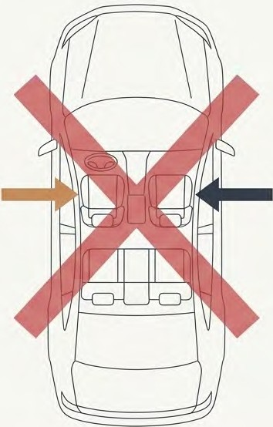
The Context Trap: When 'Right' is Wrong
'' A customer in the UK orders a wing mirror for the 'passenger side' of their car. They receive a mirror for the right side of the car. In the UK, the passenger sits on the left. The system lacked the market-specific context to deliver the correct part.
Passenger
(UK)
Passenger
(US)
Without robust metadata for language, market, and other contextual variables, Al will confidently deliver incorrect answers.
Our content must explicitly define its
context, because the machine cannot infer it.
Isl\ NotebookLM

Slide 5
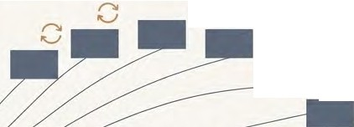

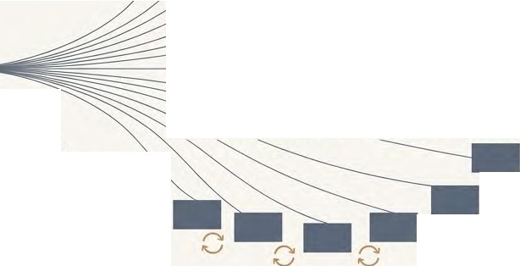




The Dirty Little Secret: The Compounding Cost of Maintenance
Content creation is only the beginning. The real, hidden cost is in maintenance.
r-,,
"'-..,I
r-,,
"'-..,I
r-,,
"'-..,I
r-,,
"'-..,I
Maintenance Cost: To update that single piece of information, you must now find and update 13 separate instances. The effort is multiplied, and the risk of inconsistency is enormous
r-,,
"'-..,I
r-,,
"'-..,I
Propagation:
That article is reused or copied into 12 other places
(different portals, manuals, knowledge bases)
r-,,
"'-..,I
Creation Cost
£100 to create one article (research, writing, reviews, sign-off).
r-,,
"'-..,I
r-,,
"'-..,I
r,,
"'-..,I
The Al Impact: If Al draws from this content lake, it has a high probability of finding an outdated, inconsistent, or incorrect version. A robust reuse strategy isn't a luxury; it's a necessity.

Slide 6
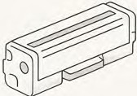

The New Standard for Success: The Right Answer, First Time
Users now expect to ask a natural language question and get a precise, correct answer on the first try.
Success is measured by avoiding a follow-up query or a call to customer support.
? I
• •
Low Stakes
"How do I change my printer cartridge?" A generic answer is unhelpful, but not dangerous. The user needs to know the specific orientation for their model, not just "put in the new cartridge."
High Stakes
"What is the correct dosage of this medication for an infant?" or 'Which investment option should I choose?" In these cases, an ambiguous or incorrect answer delivered by an Al can have life-changing consequences.
Our responsibilityis to provide the granular, structured information that ensures Al can deliver with 100% accuracy when it matters most.

Slide 7


The Blueprint: The Kinetic Information Ecosystem
To meet the demands of Al, we can't just fix individual problems. We need a new model for our content. This model treats information not as static documentation, but as a dynamic asset, ready to be activated by an external stimulus-like an Al query. We call this "Kinetic Information."
•
►
Al Query
•
•
•
•

Slide 8
The Three Pillars of a Kinetic Ecosystem
Authoring: The Foundation
Semantics & Orchestration: The Intelligence Layer
Delivery: The Experience
-
□□□□
�
L::
0
What it is: Assembling and delivering the right content to the right user in the right format.
What it is: Creating componentized, semantically-rich content.
> What it is: Building the relationships and context around the content.
The Tool: Production-grade tools like a CCMS, not a 'home kitchen' setup like Microsoft Word.
The Tool: Knowledge Graphs and Retrieval-Augmented Generation (RAG) models.
The Channel: Can be anything: PDF, HTML, Chatbot, Augmented Reality glasses, etc.
Analogy: The Doughnut Factory. You can't supply a city from your home kitchen; you need an industrial production line.
Analogy:A Mind Map. A knowledge graph isn't a simple hierarchy; it's a web of interconnected concepts.
Analogy: The Final Product. The same 'dough' from the factory can become a glazed donut, a filled donut, or a donut hole, depending on the customer's order.
/iS\ NotebookLM

Slide 9

Structure isn't a suggestion. It's a mathematical advantage.
The Experiment
The IRDS (International Registry for DITA-based Schemas) tested the accuracy of Al-generated answers based on different source content types.
85%
25%
Accuracy from highly structured content using a delivery schema + a knowledge graph.
Results are consistent and reliable.
Accuracy from unstructured content like Word documents or PDFs fed directly to an LLM. Results are unreliable and inconsistent.
'Garbage in, garbage out' is no longer strong enough. With Al, it's 'Garbage in, amplified garbage out.' Investing in structure provides a measurable, 3x improvement in the quality of Al-driven results.
I'S\ NotebookLM

Slide 10
How Structure Delivers Precision: The Dosage Test
Scenario: An LLM needs to find the correct medication dosage from a document.
Unstructured Content (e.g., a PDF) Structured Content (e.g., DITA/XML)
{
]
[
- ]
[--
<dosage audience="infant">2ml</dosage>
[-
X
✓
For infants, take 2ml.
[
]
The document uses formatting like italics for subheadings:
For adults, For teenagers, For children, For infants.
The LLM cannot reliably distinguish these audiences based on visual styling alone. It might grab the wrong dosage, as it lacks explicit context.
Result: High risk of critical error.
Each dosage instruction is tagged with specific metadata:
<audience="infant">, <audience="adult">. A knowledge graph connects these tags to defined user personas.
The LLM can use thisexplicit, machine-readable context to retrieve the exact correct dosage for the user's query.
Result: High accuracy and safety.
Isl\ NotebookLM

Slide 11




Your Role is Evolving: From Writer to Curator
The Playbook: Putting the Ecosystem Into Practice
Old Model
We were primarily writers. Our job was to create comprehensive documents (chapters, PDFs, articles).
New Model
We are now curators of content and context.
Our value isn't just in creating new words, but in structuring existing information.
We are the managing editors of our content ecosystem, ensuring every micro-fact is findable, accurate, and connected.
We add the semantic layer that makes content intelligent.
-
Writer
Curator
"We are now becoming curators as opposed to just writers... We're missing a trick here if we combine our skill set to only writing." - Rahel Bailie

Slide 12


The Path Forward, No Matter Your Starting Point
Use fit-for-purpose, production-grade tools.
For Small Teams / Startups
For Large Organizations
The Goal: Leverage scale and integrate systems.
The Tools: A full CCMS, dedicated knowledge graph software, and a Content Delivery Platform (CDP).
The Process: The LLMs within modern CDPs can alleviate some of the manual tagging burden, but the foundational Information Architecture must be sound. Look for opportunities to connect with other departments and reuse their systems or licenses.
The Goal: Start building structure now. Consistency is key.
The Tools: Markdown and GitHub can be a powerful start. An Oxygen XML Editor license provides a "modest CCMS for one."
The Process: Maintain your taxonomy in an Excel spreadsheet if you have to. What matters is that you have a taxonomy and apply tags consistently.

Slide 13
Clarity for the Machine is Clarity for the Human
Does making content better for Al make it worse for humans?
No. The principles that make content machine-readable often make it clearer for all readers.
Ambiguous
Open the cover. If DIis stuck, apply
pressure.
Clear
Open the cover. If the P2240 access panel is stuck, apply pressure.
Using precise nouns instead of pronouns removes ambiguity for the LLM. It also dramatically improves readability for human users, especially non-native speakers or anyone scanning the text quickly. The machine becomes a proxy for your clearest, most focused user.

Slide 14



Three Strategic Imperatives for an Al-Ready Future
1. Start with the ROI.
2. Work Backwards.
3. Commit to Continuous Learning.
This field is evolving monthly. Stay informed. Follow the practitioners who are experimenting and sharing their findings. Your expertise is your most valuable asset.
First, define the business goal. Are you trying to reduce support calls? Enable self-service? Guarantee 100% accurate
delivery for compliance? The 'what' and 'why' must come before the 'how.'
Once you know the goal, map the path to get there. The desired end-state dictates your content strategy, your day-
to-day practices, your team structure, and the tools you need to acquire.
Isl\ NotebookLM

