Slide 1


If your content isn't built for machines, it's built to fail.
*
f.t�.:;of�.
_,_,,,.,....,... ,._,,iv'
''If content can't be parsed by a machine, mapped or trusted by" �"(
"'9flliQll ....,,u• j>1f
"'1--1+-•..,,.,.
some kind of large language model or maybe an agentic system, it's
going to fail no matter how well
.r�- ,
written it is, no matter what ou� i • �t ....,.:...
intent is." ���:i ---b,-t-r:x...:::t
""'k? M• ---,.I=:=::...
�
I U(lAtl.t.fA
- Scott Abel
--
MNW>, OOfW..:-.
a..,...,1,1(11,.
-----<--'

Slide 2
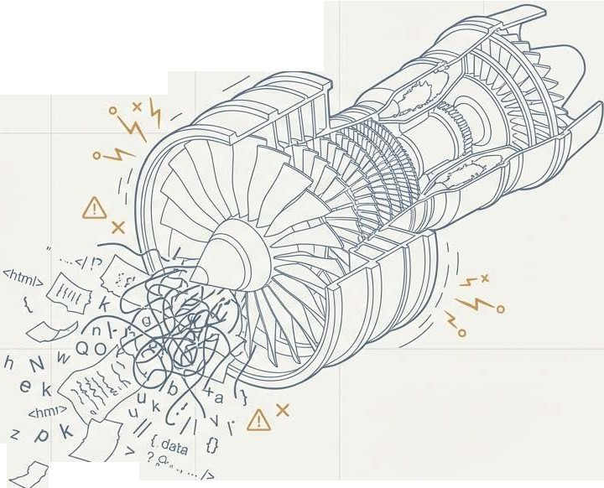
The Al revolution runs on content. Most of it isn't ready.
/--------
--
An MIT study found that most enterprise Al pilots fail due to poor underlying data and content, not the Al technology itself.
Currently, 90% of agentic Al projects are considered failures for this exact reason.
The bottleneck to Al success isn't the algorithm; it's the lack of structured, governed, and metadata-enriched content that machines can trust and reason over.
,... . l
I

Slide 3

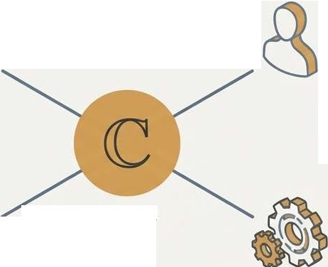


Your audience is no longer just human.
Machines
(Chatbots, LLMs, Al Agents)
••
End Users
(Prospects & Customers)
.,.,
Developers �
(API Consumers) /}
Content
Internal Teams
(Support & Product)
Core Mandate:
The same source of content must perform flawlessly across the web, embedded UI, developer portals, and Al-driven assistants-without fragmentation or reauthoring.

Slide 4
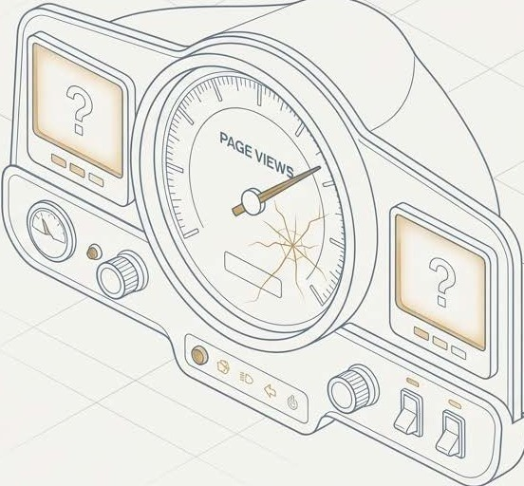
The metrics we used to trust are now just secondary signals.
Page Views measure traffic, not effectiveness.
A high-traffic page could simply mean the product is confusing₁ not that the documentation is helpful.
Page-level ranking is less meaningful when answers are delivered by in-product bots or assistants that never "view a page."
What they don't tell you:
Did the content solve the user's problem?
Was the information correct?
Did the structure support Al reuse?
Did it reduce business costs?
V
The New Role for Old Metrics: They are useful as signal indicators (e.g., a spike in views might signal user confusion), but they are not primary measures of success.

Slide 5

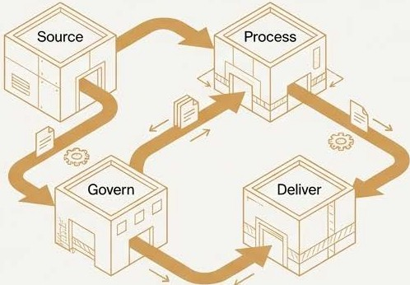

The new definition of success is a shift in focus.
�-
1
FROM
Is thedocumentation clear? (An aesthetic, subjective measure)
TO
Does the documentation reduce friction? (A functional, measurable outcome)
We are no longer just delivering the experience.
We are engineering the content that helps the machine deliver the experience.

Slide 6




The New Playbook: Measuring Machine-Readiness and Efficiency
Parsibility
How often does an LLM misinterpret or misuse your content? This measures the content's structural integrity and clarity for non-human readers.
Reuse Ratios
How many times is a single piece of content repurposed? This measures the ROI on content creation ina structured authoring environment.
Terminology Accuracy
Is terminology consistent across all systems and channels (help portal, support scripts, UItext)? This measures the coherence of the knowledge base.

Slide 7



The New Playbook: Measuring User and Business Effectiveness
First Contact Resolution Accuracy
How accurateis the answer provided by an Al system on the first try? This directly measuresthe quality and trustworthiness of the underlying content.
Support Ticket Deflection
Can you attribute a reduction in support tickets to aspecific piece of content that provided a resolution?
Task Completion Rates (Human&AI}
Were users (both human and bot) able to successfully completethetask they set out to do using the content?

Slide 8
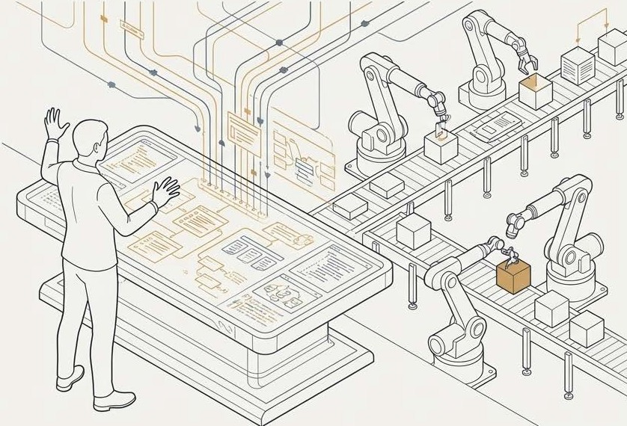
Your role is evolving from Content Creator to Content Orchestrator.
Writers are no longer judged just on writing. Thenew discipline requires a different set of skills and responsibilities:
Knowledge Modeler: Structuring information somachines can reason over it.
Systems Thinker: Establishing workflows for continuous, automated delivery.
Governance Expert:Maintaining terminology, rules, and content systems.
Al Orchestrator: Building and managing the "content factory" itself, not just working on the assembly line.
This is a shift to a "data discipline.'' building durable systems and processes that empower the next generation of authors and Al.
NotebookLM

Slide 9








To prove your value, you must speak the language leaders already understand.
What We Want to Talk About
Neue Haas Grotesk Display Pro Medium
What Leadership Cares About
Neue Haas Grotesk Display Pro Medium
Structured Content
Revenue Growth
Parsibility
Operational Costs
Reuse Ratios
Customer Retention
ru Time-to-Market
Content Models
The Bottom Line
Your most important job is totranslate your team's work into themetrics thebusiness alreadyuses tomeasure success. Don't try to convince them tocare about structured content; show themhow structured content drives theoutcomes they care about.

Slide 10
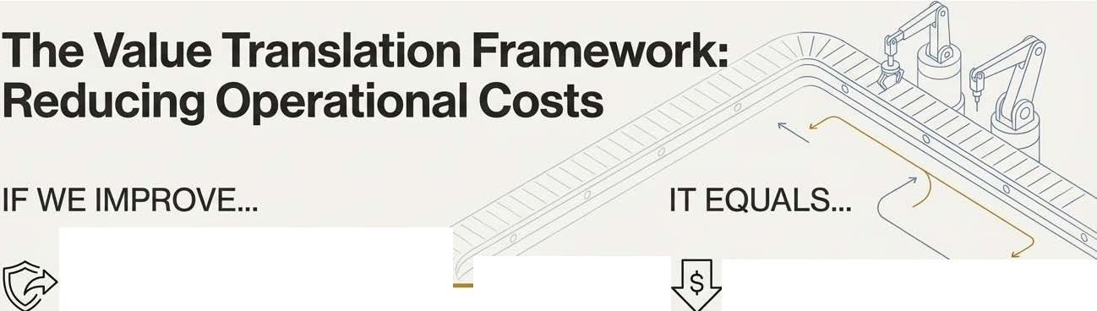






Support Ticket Deflection & First Contact Resolution
)
Lower Support Labor Costs
Content Update Velocity (from weeks to hours)
Reduced Rework Hours & Burden on Engineers/SMEs
o Faster Time-to-Market for Updates
Reduced Content Debt

Slide 11
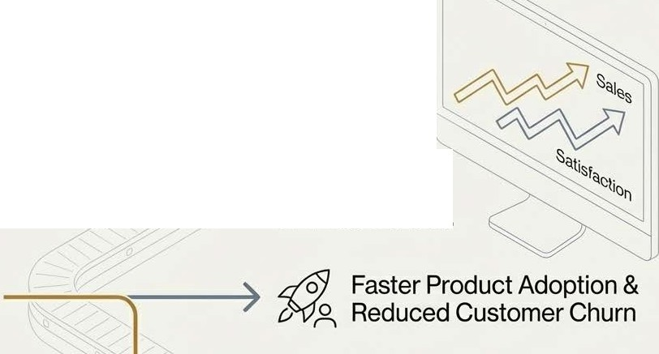


The Value Translation Framework: Increasing Revenue & Retention
IF WE IMPROVE... IT EQUALS...
� Time-to-Value &
Onboarding Time
-="-'
a�Al Answer Accuracy
�,> Higher Conversion Rates in the Sales Cycle
\cJQ for Prospects
0
�� ®;i,
Documentation-Driven Adoption Signals
0⁰0
�
Increased Customer Satisfaction & Retention

Slide 12
A case in point: They might not want savings, they might need sales.
A CEO was asked byhis board to deliver an 8%increase in sales. His job depended on it.The content team came to him offering aproject that would save the company $500,000. The CEO's response: "That's nice. But can you help me make 8°/o? If I spend $100,000 on your project and fail tomake my 8% commitment, they will ask me why I funded a project that had nothing to do with myprimary goal."
The Lesson: Always map your value proposition to what leadership is a/read
responsible for delivering.

Slide 13
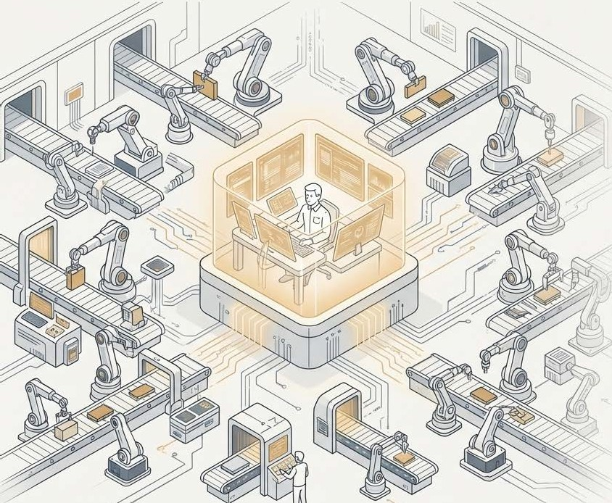
The future is not using Al to write, but to orchestrate the entire content operation.
Imagine Alagents acting as your team:
An agent debates content changes based onstyle rules.
An agent generates aprioritized report of recommendationsover the weekend.
An agent monitors the livedocumentation to ensure the approved changes were actually implemented.
Tools like Promptitude andImmerse are not just for generating text;they are orchestration layers that allow you to build,manage, and automate these complex content workflows.
Your expertise lies indesigning,building, and managing this intelligent system.You become indispensable.

Slide 14
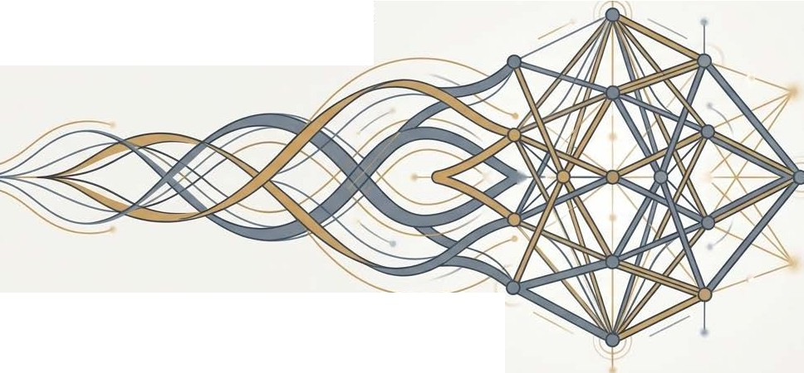

From Crafting Pages to Engineering Intelligence
I r
Our discipline is no longer about the craft of writing individual pages.
It is about the engineering of an intelligent content ecosystem.
Success means creating content that is structured, governed, and enriched, enabling machines to deliver precise, frictionless experiences that directly drive business value.

