Slide 1

Pitch
www.parkhere.in
Copyright © 2012 ParkHere.in

Slide 2

ParkHere.in is a nifty mobile app that helps you find parking spaces near you.
It shows all parking lots closest to wherever you are, with details like paid or free parking, capacity, parking charges, open hours, even street-side parking (P1/P2).
With ParkHere.in, you can:
• Find a parking space quickly.
• Park your vehicle at safe places.
• Avoid No-Parking zones and illegal parking.
• Never worry about Traffic Police towing away your vehicle.
Right now, ParkHere.in’s Android version is available for Pune city.

Slide 3
How does it work?

Slide 4

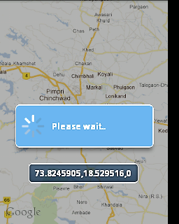
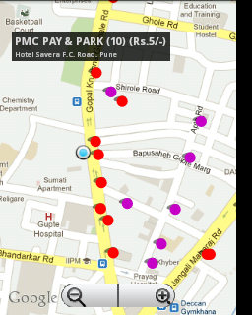
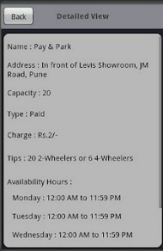
1
2
3
4

Slide 5
Making Money

Slide 6
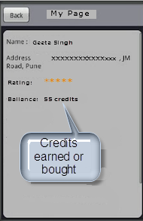
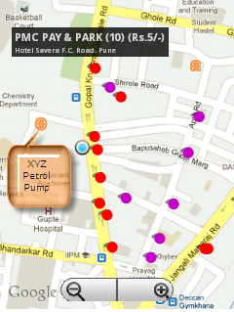

Slide 7
How to find us?

Slide 8
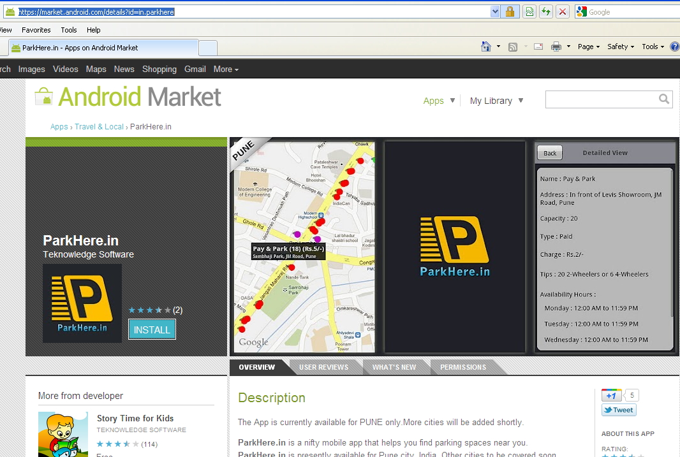

Slide 9
www.parkhere.in
Android Market: Apps › Travel & Local › ParkHere.in https://market.android.com/details?id=in.parkhere
http://www.facebook.com/ParkHere.in
http://twitter.com/#!/parkherein
contact@parkhere.in
Copyright © 2
012 ParkHere.in
Copyright © 2012 ParkHere.in

