Slide 1
Hidden Surface Removal

Slide 2
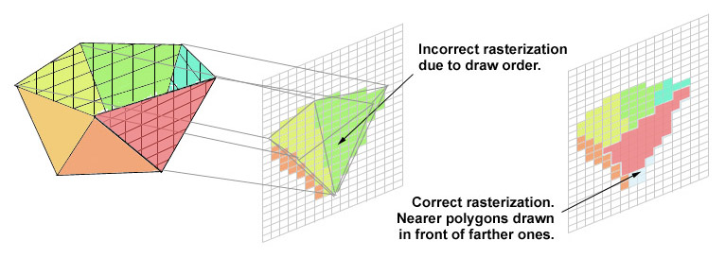
Hidden Surface Removal
Depth Sorting
Given a collection of polygons:
What order do we draw them in?

Slide 3
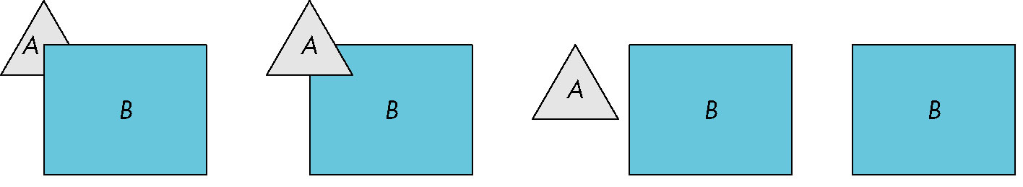
Hidden Surface Removal
Object-space approach: use pairwise testing between polygons (objects)
Worst case complexity O(n²) for n polygons
partially obscuring
can draw independently
Angel: Interactive Computer Graphics 5E © Addison-Wesley 2009

Slide 4
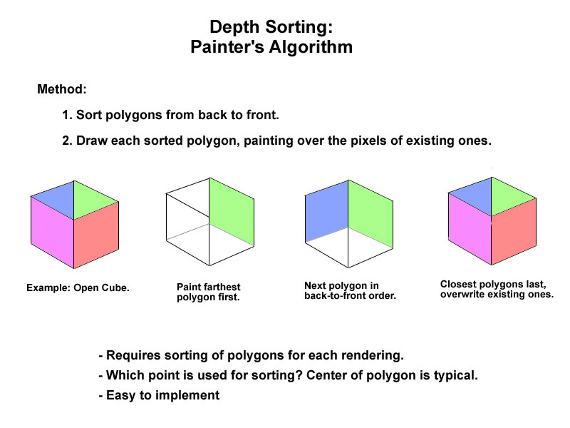

Slide 5
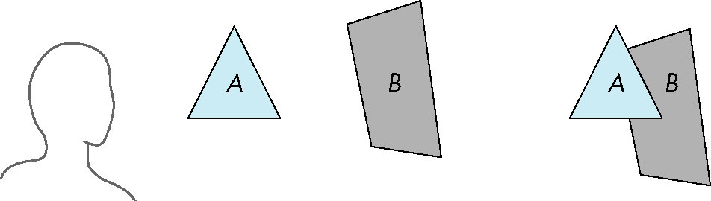
Painter’s Algorithm
Render polygons in back to front order so that polygons behind others are simply painted over
B behind A as seen by viewer
Fill B then A
Angel: Interactive Computer Graphics 5E © Addison-Wesley 2009

Slide 6
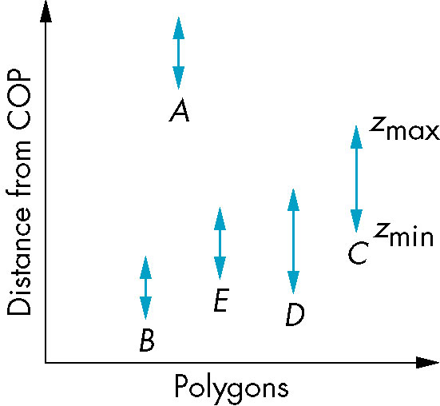
Depth Sorting
Requires ordering of polygons first
  O(n log n) calculation for ordering
  Not every polygon is either in front or behind all other polygons
Order polygons and deal with
easy cases first, harder later
Polygons sorted by
distance from COP
Angel: Interactive Computer Graphics 5E © Addison-Wesley 2009

Slide 7
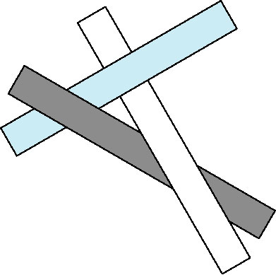
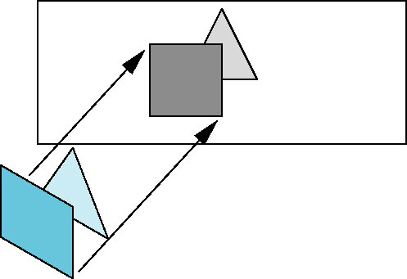
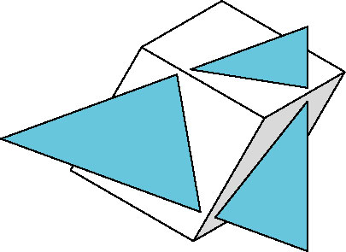
Depth Sorting - Hard Cases
cyclic overlap
Easy cases – One polygon
is completely behind
the other.
Just “paint” over it.
penetration
Angel: Interactive Computer Graphics 5E © Addison-Wesley 2009

Slide 8
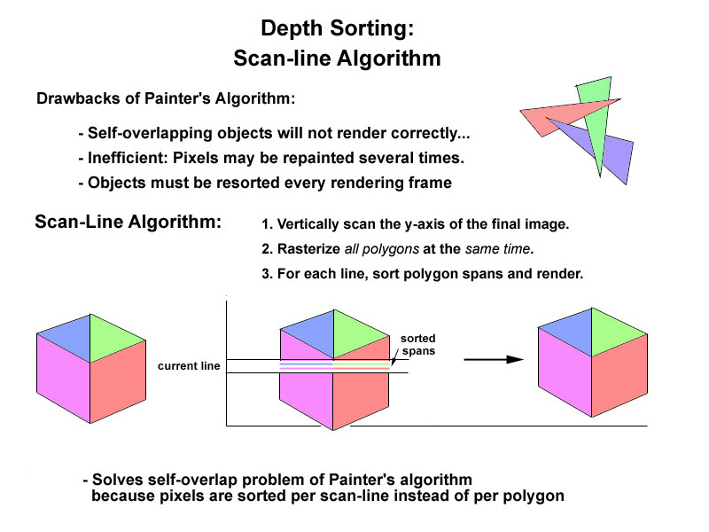

Slide 9
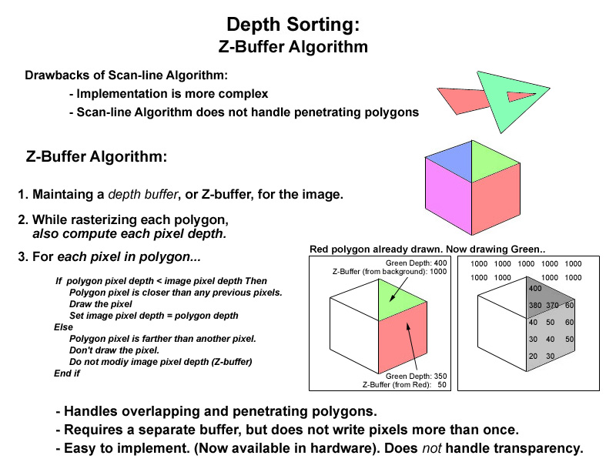

Slide 10
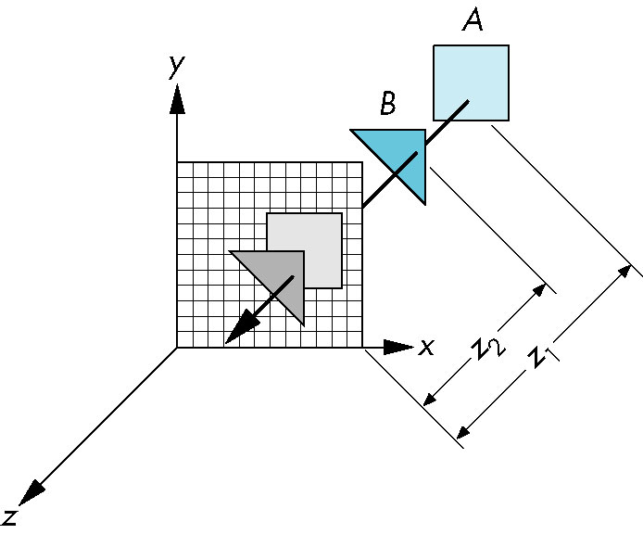
Z-Buffer Algorithm
As we render each polygon, compare the depth of each pixel to depth in z buffer
If less, place shade of pixel in color buffer and update z buffer
Angel: Interactive Computer Graphics 5E © Addison-Wesley 2009

