Slide 1

SMART INDIA HACKATHON 2026
Problem Statement ID – 26005
Problem Statement Title – Solar Cold Storage
for Vendors
Theme – Agriculture & Rural Development
PS Category – Software/Hardware
Team ID – Hardware
Team Name – Senzo Tech

Slide 2

Senzo
Tech
SOLAR COLD STORAGE FOR VENDORS
Problem
Our Idea
Innovation/Uniqueness
• Post-harvest loss: Fresh vegetables can lose quality when stored without temperature control.
• Power & access: Unreliable electricity, difficult terrain and transport delays make fixed cold storage difficult.
• Vendor constraint: Pushcart and small vendors need compact storage that moves with them.
• SolarChill: A compact solar-powered active cold-storage box designed for vendors.
• Target range: Maintain the produce zone around 4–8°C.
• Energy concept: 40W solar panel + PWM controller + 12V/20Ah battery buffer.
• Day-active cooling: Compressor operation is concentrated in sunlight hours.
• Insulation-first: 75mm insulation reduces overnight heat gain.
• Low-cost target: Project concept targets about ₹8,500.
• Vendor-first: Designed for individual pushcart/dairy vendors rather than only large cold rooms.
Proposed Solution
• Solar input: 40W panel supplies daytime energy.
• Cooling: 12V DC mini-compressor provides active cooling.
• Insulation: 75mm insulated box reduces heat gain and supports cold retention.
• Monitoring: Temperature measurement verifies the 4–8°C operating target.
• Portable form: Designed as a vendor-level mini cold-storage unit.
2

Slide 3
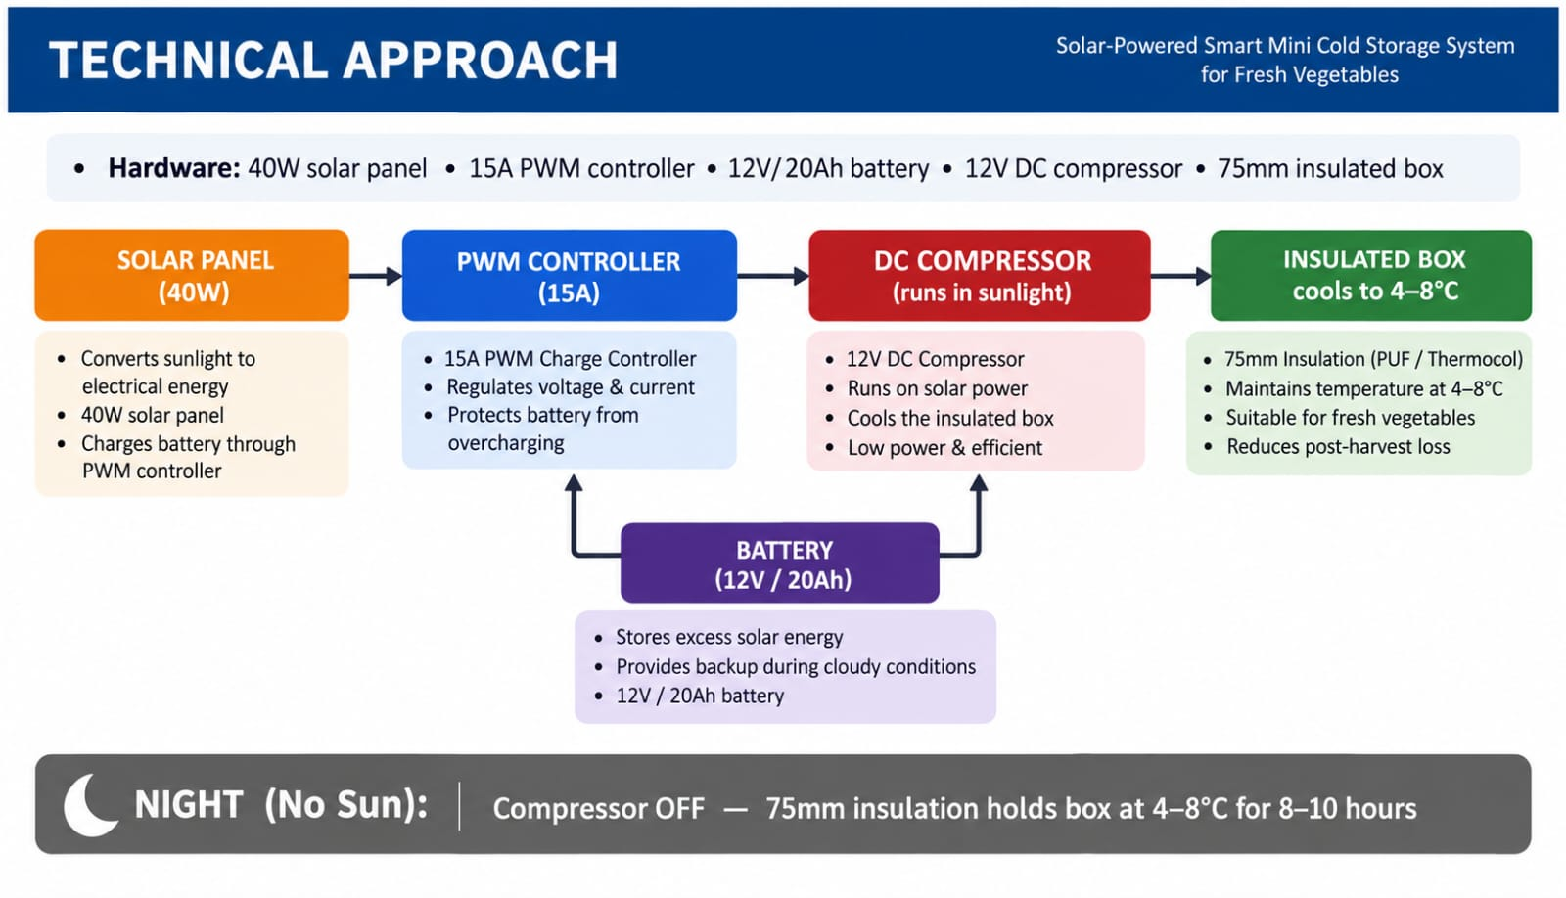
Senzo
Tech
TECHNICAL APPROACH
FLOW CHART
Hardware &
Software
• 40W Solar Panel
• PWM Charge Controller 15A
• 12V / 20Ah Battery
• 12V DC Compressor
• 75mm Insulated Box
• Temperature Sensor
3

Slide 4
Senzo
Tech
FEASIBILITY AND VIABILITY
FEASIBILITY
STRATEGY
• Compact & Affordable: Built from locally available/off-the-shelf components.
• Energy Source: Uses solar generation with a battery buffer.
• Simple Cooling: 12V DC compressor and insulated enclosure.
• Prototype Build: Wiring and temperature tests can be performed at small scale.
Daytime Cooling: Use solar energy when available.
CHALLENGES
Thermal Retention: Use thick insulation to reduce night-time load.
• Monsoon / Cloud Cover: Lower solar generation may reduce cooling time.
• Temperature Drift: Weak insulation can increase heat gain.
• Battery Ageing: Lead-acid battery has a finite service life.
• User Adoption: Daily operation should remain simple.
Testing: Measure temperature, cooling time and energy use.
COMMERCIAL FEASIBILITY
• Affordable Production: Target project cost is around ₹8,500.
• Vendor Market: Designed around small individual sellers.
• Multiple Uses: Vegetables, fruits and appropriate dairy applications.
• Scalable Product: Can evolve from mini prototype to larger vendor units.
Iteration: Improve enclosure and control based on measured results.
4

Slide 5
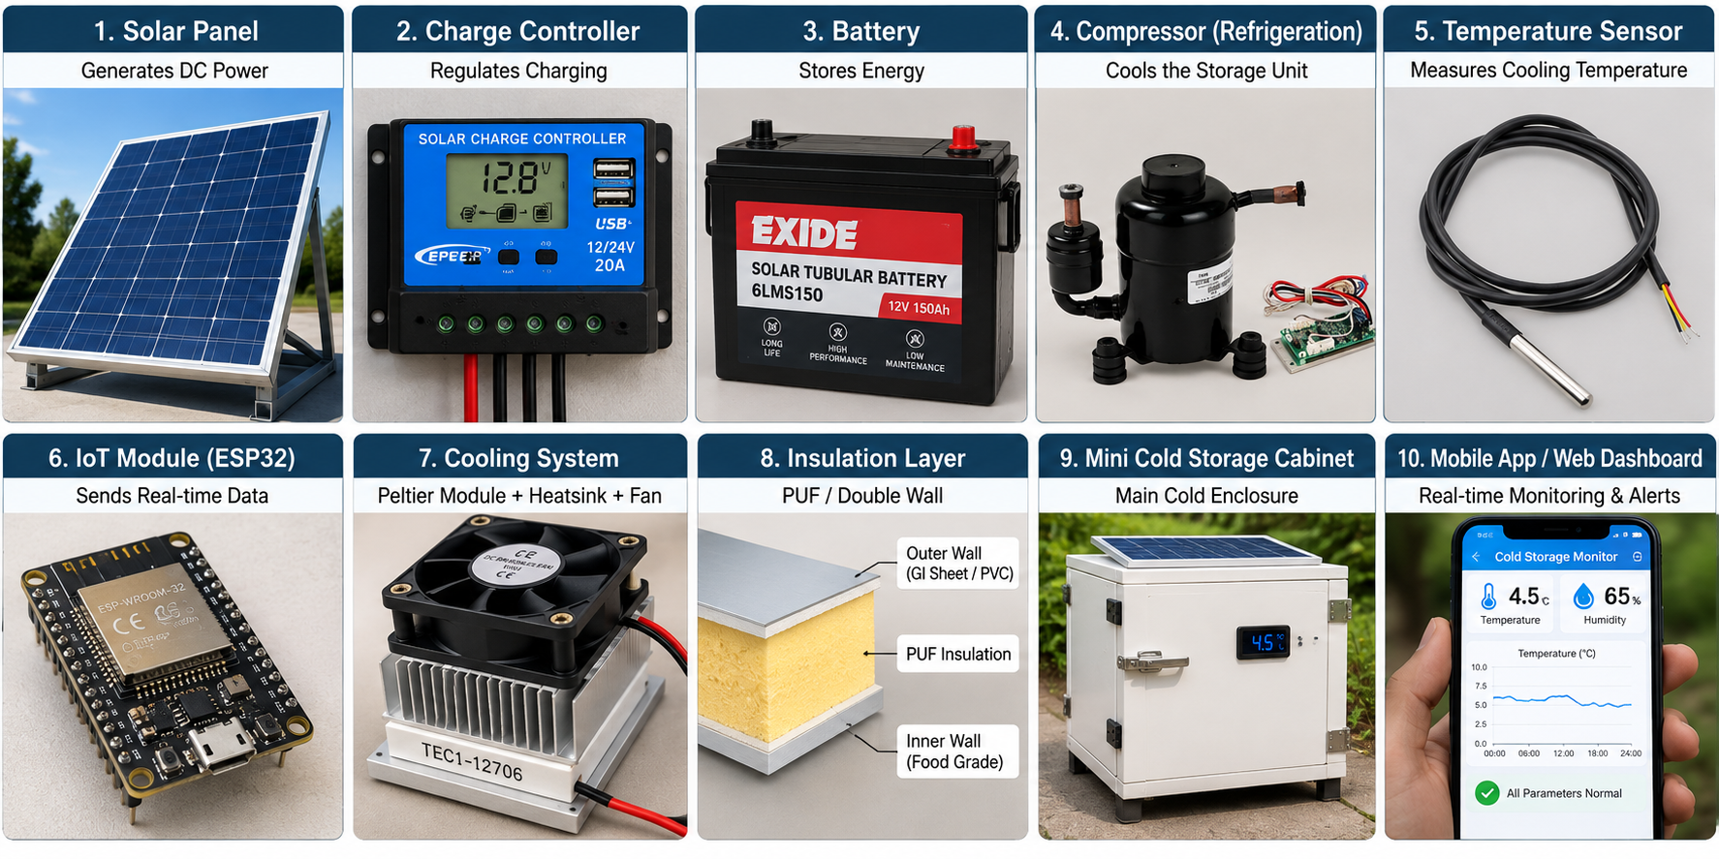
Senzo
Tech
IMPACT AND BENEFITS
DIRECT IMPACT ON TARGET USERS
ECONOMIC & STRATEGIC BENEFITS
PROTOTYPE SUCCESS METRICS
• Reduced spoilage: Better temperature control can protect perishable produce.
• Longer selling window: Cooling can support longer selling hours.
• Portable storage: Brings cold storage closer to mobile vendors.
• Food quality: Helps keep produce cooler during the selling period.
• Low target cost: Project concept targets approximately ₹8,500.
• Vendor-focused: Individual sellers can use a compact cold-storage unit.
• Energy saving concept: Day-active cooling + insulation avoids unnecessary night-time operation.
• Scalability: Design can be expanded after prototype validation.
• Temperature: Target 4–8°C.
• Cooling time: Measure time required to reach target.
• Energy use: Measure solar/battery consumption.
• Retention: Check overnight temperature stability.
STRATEGIC IMPACT
• Decentralized cooling: Moves beyond dependence on fixed cold rooms.
• Solar operation: Uses renewable daytime energy.
• Local fabrication: Supports a simple prototype using accessible components.
• Future growth: Can be adapted for different vendor capacities.
5

Slide 6
Senzo
Tech
RESEARCH AND ANALYSIS
6
Research References
🔗
Solar refrigeration research (verified): Sidney, Prabakaran, Kim & Dhasan (2021/2022) — “A novel solar-powered milk cooling refrigeration unit with cold thermal energy storage for rural application,” published in Environmental Science and Pollution Research. (DOI: 10.1007/s11356-021-16852-5)
🔗
Promethean Power Systems: Commercial thermal-battery milk chilling deployments across rural India (company/product reference, not a journal paper). (promethean.co.in)
🔗
Ecozen Solutions: Ecofrost solar cold-storage systems for agricultural applications (company/product reference). (ecozensolutions.com)
🔗
IIT Madras Tan90 (Tan90 Thermal Solutions): Portable solar cold-storage work using phase-change materials; incubated via Nirmaan, IIT Madras's pre-incubator (startup reference, not a journal paper). (tan90thermal.com)
Real-world visual references • SolarChill concept
Team Senzo Tech | Team ID 26005 | SMART INDIA HACKATHON 2026

