Slide 1
COVID VACCINE Analysis PHASE -3

Slide 2
1: Importing the required Libraries
Numpy:
NumPy: aims to provide an array object that is up to 50x faster than traditional Python lists. The array object in NumPy is called nd array , it provides a lot of supporting functions that make working with nd array very easy. Arrays are very frequently used in data science, where speed and resources are very important.
Pandas:
pandas is a fast, powerful, flexible and easy to use open source data analysis and manipulation tool, built on top of the Python programming language.
Matplotlib:
Matplotlib is a comprehensive library for creating static, animated, and interactive visualizations in Python.

Slide 3
Scikit-Learn :
Scikit-Learn, also known as sklearn is a python library to implement machine learning models and statistical modelling. Through scikit-learn, we can implement various machine learning models for regression, classification, clustering, and statistical tools for analyzing these models.

Slide 4
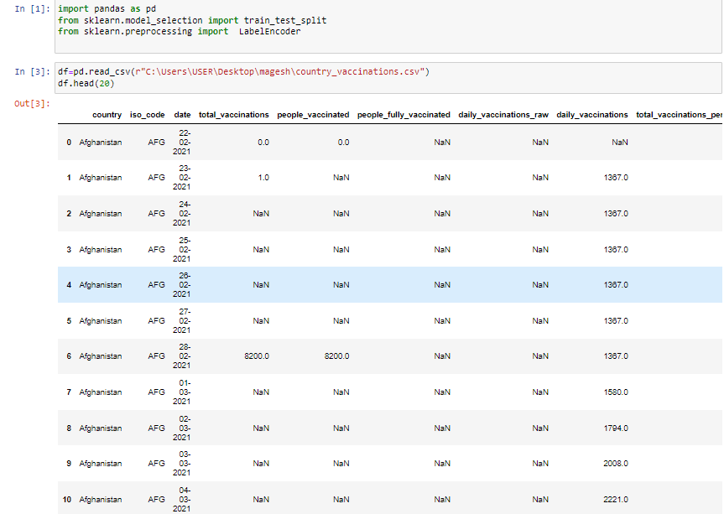

Slide 5
2: Importing the Dataset
To import a CSV file and put the contents into a Pandas dataframe we use the read_csv() function, which is appended after calling the pd object we created when we imported Pandas. The read_csv() function can take several arguments, but by default you just need to provide the path to the file you wish to read.

Slide 7
3: Handling Missing data's
Missing values can be handled by deleting the rows or columns having null values. If columns have more than half of the rows as null then the entire column can be dropped. The rows which are having one or more columns values as null can also be dropped.

Slide 8
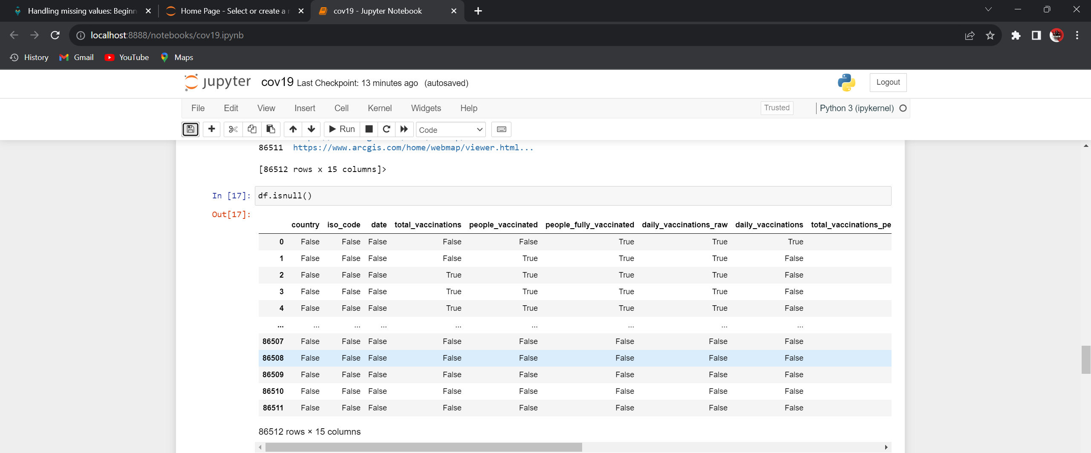
To use isnull method

Slide 9
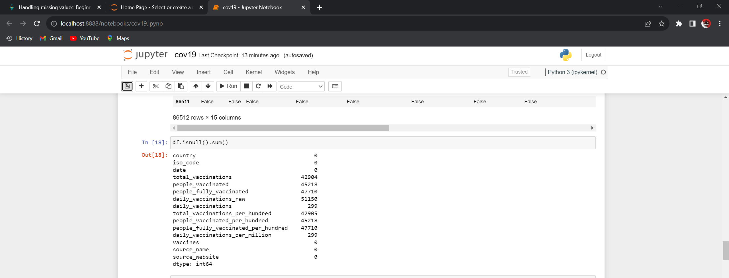
To use isnull() .sum ()method

Slide 10
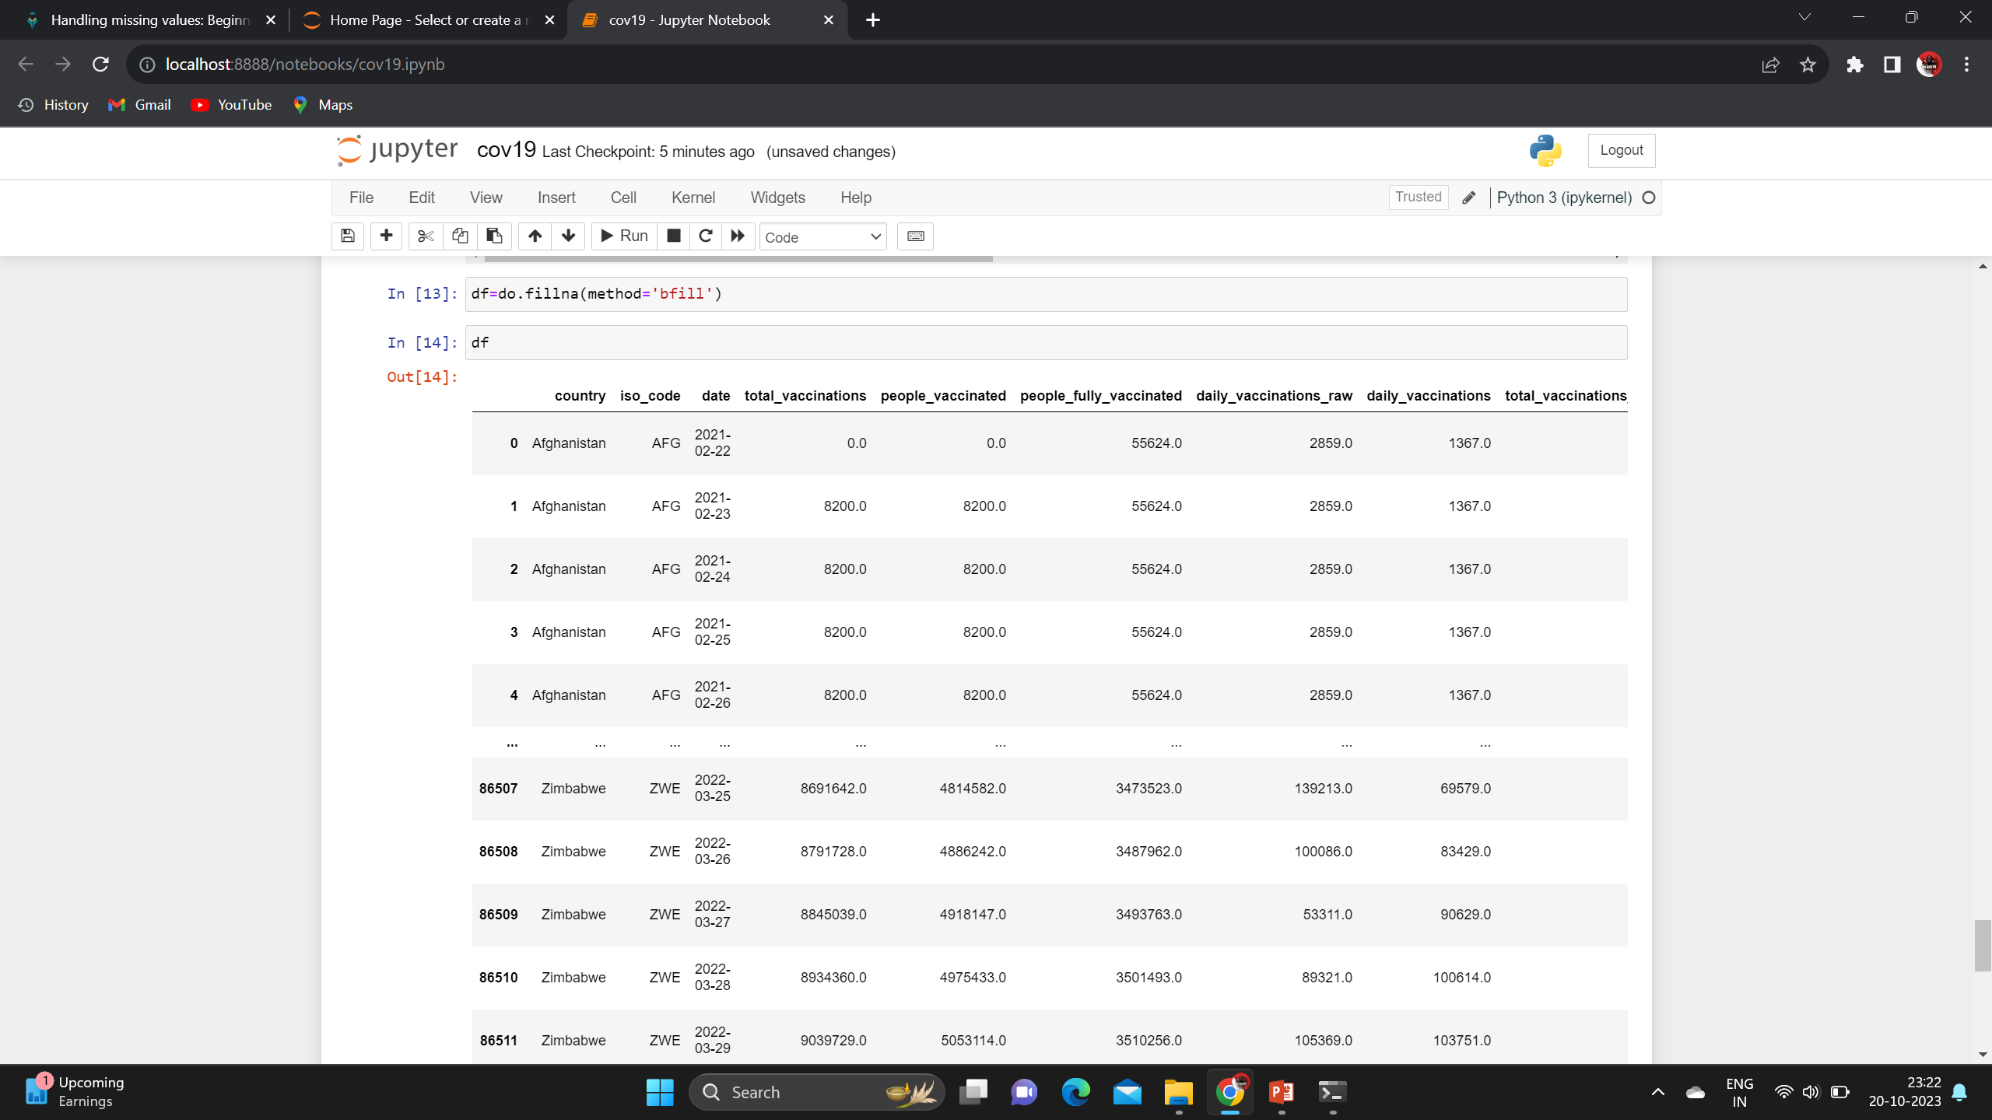
Using backward fill method

Slide 11
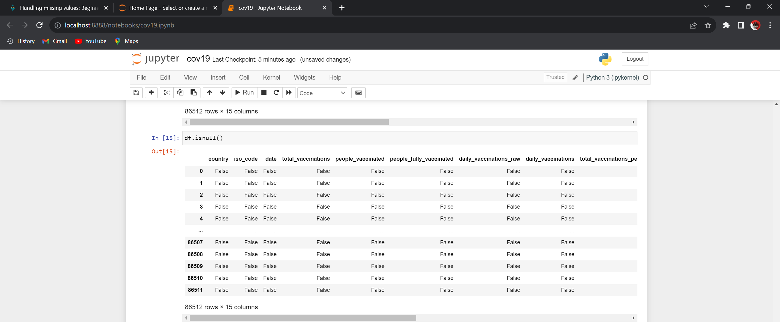
To use isnull method

Slide 12
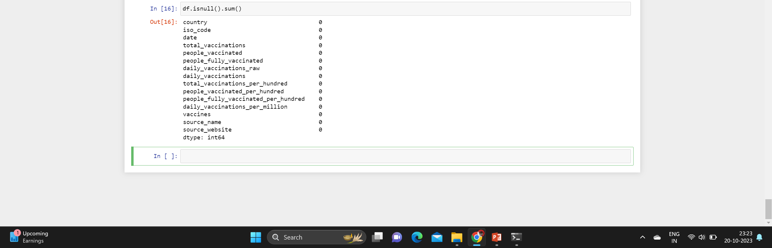
To use isnull() .sum ()method

Slide 13
4: Encoding the categorical data
One-hot encoding is a technique used to convert categorical data into a numerical format that can be used for machine learning algorithms. It's particularly useful when dealing with categorical variables that don't have an inherent ordinal relationship (i.e., the categories don't have a meaningful numerical order). Here's how you can use one-hot encoding:

Slide 14
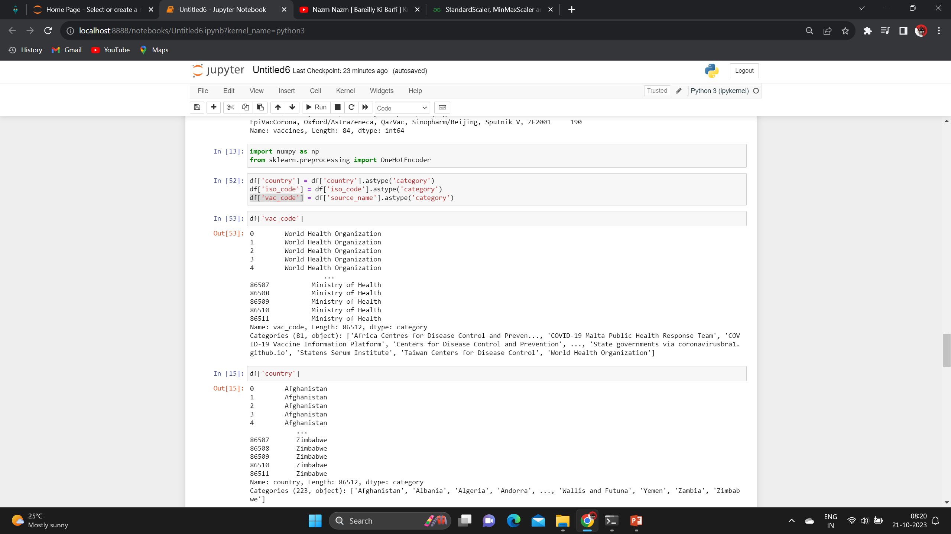
Import the one-hot Encoder

Slide 15
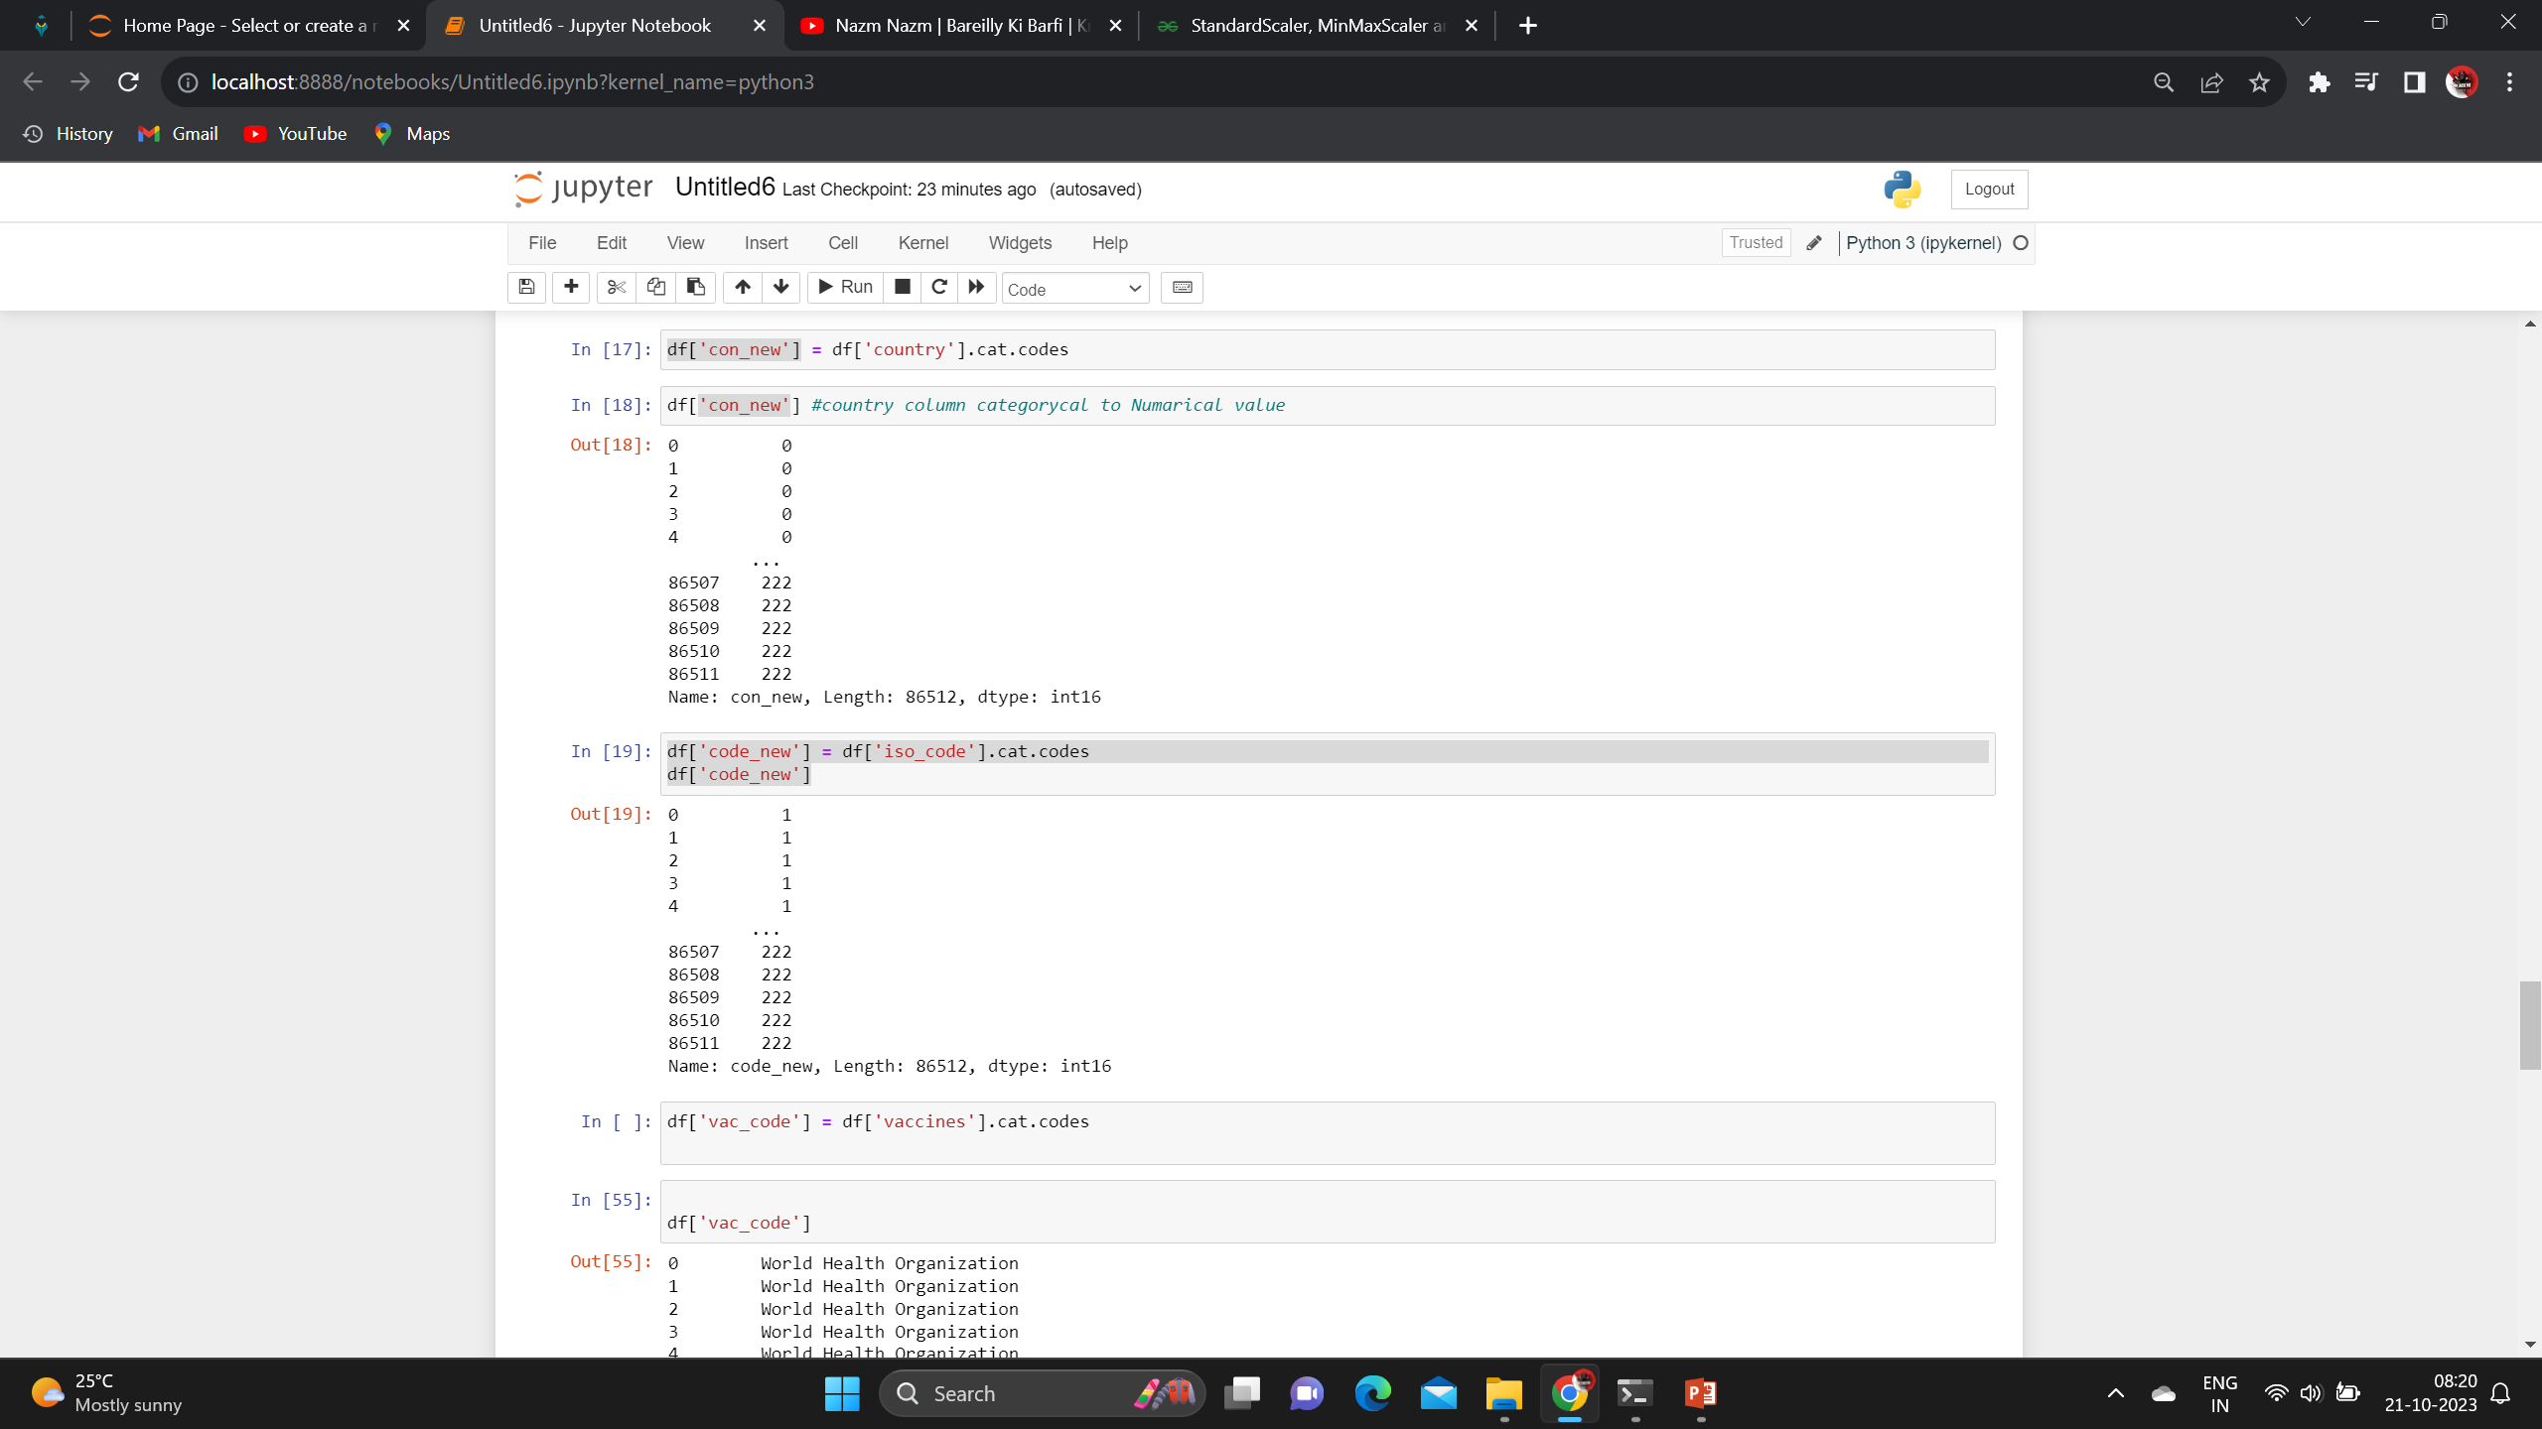
categorical to numerical

Slide 16
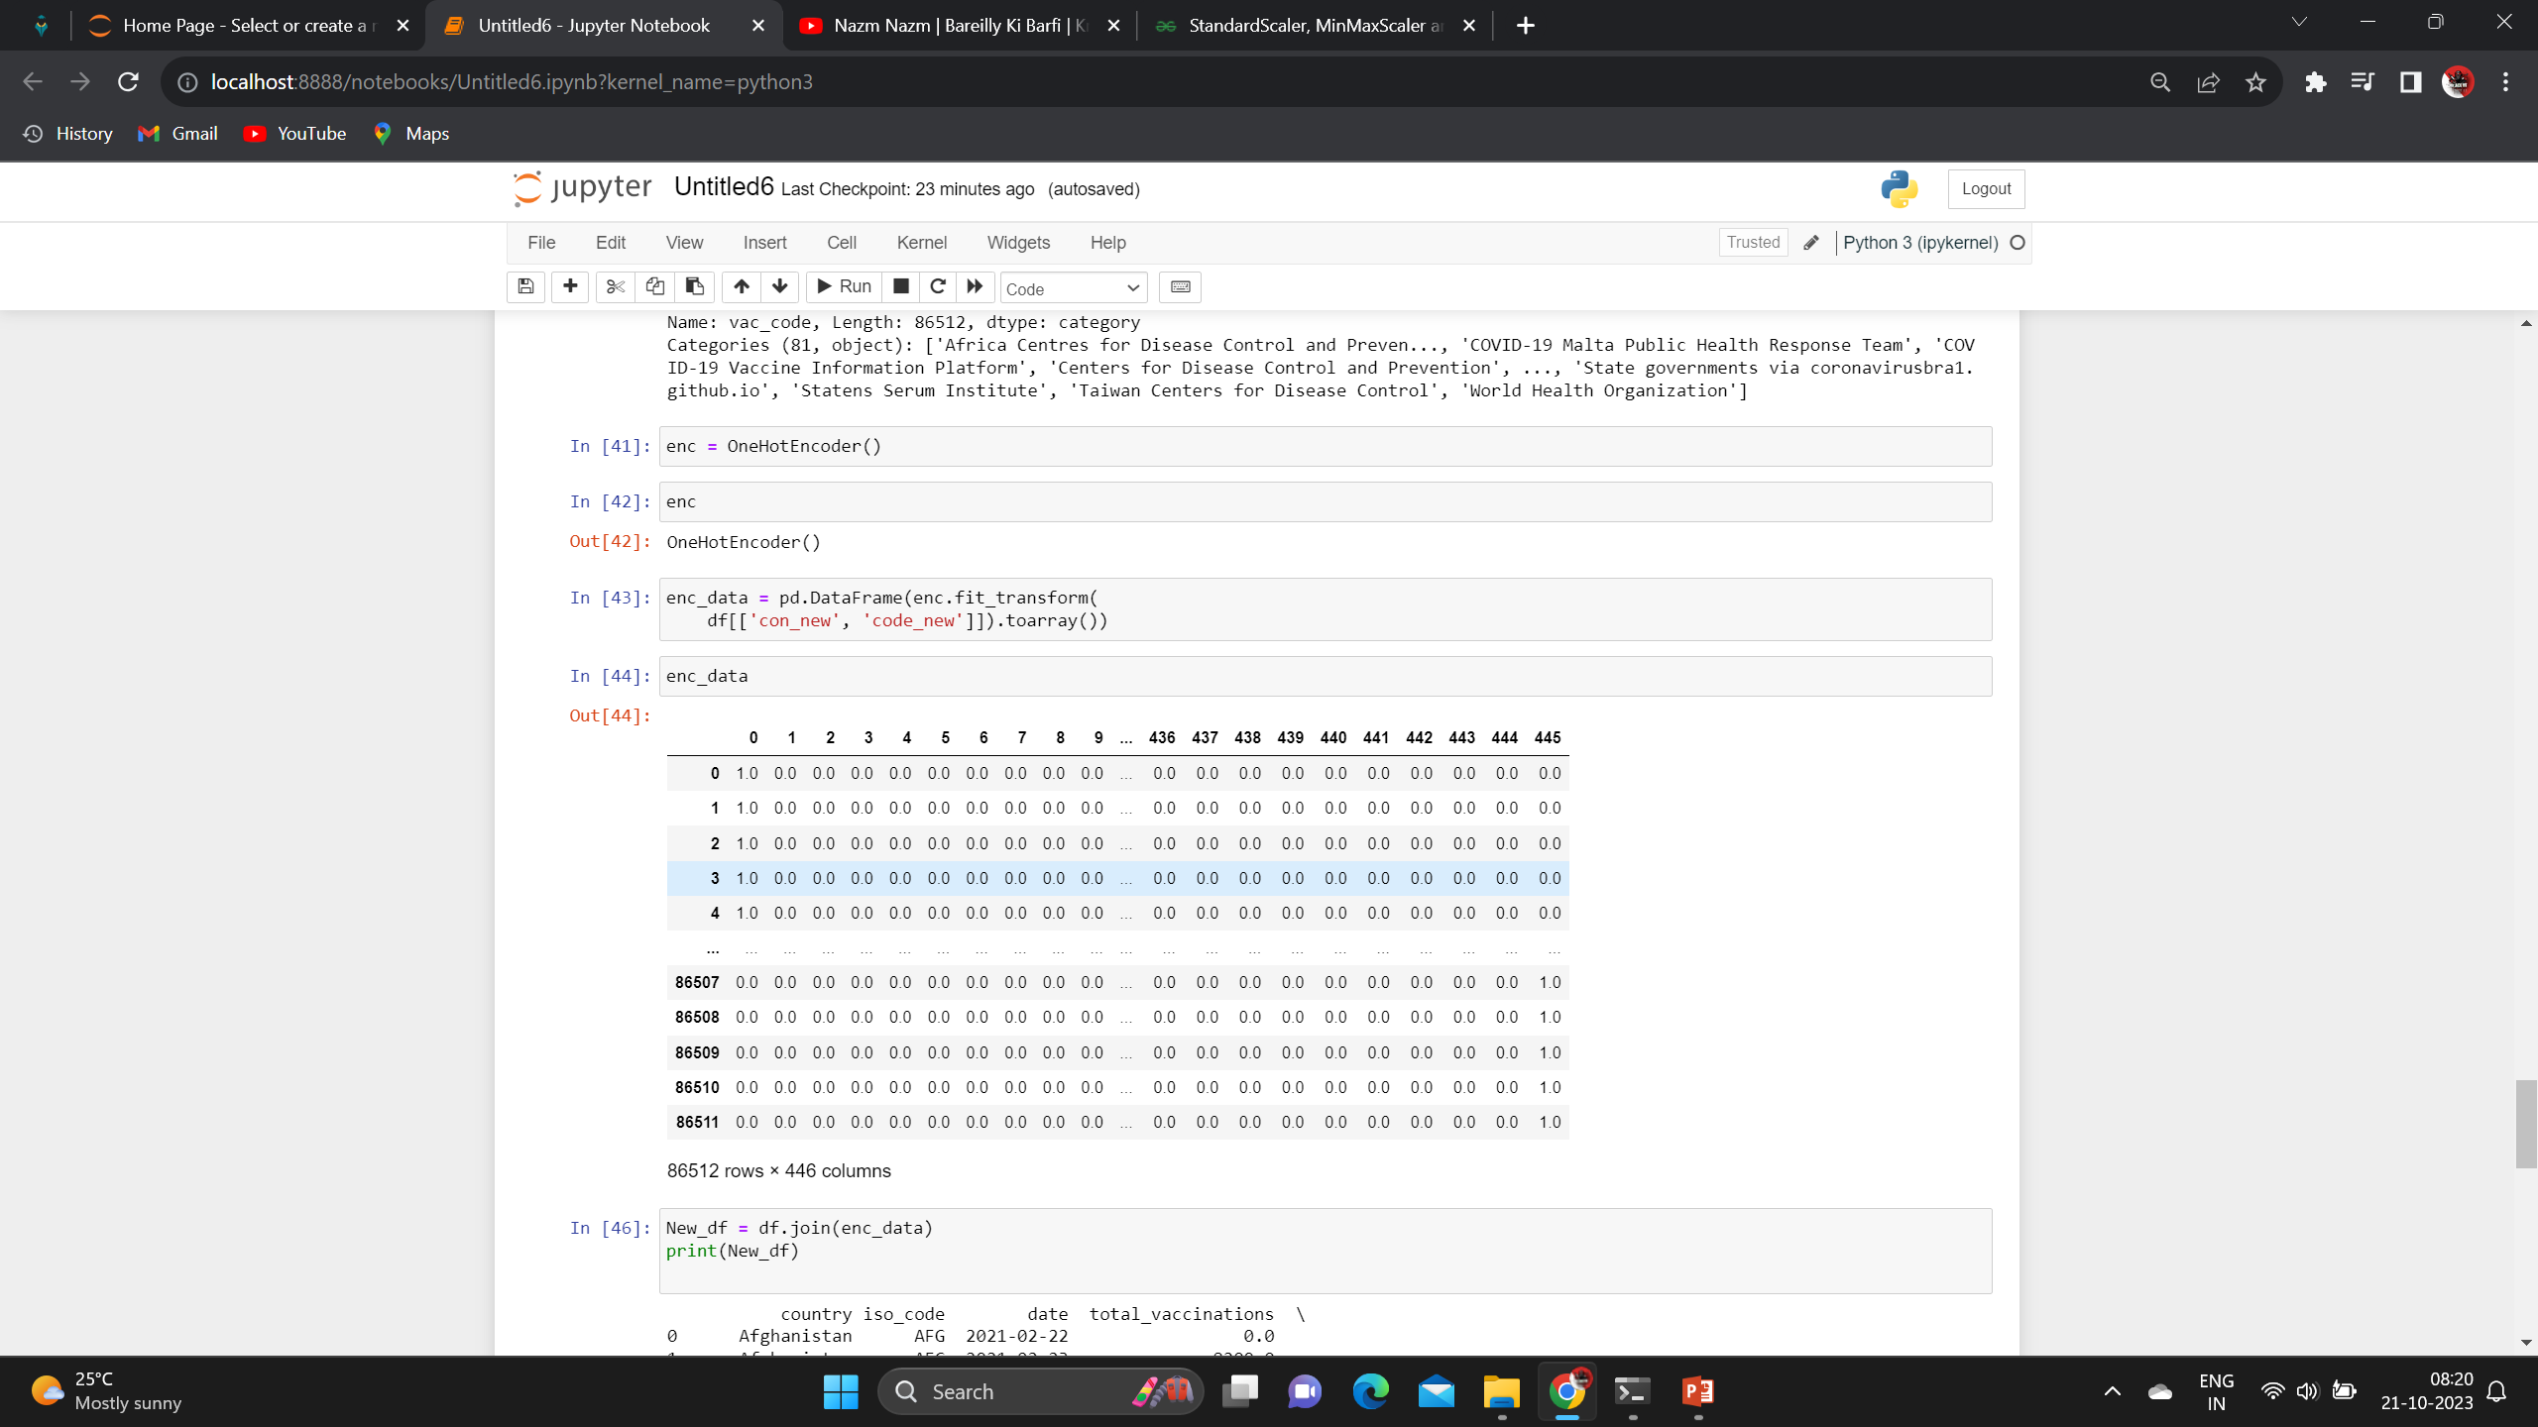
categorical to numerical

Slide 17
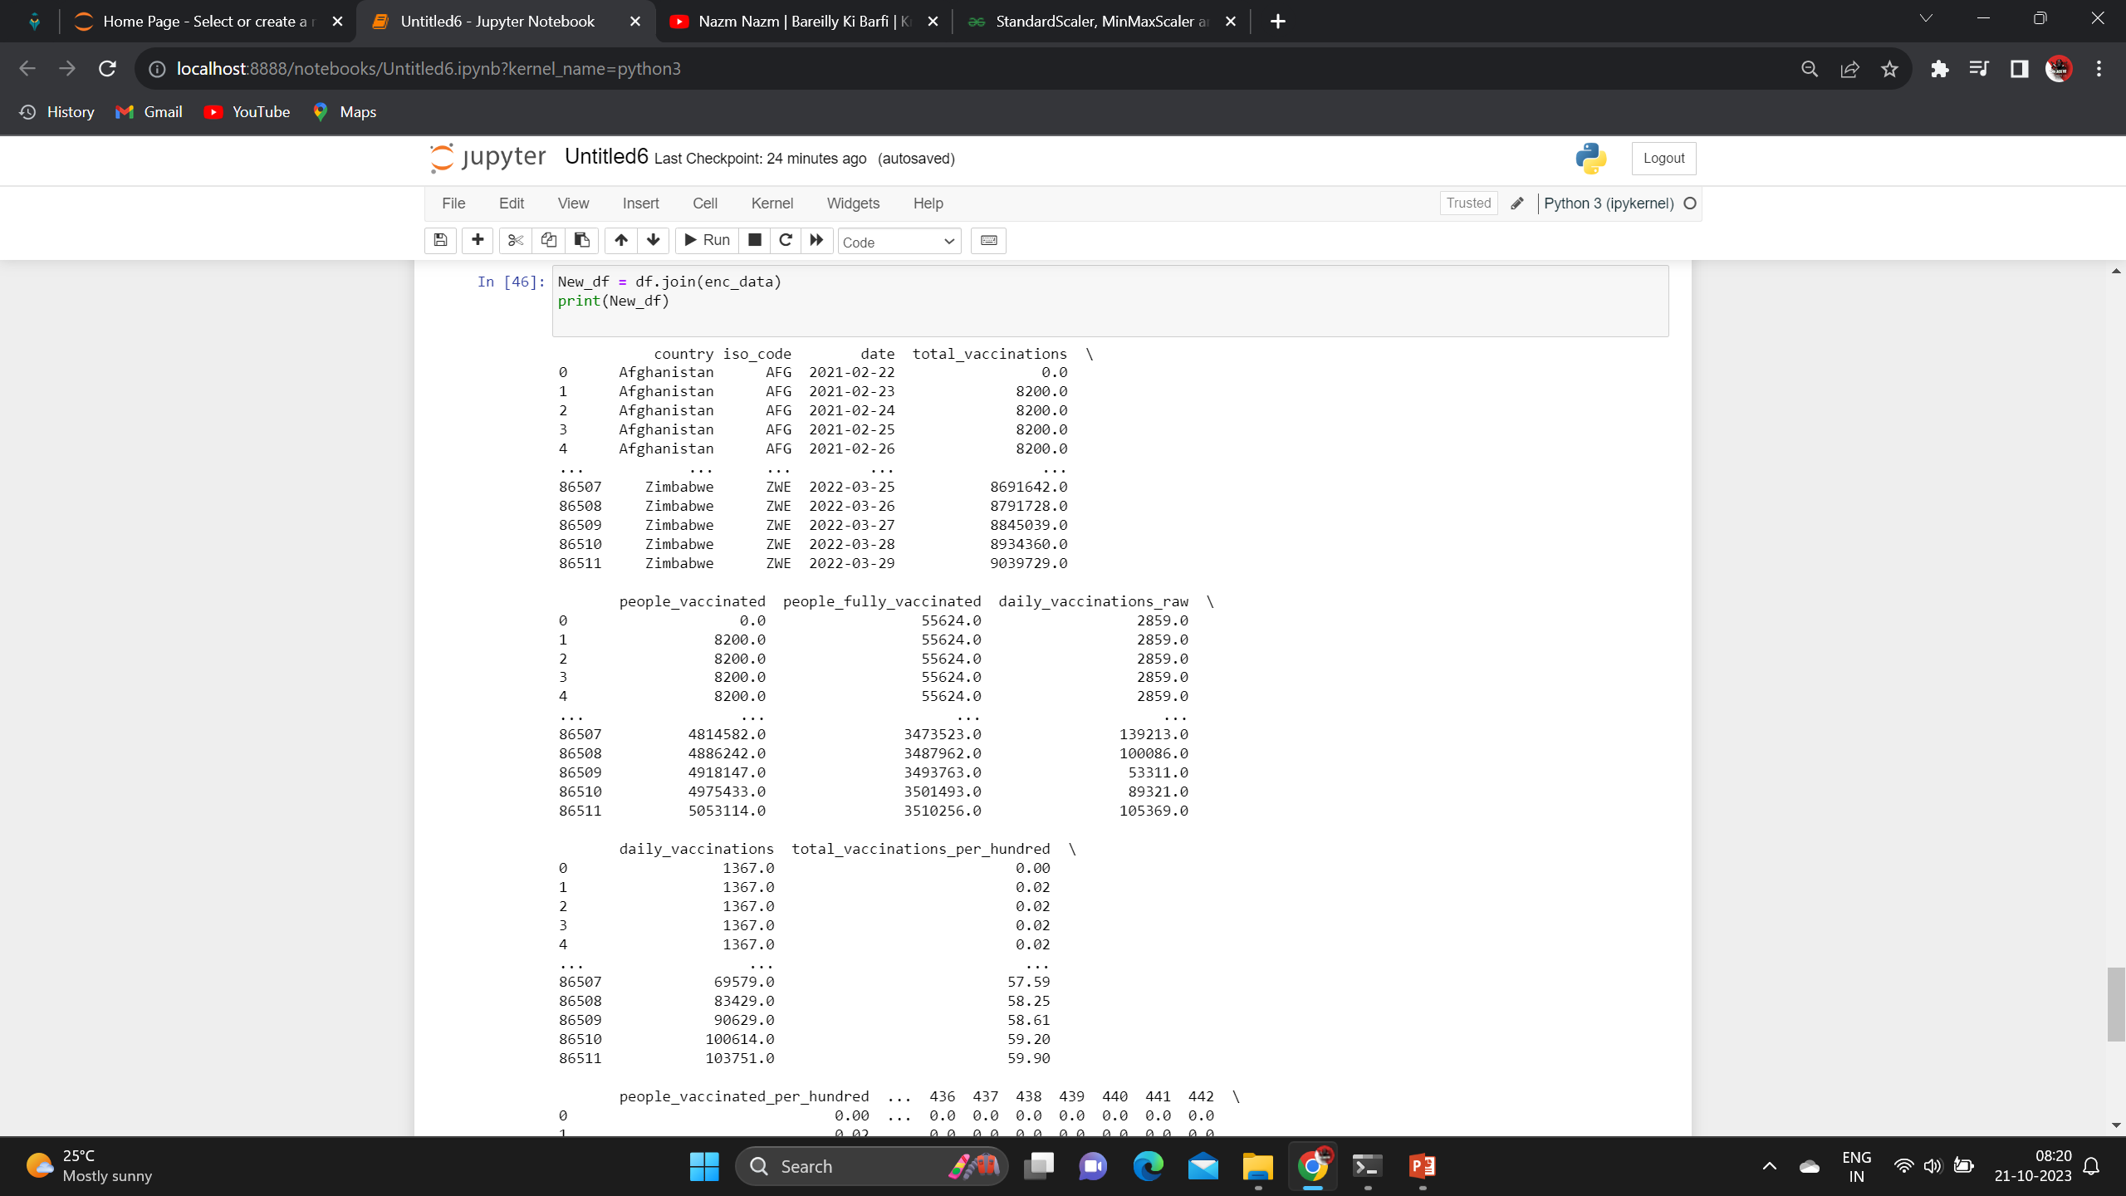
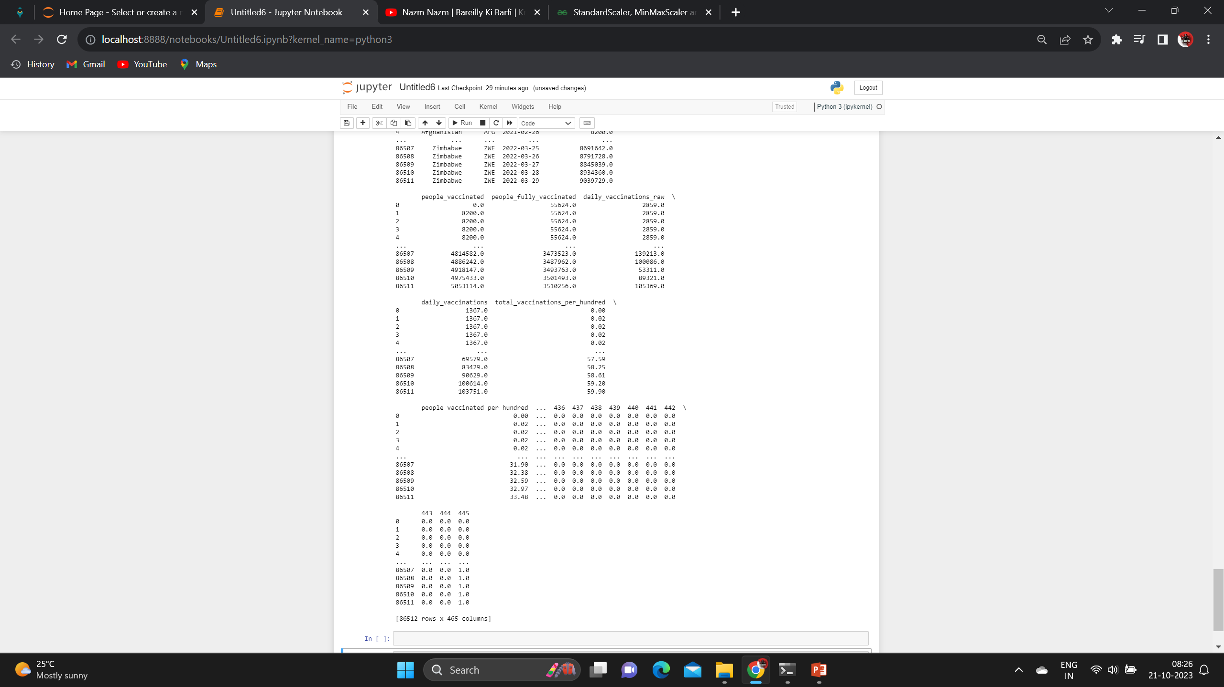
output

Slide 18
5: splitting the dataset Test & train
The simplest way to split the modelling dataset into training and testing sets is to assign 2/3 data points to the former and the remaining one-third to the latter. Therefore, we train the model using the training set and then apply the model to the test set. In this way, we can evaluate the performance of our model.

Slide 19
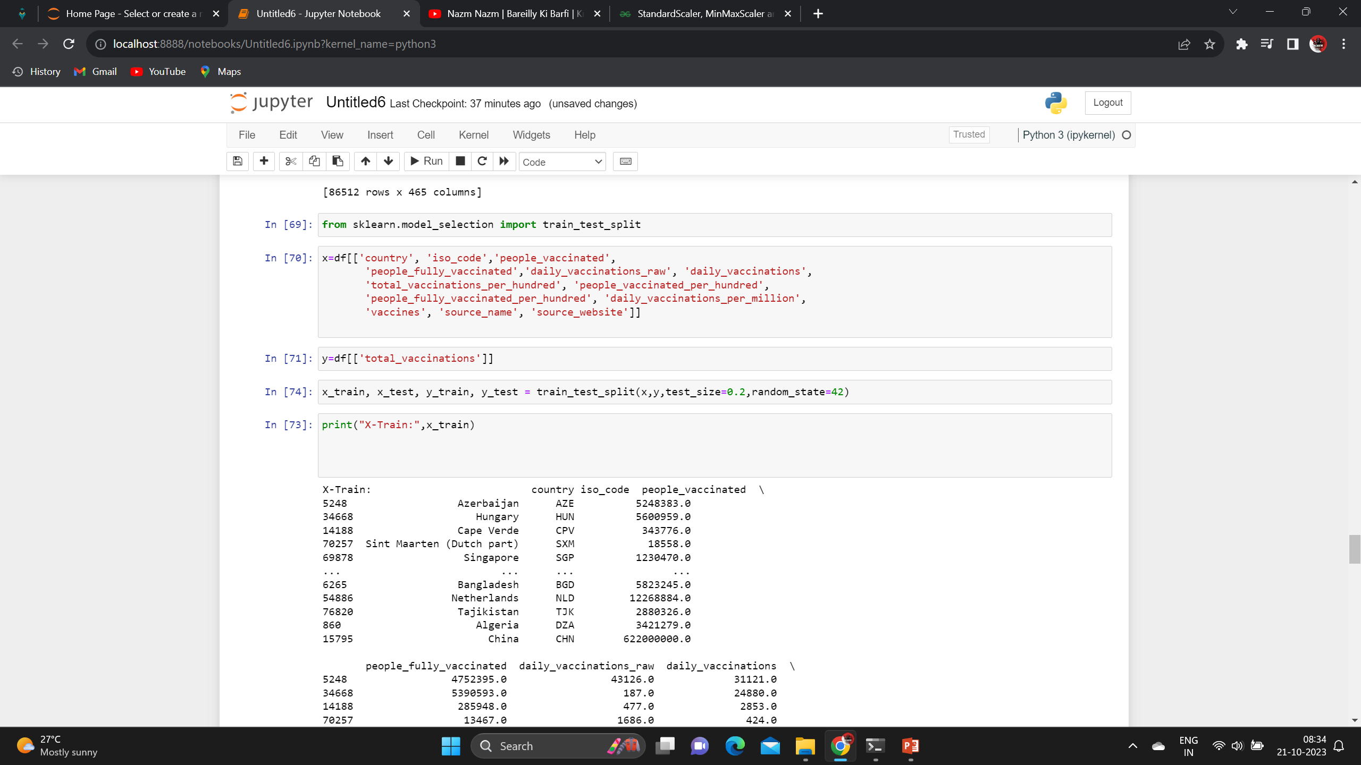
Import the test and train the dataset

Slide 20
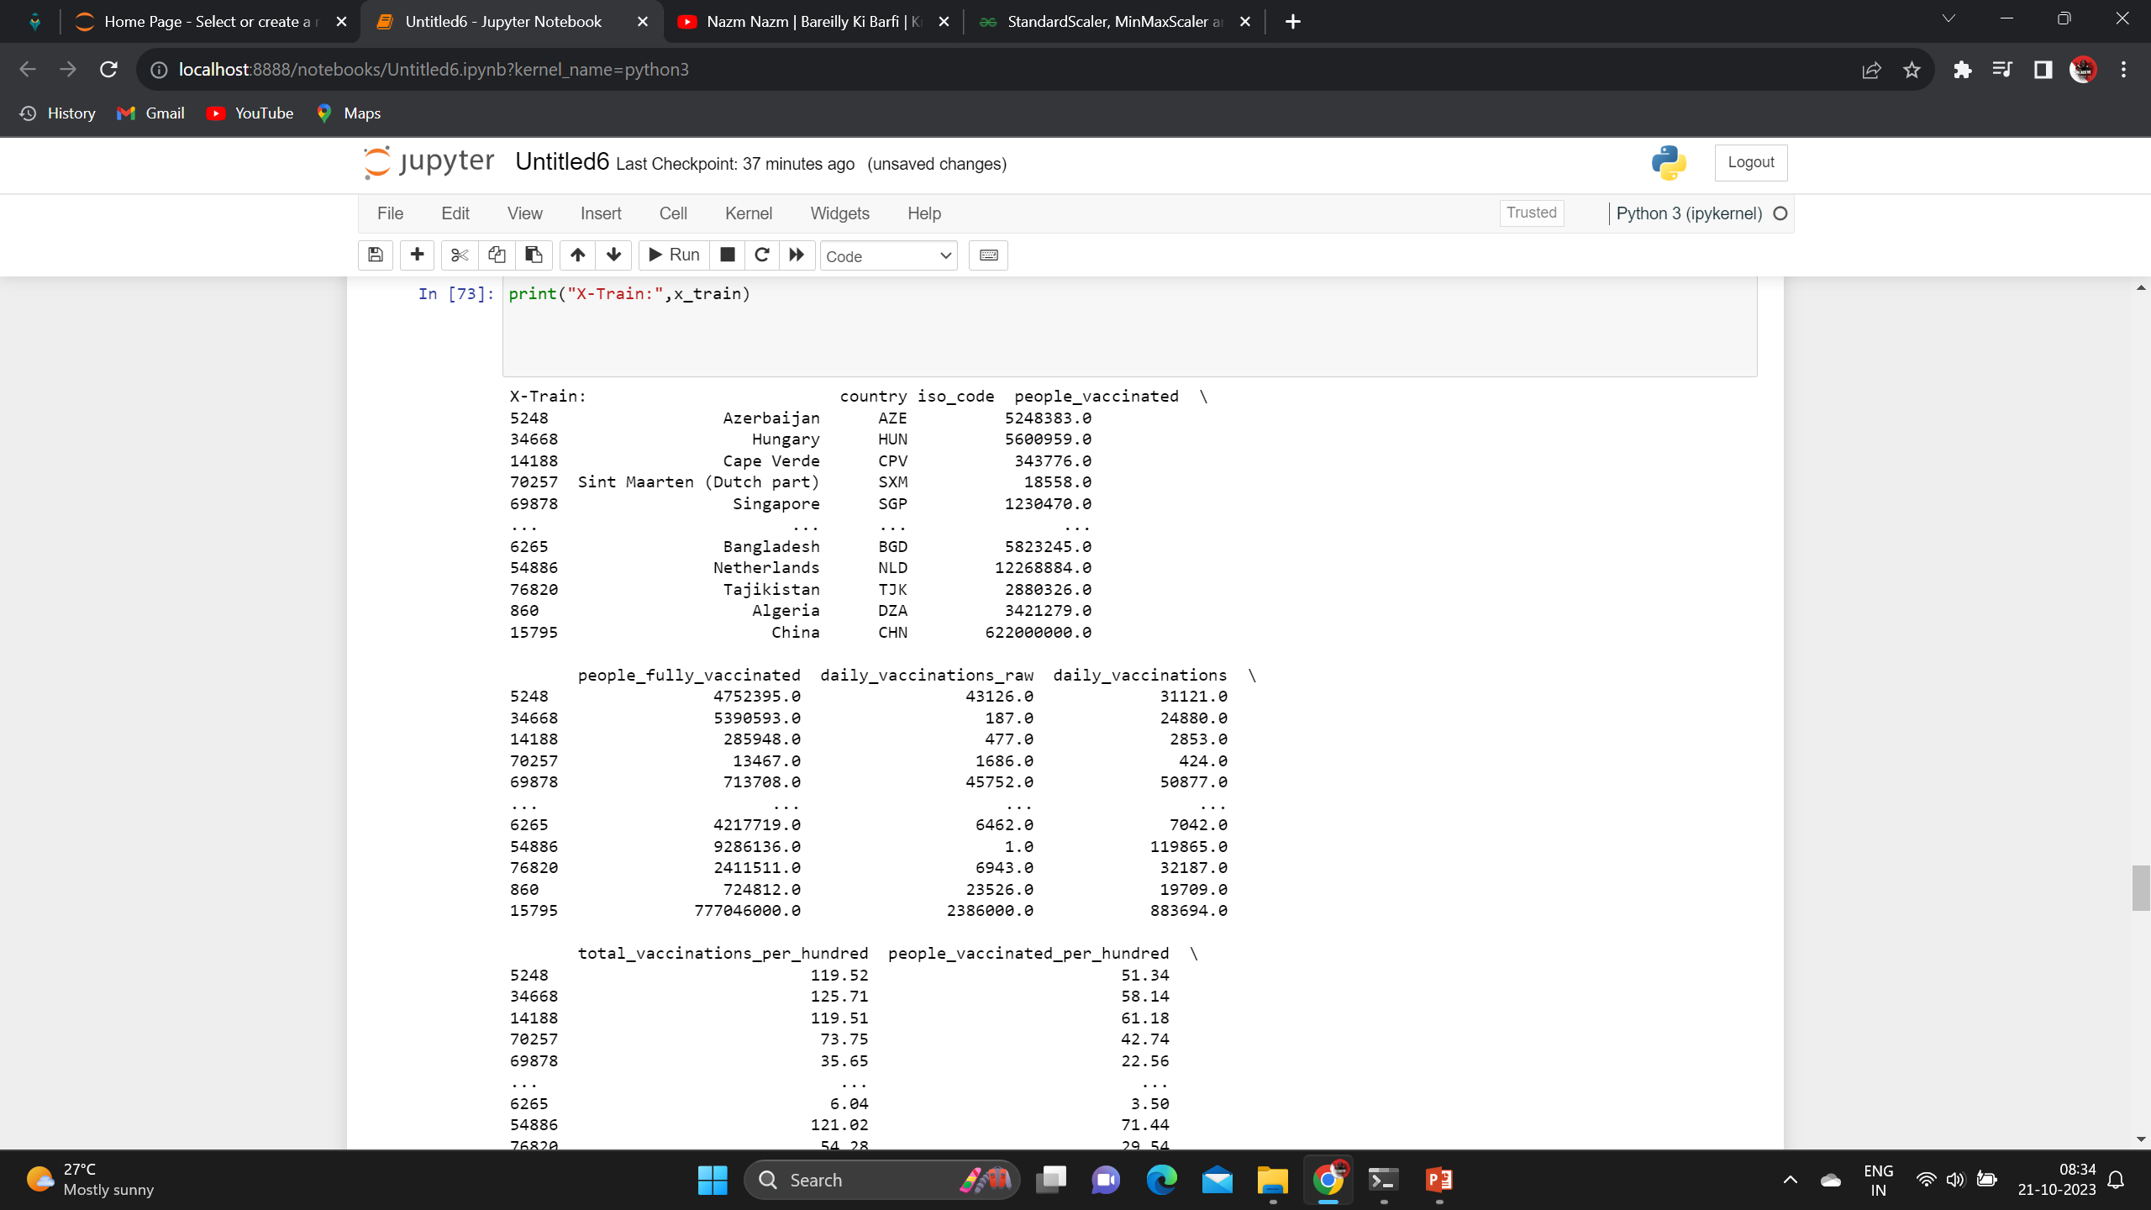
X-train data

Slide 21
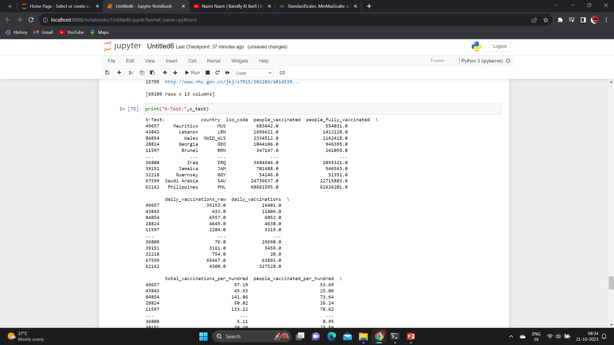
X-test data

Slide 22
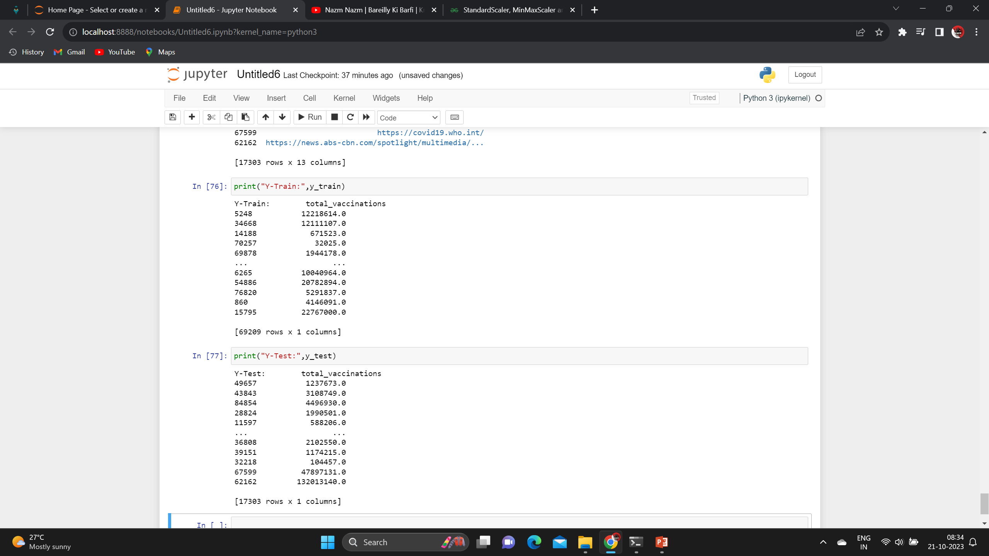
Y-train & Y-test data

Slide 23
6: feature scaling
StandardScaler is a One of the most commonly used feature scaling techniques is StandardScaler. It scales the data such that the mean is 0 and the standard deviation is 1. This means that the scaled data will have a normal distribution with a mean of 0 and a standard deviation of 1.

Slide 24
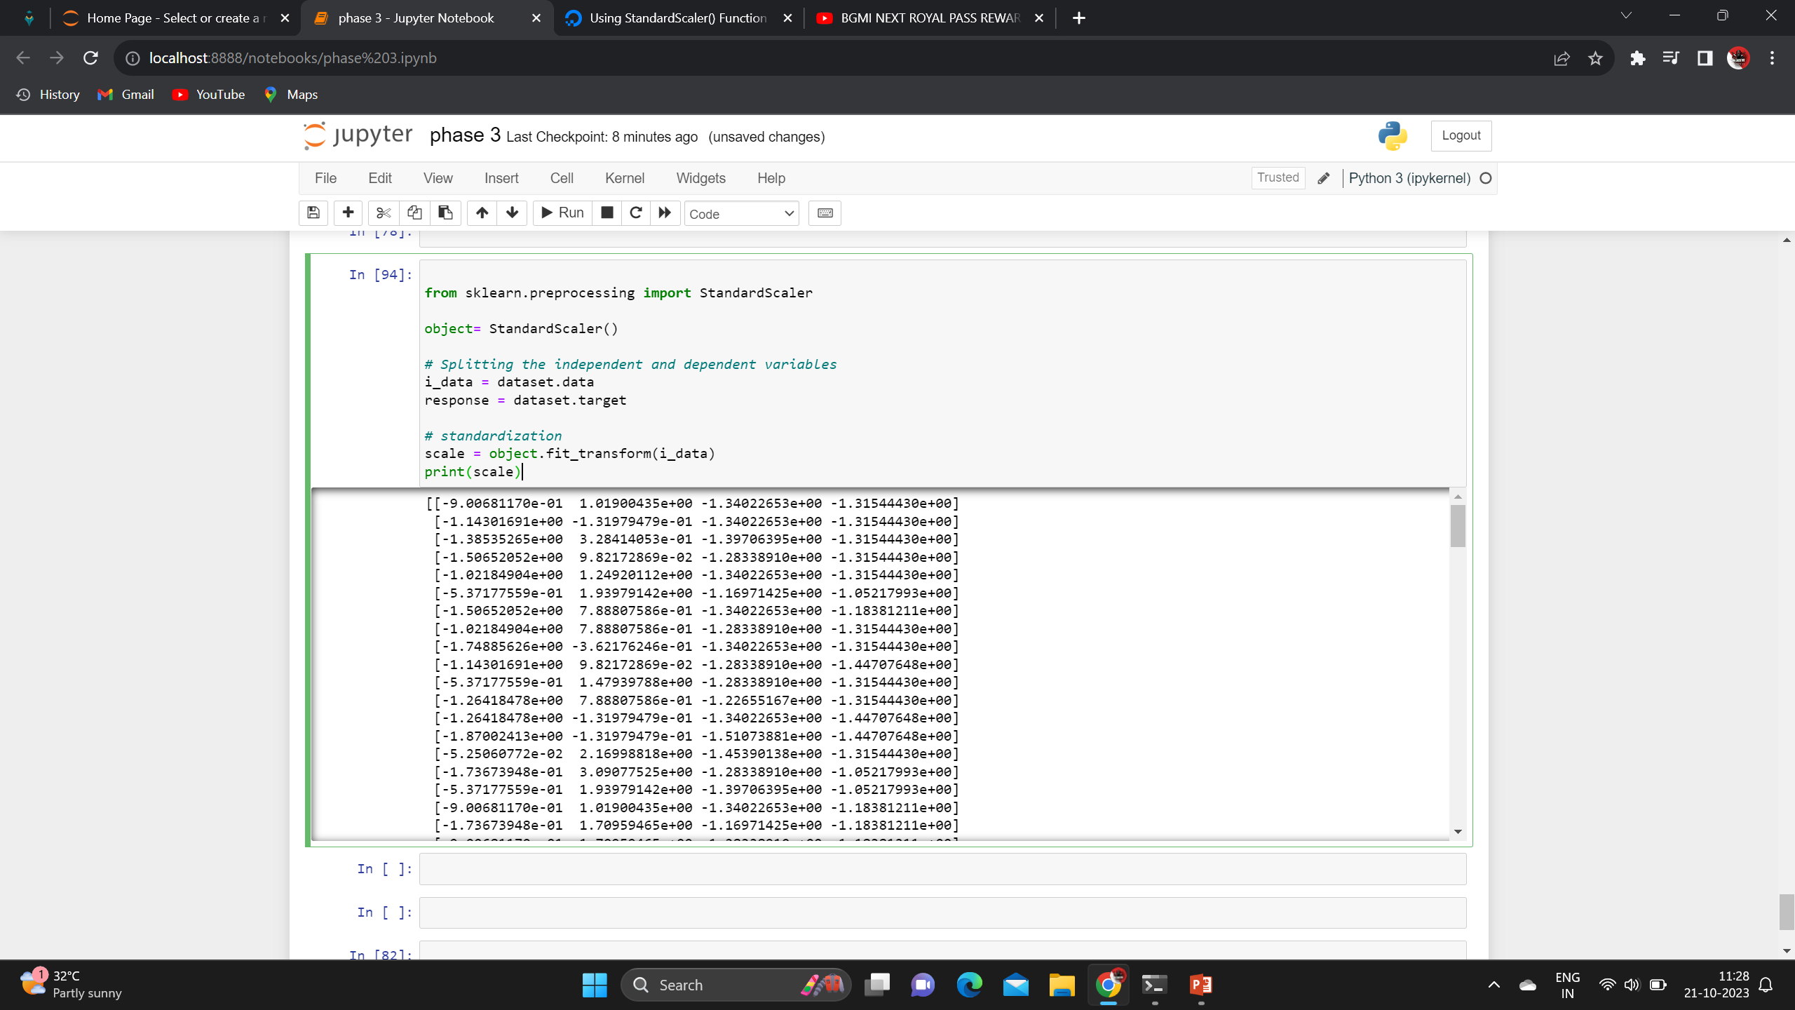
example

Slide 25


