Slide 1
COVID VACCINE Analysis PHASE -2

Slide 2
INNOVATION
INTRODUCTION
IMPORTING DATASET
DATA PREPROCESSING
MODEL SELECTION
MODEL TRAINING
EVALUATION

Slide 3
INTRODUCTION
Aim of this project is to analyze the data in detail on vaccinated people and fully vaccinated people by country in 2021-2022 Introduction Since the start of the COVID-19 outbreak, WHO has worked with countries and areas in Different regions on public health measures to slow or stop the spread of the virus. Safe…

Slide 4
2: Where you got the dataset and its detail ?
Context
Data is collected daily from Our World in Data GitHub repository for covid-19, merged and uploaded. Country level vaccination data is gathered and assembled in one single file. Then, this data file is merged with locations data file to include vaccination sources information. A second file, with manufacturers information, is included.
Dataset Link: https://www.kaggle.com/datasets/gpreda/covid-world-vaccination-progress

Slide 5
3: Details about columns (columns which you gonna use)
Content
The data (country vaccinations) contains the following information:
Country- this is the country for which the vaccination information is provided;
Country ISO Code - ISO code for the country;
Date - date for the data entry; for some of the dates we have only the daily vaccinations, for others, only the (cumulative) total;
Total number of vaccinations - this is the absolute number of total immunizations in the country;
Total number of people vaccinated - a person, depending on the immunization scheme, will receive one or more (typically 2) vaccines; at a certain moment, the number of vaccination might be larger than the number of people;
Total number of people fully vaccinated - this is the number of people that received the entire set of immunization according to the immunization scheme (typically 2); at a certain moment in time, there might be a certain number of people that received one vaccine and another number (smaller) of people that received all vaccines in the scheme;

Slide 6
3:Details about columns (columns which you gonna use)
Daily vaccinations (raw) - for a certain data entry, the number of vaccination for that date/country;
Daily vaccinations - for a certain data entry, the number of vaccination for that date/country;
Total vaccinations per hundred - ratio (in percent) between vaccination number and total population up to the date in the country;
Total number of people vaccinated per hundred - ratio (in percent) between population immunized and total population up to the date in the country;
Total number of people fully vaccinated per hundred - ratio (in percent) between population fully immunized and total population up to the date in the country;
Number of vaccinations per day - number of daily vaccination for that day and country;
Daily vaccinations per million - ratio (in ppm) between vaccination number and total population for the current date in the country;
Vaccines used in the country - total number of vaccines used in the country (up to date);
Source name - source of the information (national authority, international organization, local organization etc.);
Source website - website of the source of information;

Slide 7
04:Details of libraries to be used and way to download?
Numpy:
NumPy: aims to provide an array object that is up to 50x faster than traditional Python lists. The array object in NumPy is called nd array , it provides a lot of supporting functions that make working with nd array very easy. Arrays are very frequently used in data science, where speed and resources are very important.
Pandas:
pandas is a fast, powerful, flexible and easy to use open source data analysis and manipulation tool, built on top of the Python programming language.
Matplotlib:
Matplotlib is a comprehensive library for creating static, animated, and interactive visualizations in Python.

Slide 8
Scikit-Learn :
Scikit-Learn, also known as sklearn is a python library to implement machine learning models and statistical modelling. Through scikit-learn, we can implement various machine learning models for regression, classification, clustering, and statistical tools for analyzing these models.
Clustering:
Automatic grouping of similar objects into sets.
Applications: Customer segmentation, Grouping experiment outcomes Algorithms: k-Means, HDBSCAN, hierarchical clustering, and more...
Time series Forecasting Techniques :
Forecasting techniques like LSTM (Long Short-Term Memory) and Prophet are used for predicting future values or trends based on historical data.
LSTM(Long Short-term Memory):
Long Short-Term Memory (LSTM) is a type of recurrent neural network (RNN) architecture that is designed to handle long-term dependencies in sequential data.
It is particularly effective for tasks involving time series data or sequences of data points.

Slide 9
How to train and test?
Train a Model:
We take 80% train data and training a model.
Test a Model:
We test a model 20% test data the data directly evaluated a model using training data

Slide 10
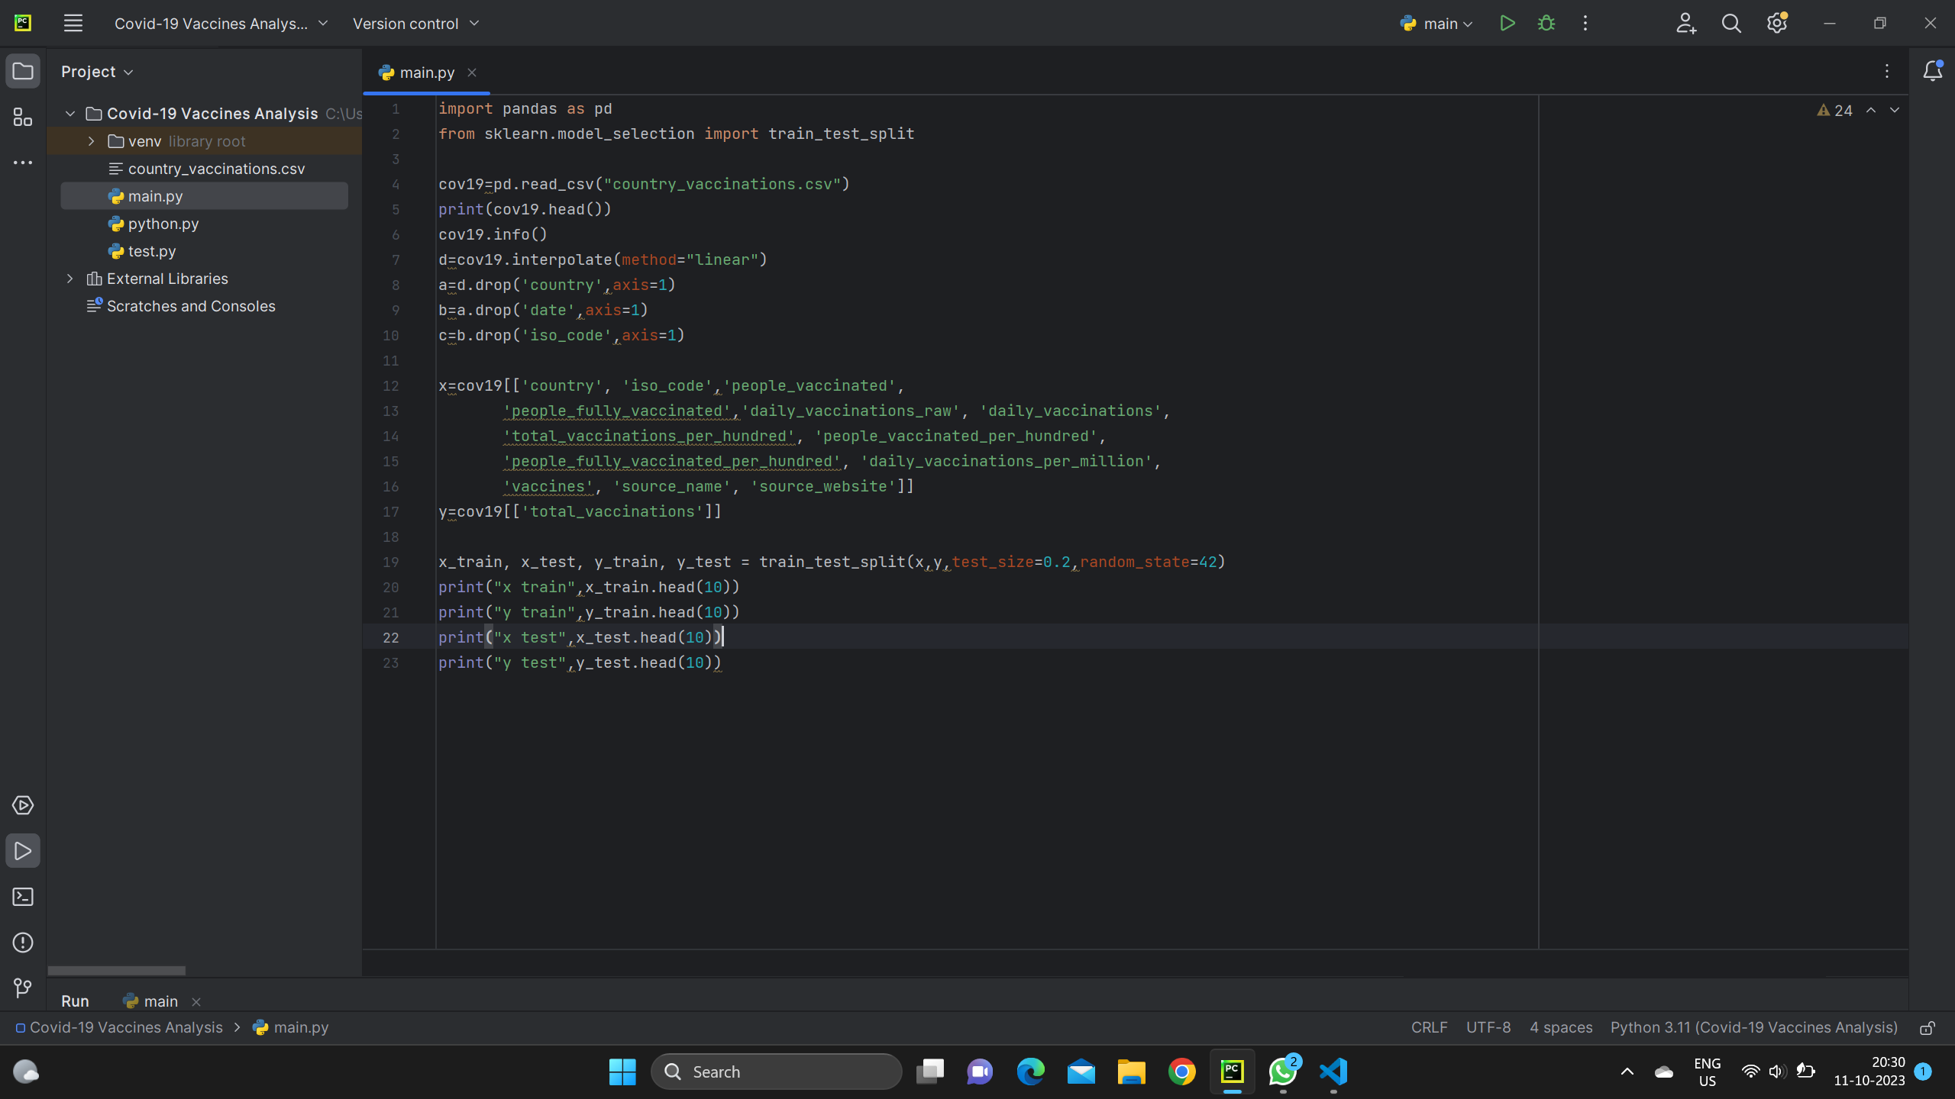
Write a code to Train and Test a Model:

Slide 11
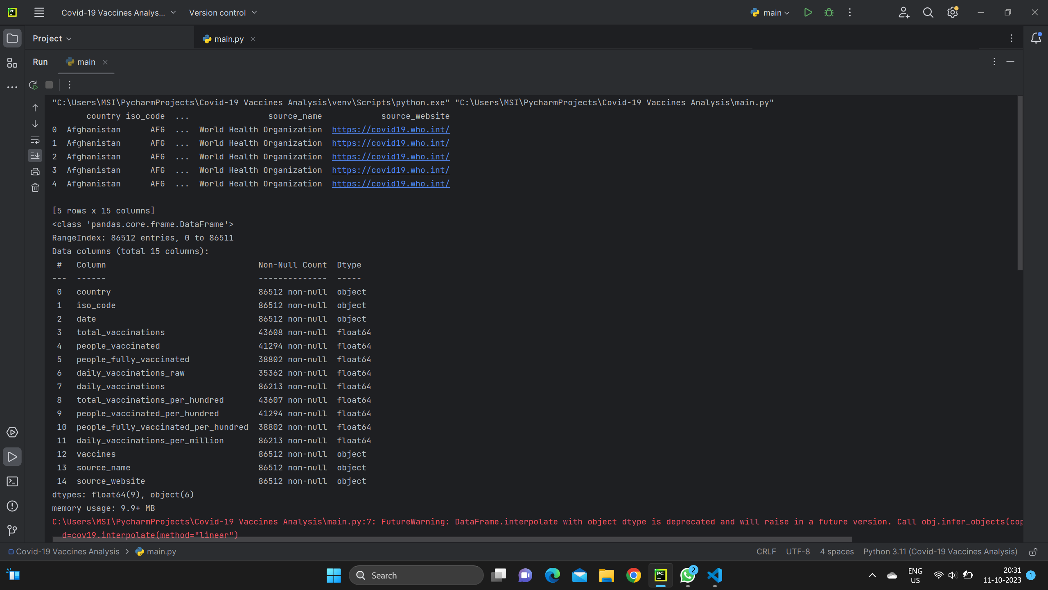
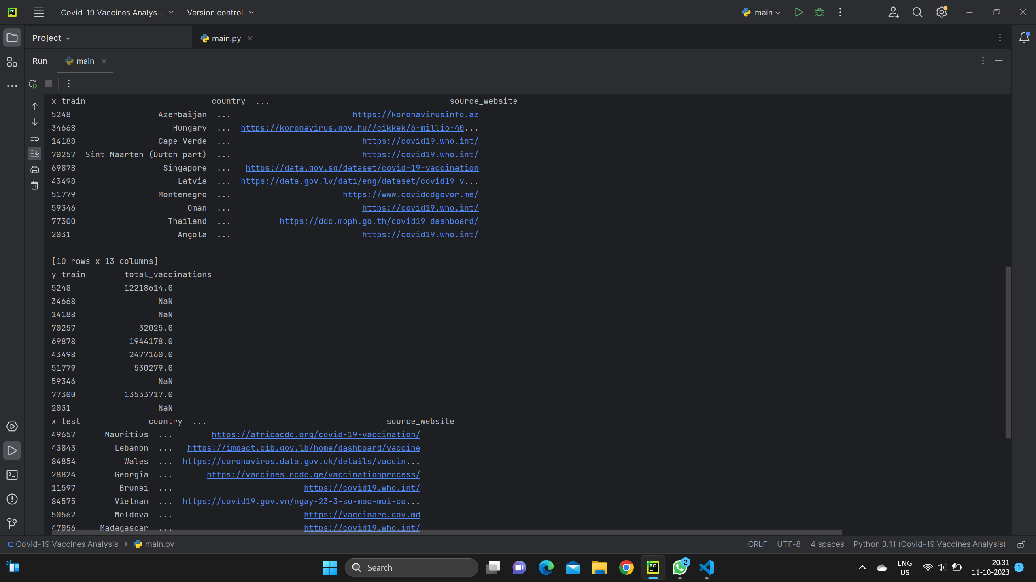
Here X train & y train a Model:

Slide 12
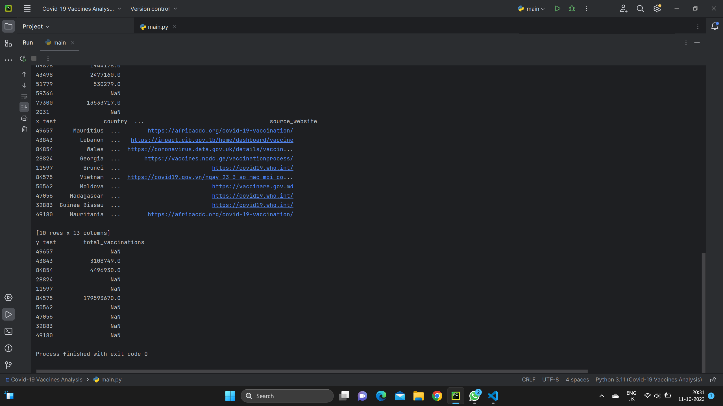
Test a Model (X-test & Y-Test):

Slide 13
X: Input features (independent variables).
y: Target variable (dependent variable).
test_size: The proportion of the dataset to include in the test split.
In this example, it's set to 20%, meaning 80% will be used for training.
random_state: Seed for the random number generator. Setting this ensures that the split is reproducible.
After running this code, you will have X_train, X_test, y_train, and
y_test containing the training and testing sets for both your input
features and target variable.

Slide 14
Model Evaluation
Evaluate the model's performance on the testing data using appropriate metrics (e.g., accuracy, mean squared error, etc.). This step helps you understand how well your model is likely to perform on new, unseen data

Slide 15
What metrics used for the accuracy check ?
The two most popular metrics evaluation metrics for clustering algorithms are the Silhouette coefficient and Dunn’s Index which you will explore next.
Silhouette Coefficient:
The Silhouette Coefficient is defined for each sample and is composed of two scores:
a: The mean distance between a sample and all other points in the same cluster.
b: The mean distance between a sample and all other points in the next nearest cluster.
The Silhouette Coefficient for a set of samples is given as the mean of the Silhouette Coefficient for each sample. The score is bounded between -1 for incorrect clustering and +1 for highly dense clustering. Scores around zero indicate overlapping clusters. The score is higher when clusters are dense and well separated, which relates to a standard concept of a cluster.

Slide 16
Dunn’s Index:
Dunn’s Index (DI) is another metric for evaluating a clustering algorithm. Dunn’s Index is equal to the minimum inter-cluster distance divided by the maximum cluster size. Note that large inter-cluster distances (better separation) and smaller cluster sizes (more compact clusters) lead to a higher DI value. A higher DI implies better clustering. It assumes that better clustering means that clusters are compact and well-separated from other clusters

