Slide 1
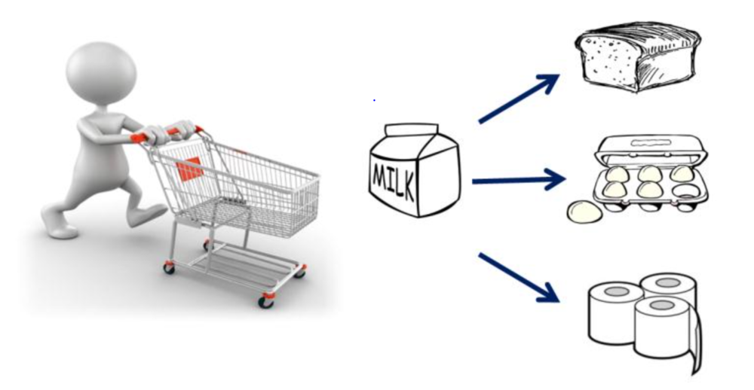
MARKET – BASKET ANALYSIS
MENTOR :
DR. P. JANARDHANAN
TEAM MEMBERS :
1. M Abishaik 2. G Arvind 3. H Arvind

Slide 2
ABSTRACT:
Transaction marketing has become the most important source of profit for various organizations representing one of the largest and most dynamic datasets of user purchased products.
When these transactions are processed in large volumes, they could unravel potential information.
The information could be about the frequent itemset brought by the customer or any relationship between the products or other exploratory data.
With this massive amount of information hidden, there has to be an automatic tool that can discover the patterns based on user-transactions.
The proposed system would help in the following tasks :-
1. Improving marketing strategies.
2. Determining the placement of goods.
3. Designing sales promotions for targeted customers.
This approach uses the K-Apriori algorithm to mine frequent itemsets from the market-basket database after which the association rules are generated.
KEYWORDS:
Transaction marketing , datasets , itemset , K-Apriori algorithm , association rules.

Slide 3
PROPOSED SYSTEM :
The proposed system is to analyse the buying pattern of customers and help the sales team to plan offers and combos to increase the bottom-line of the company to upsell or cross sell the products which are slow moving due to brand competition.
MODULES :
Collecting the retail customer datsets and standardizing the datasets. (Completed)
Carrying out data quality analysis. (Current)
Identifying product purchase behaviour with respect to customer segments.
Identifying low demand products which are either not purchased or purchased in low volumes.
Discovering combinations of fast moving products that can go with low demand products as a combo offer. Recommending the combos by ranking.
PLATFORM :
R Language.

Slide 4
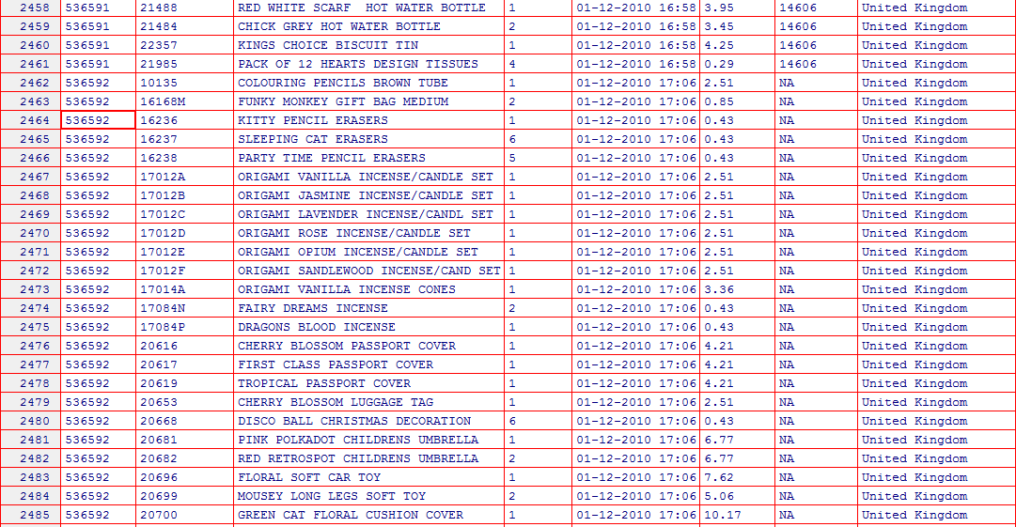
SAMPLE DATASET: (RAW/UNCLEAN DATAS)(MODULE-1 IMPLEMENTATION)

Slide 5
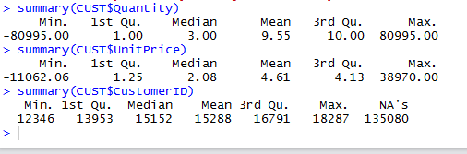
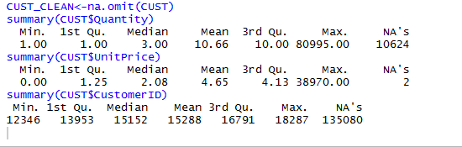
UNCLEAN ANALYSIS RESULTS:
Hence, the analysis of unclean data(data stored as retrieved) gives us misleading information. For instance,
the summary of minimum quantities gives us a negative value which is a wrong analysis.
Only after the removal of ambiguous values(cleaning the data) can the data analysis begin.
CLEAN ANALYSIS RESULTS:

Slide 6
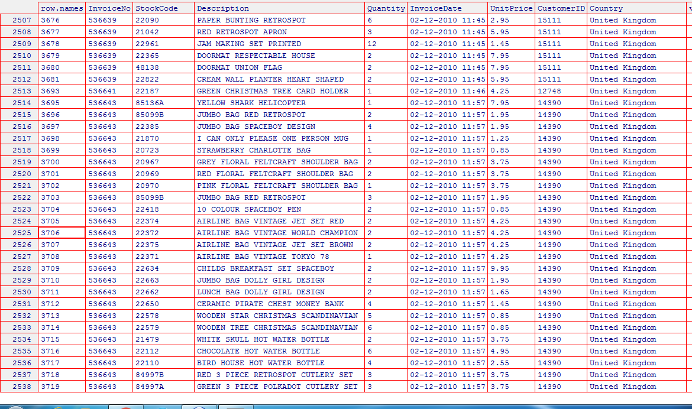
UNAMBIGUOUS TABLE:

Slide 7
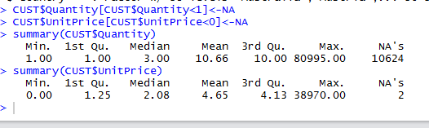
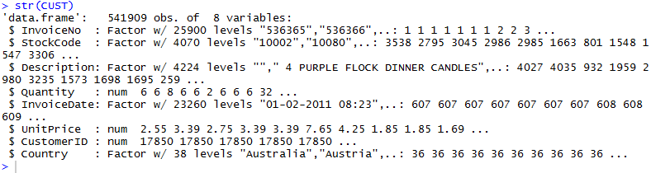
DATA ANALYSIS:
As we can see, the removal of unavailable values(NA) produces a valid result.
The summary of the analyses,i.e, the minimum quantity being 1 and maximum quantity being a finite positive integer is valid.
COMPACT REPRESENTATION:

Slide 8
The main purpose of data analysis is to reveal the hidden information in an efficient and understandable way.
Given a large dataset, it is impractical to calculate the mean, median or other mathematical analysis and provide a summary.
The summary() and str() applied on an unambiguous dataset provides us a clean and compact result.
Hence,the dataset is ready for further analysis.
MODULE 1 COMMANDS:
DATASET IMPORT: var_name <- read.csv/xls(“filepath”,header = TRUE, sep = “,”).
REMOVE NA: var_name <- na.rm = true.
SUMMARY OF A FIELD/DATASET: summary(TABLE_NAME$FIELD_NAME).
COMPACT REPRESENTATION : str(TABLE_NAME).

Slide 9
TECHNICAL KEYWORDS RELATED TO MARKET-BASKET:
Consider the association rule Y => Z, where Y and Z are two products. Y is the antecedent and Z is the consequent.
SUPPORT:
% of all baskets that contain both Y and Z.
Support = P(Y^Z).
CONFIDENCE:
% of times the statements are found to be true. It is a conditional probability.
Confidence(Y=>Z) equals support(Y,Z) / support(Y)
Association-rule discovery is the process of finding strong product associations with a minimum support and/or confidence and an interest of at least one.
The standard for determining associations is achieved by K-Apriori algorithm.

Slide 10
Example (SUPPORT):
Database with transactions ( customer_# : item_a1, item_a2, … )
1: 1, 3, 5.
2: 1, 8, 14, 17, 12.
3: 4, 6, 8, 12, 9, 104.
4: 2, 1, 8.
support {8,12} = 2 (,or 50% ~ 2 of 4 customers).
support {1, 5} = 1 (,or 25% ~ 1 of 4 customers ).
support {1} = 3 (,or 75% ~ 3 of 4 customers).
An itemset is called frequent if its support is equal or greater than an agreed upon minimal value – the support threshold.
add to previous example:
if threshold is assumed 50%, then itemsets {8,12} and {1} called frequent.

Slide 11
EXAMPLE (CONFIDENCE):
Database with transactions ( customer_# : item_a1, item_a2, … )
1: 3, 5, 8.
2: 2, 6, 8.
3: 1, 4, 7, 10.
4: 3, 8, 10.
5: 2, 5, 8.
6: 1, 5, 6.
7: 4, 5, 6, 8.
8: 2, 3, 4.
9: 1, 5, 7, 8.
10: 3, 8, 9, 10.
Conf ( {5} => {8} ) ?
supp({5}) = 5 , supp({8}) = 7 , supp({5,8}) = 4,
then conf( {5} => {8} ) = 4/5 = 0.8 or 80%.

Slide 12
COMPARISON:
Conf ( {5} => {8} ) ? 80% Done.
Conf ( {8} => {5} ) ? 57% Done.
Rule ( {5} => {8} ) more meaningful then
Rule ( {8} => {5} ) .
APRIORI ALGORITHM
Apriori algorithm is an efficient algorithm to find association rules (or, actually, frequent itemsets). The apriori technique is used for “generating large itemsets.” Out of all candidate (k)-itemsets, generate all candidate (k+1)-itemsets.
Example: with k=3(& k-itemsets lexicographically ordered).
{3,4,5}, {3,4,7}, {3,5,6}, {3,5,7}, {3,5,8}, {4,5,6}, {4,5,7}.
generate all possible (k+1)-itemsets, for each sets where we have,
{a1,a2,..a(k-1),X} and {a1,a2,..a(k-1),Y}, results in candidate {a_1,a_2,...a_(k-1),X,Y}.

Slide 13
{3,4,5,7}, {3,5,6,7}, {3,5,6,8}, {3,5,7,8}, {4,5,6,7}.
Out of the above transactions, {3,4,5,7}, {3,5,6,7}, {3,5,6,8}, {3,5,7,8}, {4,5,6,7}
Delete (prune) all itemset candidates with non-frequent subsets. Like; {3,5,6,8} self never frequent since subset {5,6,8} is not frequent.
Actually, here, only one remaining candidate {3,4,5,7}
Last; after pruning, determine the support of the remaining itemsets, and check if they make the threshold.
REFERENCES:
http://www.anderson.ucla.edu/faculty/jason.frand/teacher/technologies/palace/datamining.htm
Textbook: DATABASE Systems Concepts (Silberschatz et al.)

Slide 14
THE END

