Slide 1
AUTOMATED
GEOMETRIC FEATURE
EXTRACTION
from 3D CAD Models using Siemens NX 2506 Open Python API
B-Rep Geometry Analysis
NX Open Python
Zero Feature-Tree Dependency
TXT + CSV Output
March 2026
Siemens NX v2506 | NX Open Python | Geometric B-Rep Analysis

Slide 2
What Is This Project?
A plain-English explanation before the technical details
The Problem
The Solution
Every 3D CAD model contains features: holes, rounded edges (fillets), angled cuts (chamfers), flat walls...
Run ONE script in NX. It reads the raw surface geometry of every face.
To document these, engineers manually click through menus — slow, error-prone, and impossible on imported models with no feature history.
Classifies each face: Is it a hole wall? A fillet? A flat face?
Reports the 3D position (X, Y, Z) and dimensions for every feature.
Saves results to a .txt report AND a .csv spreadsheet — automatically.
NX Open Python | Siemens NX v2506 | Geometric Feature Extraction

Slide 3
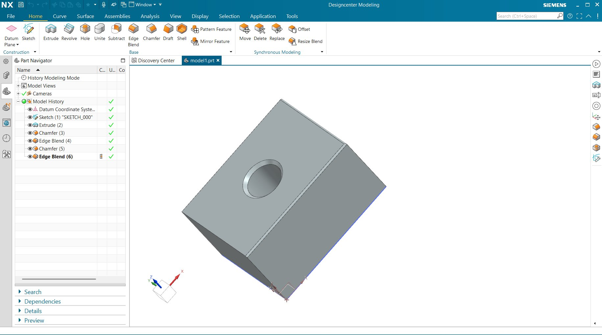
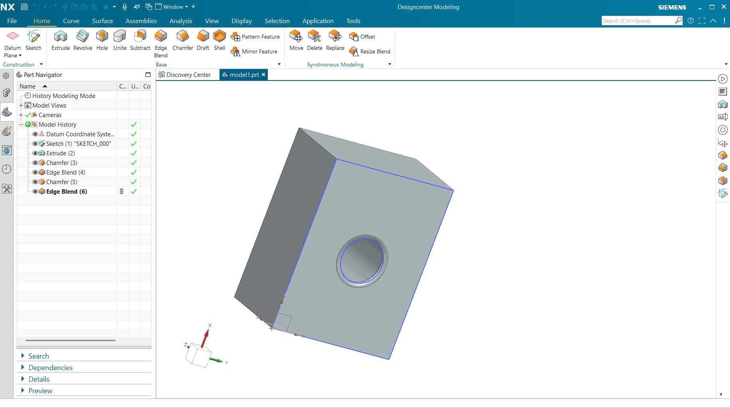
Test Model — Siemens NX 2506
A solid block with 6 applied features — hole, chamfers, fillets
Fig 1: Isometric view — chamfer, fillet, hole visible
Fig 2: Front-face view — entry chamfer on hole visible
Extrude: 430×320×230mm base block
Chamfer (3): 5×5mm on edge
Edge Blend (4): R10mm fillet
Chamfer (5): 10×10mm
Edge Blend (6): R5mm fillet
Hole: Ø110mm, 230mm deep, 45° entry chamfer
NX Open Python | Siemens NX v2506 | Geometric Feature Extraction

Slide 4
How It Works — Processing Pipeline
6 steps from open model to structured output file
STEP 1
Open Part
STEP 2
Get Faces
STEP 3
Classify
Access active NX part + iterate all solid bodies
body.GetFaces() → list of all surface faces
SolidFaceType.value + GetHoleData/BlendData/ChamferData
STEP 4
Extract Data
STEP 5
Coordinates
STEP 6
Write Output
Dimensions, MCS coordinates, axis direction
Parse JournalIdentifier | fallback: edge midpoints
Save .txt report + .csv spreadsheet
NX Open Python | Siemens NX v2506 | Geometric Feature Extraction

Slide 5
API Discovery — Diagnostic-First Approach
Nothing was assumed. Every call was tested live in NX 2506
DIAG 1
API Inventory
DIAG 2
Return Structures
face.GetHoleData(), GetBlendData(), GetChamferData() exist
GetBlendData() → (float, bool)
uf.Modl.AskFaceData() → DOES NOT EXIST in NX 2506
GetChamferData() → (bool, Enum, [d1, d2])
DIAG 3
Enum Values + Hole Data
DIAG 4
Coordinate Units
SolidFaceType.value → 1,2,3,5 confirmed
GetOrigin() returns METRES — multiply ×1000
GetHoleDiameter(), GetHoleDepth() return real mm values
JournalIdentifier {(X,Y,Z)} gives correct mm coordinates
NX Open Python | Siemens NX v2506 | Geometric Feature Extraction

Slide 6
Feature Classification Logic
Priority-ordered decision tree applied to every face
Priority
Feature Type
Condition
Rationale
1
HOLE — Simple/CB/CS
GetHoleData()≠None AND SolidFaceType=2
Type=2 filter prevents the entry-chamfer cone (type=3) from being double-counted as a hole
2
FILLET / ROUND
GetBlendData()[1] == True
Second element of GetBlendData() is the is_blend flag. Radius = GetBlendData()[0]
3
CHAMFER
GetChamferData()[0] == True
First element is a boolean flag. Dimensions in GetChamferData()[2] as [d1, d2]
4
BOSS / PIN
SolidFaceType=2 (no hole data)
Cylindrical face with no associated hole data → external cylinder
5
PLANAR FACE
SolidFaceType=1
Flat surface. All edge lengths extracted for dimension reporting
NX Open Python | Siemens NX v2506 | Geometric Feature Extraction

Slide 7
Extraction Results — model1.prt
11 features detected and documented from the test model
11
1
2
2
6
Total Features
Hole Detected
Chamfers
Fillets
Planar Faces
ID
Type
X (mm)
Y (mm)
Z (mm)
Key Dimensions
#0001
CHAMFER
216.29
2.50
227.50
5×5 mm
#0002
FILLET
152.07
160.00
2.93
R=10 mm
#0005
CHAMFER
150.00
160.00
225.00
10×10 mm
#0007
FILLET
428.54
159.04
228.54
R=5 mm
#0011
HOLE — SIMPLE
265.00
160.00
115.00
Ø110 mm, D=230mm, 45° chamfer
#0003-10
PLANAR FACE (×6)
—
—
—
Various wall, top, floor faces
NX Open Python | Siemens NX v2506 | Geometric Feature Extraction

Slide 8
Output Format — Two Files Generated Automatically
📄 TXT Report
📊 CSV Spreadsheet
ID : #0011 Body: Body-1
Type : HOLE — SIMPLE
MCS Position
X = +265.0000 mm
Y = +160.0000 mm
Z = +115.0000 mm
Dimensions
Diameter = +110.0000 mm
Depth = +230.0000 mm
Chamfer = +45.0000 deg
ID
Type
X
Y
Z
Dia
Depth
#11
HOLE
265
160
115
110
230
#2
FILLET
152
160
2.9
—
—
#1
CHAMFER
216
2.5
228
—
—
One row per feature. All dimensions as columns.
Filter and sort directly in Excel.
NX Open Python | Siemens NX v2506 | Geometric Feature Extraction

Slide 9
Key Technical Findings
Verified facts discovered through live NX 2506 diagnostics
AskFaceData() is GONE in NX 2506
The UF legacy function uf.Modl.AskFaceData() that worked in older NX versions does not exist in NX 2506. All geometry must be read via face.Get*() object methods.
GetOrigin() returns METRES not mm
ResizeHoleData.GetOrigin() returns a Point3d in metres (e.g. 0.265). Multiply ×1000 for mm. GetHoleDiameter() and GetHoleDepth() return mm — the API is internally inconsistent.
SolidFaceType needs .value not int()
int(face.SolidFaceType) throws an error. The correct access is face.SolidFaceType.value which returns an integer: 1=Planar, 2=Cylinder, 3=Cone, 5=Torus.
Holes report on two faces — filter by type
JournalIdentifier is the best coordinate source
NX Open Python | Siemens NX v2506 | Geometric Feature Extraction
GetHoleData() returns data for BOTH the cylindrical wall (type=2) AND the conical entry chamfer (type=3). Filter: only classify as HOLE when type==2, or you get duplicate hole records.
face.JournalIdentifier contains '{(X,Y,Z)}' in mm — parsed with a regex, this gives the most reliable MCS feature centre. More consistent than GetOrigin() across face types.

Slide 10
How to Run — It's Just Three Steps
1
Open Your Model
2
Run the Journal
3
Collect Your Files
File → Open → select your .prt
(or import STEP/IGES — works on dumb solids too)
Tools → Journal → Play Journal
Browse to NX_Feature_Extractor_v1.py → OK
Two files saved next to your .prt:
YourPart_FEATURES.txt
YourPart_FEATURES.csv
No installation. No extra Python packages. No admin rights required. Runs entirely inside NX using the built-in Python interpreter.
NX Open Python | Siemens NX v2506 | Geometric Feature Extraction

Slide 11
CONCLUSION
What was built: A production-ready NX 2506 macro that extracts geometric features from any solid body — native or imported — and saves a structured report + spreadsheet.
What makes it reliable: Every API call was verified live in NX 2506. No assumptions. Broken legacy functions caught, unit inconsistencies documented, enum patterns confirmed.
What comes next: True face normals, thread detection, assembly support, slot/pocket grouping, HTML reports.
GitHub: github.com/[your-username]/nx-feature-extractor
Siemens NX v2506 | NX Open Python API | March 2026

