Slide 1

Product Inventory Management: Optimizing Stock for Business Success
Master theartofbalancingstocklevelstomaximizeprofitabilitywhile
meeting customerdemand.

Slide 2

Why Inventory Management Matters
A Critical Business
TheCostofPoor Control
Asset
Inventory representsone ofthe largest assets on your balance sheet, directly influencing revenue streams and customer satisfaction
levels.
Withoutproper management,
businesses face costly stockouts that disappoint customers or overstocking that ties up capital
and increases holding costs.

Slide 3
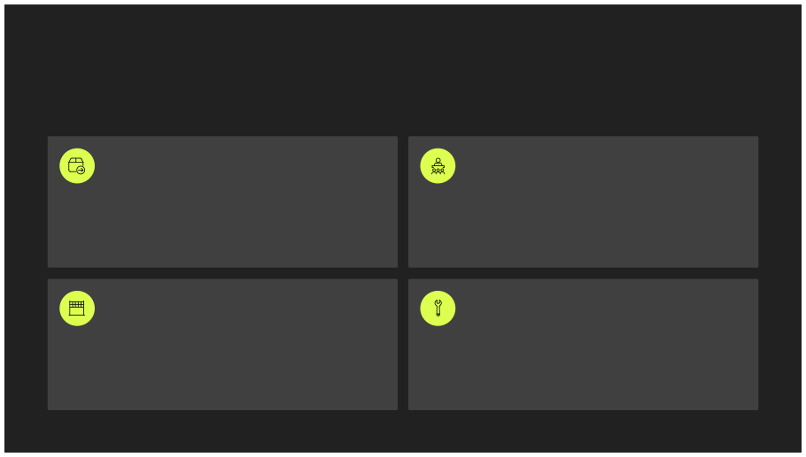
Types of Inventory You Need to Know
Understanding the different categories of inventory helps you apply the right management strategies to each type.
Raw Materials
Work-in-Process (WIP)
Basic inputs and components used in the production process to
create finished goods.
Semi-finished goods currently moving through various
production stages and manufacturing operations.
Finished Goods
MRO Supplies
Completed products ready for immediate sale and delivery to
end customers.
Maintenance, repair, and operating supplies that support
production but don't become part of the final product.

Slide 4

Key Inventory Management Objectives
01
Ensure Product Availability
Meetcustomerdemandconsistentlywithoutinterruption or delay.
02
Minimize Costs
Reduceinventoryholding and ordering expenses while maintaining service levels.
03
Balance Stock Levels
Avoidbothexcessinventorythatties up capital and shortages that lose sales.
04
Improve Efficiency
Enhanceoperationalperformance and increase forecasting accuracy across all channels.

Slide 5
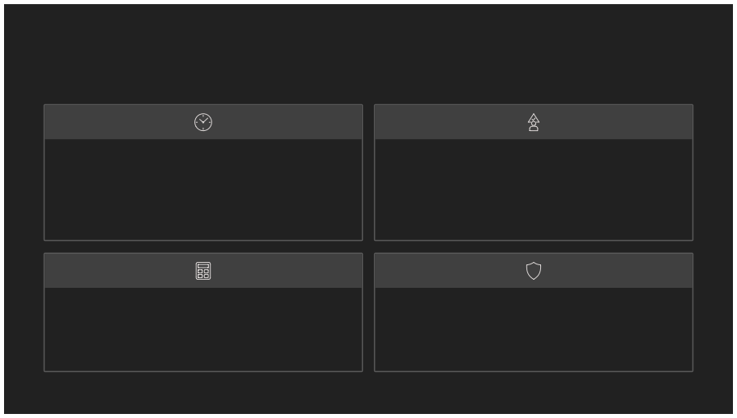
Proven Inventory Management Strategies
Just-In-Time (JIT)
ABC Analysis
Prioritize management efforts based on item value and turnover rate, focusing resources on high-impact inventory items.
Reduce inventorycostsbyreceiving goods only as they're needed in production, minimizing storage requirements and waste.
Economic Order Quantity (EOQ)
Safety Stock
Calculate theoptimalordersizethatminimizes total inventory costs including ordering and holding expenses.
Maintainbufferinventory to prevent stockouts during
unexpected demand spikes or supply chain delays.

Slide 6



Leveraging Technology: Real- Time Inventory Tracking
Channel Integration
ConnectwithPOSsystemsandsales channels for accurate, real-time stock level visibility across all
locations.
Automated Alerts
Receivenotificationswheninventory reaches reorder points or drops to critical low levels.
Data Analytics
Identifyslow-movingitems and optimize replenishment schedules using intelligent data analysis.
Proven Results
Companiesusingreal-time tracking reduce stockouts by up to 30% and improve order accuracy
significantly.

Slide 7

Common Challenges in Inventory Management
Inventory Shrinkage
Lossduetotheft,damage,orrecording errors that erodes profitability.
Deadstock
Unsellableorobsolete inventory that ties up valuable capital and
storage space.
Forecasting Errors
Inaccuratepredictionsleadingto either overstock situations or
disappointing stockouts.
Multi-Location Complexity
Coordinatinginventoryacrossmultiplewarehouses and retail locations.

Slide 8

Best Practices for Inventory Optimization
Regular Cycle Counting
Conduct frequentauditsandphysicalcounts to maintain inventory accuracy and
identify discrepancies quickly.
Demand Forecasting
Analyzehistoricalsalesdataand market trends to predict future inventory needs
with greater precision.
Supplier Collaboration
Buildstrongrelationshipswithsuppliers for flexible lead times and rapid
replenishment when needed.
Continuous Review Systems
Monitorhigh-valueorfast-movingitemsconstantly to optimize reorder
points and quantities.

Slide 9
Measuring Success: Key Metrics to Track
Monitor these critical performance indicators to evaluate and improve your inventory management effectiveness.
8
2%
30
25%
Inventory Turnover
DaysofInventory
Stockout Rate
CarryingCostof
Ratio
on Hand
Frequency of running out of
Inventory
How often inventory is sold
Average number of days
stock for key items (target:
Total cost to hold inventory
and replaced during a specific
inventory sits in storage before being sold (lower is better).
under 3% for most
businesses).
including storage, insurance, and depreciation (typically 20- 30% of inventory value).
period (industry average: 4-12 times annually).

Slide 10

Transform Your Inventory Management Today
Drive Profitability
Boost Customer Satisfaction
Effective inventory management directly impacts your bottom line by reducing costs and optimizing
working capital.
Neverdisappoint customers with
stockouts when you have the right products available at the right time.
Gain Operational Agility
Investintechnology, adopt provenbestpractices, and continuously monitor
key metrics to unlock your business's full potential.
Start your journey to smarter inventory control now and watch your business
transform.

