Slide 1
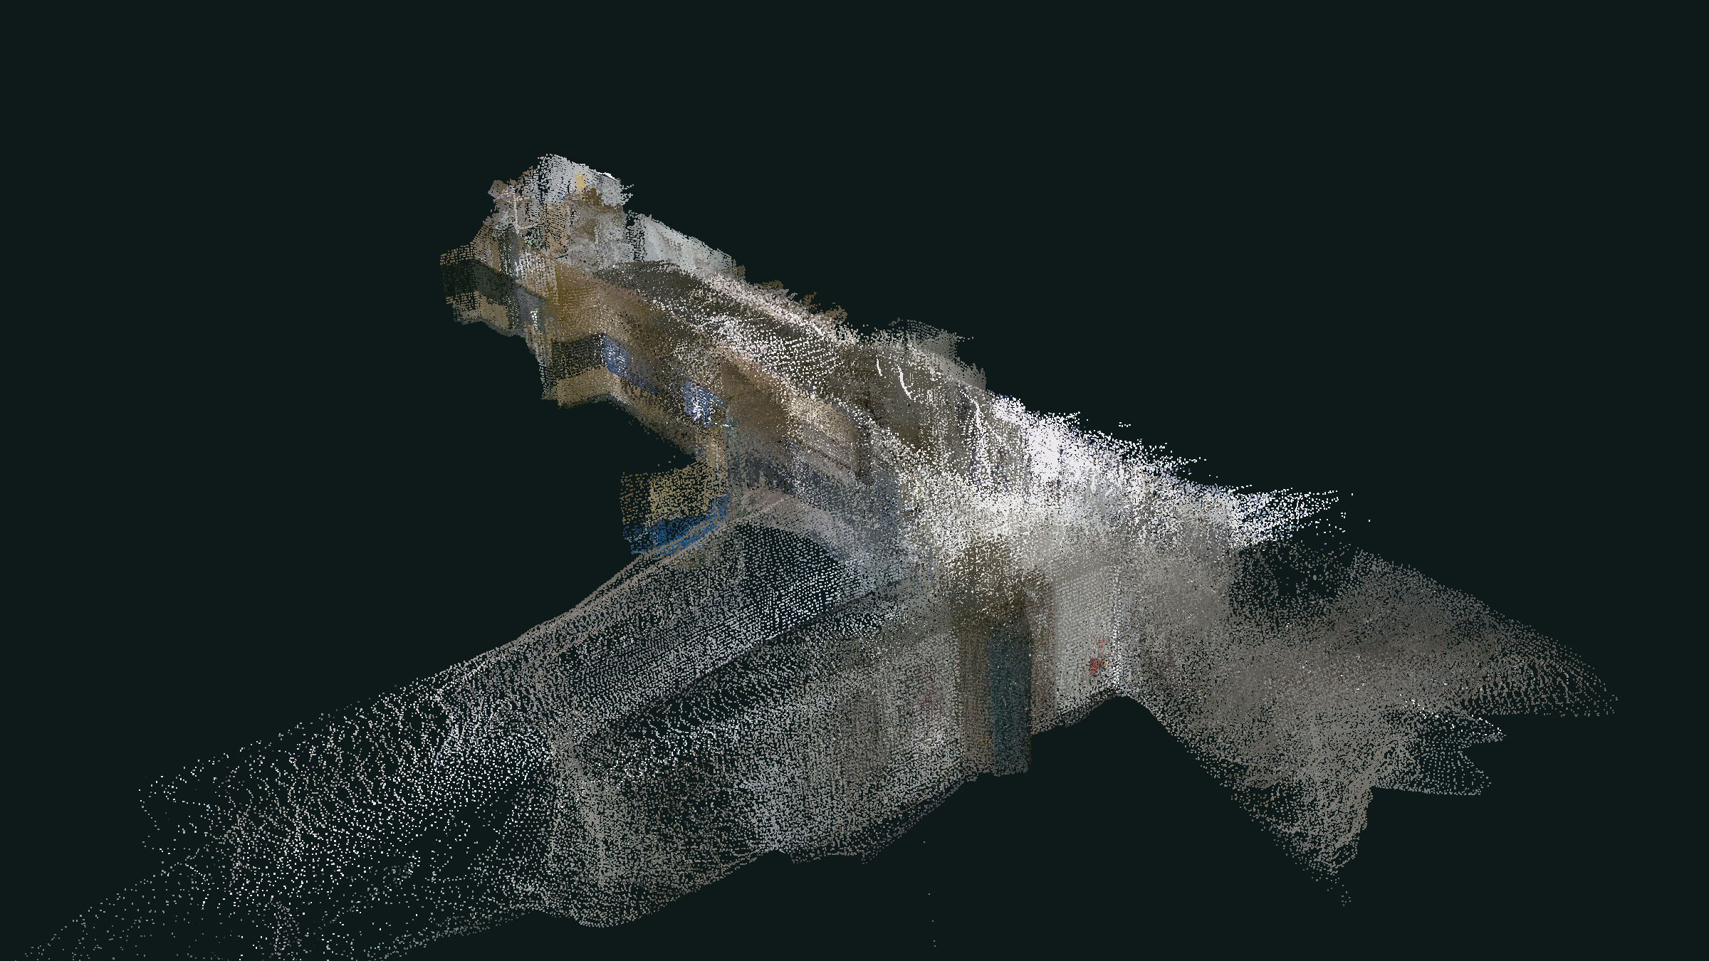
SMART FACILITY MANAGEMENT · WEEK 04
Point Cloud Data
Exploring a robot facility scan
포인트 클라우드 데이터 — 로봇 시설 스캔 탐색하기
What a point cloud is, how our robot captured one in a real building, and what a facility manager can do with it.
포인트 클라우드란 무엇이며, 로봇이 실제 건물에서 어떻게 수집했고, 시설 관리에 어떻게 활용할 수 있는지 알아봅니다.
660,034 points · scanned by our UGV, Sept 2026
Smart Facility Management · Week 04 — Point Cloud Data
Notes:
Welcome to week 4. Before we write any code, we need to understand the kind of data we'll be working with: point clouds. The image on the right is not a photo and not a 3D model — it is 660,000 individual dots measured by our robot as it drove through a corridor in our building. By the end of this short lecture you should be able to explain what each of those dots is, how the robot measured them, and why they are useful for facility management.

Slide 2
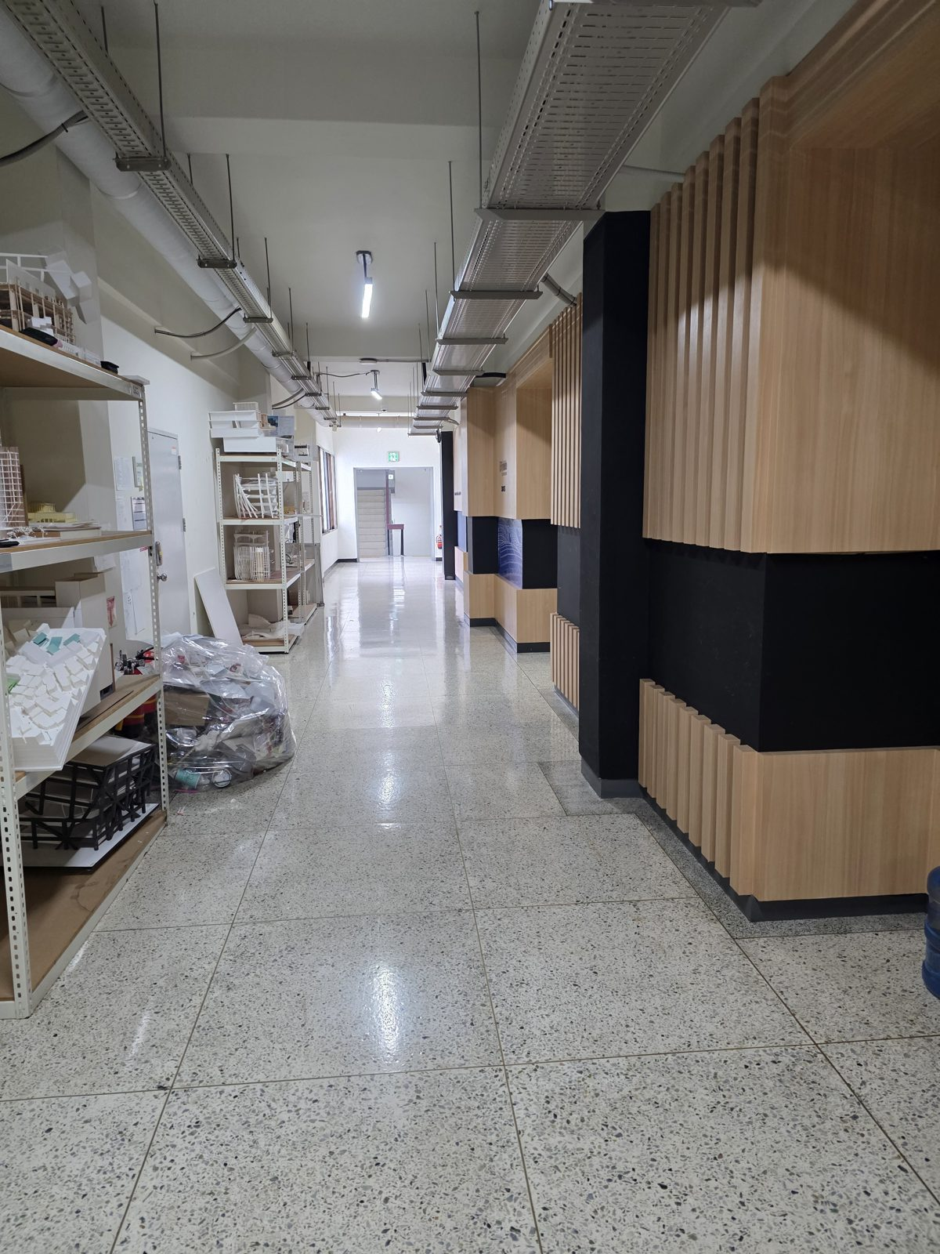
POINT CLOUD DATA · WEEK 04
A photo vs. a point cloud
사진 vs. 포인트 클라우드 — 같은 복도, 다른 데이터
Photo · 사진
Colour on a flat grid of pixels. No depth — you can't measure the corridor from it.
Point cloud · 포인트 클라우드
Hundreds of thousands of dots, each at a real 3D position in metres. You can walk around it — and measure it.
Smart Facility Management · Week 04 — Point Cloud Data
2 / 15
Notes:
On the left is a normal photo of the corridor. A photo stores colour on a flat grid — every pixel knows its colour, but not how far away it is. You cannot measure the width of the corridor from this picture. On the right is the robot's scan of the same space. It looks a bit like a ghostly model, because it is made only of dots. But every dot has a real position in metres, so we can rotate it, look from any angle, and measure distances. That is the key difference: a point cloud is measured 3D geometry, not a picture.

Slide 3
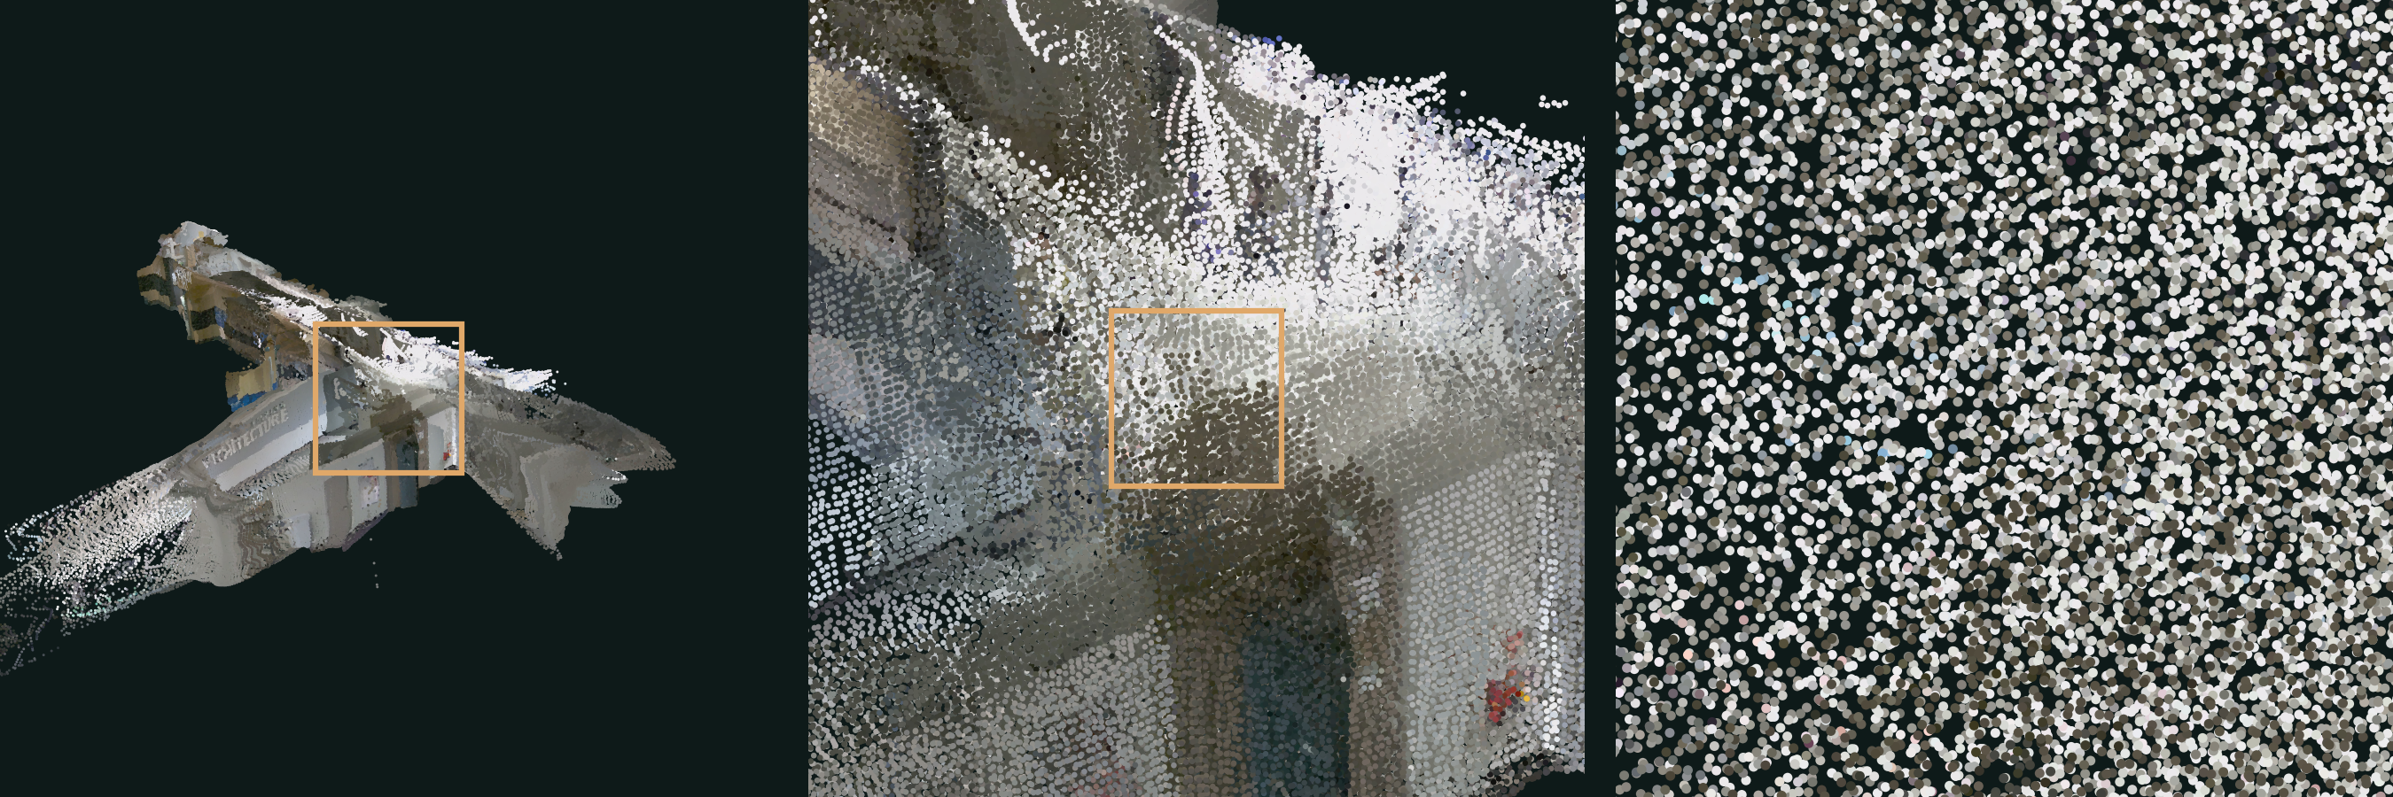
POINT CLOUD DATA · WEEK 04
Zoom in far enough: it's just dots
확대해 보면 — 점들의 모음일 뿐입니다
1 · The whole scan
Looks like a solid 3D model of the corridor.
2 · One wall
Surfaces start to look grainy.
3 · Individual points
Separate dots about 5 cm apart. Nothing in between.
A point cloud = a collection of points in 3D space, each one a spot on a surface the sensor measured.
Smart Facility Management · Week 04 — Point Cloud Data
3 / 15
Notes:
Let's zoom in. From far away the scan looks like a solid model. The orange box shows where we zoom next. At the wall level it starts to look grainy, and at the closest zoom you can see it is really just separate dots with empty space in between. There are no surfaces, no walls as objects — only points. Each point is one spot on a real surface that the sensor hit. That's the whole idea: a point cloud is simply a big collection of 3D points.

Slide 4
POINT CLOUD DATA · WEEK 04
Every point is just a row of numbers
점 하나 = 숫자 한 줄 (위치 x, y, z + 색상 r, g, b)
position (metres) |  |  | colour (0–255)
x | y | z | r | g | b
1.060 | -11.999 | 0.601 | 89 | 82 | 63
1.101 | -12.008 | 0.601 | 124 | 120 | 119
1.017 | -11.999 | 0.618 | 90 | 83 | 65
1.108 | -11.988 | 0.605 | 86 | 81 | 61
1.072 | -12.053 | 0.603 | 89 | 84 | 64
… 660,034 rows in facility_scan_color.ply
z
the highlighted row
y
x
Points can carry more than position and colour: laser intensity (how strongly it bounced back), time, surface direction (normal), and a class label such as wall, floor or door.
x 1.060 y −11.999 z 0.601
rgb(89, 82, 63)
위치와 색 외에도 반사 강도, 시간, 표면 방향, 분류(벽·바닥·문) 같은 정보를 담을 수 있습니다.
Smart Facility Management · Week 04 — Point Cloud Data
4 / 15
Notes:
Here are real rows from the file you'll open today. Each point is one row: x, y, z give its position in metres, and r, g, b give its colour from 0 to 255. The highlighted row is the point drawn on the right — it sits at x = 1.06 m, y = −12.0 m, z = 0.60 m, and it's a brownish grey. That's all a point cloud file is: a very long table. Our colour scan has 660,034 rows. Some sensors add extra columns, like laser intensity or a class label saying whether the point belongs to a wall, floor or door.

Slide 5
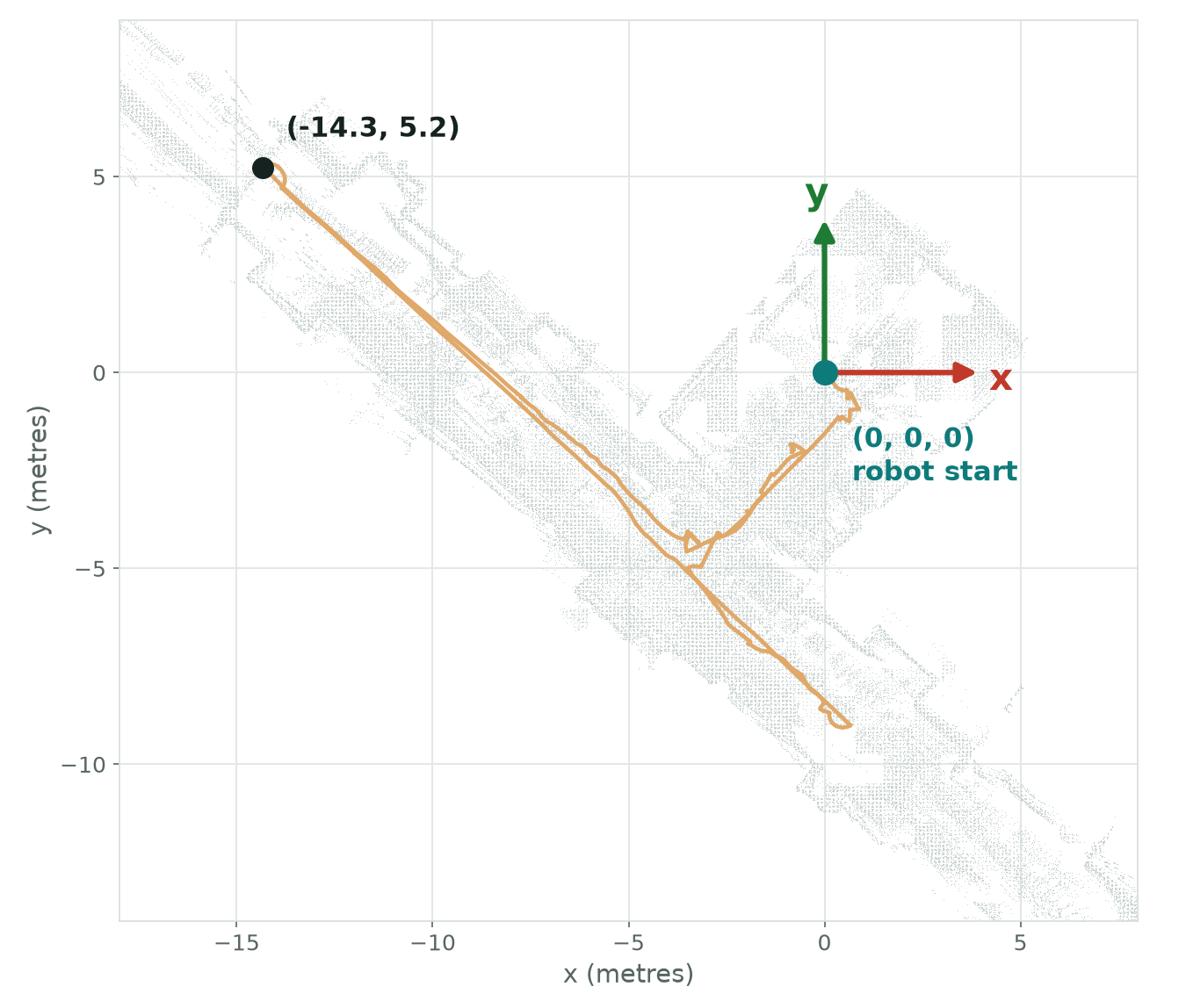




POINT CLOUD DATA · WEEK 04
Where is (0, 0, 0)?
좌표계 — (0, 0, 0)은 어디일까? 숫자를 위치로 읽는 법
Origin = where the robot started
The map's (0, 0, 0) is the robot's start point, not a corner of the building.
Units are metres
(−14.3, 5.2) means 14.3 m along −x and 5.2 m along +y from the start.
z points up
Height above the start. The floor sits a little below 0 because the sensor is on top of the robot.
Every scan has its own origin
The colour scan and the lidar map start from different places, so their numbers don't line up.
Smart Facility Management · Week 04 — Point Cloud Data
5 / 15
Notes:
If every point is x, y, z, the obvious question is: measured from where? A point cloud always lives in a coordinate system. For our robot, (0, 0, 0) is simply where the robot was when it started scanning — here, in the side room. The units are metres, x and y are horizontal, and z points up. So the black dot at (−14.3, 5.2) is the far end of the corridor: 14.3 metres in the negative x direction and 5.2 metres in positive y from the start. One caution: each scan picks its own origin. Our colour scan and lidar map were made in separate runs, so the same wall has different numbers in each file. Lining up scans is called registration — a topic for later.

Slide 6
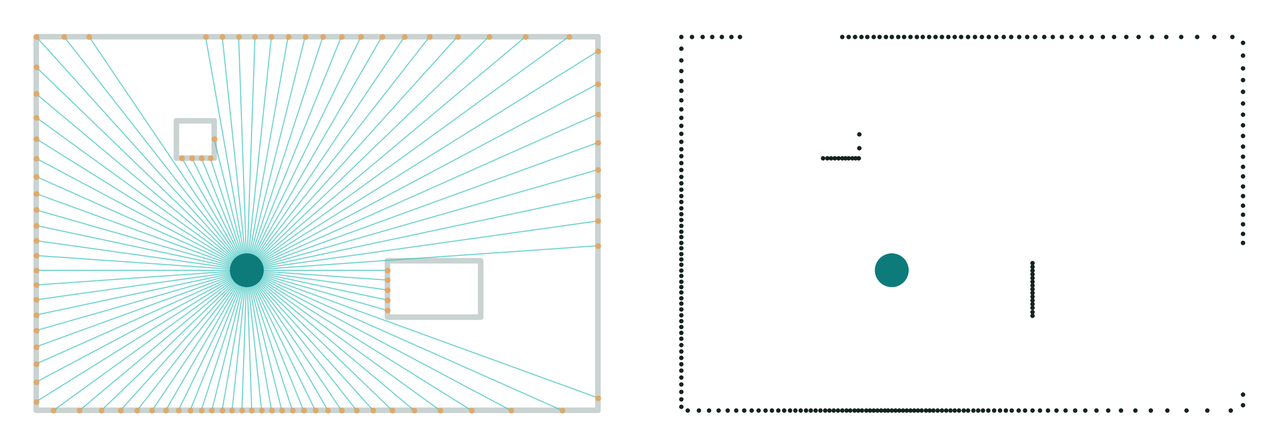
POINT CLOUD DATA · WEEK 04
How a LiDAR measures distance
라이다(LiDAR)는 어떻게 거리를 잴까? — 빛이 돌아오는 시간을 잰다
1
Fire
Send a short, eye-safe laser pulse.
2
Time the echo
Measure how long until the light bounces back.
3
Compute distance
distance = speed of light × time ÷ 2
(echo after 20 ns → 3 m away)
What the sensor does
Beams spin out and hit the walls, a table and a column.
What the robot actually gets
Only the points. Notice the gaps — shadows behind objects the laser couldn't see.
4
Spin and repeat
96 beams × 360°, 10 turns a second → up to 860,000 points every second.
Smart Facility Management · Week 04 — Point Cloud Data
6 / 15
Notes:
LiDAR stands for Light Detection And Ranging. It works like an echo, but with light. The sensor fires a laser pulse, times how long it takes to bounce back, and because we know the speed of light we can calculate the distance. We divide by two because the light travels there and back. Light is fast — an echo after just 20 nanoseconds means the wall is 3 metres away. The sensor spins and has many beams, so it builds up hundreds of thousands of points per second. The diagram on the right shows this from above: the beams hit the room, and on the far right is what the robot actually receives — only dots. Point out the gaps behind the column and table: the laser can't see through objects, so there are shadows. That's why the robot must drive around to scan everything.

Slide 7
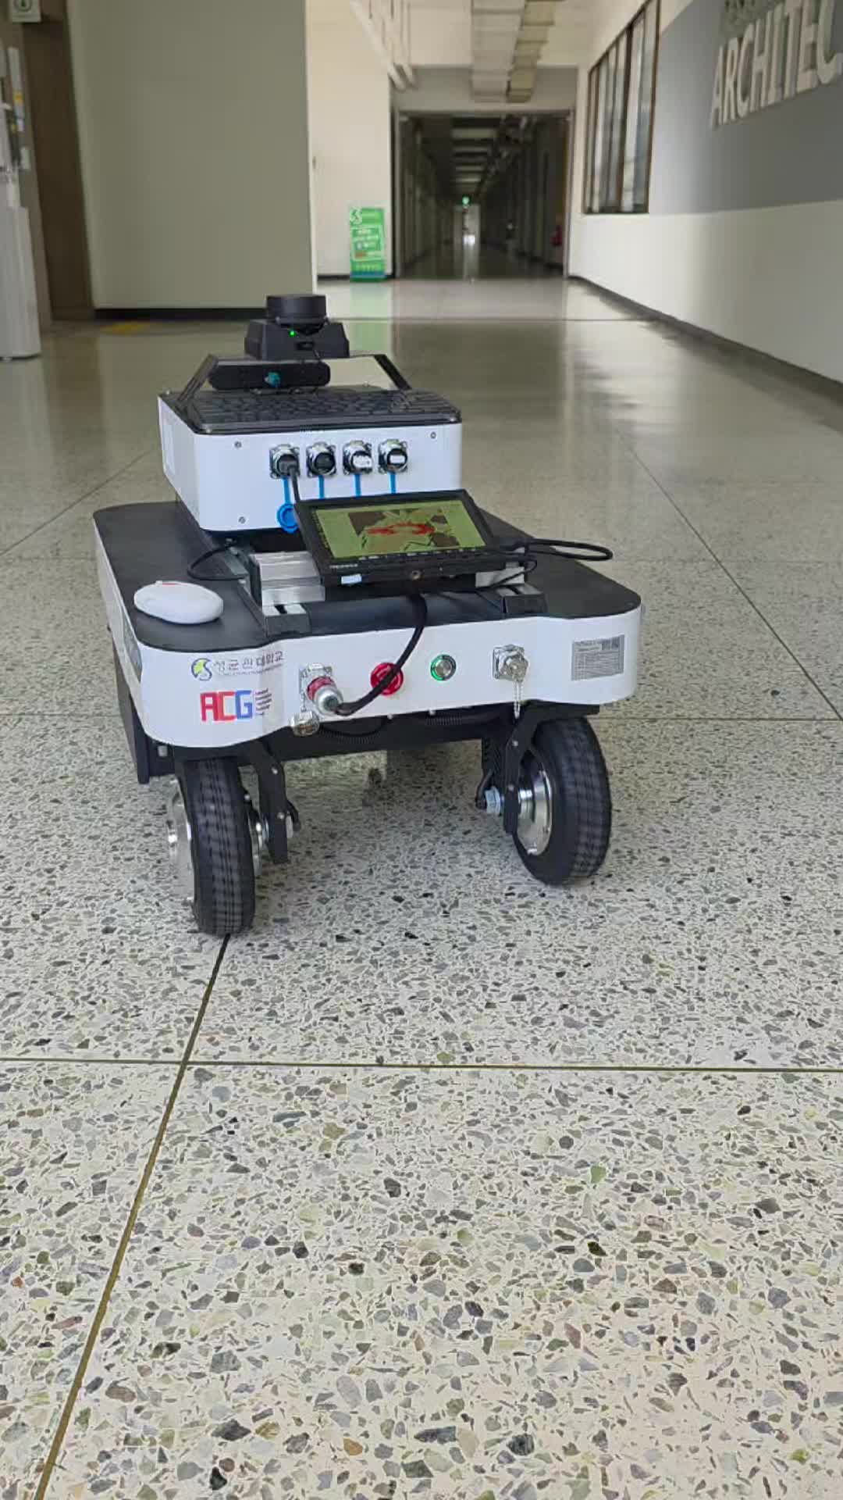
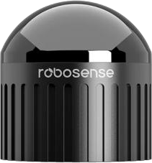

POINT CLOUD DATA · WEEK 04
Our robot and its two 'eyes'
우리 로봇과 두 개의 '눈' — 라이다는 형태, 카메라는 색
3D LiDAR
Stereo camera
RoboSense Airy
ZED X
Measures shape: where things are
Adds colour: what things look like
형태 측정 — 사물의 위치
색상 추가 — 사물의 모습
96 laser beams
360° × 90° field of view
Up to 860,000 points / second
Range up to 60 m
Two lenses, like human eyes
Depth from 0.3 to 20 m
1920 × 1200 colour at 60 fps
Gives each point its r, g, b
Smart Facility Management · Week 04 — Point Cloud Data
7 / 15
Notes:
This is the robot that collected today's data — an unmanned ground vehicle built on an AgileX Ranger Mini base with an NVIDIA Jetson computer. It has two key sensors. The dome on top is a RoboSense Airy 3D LiDAR: 96 laser beams, sees all the way around and 90 degrees vertically, up to 860,000 points per second. It gives us accurate shape. The ZED X is a stereo camera — two lenses like our two eyes — which estimates depth and, importantly, captures colour. When we combine them, each point gets a position from the geometry and a colour from the camera. That's how we get the coloured scan you saw on the earlier slides.

Slide 8
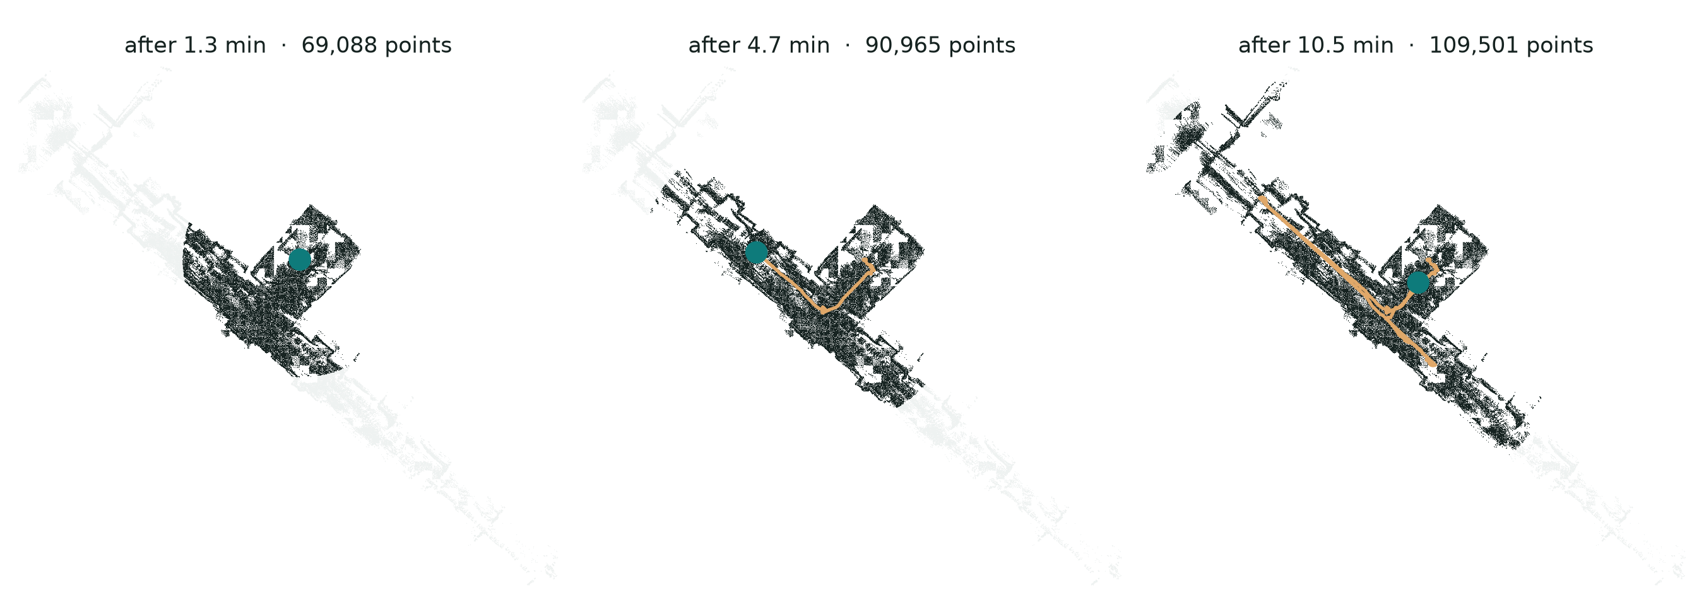
POINT CLOUD DATA · WEEK 04
Building the map while driving (SLAM)
주행하면서 지도 만들기 — SLAM: 위치 추정과 지도 작성을 동시에
10.5 min
of driving
64 m
travelled
4,856
robot positions logged
SLAM = Simultaneous Localization And Mapping. Each new scan is matched to the map so far: that tells the robot where it is, and the new points extend the map. Orange = robot path, teal = robot now, dark = map built so far.
새 스캔을 기존 지도와 맞춰 로봇의 위치를 알아내고, 새 점들로 지도를 넓혀 갑니다.
Smart Facility Management · Week 04 — Point Cloud Data
8 / 15
Notes:
One scan only sees what's around the robot at that moment, with shadows. To map a whole floor, the robot drives and keeps scanning. The clever part is SLAM: each new scan is matched against the map built so far. That match tells the robot where it is, and the new points are added to extend the map — both at the same time. These three pictures are from our real run: after 1.3 minutes the robot has mapped the room it started in; after 4.7 minutes it has entered the corridor; after 10.5 minutes it has covered 64 metres. The orange line is the robot's path — you'll plot exactly this path yourselves in the hands-on part.

Slide 9
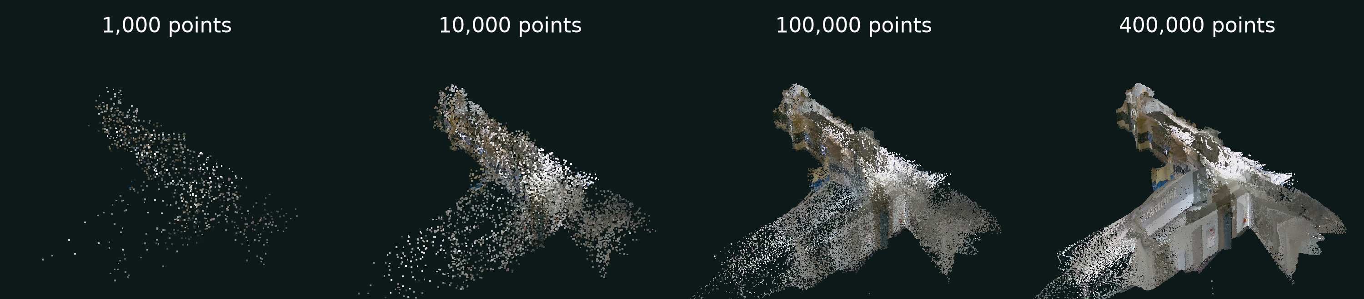
POINT CLOUD DATA · WEEK 04
More points = more detail (and bigger files)
점이 많을수록 더 자세하지만 파일도 커집니다
Raw scan from the robot
Class file you'll download
Downsampling
Keep one point per 5 cm cube (a “voxel”). Plenty for measuring a corridor — and it loads in a second.
8.1 million points
660,000 points
252 MB
10 MB
Smart Facility Management · Week 04 — Point Cloud Data
9 / 15
Notes:
How many points do you need? With 1,000 points you can barely tell it's a building. At 10,000 you see the shape. At 100,000 you can recognise walls and doors, and at 400,000 you see details. More points means more detail — but also bigger files and slower software. The robot's raw scan had 8.1 million points and was 252 MB, too big to download in class. So I downsampled it: split space into 5 cm cubes, called voxels, and keep one point per cube. That gives 660,000 points in about 10 MB, which is still detailed enough for everything we'll do today. Choosing the right density is a real decision in facility projects.

Slide 10
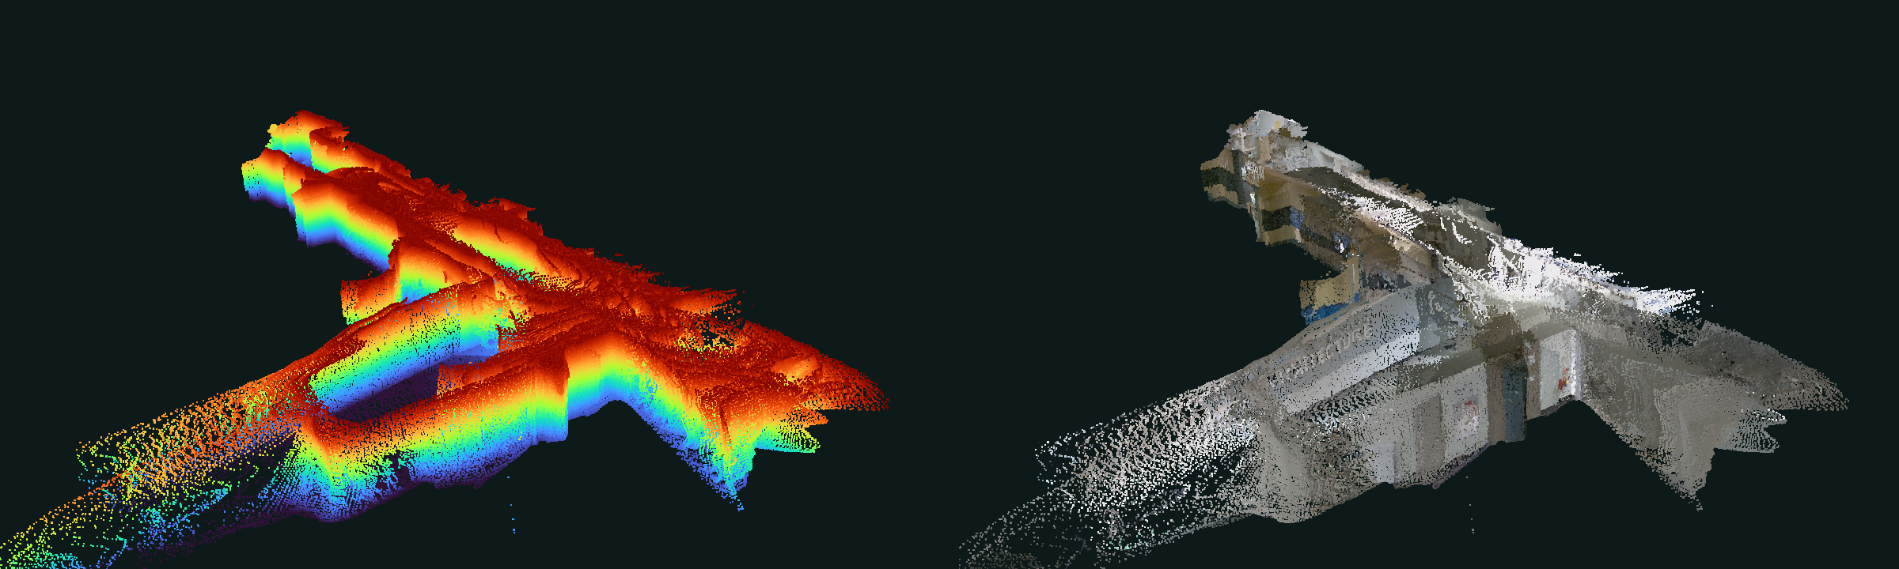
POINT CLOUD DATA · WEEK 04
Same points, different colours
같은 점, 다른 색 — 무엇으로 색을 칠할지 고를 수 있습니다
Coloured by height (z)
Blue = floor, red = about 2 m up (ceiling removed so we can see inside). Great for spotting the floor, steps and clutter.
Coloured by the camera (r, g, b)
The real colours of walls, panels and doors. Great for recognising what things are.
The geometry doesn't change — only the rule for colouring each point. In Python it's a single line of code.
Smart Facility Management · Week 04 — Point Cloud Data
10 / 15
Notes:
Because every point is just numbers, we can choose how to colour it. On the left, each point is coloured by its height — blue is the floor, red is high up. We removed the ceiling points so we can look inside like a dollhouse. On the right, the same points are coloured using the camera's real colours. The positions are identical; only the colouring rule changed. Height colouring makes the floor and obstacles pop out; real colour helps you recognise what things are. Later you'll switch between these with a single line of code.

Slide 11
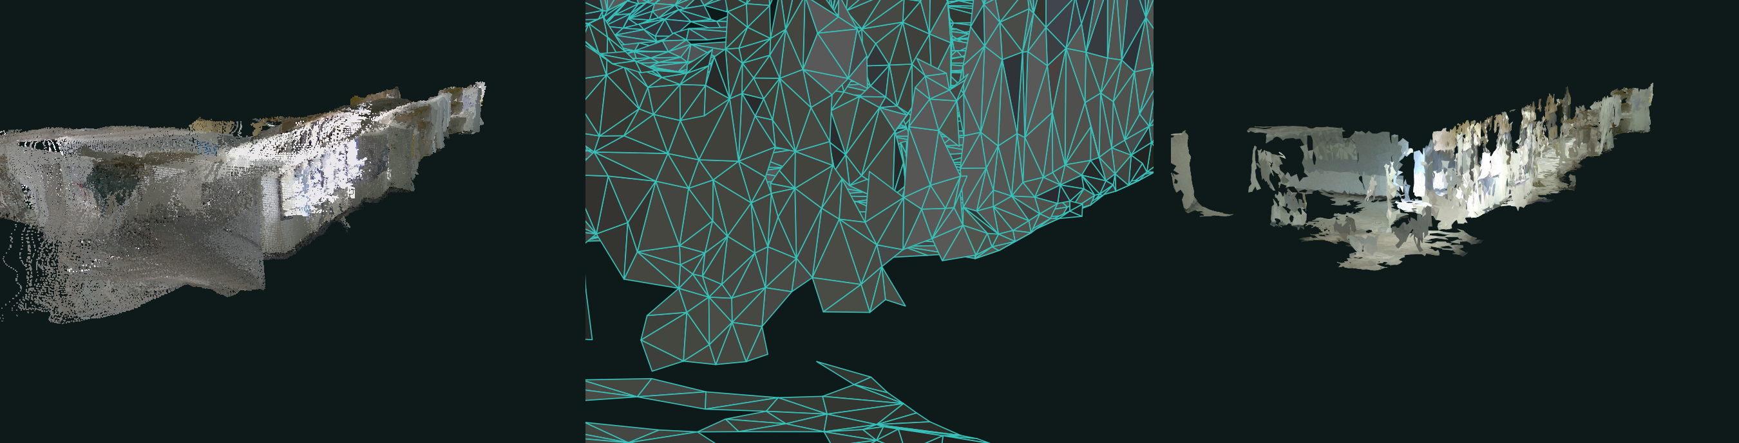
POINT CLOUD DATA · WEEK 04
From points to surfaces: meshes
점에서 면으로 — 메시(mesh): 점들을 삼각형으로 연결
1 · Point cloud
Separate dots with gaps in between.
2 · Mesh (zoomed in)
Triangles connect neighbouring points into surfaces.
3 · Textured mesh
The camera's photos painted onto the triangles.
Meshes look solid and feed digital twins and BIM — but they leave holes wherever the scanner saw nothing.
Smart Facility Management · Week 04 — Point Cloud Data
11 / 15
Notes:
A point cloud has no surfaces — just dots. Many tools turn it into a mesh: software connects neighbouring points with small triangles, so walls and floors become real surfaces. The middle picture zooms right in so you can see those triangles. Then the camera's photos can be painted onto the triangles — that's the textured mesh on the right, made from the same robot run. Meshes look solid and are what you usually see in digital twins and BIM models, and they're great for visualisation. But look at the holes: wherever the scanner saw nothing, there is simply no surface. The point cloud is the measurement; the mesh is an interpretation built on top of it.

Slide 12
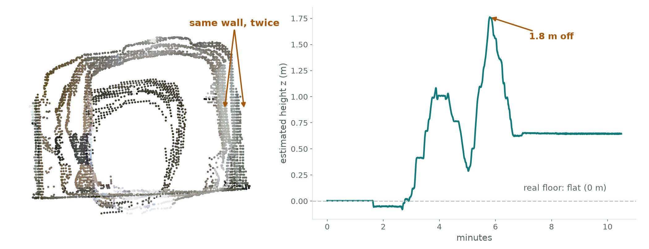




POINT CLOUD DATA · WEEK 04
Scans aren't perfect
스캔은 완벽하지 않습니다 — 흔한 오차 알아보기
Other things to watch for
Glass and mirrors
Lasers pass through or bounce off: missing or phantom points.
Moving people
Leave smeared 'ghost' trails.
Shadows
Nothing is recorded behind objects.
Always sanity-check
Compare one measurement with a tape measure or drawing.
Ghost walls
A slice across the corridor at y = −6 m. The robot passed twice and saw the wall in slightly different places.
Drift
The floor is flat, but the robot's estimate of its own height drifted by up to 1.8 m.
Smart Facility Management · Week 04 — Point Cloud Data
12 / 15
Notes:
Before we trust numbers from a scan, we need to know how scans go wrong. These are real problems from our own data. On the left is a slice across the corridor: the robot drove past this spot more than once, and each time it thought it was in a slightly different place, so the same wall appears twice — a ghost wall. On the right is the robot's own estimate of its height over the run. The floor is flat, so this line should stay at zero, but small errors added up and it drifted by 1.8 metres. This is called drift, and it's why SLAM systems try to recognise places they've already been and correct themselves. Other common problems: glass and mirrors confuse lasers, people walking past leave ghost trails, and you get shadows behind objects. The lesson for facility managers: always check at least one measurement against a tape measure or a drawing.

Slide 13
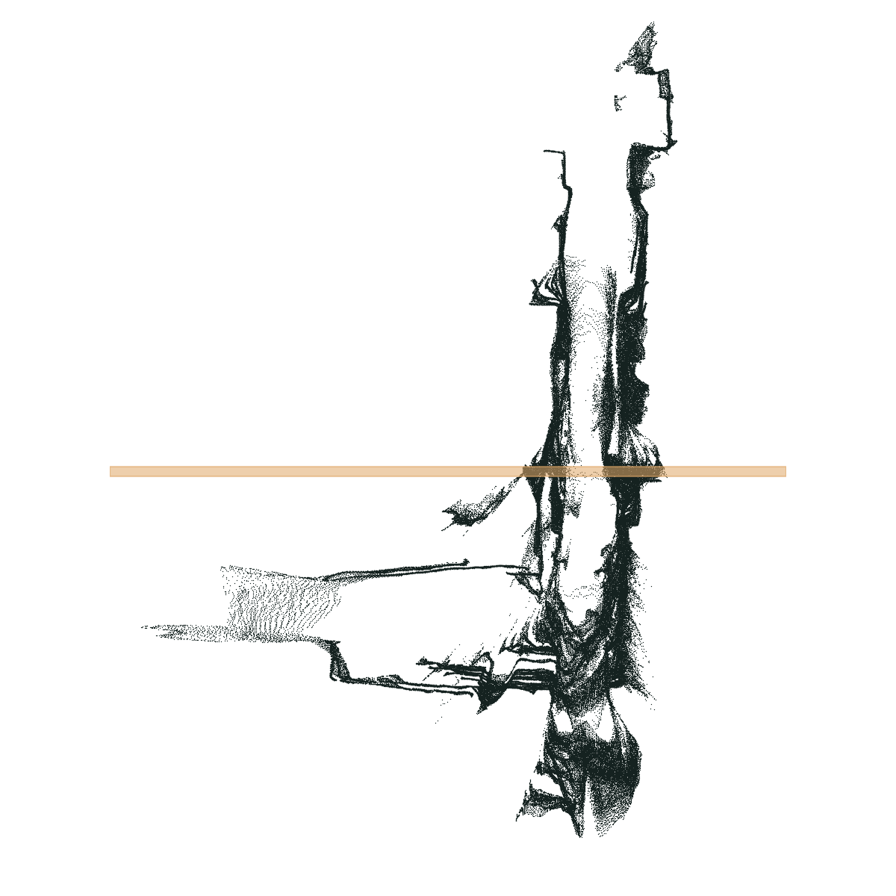
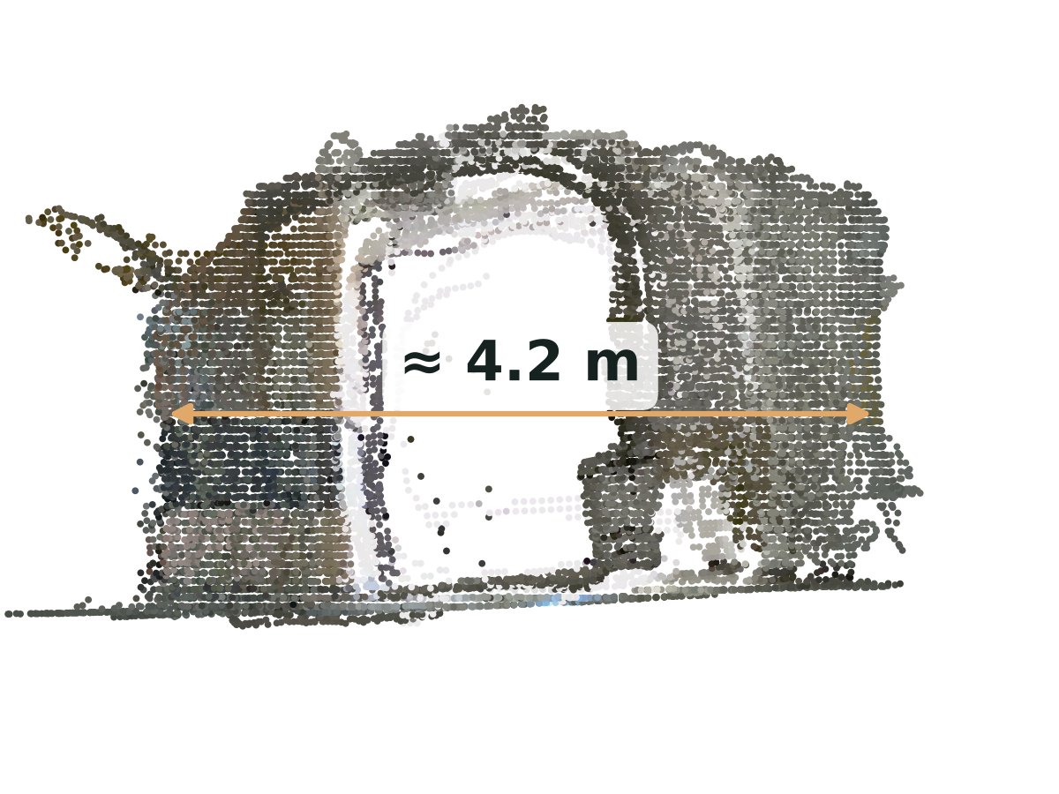




POINT CLOUD DATA · WEEK 04
From points to facility answers
점에서 시설 관리 정보로 — 평면도, 치수, 점검
What facility managers use it for
Measure
widths, heights, areas
Floor plans
as-built drawings
Escape routes
check clearances
Asset register
tag where things are
Change detection
compare scans over time
1 · Slice at desk height
Keep points 0.6–1.6 m above the floor → a floor plan. Orange line = where we cut.
2 · Cut across the corridor
Look at a 30 cm slice from the side → measure the width: about 4.2 m.
Smart Facility Management · Week 04 — Point Cloud Data
13 / 15
Notes:
Why does a facility manager care? Because once you have measured 3D points, you can answer real questions. On the left, we kept only the points between desk height and head height and looked from above — that gives an as-built floor plan. On the right, we took a thin slice across the corridor, where the orange line is, and looked at it from the side. Now we can measure: the corridor here is about 4.2 metres wide. Note it's approximate — the scan has some noise. The same idea supports escape-route clearance checks, asset registers, and comparing scans over time to detect changes, like new obstructions in a corridor.

Slide 14
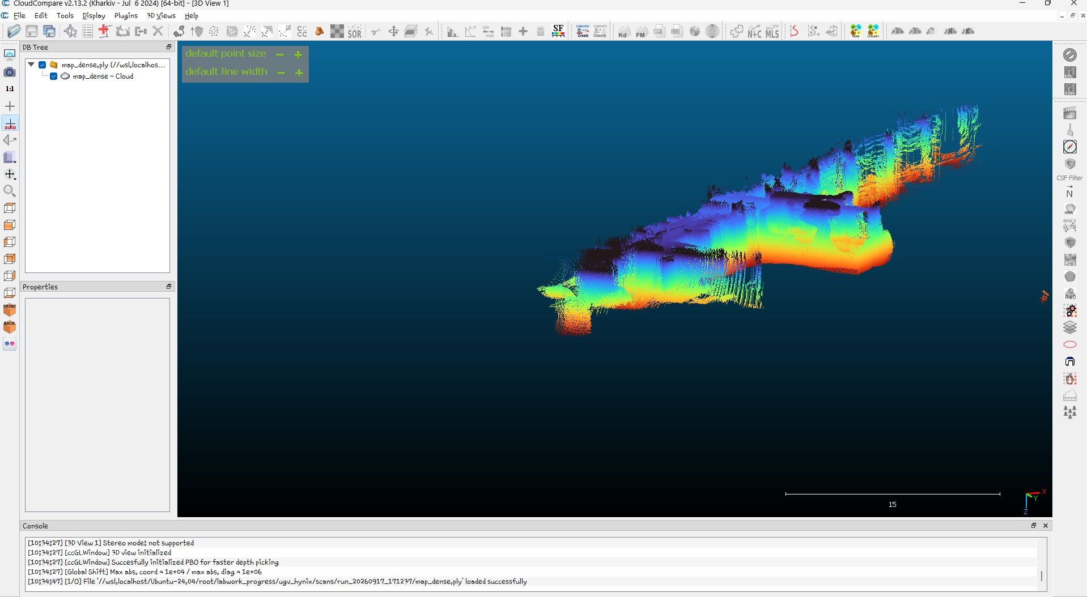
POINT CLOUD DATA · WEEK 04
Tools and file formats
도구와 파일 형식 — 포인트 클라우드를 열고 저장하기
Common file formats
.ply
Simple and widespread — today's files
.pcd
Point Cloud Library, used by ROS robots
.las / .laz
Surveying and drones (.laz = compressed)
.e57
Professional laser scanners
Viewers and libraries
Open3D — Python; what we use today
CloudCompare — measure, clean, compare
MeshLab — view and edit meshes
CloudCompare
Free desktop viewer. Here: our lidar map, coloured by height.
Smart Facility Management · Week 04 — Point Cloud Data
14 / 15
Notes:
A few practical notes before the hands-on. Point clouds come in several file formats. Today we use .ply — simple and supported almost everywhere. .pcd comes from the Point Cloud Library and is common on ROS robots like ours. .las and .laz are the standards for surveying and drone mapping. .e57 is what professional terrestrial laser scanners export. To look at them, today we'll use Open3D from Python. For desktop work, CloudCompare is free and excellent — this screenshot is our lidar map in CloudCompare, coloured by height. MeshLab is best for meshes. You don't need to install these today, but they're worth knowing.

Slide 15
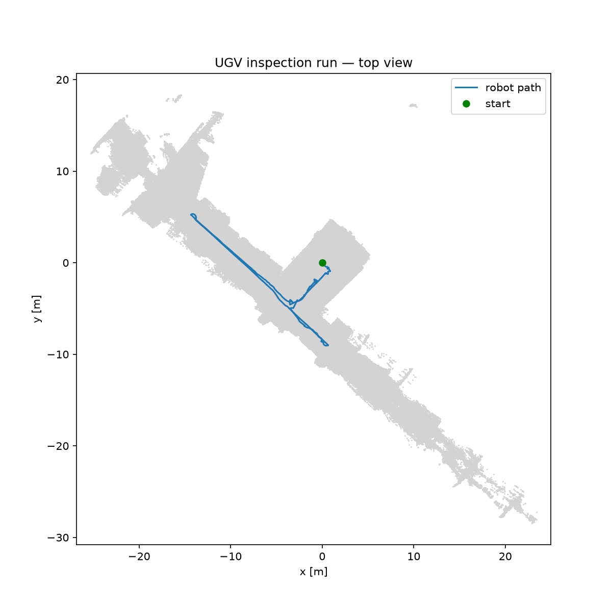
HANDS-ON · WEEK 04
Now it's your turn
이제 직접 해 봅시다 — 오늘의 실습
1
Create the project
uv init facility-scan
2
Add the libraries
uv add numpy pandas matplotlib open3d
3
Download the scan
class_data.zip → data/
4
Map the robot's route
python first_look.py
5
Explore the scan in 3D
python view_scan.py
Follow along on the course website:
mugojames254.github.io/smart_facility_coursework/week04.html
What you'll make in step 4: the lidar map with the robot's path on top.
Smart Facility Management · Week 04 — Point Cloud Data
15 / 15
Notes:
That's the theory. Now let's get hands-on. Open the Week 4 page on the course website and follow the steps: create a new uv project, add the four libraries, download the class data, then run two scripts. The first one reads the robot's trajectory and the lidar map and produces this picture — the map from above with the robot's route on top — plus the distance and time the robot drove. The second opens the coloured scan in a 3D window you can rotate and zoom. The files are .ply format; you'll also meet .pcd, .las and .e57 in industry, and CloudCompare is a good free desktop viewer.

