Slide 1
Concepts and terms for web development

Slide 2
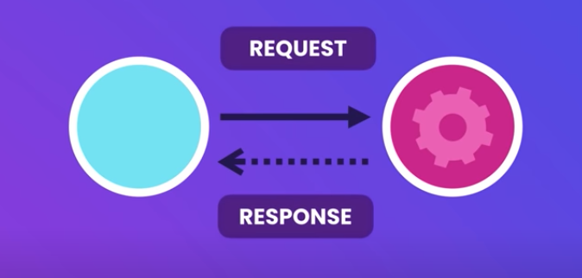



Client – server

Slide 3
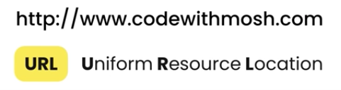
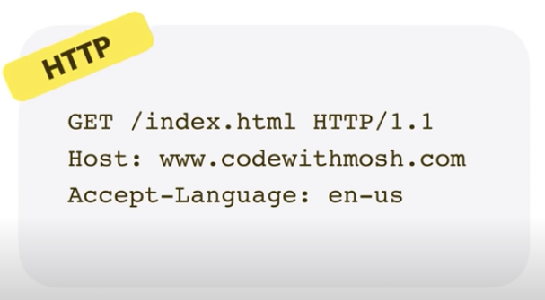
Client (Browser)
Resources:
Web Pages (HTML Documents)
Images
Video Files
Fonts

Slide 4
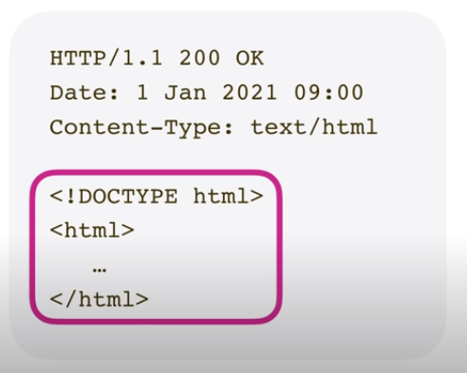
Server (PC)
Version protocol and Status code of response
Date and time of the response
Type of contente that the server back to the cliente
HTML document that representes the homepage code

Slide 5
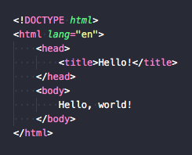
DOM (Document Object Browser)
html
head
body
title
Hello, world!
Hello!

Slide 6
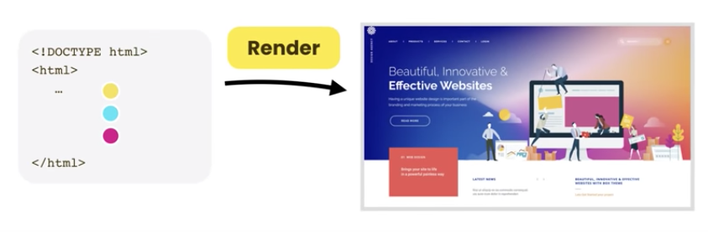
Client (Browser)

Slide 7
Web programming languages
Backend
NodeJS (Javascript)
python
FrontEnd
HTML
CSS
Javascript (dynamic language)

Slide 8
Javascript
Primitives / Value Types
String
Number
Boolean
undefined (es un tipo pero también un valor de variable)
null
Reference Types
Objects
Array
Function

