Slide 1
Import Parity Prices

Slide 2
Objectives
What is an Import Parity Price (aka IPP)?
Why we use IPP
How we calculate them
Example case of using IPPs
Challenges in creating IPPs

Slide 3
Definition: IPP
The value of a unit of product brought from a foreign country and priced at a geographic location of interest in the importing country.

Slide 4
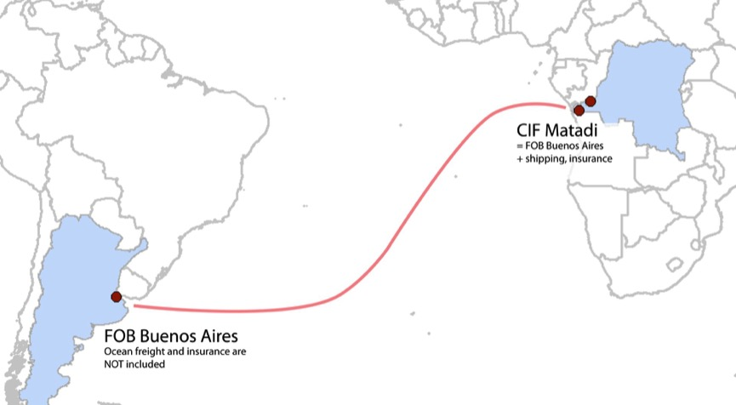
Example: Argentine Wheat imported in the DRC

Slide 5
Example 2: Soybean Oil imported into Ethiopia!
Soybean Oil Import Parity Price Calculation
No. | Item | Source | US$/MT
1 | Refined Soybean Oil Ex Rotterdam | USDA FAS Data. | 748
2 | Ocean Freight | Marill Freight | 50
3 | Insurance | 1% of #1 | 7.5
4 | CIF Djibouti | #1+#2+#3 | 805.5
5 | Customs Duty | 30% of #4 | 241.6
6 | VAT | 15% of (#4+#5) | 157.1
7 | Withholding Tax | 3% of #4 | 24.2
8 | Port Charges, handling etc. | Axis Transit Services | 39.5
9 | Inland Freight | Axis Transit Services | 41.1
10 | Storage | ECEX | 7.5
11 | Packaging | Whey Consulting Ltd. | 119.5
12 | Administration | World Bank Salary Data | 4.0
13 | Total Import Parity Price | Sum(#4:#12) | 1440.1

Slide 6
Uses
We use IPP to Assess Incentives to Trade and Produce Goods
Notes:
“…where local producers are in competition with producers and suppliers from outside the country or across the border.”
FEWS NET Import/Export Parity Price Analysis, May 2008

Slide 7
Let’s Become a Major Stuffed Animal Supplier for the Washington DC Market!
In Depth Example:
Notes:
Assessing incentives….
Opportunity in Market to sell stuffed animals.
For sale everywhere.
Really expensive!
Opportunity to make a lot of profit
Via Market research, you identify 2 suitable suppliers: (next page)

Slide 8
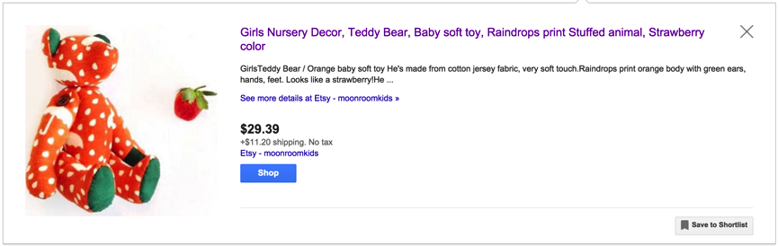
Supplier 1: NYC - $40.59 each
Source: https://goo.gl/Otltc1
Notes:
Expensive.
Small minimum order (1!)
Very close though.

Slide 9
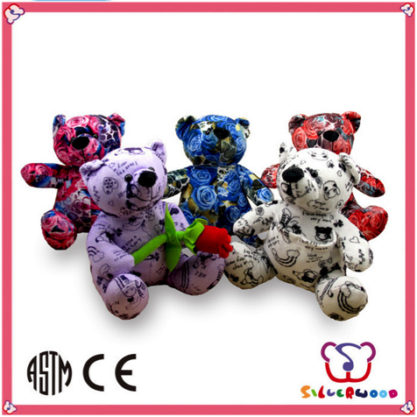
Supplier 2: China -$1.5 - $2.5 each
GSV certification lovely animal cheap custom cute animal stuffed teddy bear:
Animal Stuffed Teddy Bear
Fashionable cartoon design, various styles, sizes and colors
Outside material is suitable for imprint or embroidery
With very soft feeling
For babies/kids or for promotion
Packing: polybag/ display box or per client's request
Source: http://www.alibaba.com/product-detail/GSV-certification-lovely-animal-cheap-custom_60084794878.html?s=p
Notes:
Suitable product for the market
Recommended manufacturer
Low cost (turn page)

Slide 10
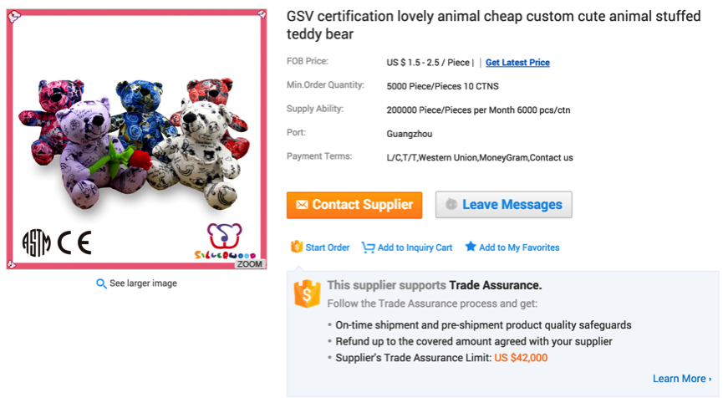
The Cost: $10,000 (5000 pieces*$2)
Notes:
But very large minimum order

Slide 11
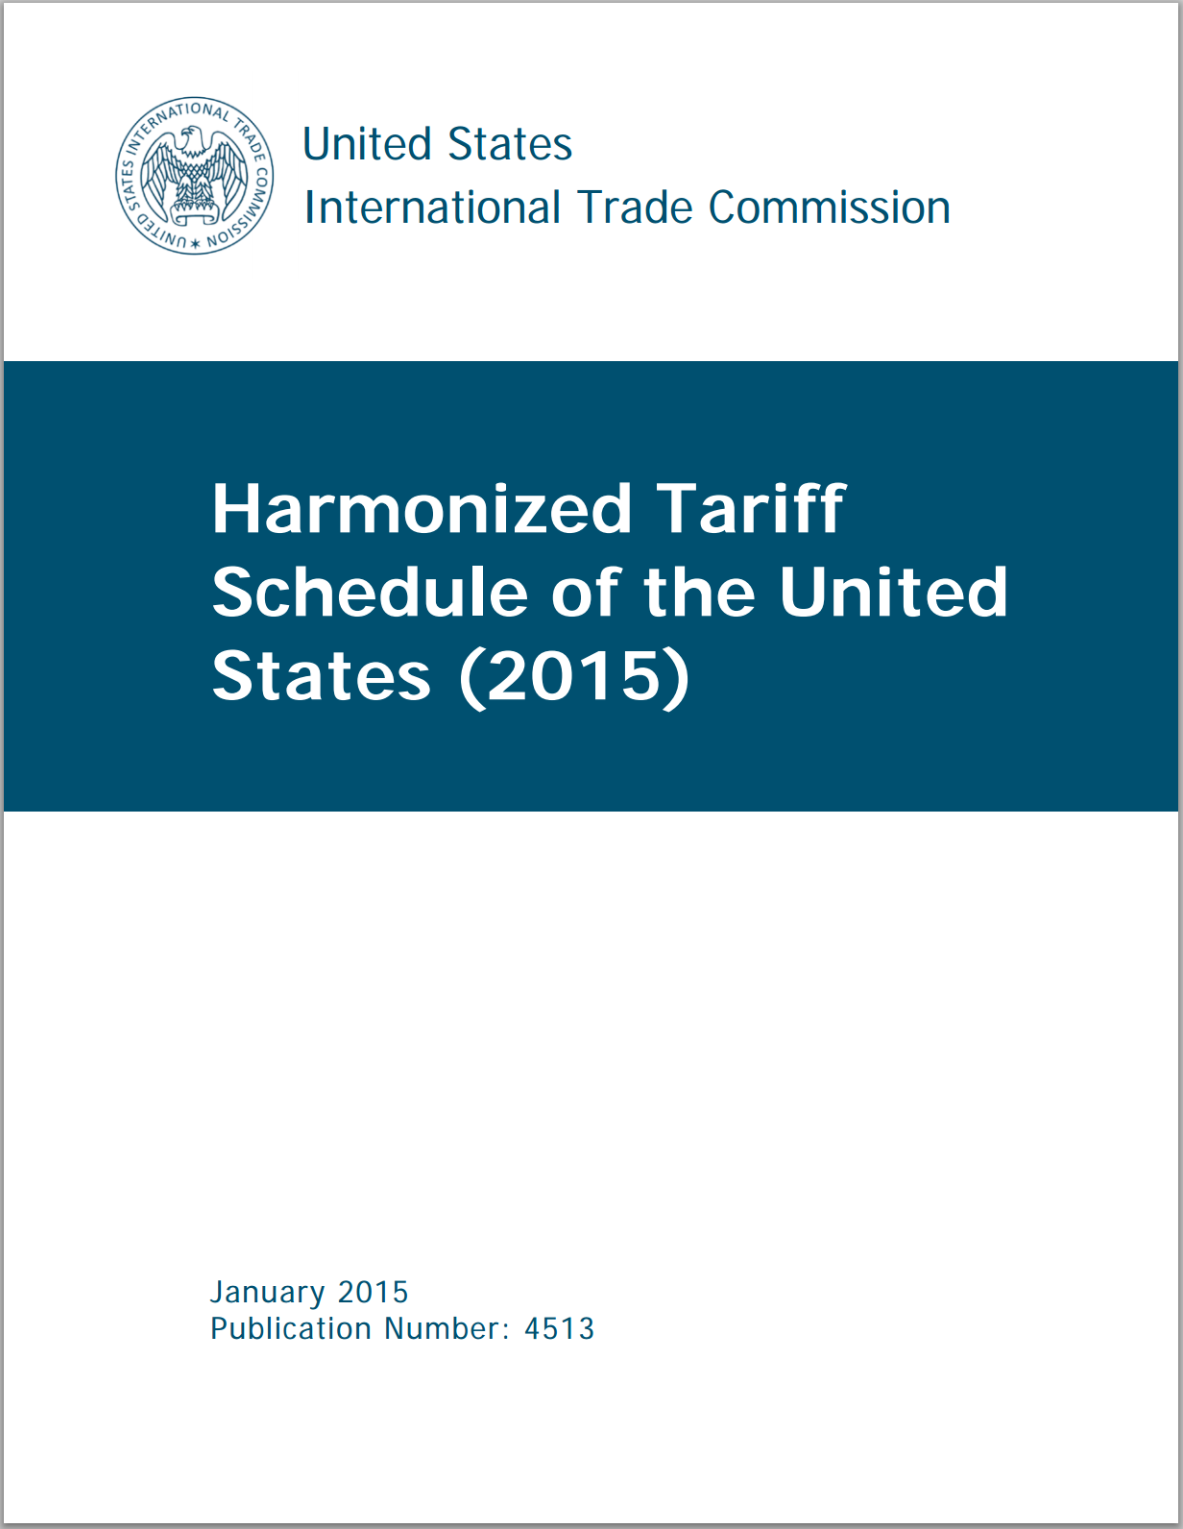
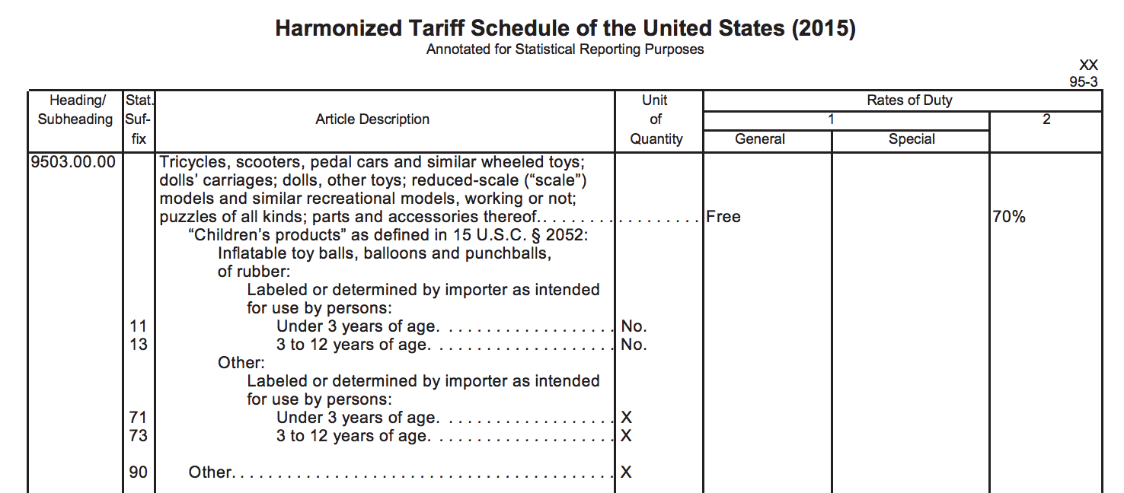
Duty: $0
Source: http://www.usitc.gov/publications/docs/tata/hts/bychapter/1501c95.pdf
Notes:
A tax placed on imports by customs authorities of a country. Used to raise tax revenue

Slide 12
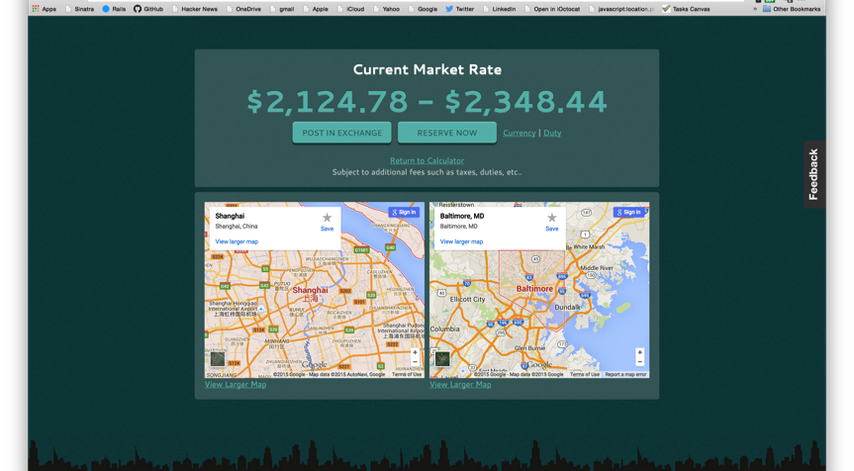
Shipping Estimate: $2,220

Slide 13
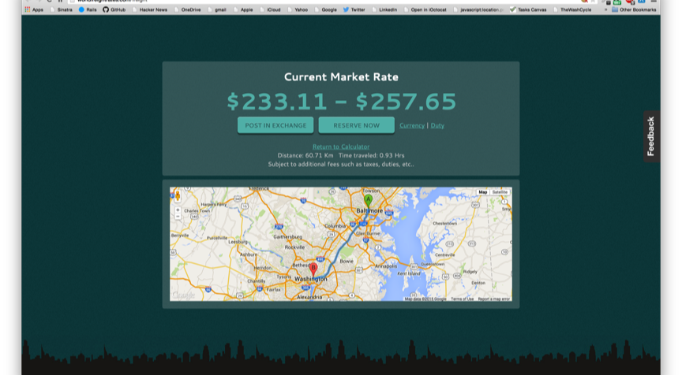
Inland Shipping: $245

Slide 14

Total Cost: $13,695
Item | Cost
count | 5,000 teddy bears
cost | $10,000
Insurance | $100
freight | $3,350
Duty | $0
inland Shipping | $245
total Cost | $13,695
Per item | $2.74
Per Item: $2.74

Slide 15
So which do I buy?
Notes:
Overview:
Supplier 1:
High cost (approx. $49.50, incl. shipping)
Local manufacture
Small volume of goods (presumably)
Speak the same language
Can pick up the phone, return item if have a problem
Can return item if
Supplier 2
Low cost (Approximately $2.74 each, delivered)
High volume – can sell a lot
Cost isn’t everything though – have to understand market context. (next page)

Slide 16
Other Factors?
Notes:
Local Preferences? – do people want high quality hand made pieces? Do they care? Have you even seen or felt a copy of the one you’re looking at importing? Do they want teddy bears that look like bears? Or Dogs, or anything else? Do they like red, or purple, or printed items?
Relevant Policies – We looked at the import duties that the US charges, but does China charge a duty on exports? Does china allow exports of teddy bears? Do intermediary countries of transit allow transit of teddy bears?
Climactic Conditions: Are vessel conditions suitable for shipment of teddy bears? Will teddy bears spoil while in storage prior to sale?
Risk: Will you be able to sell all your stock of teddy bears? Can you afford cost of overhead of storing teddy bears, or support staff necessary to sell?
Other fees – Port handling fees, Freight forwarder fees, local petty corruption (have to pay a customs official at an intermediary port to help “speed along” your shipment?)

Slide 17
Challenges
Notes:
Understanding local market context and preferences – everything we just talked about and more
Are data available? Are they reliable? How do you know how many teddy bears your market demands? What is current supply? Can you sell your teddy bears at a profit within that market context?
Are other sources available to triangulate it?
Are prices available for comparable commodities?
Do we know port fees and duty rates?
Storage and transportation rates
Will relevant traders share market information?

Slide 18
Decision?
Notes:
Incentive to import?

Slide 19
Sources, Further Reading, Etc.
Select data and content used in this presentation: USAID-BEST. Import Parity Prices. Presentation, 2011
Reference document for Import Parity Pricing: FEWS NET. Import/Export Parity Price Analysis. FEWS NET Market Guidance, No. 1. May 2008. http://pdf.usaid.gov/pdf_docs/PNADL964.pdf.
Import Duties for US: USITC – Harmonized Tariff System for the United States, 2015. http://hts.usitc.gov/
Overseas Teddy Bear Suppliers: Alibaba.com
Sample freight rates: http://worldfreightrates.com/freight
Definition: Import Duty: http://www.investopedia.com/terms/i/import-duty.asp
Select Sources for Trade data and Statistics:
http://comtrade.un.org/
http://www.trademap.org/Index.aspx
https://www.piers.com/
http://gain.fas.usda.gov/Pages/Default.aspx,
http://apps.fas.usda.gov/psdonline/psdQuery.aspx; http://apps.fas.usda.gov/gats/ExpressQuery1.aspx
http://www.census.gov/foreign-trade/statistics/country/index.html

Slide 20
Import Parity Prices

